Slide 1
While loops

Slide 2
While Loops
Used for repeating an piece of code multiple times, when the value is a conditional statement
Syntax:
while (comparison)
{
// code
}

Slide 3
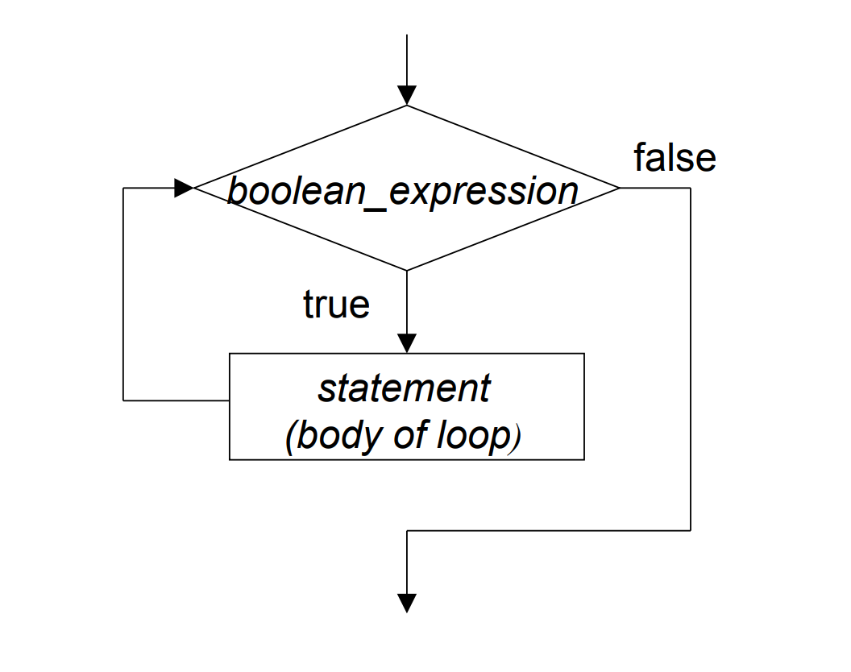
While Loop Flowchart

Slide 4
Whiteboard Example
int count = 0;
while (count < 5)
{
Console.WriteLine("*");
count++;
}
Notes:
Write out this example on the whiteboard, keeping track of the `count` variable and the output

Slide 5
Example
while (Console.ReadLine() != "STOP")
{
Console.WriteLine("Enter Command:");
}
Console.WriteLine("You chose to stop");

Slide 6
Example
while (true)
{
Console.WriteLine("Can't Stop");
}

Slide 7
Break && Continue
continue
The continue statement passes control to the next iteration of the enclosing while, for, or foreach statement in which it appears.
break
The break statement terminates the closest enclosing loop in which it appears.

