Slide 1



Rock Paper Scissors Game using Python Flask and MongoDB
Python project
Review date – 26/04/2025
BY:
MONIKA T – 23CDR101
NANDHINI K –23CDR106

Slide 2
Introduction
This project aims to implement the classic game Rock Paper Scissors in a web-based environment using Python's Flask framework and MongoDB for data storage. The goal is to create a fully functional interactive game where users can input their name, make a selection (rock, paper, or scissors), and receive feedback on whether they win, lose, or tie. The results, along with the user's name, are stored in MongoDB for future analysis. This project demonstrates key web development concepts such as server-side logic, routing, and data persistence in databases.
.

Slide 3
Objectives
Implement a web-based interactive game using Python Flask for backend processing.
Use MongoDB to store game results, including user names, choices, and outcomes.
Provide a seamless user experience where users interact with the game through a simple web interface
and results are dynamically displayed after each game.
Demonstrate basic Python logic (conditionals, loops, and randomization) and
web technologies (HTML, CSS).
3

Slide 4
Tech Stack
Python: The core programming language for backend logic and web development.
Flask: A lightweight Python framework used to handle HTTP requests and create routes.
MongoDB: A NoSQL database that stores user game data in a flexible format (document-based storage).
HTML/CSS: Basic frontend technologies used for structuring and styling the web pages.
Random Module: Python's built-in module used to generate the computer's choice randomly for the game.
PyMongo: A Python library that allows Python applications to interact with MongoDB.
4

Slide 5
System Architecture
User Input: Users enter their name and select their move (rock, paper, or scissors) via the web interface.
Flask Backend: The Flask application receives the request, processes the user’s input, and
generates the computer's choice using the random module.
Game Logic: The game logic compares the user’s and the computer’s choices and determines
whether the user wins, loses, or ties.
MongoDB: The game result (along with the user’s name and choice) is stored in the MongoDB
database for future reference.
User Feedback: The result is dynamically displayed to the user on a result page.

Slide 6
Code Structure Overview
app.py: The main Flask application file containing all routes, game logic, and database interactions.
templates/index.html: The HTML form where the user inputs their name and selects
their move (rock, paper, or scissors).
templates/result.html: Displays the outcome of the game (win, loss, tie) and stores the game
result in MongoDB.
static/: Folder for static assets like CSS or image files (if required).
MongoDB: Stores player data and results in a collection.

Slide 7
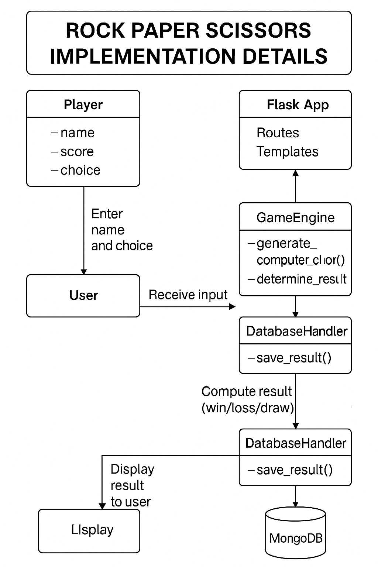
Implementation Details

Slide 8
User Input: Captures name and move.
Randomization: Generates computer move using random.choice().
Game Logic: Determines win/loss/tie based on conditions.
Result: Stores in MongoDB with insert_one().
Code:
if user_choice == computer_choice:
result = "It's a tie!"
elif (user_choice == 'rock' and computer_choice == 'scissors') or
(user_choice == 'paper' and computer_choice == 'rock') or
(user_choice == 'scissors' and computer_choice == 'paper'):
result = "You win!"
else:
result = "You lose!"
Python code walkthrough

Slide 9
MongoDB Interaction
MongoDB Setup: We use PyMongo to connect to a local MongoDB instance. The game results are stored in a game_results collection
Data Structure: Each document in the collection contains the following fields:
name: The player's name.
choice: The player's selected move (rock, paper, or scissors).
result: The outcome of the game (win, loss, tie).
.
Inserting Data: The result is inserted into MongoDB using insert_one(), ensuring that each game session is
stored separately.
client = pymongo.MongoClient("mongodb://localhost:27017/")
db = client["game_db"]

Slide 10
Future Scope
Leaderboard System 🏆:
Add a ranking system where users can view their performance (win/loss count) against others.
Multiplayer Mode 🎮:
Extend the game for multiplayer functionality, allowing multiple users to play against each other.
Enhanced User Interface 🎨:
Implement a more sophisticated and interactive frontend using JavaScript and AJAX for real-time
updates without refreshing the page.
AI Improvements 🤖:
Introduce advanced AI logic to make the computer's choices less predictable, perhaps using a
machine learning model to improve decision-making.
Mobile Optimization 📱:
Make the web interface responsive for mobile users, ensuring smooth gameplay on smartphones and tablets.
10

Slide 11
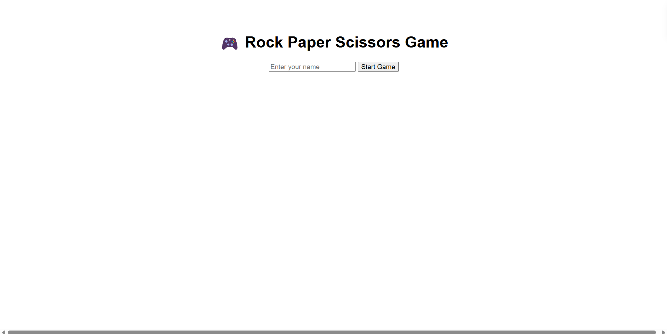
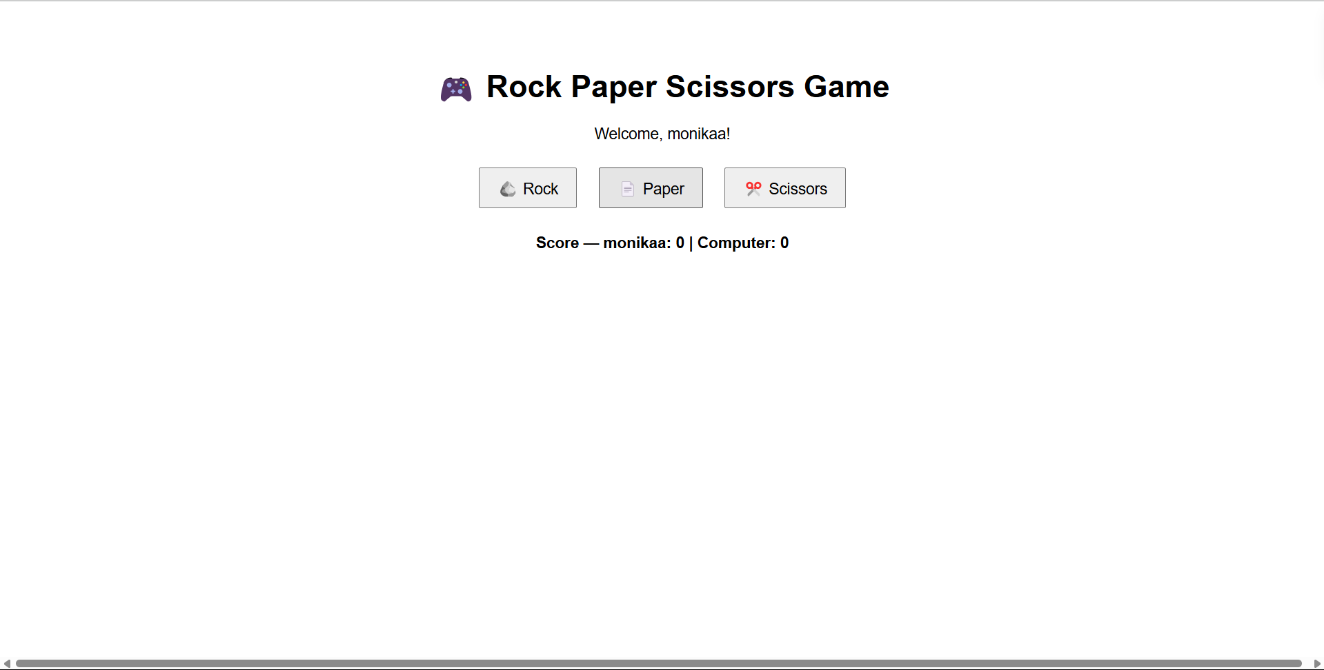
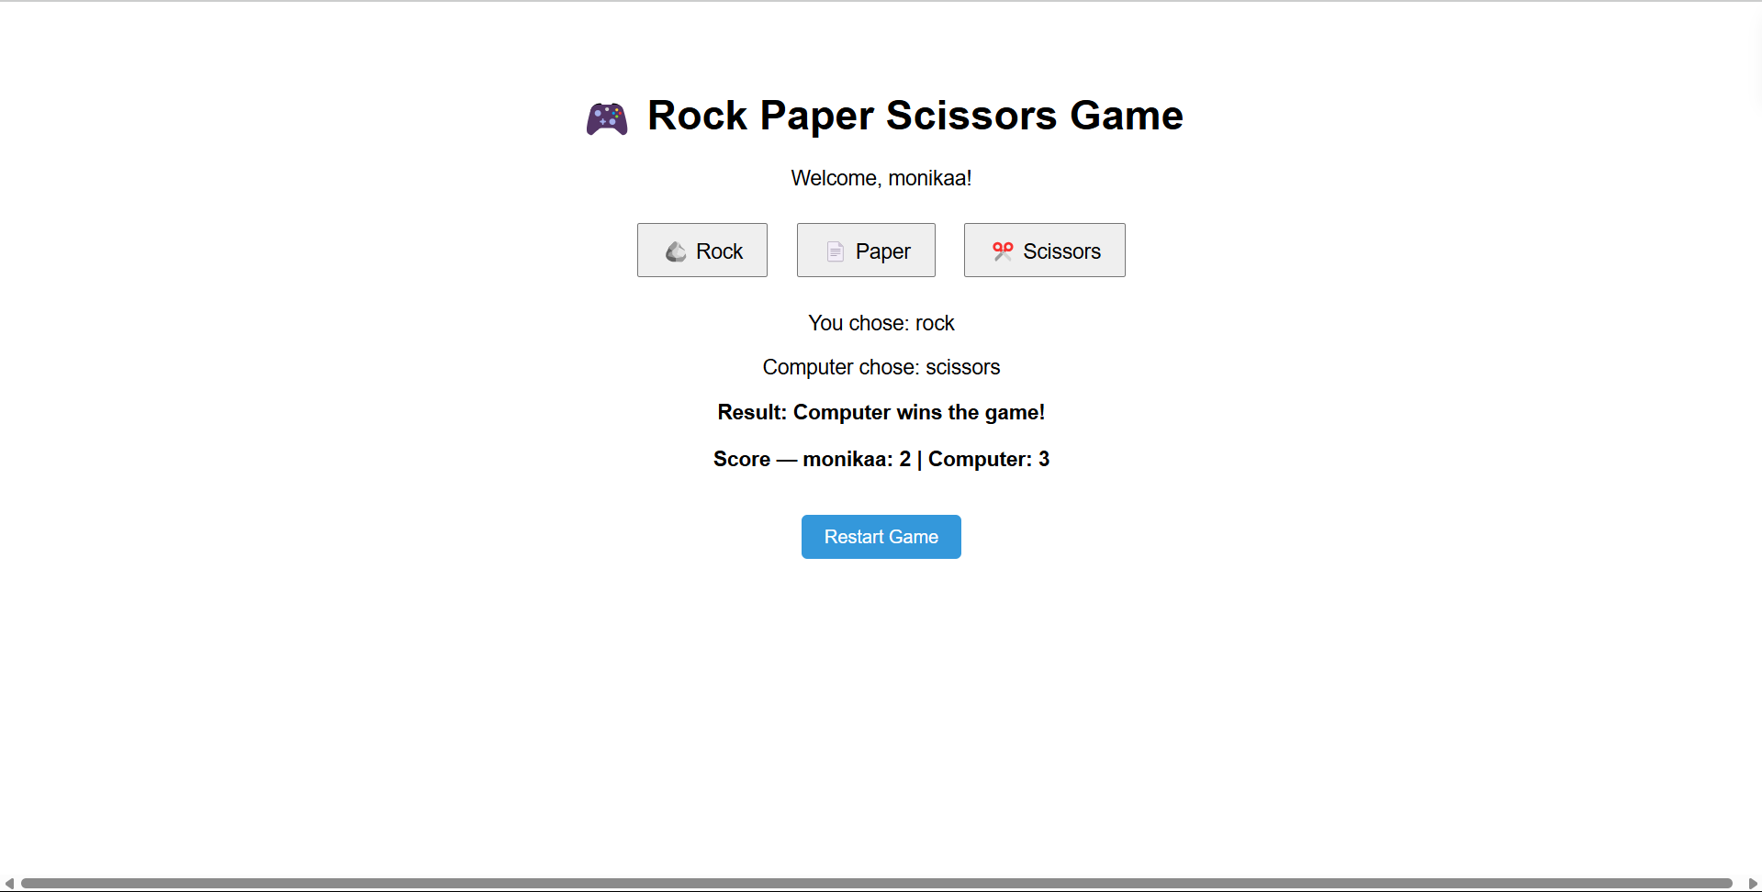
Implementation

Slide 12
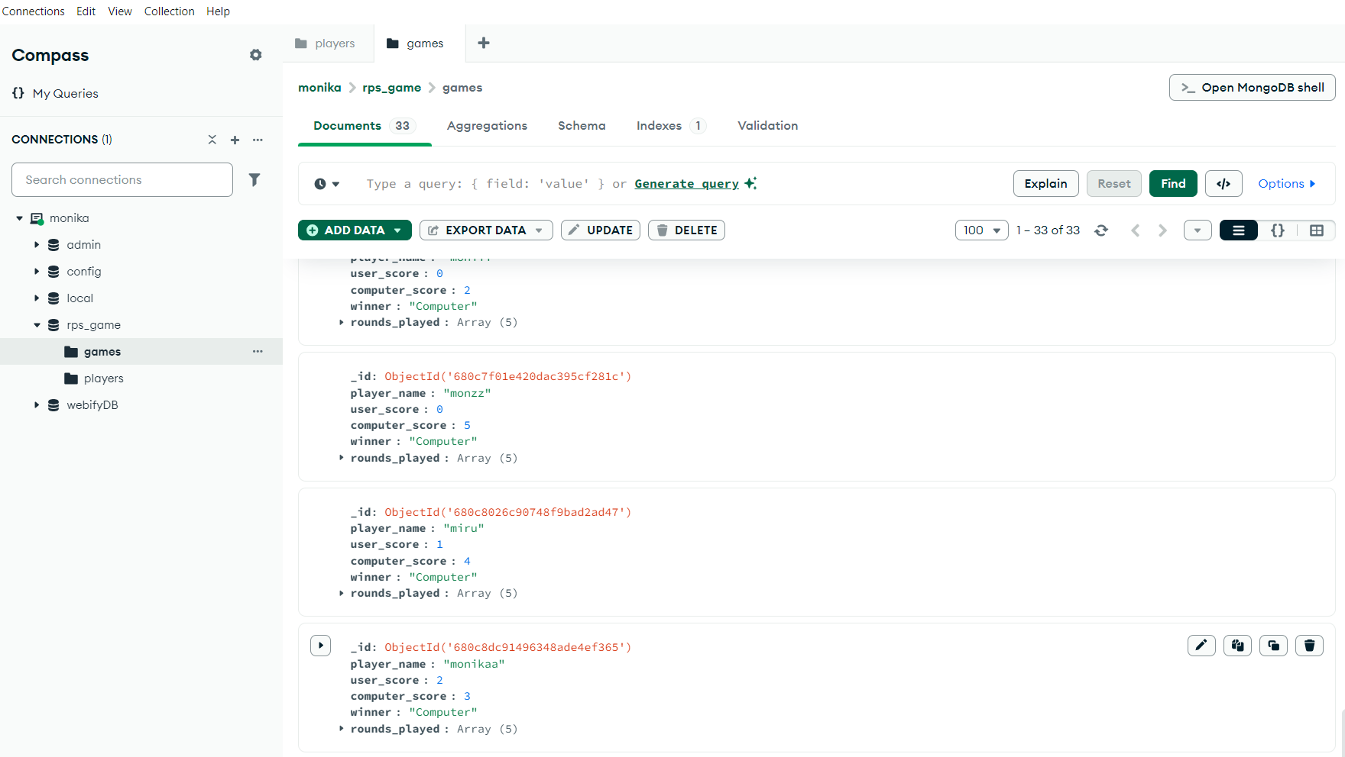
Database:

Slide 13
Thank you!

