Slide 1
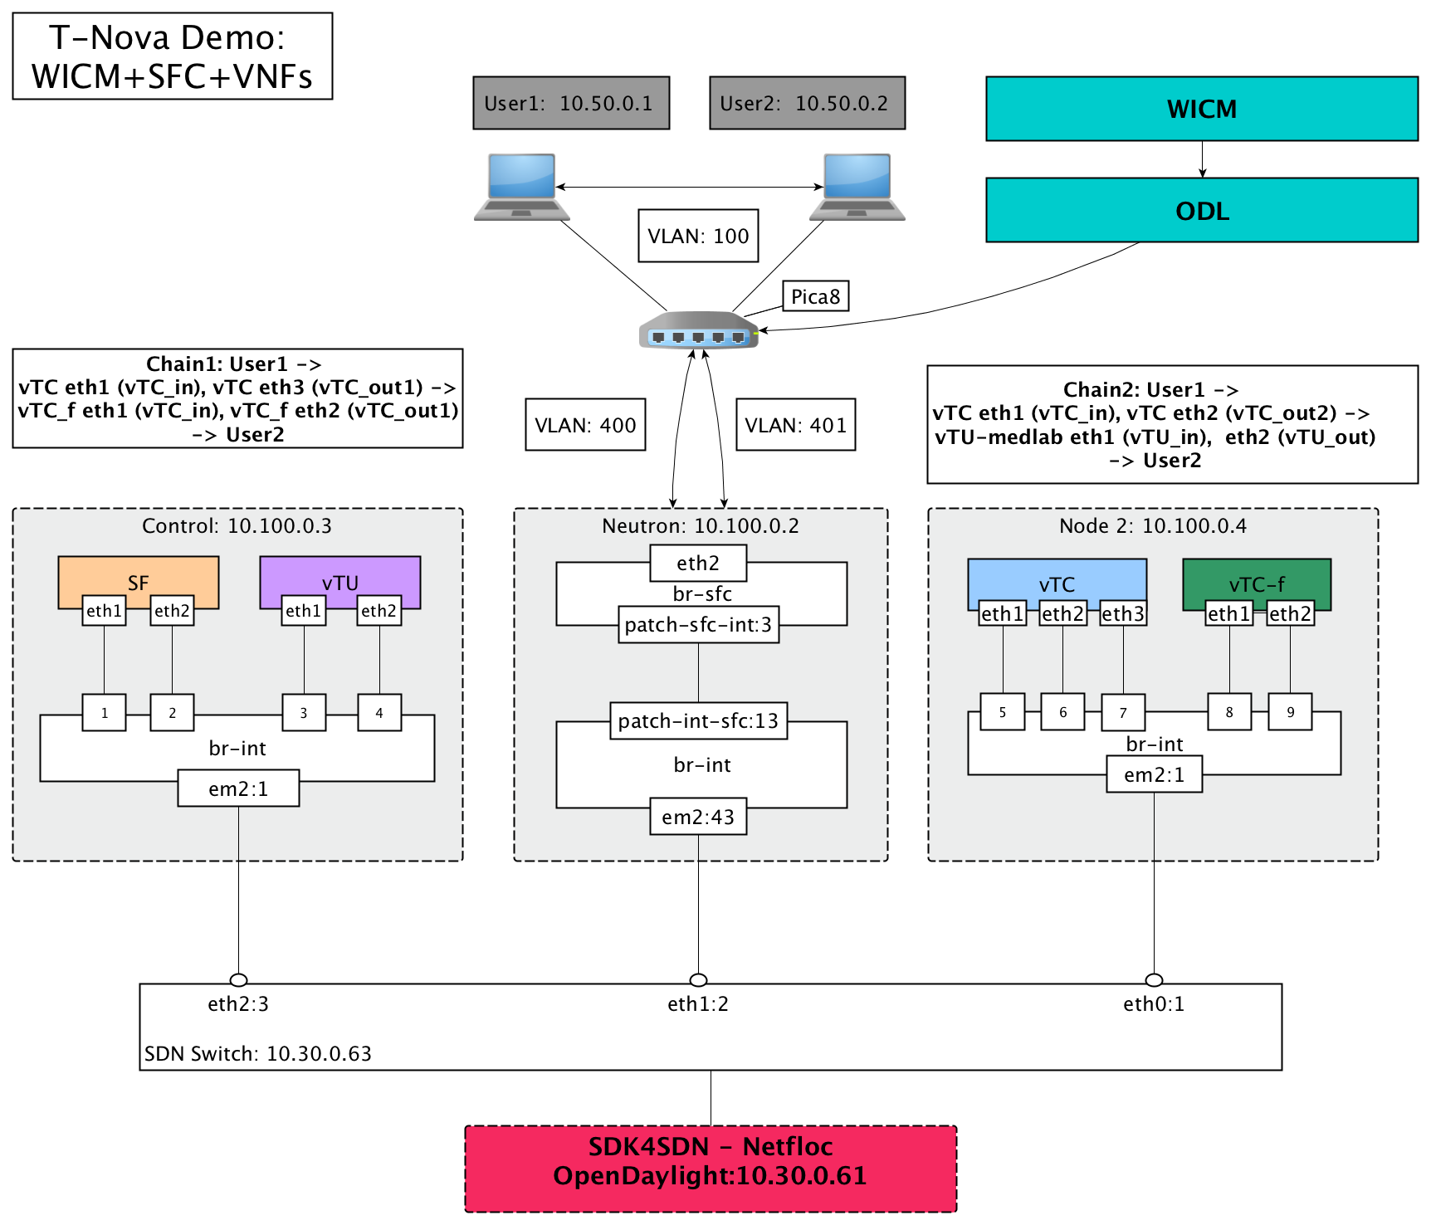

Slide 2
No Redirection

