Slide 1

Staff Track Pro

Slide 2
Contents
Description.
Need of Project.
Existing System.
Proposed System.
Use Case Diagram.
Technology.
Modules.
Conclusion.

Slide 3

Description
In this mini project, I develop an Enhanced Staff Track Pro System using Java collections module. This system will allow you to manage a collection of employees with various attributes. I have implemented methods to perform operations on this collection of employees, including the ability to store mobile numbers, handle custom exceptions, and search for employees within an age range.

Slide 4
Need of Project
Staff Track Pro that will be developed to Maintain the details of an employee.
The Staff Track Pro mainly used to store and manipulate the details of an employee.
The Staff Track Pro System would maintain the information about the employee this system holds the information such ac Employee Id , Employee Name, mobile no, Salary , Age, Position.

Slide 5
Existing System
In Existing System the employee details are stored in a register. Storing the details in a register book is very time consuming process
If We want to perform the operations like add, delete , update ,find is very difficult in existing System.
To over come these difficulties we develop a Staff Track Pro.
Disadvantage:
Time Consuming process.
Danger of Loss of some files.
Manipulations on these details are very difficult.

Slide 6
Proposed System
In this proposed System we develop a System that would provide some operations to store the details of an employee.
This proposed System contains some operations like add,delete,update,view all employee,search by Id.
By help of the above operations we can easily maintain and manipulate the information of an employee.
Advantages
Accuracy
Time save
Easy to Modify

Slide 7
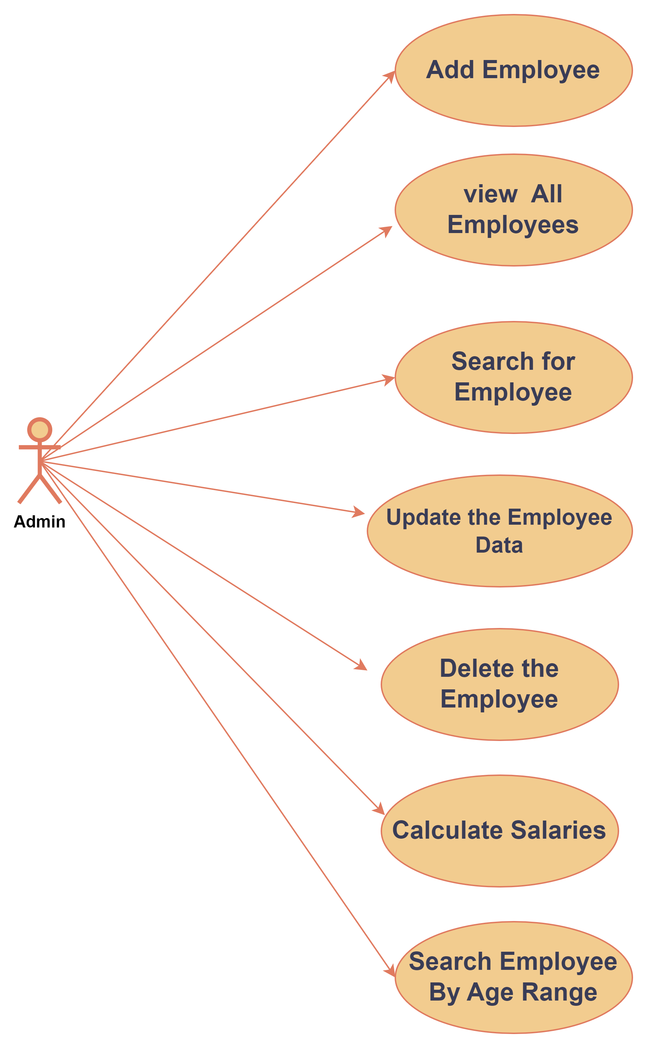
Use Case Diagram:

Slide 8
Modules:
Add an Employee
View All Employees
Update Employee Information.
Search By employee Id
Delete an Employee.
Calculate Total Salary.
Search By Age Between Range.

Slide 9
Add an Employee: Add a new employee to the system. Prompt the user for input for each attribute, including the mobile number, and create a new employee entry in the collection.
View All Employees: Display a list of all employees in the system, including their attributes and mobile numbers.
Search for an Employee: Allow the user to search for an employee by their Employee ID, name, position, or age and display their details. Handle the EmployeeNotFound custom exception if the employee is not found.
Update Employee Information: Allow the user to update the information of an employee, given their Employee ID. Include the ability to update the mobile number.
Delete an Employee: Remove an employee from the system, given their Employee ID.
Calculate Total Salary: Calculate and display the total monthly salary expense for all employees in the system.
Search Employees by Age Range: Allow the user to search for employees within a specified age range (e.g., between 25 and 35) and display their details.

Slide 10


Technology
Platform

Slide 11
Conclusion:
My Mini project is mainly focused on the manipulating the employee details System using Java collections module . In this Staff Track Pro it is used to maintain the details of the employee in an easy and effective way . By using this System we can easily add ,delete , search , update, an employee , view the list of employees.

Slide 12


