Slide 1
HW#4
Dit Dejphachon #6131765321

Slide 2
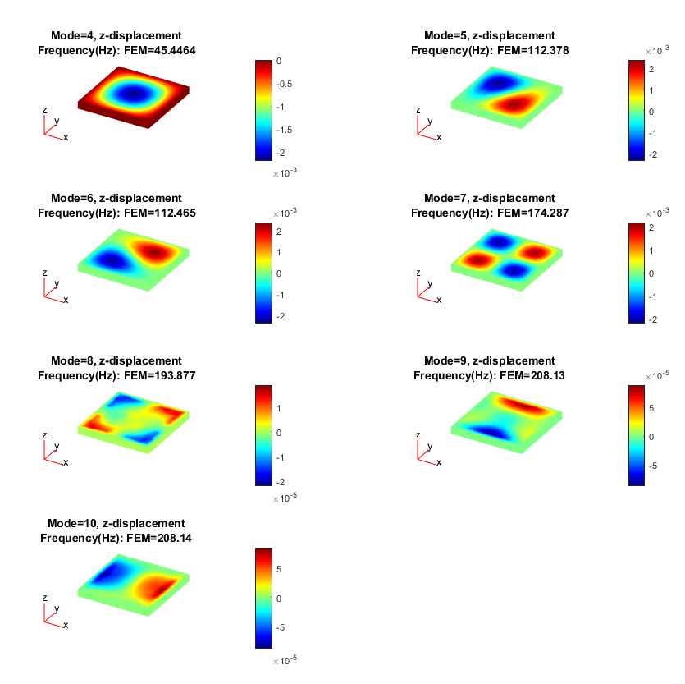
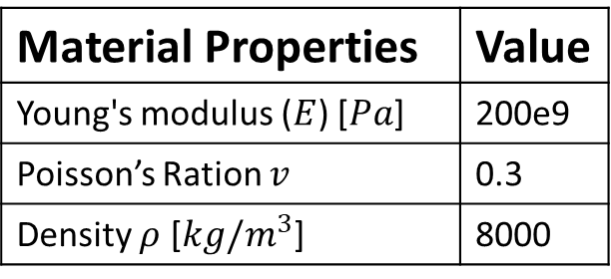
Problem#1
Material Properties | Value
Young's modulus ($E$) [$Pa$] | 200e9
Poisson’s Ration $v$ | 0.3
Density $ρ$ [$kg/m^{3}$] | 8000
Figure 1: Square case

Slide 3
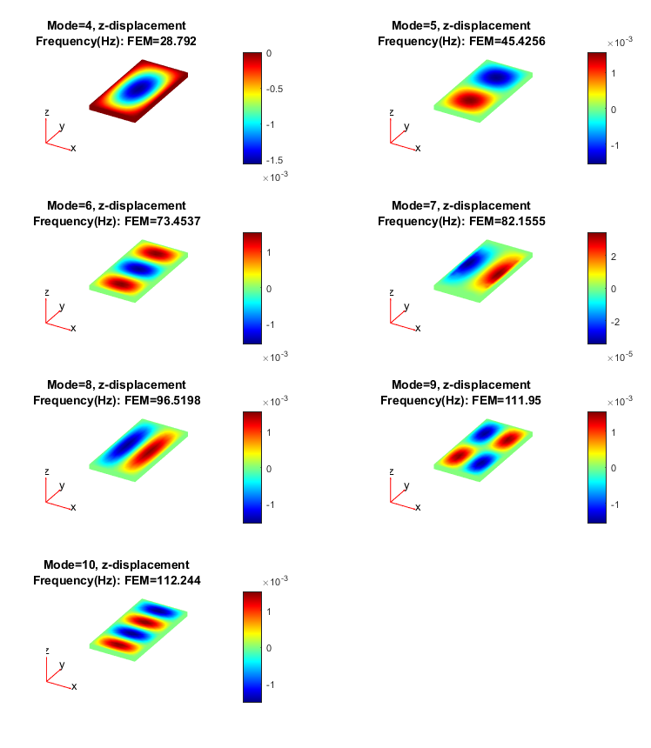
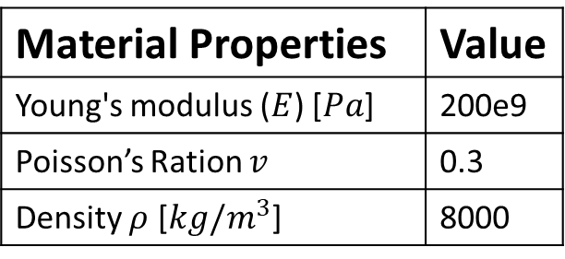
Problem#2
Material Properties | Value
Young's modulus ($E$) [$Pa$] | 200e9
Poisson’s Ration $v$ | 0.3
Density $ρ$ [$kg/m^{3}$] | 8000
Base case => Problem#1
Squ case (Hz) | Rect case (Hz) | Squ Ratio | Rect Ratio
45.45 | 28.79 | 1.00 | 1.00
112.38 | 45.43 | 2.47 | 1.58
112.47 | 73.45 | 2.47 | 2.55
174.29 | 82.16 | 3.84 | 2.85
193.88 | 96.52 | 4.27 | 3.35
Figure 2: Rectangle case

Slide 4
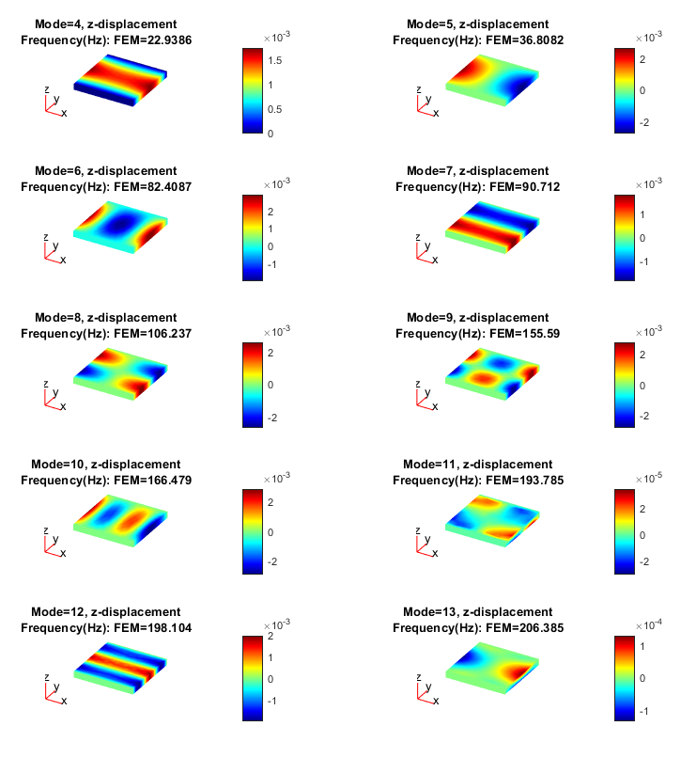
Problem#3 => Diagonal square
Fix Squ case (Hz) | Dia Squ case (Hz) | Ratio
45.45 | 22.94 | 0.50
112.38 | 36.81 | 0.33
112.47 | 82.41 | 0.73
174.29 | 90.71 | 0.52
193.88 | 106.24 | 0.55
208.13 | 155.59 | 0.75
208.14 | 166.48 | 0.80
219.31 | 193.79 | 0.88
219.67 | 198.10 | 0.90
219.84 | 206.38 | 0.94
Figure 3: Diagonal square case

Slide 5
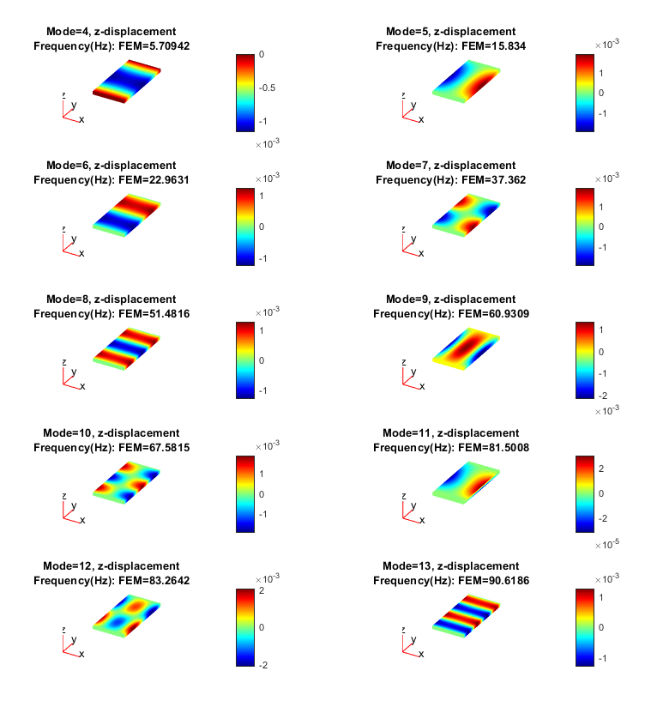
Problem#3 => Diagonal rectangle
Fix Rect case (Hz) | Dia Rect case (Hz) | Ratio
28.79 | 5.71 | 0.20
45.43 | 15.83 | 0.35
73.45 | 22.96 | 0.31
82.16 | 37.36 | 0.45
96.52 | 51.48 | 0.53
111.95 | 60.93 | 0.54
112.24 | 67.58 | 0.60
123.94 | 81.50 | 0.66
137.43 | 83.26 | 0.61
138.01 | 90.62 | 0.66
Figure 4: Diagonal rectangle case

Slide 6
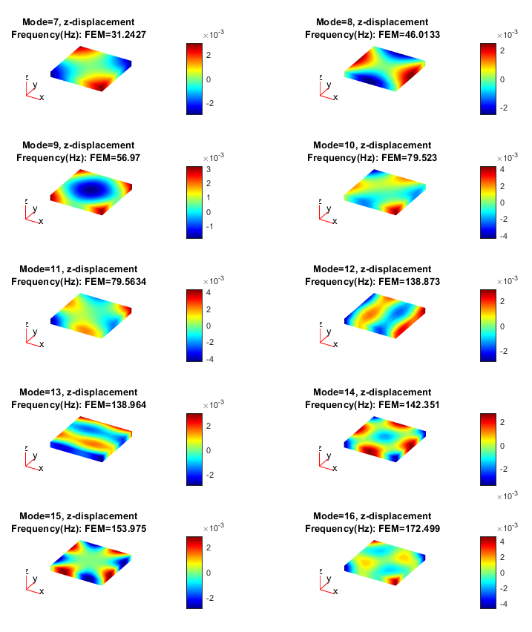
Problem#4
Fix Squ case (Hz) | Free Squ case (Hz) | Ratio
45.45 | 31.24 | 0.69
112.38 | 46.01 | 0.41
112.47 | 56.97 | 0.51
174.29 | 79.52 | 0.46
193.88 | 79.56 | 0.41
208.13 | 138.87 | 0.67
208.14 | 138.96 | 0.67
219.31 | 142.35 | 0.65
219.67 | 153.98 | 0.70
219.84 | 172.50 | 0.78
Figure 5: Free square case

Slide 7
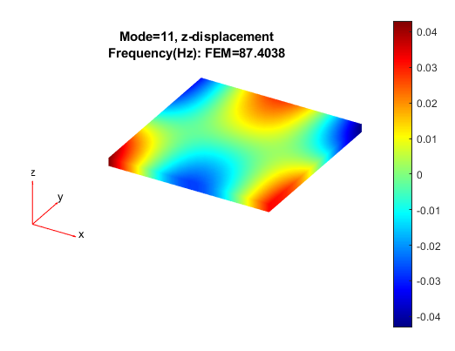
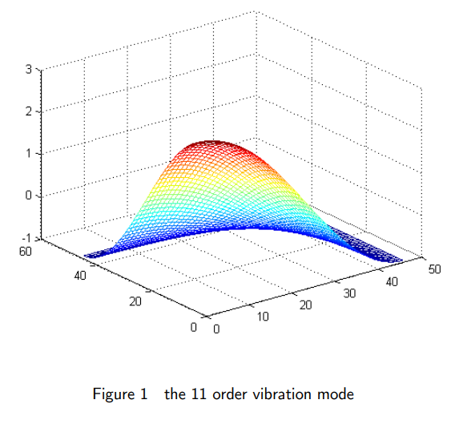
Problem#5 => Mode = 11
Figure 6: Comparison between Student version and Research result at mode#11

Slide 8
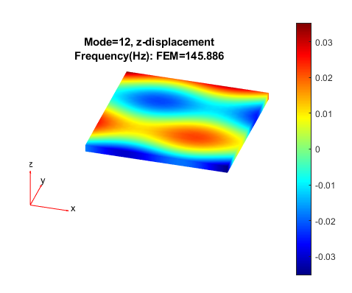
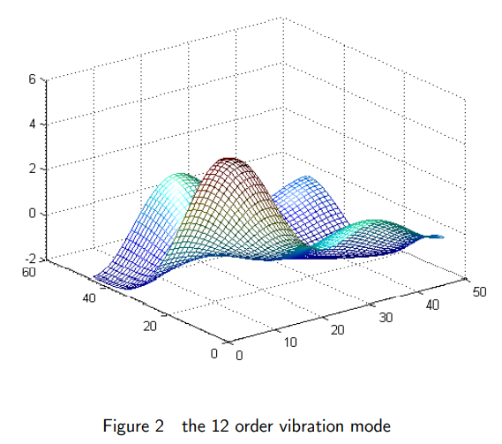
Problem#5 => Mode = 12
Figure 7: Comparison between Student version and Research result at mode#12

Slide 9
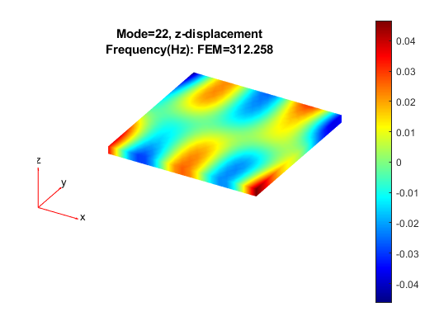
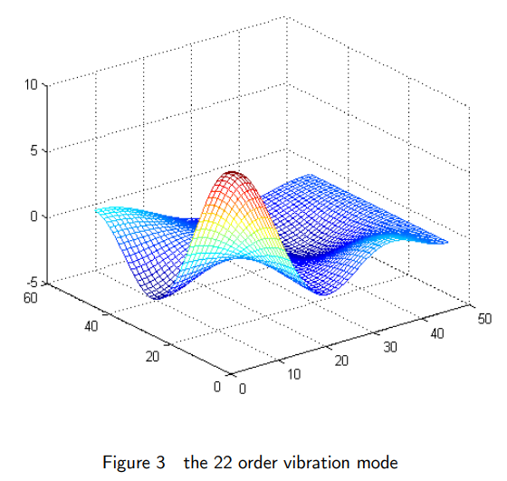
Problem#5 => Mode = 22
Figure 8: Comparison between Student version and Research result at mode#22

Slide 10
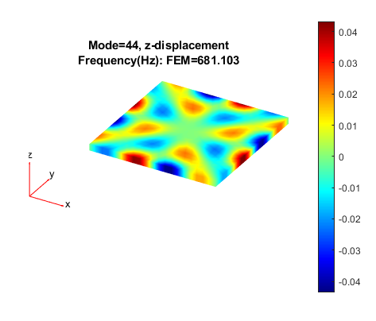
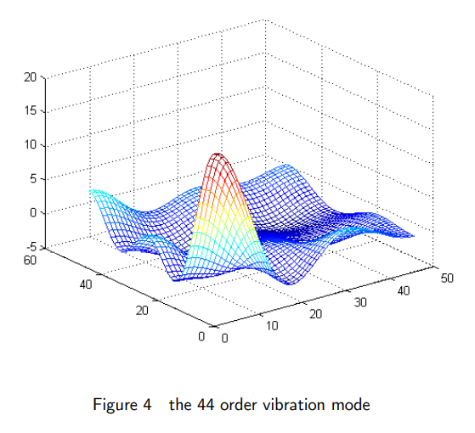
Problem#5 => Mode = 44
Figure 9: Comparison between Student version and Research result at mode#44

Slide 11
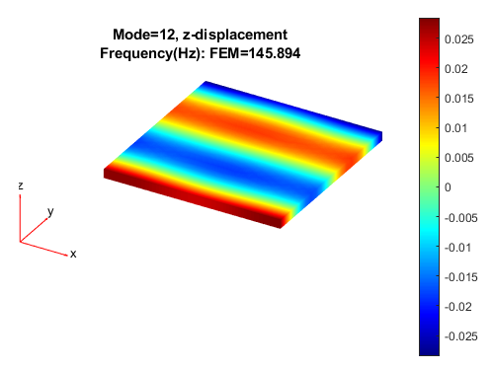
Problem#5 => Conclusion
The result from student and research are not identical. The reason behind this phenomena could be the result from various parameters: number of element in X, Y, and Z axis. From Figure 10, the difference between results at mode 12 using number of element of {16,16,10} and {50,50,10} is visible.
Figure 10: Difference between results at mode 12 using number of element of {16,16,10} and {50,50,10}

