Slide 1
The effect of distance to SPL on various keyboard types
Chinnakrit Kritsanayunyong 6131744121
Dit Dejphachon 6131765321

Slide 2
Motivation
Nowadays, mechanical keyboards have become the go-to keyboard for many people and have replaced the old membrane keyboard.
However, one of the main quirks of mechanical keyboards is the noise generated from the switch unlike that of membrane keyboards.
So, it is important to determine the difference in noises generated from these two keyboard types.

Slide 3

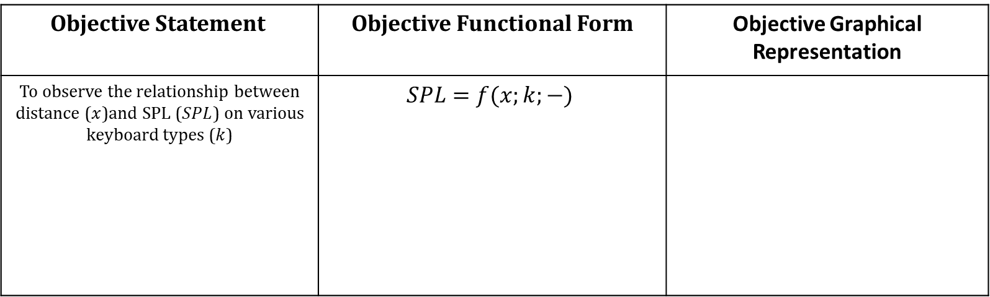


Objective
Objective Statement | Objective Functional Form | Objective Graphical Representation
To observe the relationship between distance ($x$)and SPL ($SPL$) on various keyboard types ($k$) | $$SPL=f(x;k;−)$$
$$p=k$$
$$SPL$$
$$x$$

Slide 4
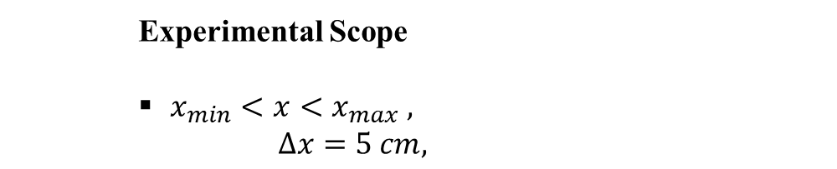
Experimental Conditions and Scope
Experimental Condition
Fixed recording application
(Android’s Spectrum Analyzer running on Huawei mate 10 Pro)
Keyboard types: membrane (Lenovo Legion 5 2021
built-in keyboard) and mechanical (Corsair k70 red switch)
Experimental Scope
$x_{min}<x<x_{max} ,$
$$∆x=5 cm,$$

Slide 5
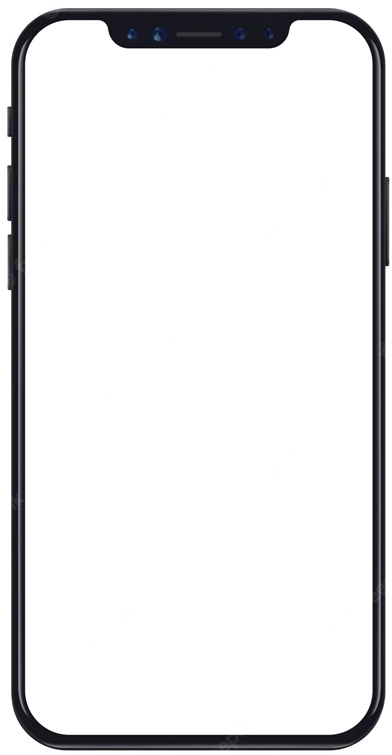
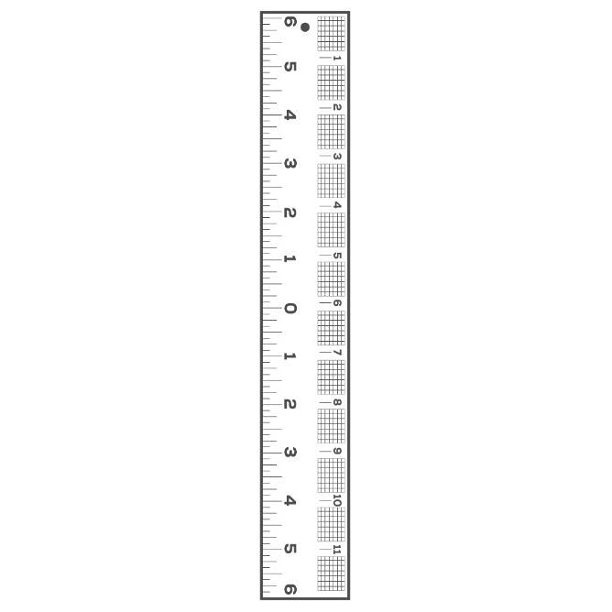
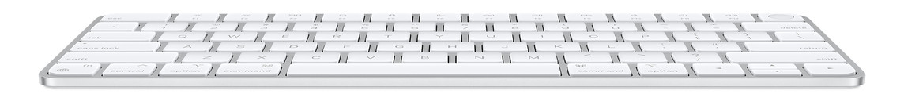


Experimental Principle and Setup
Android’s Spectrum Analyzer (determine $SPL$)
Ruler (vary $x$)
$$x$$
Keyboard

Slide 6
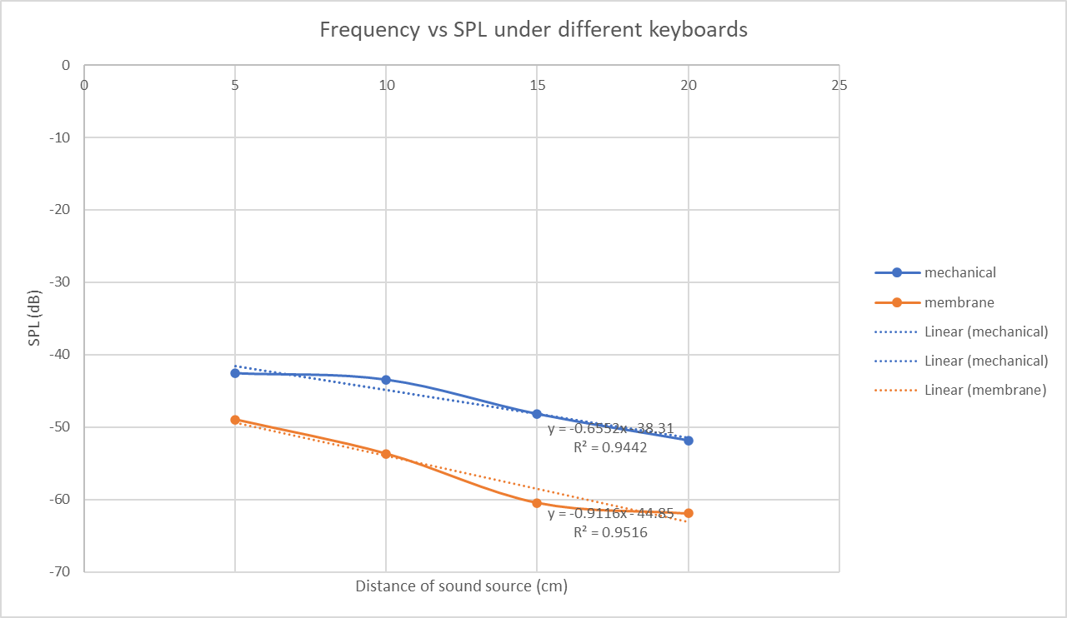
Result
Distance of sound source vs SPL under different keyboards

Slide 7
Discussion
The measuring application ‘Spectrum Analyzer’ has significant amount of noises which could be from the environment and the hardware device.
The noises greatly affect the measurement.

Slide 8
Conclusion
The relationship between distance to SPL is inversely proportional.
Moreover, the type of keyboard also has an effect on SPL.

