Slide 1
The effect of distance to SPL on various keyboard types
Chinnakrit Kritsanayunyong 6131744121
Dit Dejphachon 6131765321

Slide 2

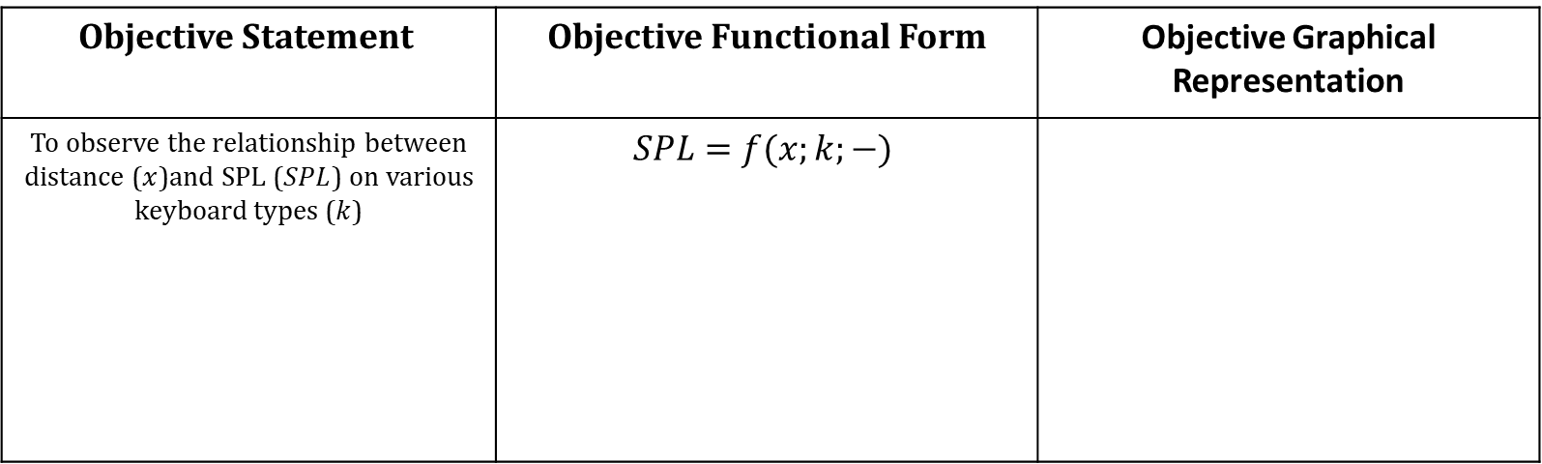


Objective
Objective Statement | Objective Functional Form | Objective Graphical Representation
To observe the relationship between distance ($x$)and SPL ($SPL$) on various keyboard types ($k$) | $$SPL=f(x;k;−)$$
$$p=k$$
$$SPL$$
$$x$$

Slide 3
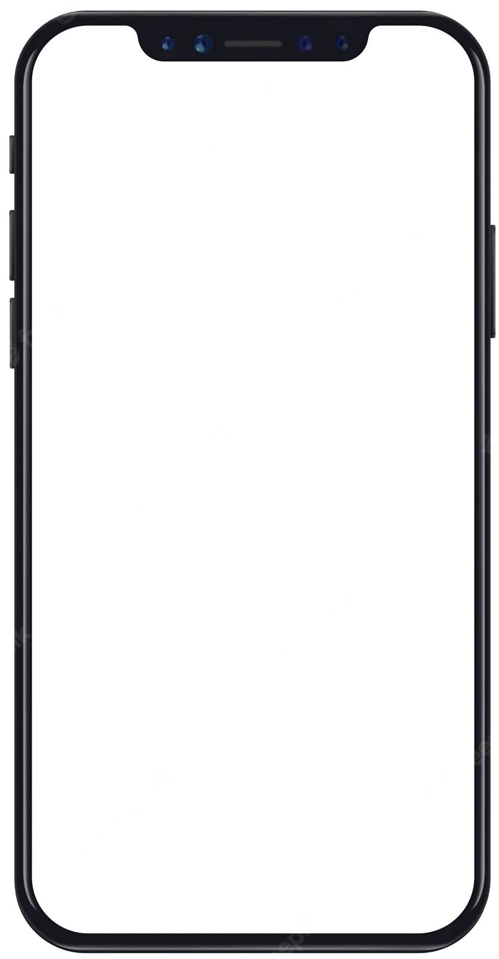
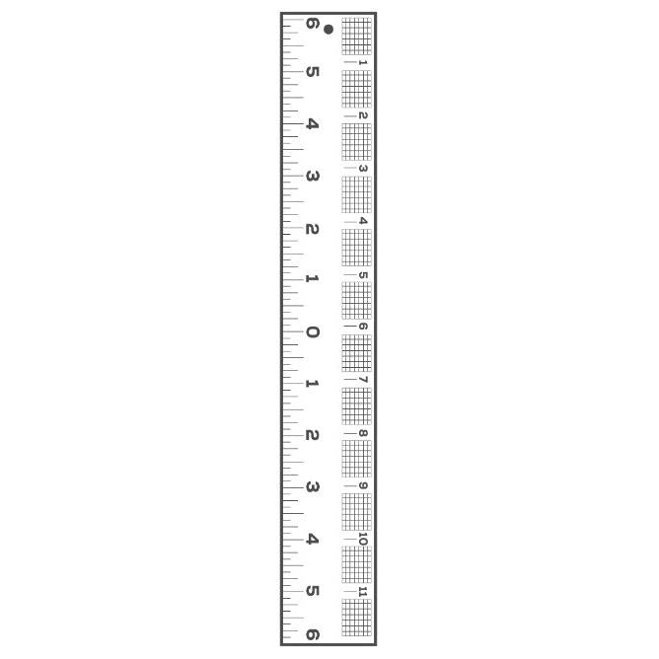
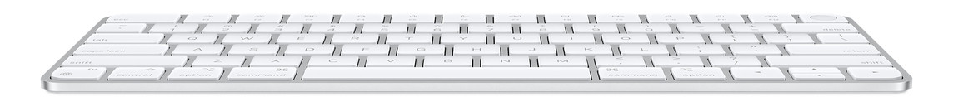


Experimental Principle and Setup
Android’s Spectrum Analyzer (determine $SPL$)
Ruler (vary $x$)
$$x$$
Keyboard

Slide 4
Result

Slide 5
Discussion
The measuring application ‘Spectrum Analyzer’ has significant amount of noises which could be from the environment and the hardware device.
The noises greatly affect the measurement.

Slide 6
Conclusion
The relationship between distance to SPL is proportional in both keyboards.
Moreover, the type of keyboard also has an effect on SPL where the membrane generates less SPL than mechanical keyboard.

