Slide 1
STM32 Bridge: An EV2300 Replacement
Keilan Levesque | Cesar Magana | Brighton Sikarskie
ESET 453 - Validation and Verification
Texas A&M University

Slide 2
What This Deck Covers
1. Why we replaced the TI EV2300 with an STM32F405 Feather.
2. Installing the Python toolkit that drives both bridges.
3. Wiring the adapter to the BQ76920 EVM.
4. The power-on order that keeps I2C happy.
5. Verifying the REPL sees the bridge and the BQ answers.
6. Reading and writing BQ registers from Python.
7. Doing the same from LabVIEW and TestStand.
8. Troubleshooting the common failure modes.

Slide 3
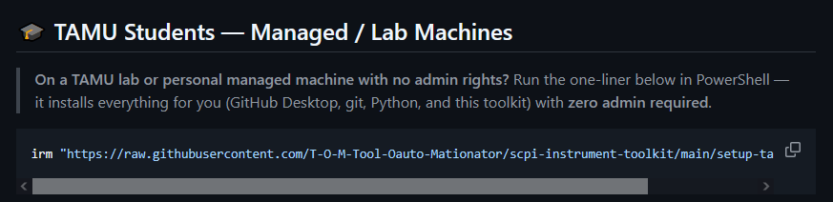
Setup: Install the Python Toolkit
What the toolkit does
Controls every BQ76920 EVM + STM32 bridge in the VOAL lab from one REPL.
Source (open): github.com/T-O-M-Tool-Oauto-Mationator/scpi-instrument-toolkit
Install on a TAMU-managed Windows machine (no admin rights)
irm "https://raw.githubusercontent.com/T-O-M-Tool-Oauto-Mationator/scpi-instrument-toolkit/main/setup-tamu.ps1" | iex
Install on a personal machine
pip install git+https://github.com/T-O-M-Tool-Oauto-Mationator/scpi-instrument-toolkit.git
Verify
scpi-repl --version -> should print the current version.

Slide 4
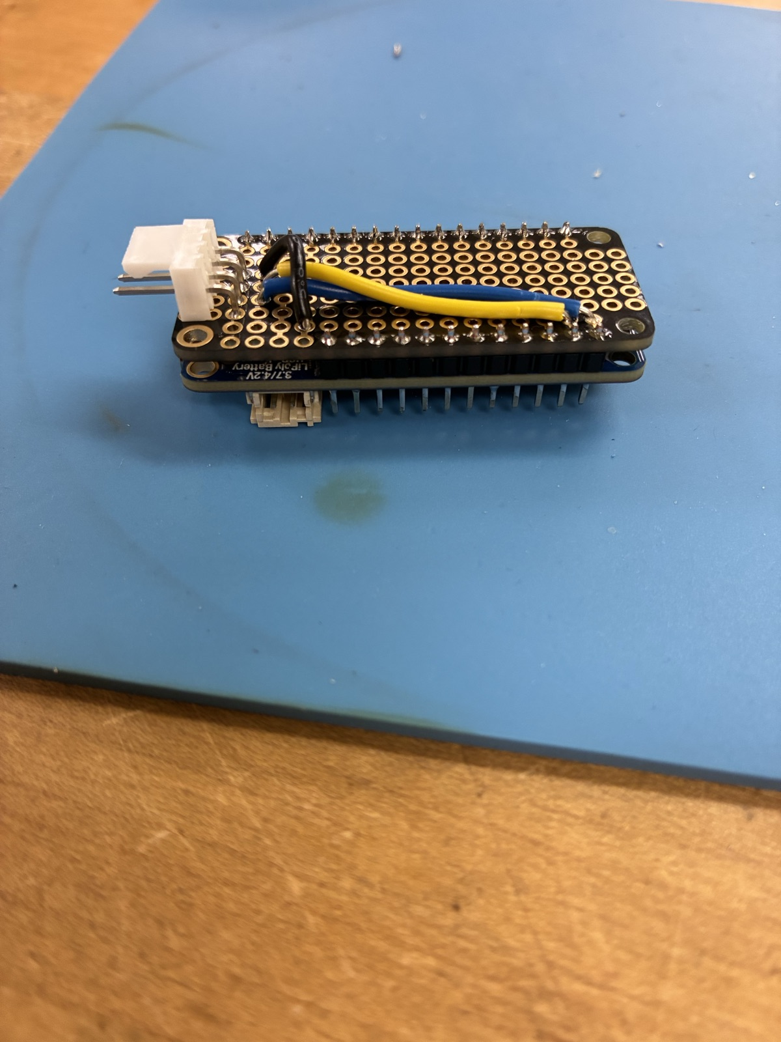
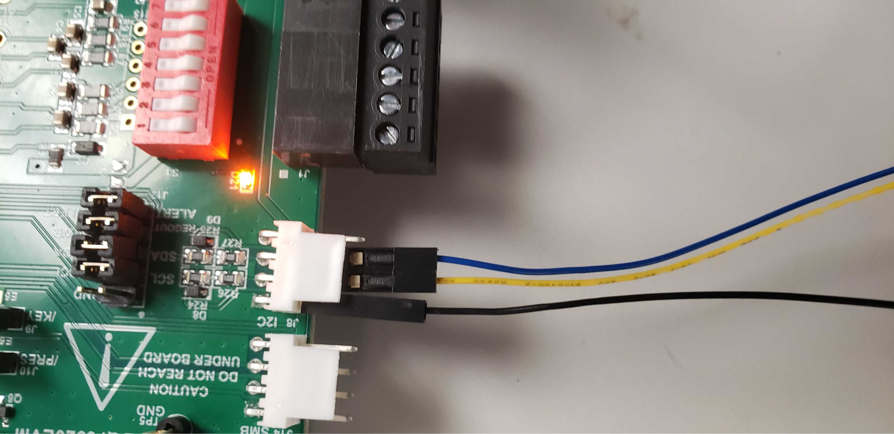
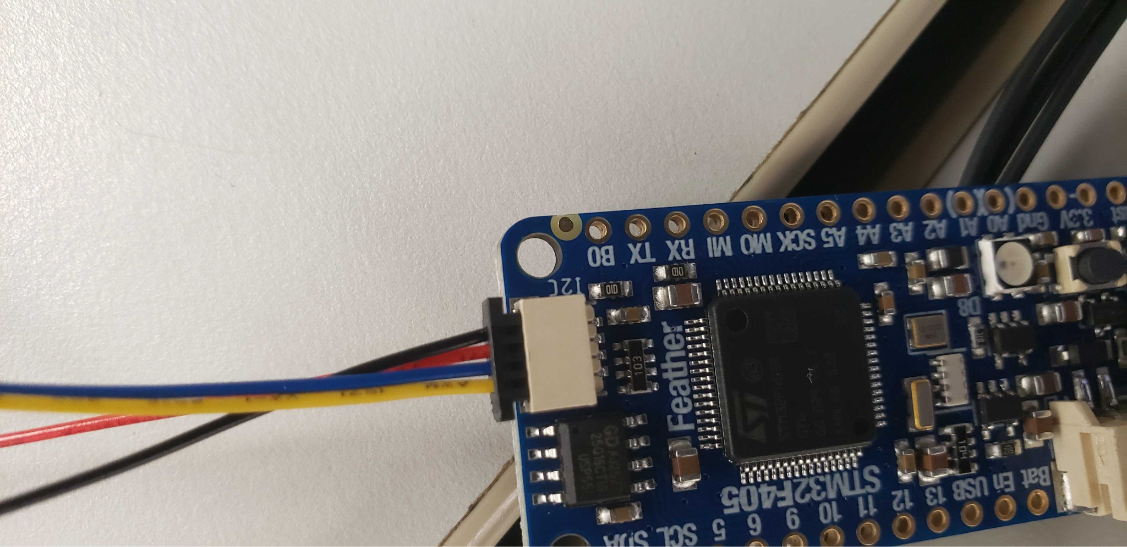
Setup: Physical Connections
STM32F405 Feather acts as a drop-in EV2300 replacement.
USB-C from the Feather -> host computer.
JST pigtail from the adapter -> BQ76920 EVM I2C header.
Wire map (JST side)
Pin 1: 3V3 Pin 2: SDA (yellow)
Pin 3: SCL (blue) Pin 4: GND
The red ribbon wire on the EVM cable is a NO-CONNECT. Do not route it.

Slide 5
Safety and Power-On Order
Always power the EVM before plugging in the bridge USB.
1. Set bench PSU to 18 V, current limit ~0.5 A.
2. Connect PSU to the BQ76920 EVM external power input.
3. Turn the PSU on. Confirm the EVM LED lights.
4. Plug the STM32 bridge USB-C cable into the host.
5. Press the BOOT button on the BQ EVM once.
6. Launch scpi-repl and run 'scan'.
Why this order?
The STM32 firmware samples the BQ at boot. If the EVM is unpowered, init fails and the bridge retries every 2 s. Powering EVM first avoids the 30-second dead-start window.
Pressing BOOT clears stuck state from the previous student's session.

Slide 6
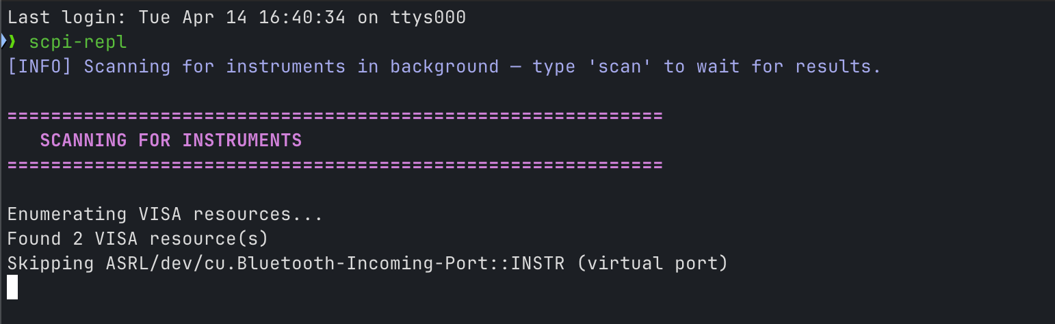
Check: The REPL Launches and Finds the Bridge
Open PowerShell (Windows) or Terminal (mac/Linux).
Run: scpi-repl --no-color
You should see:
[INFO] Scanning for instruments in background...
[SUCCESS] Scan complete: found N device(s).
eset>
'ev2300' must appear in the device list (the STM32 bridge enumerates with the same VID/PID as the original EV2300A).
If you see 'Skipping ASRL/dev/cu.Bluetooth-Incoming-Port::INSTR (virtual port)' - normal, ignore.

Slide 7
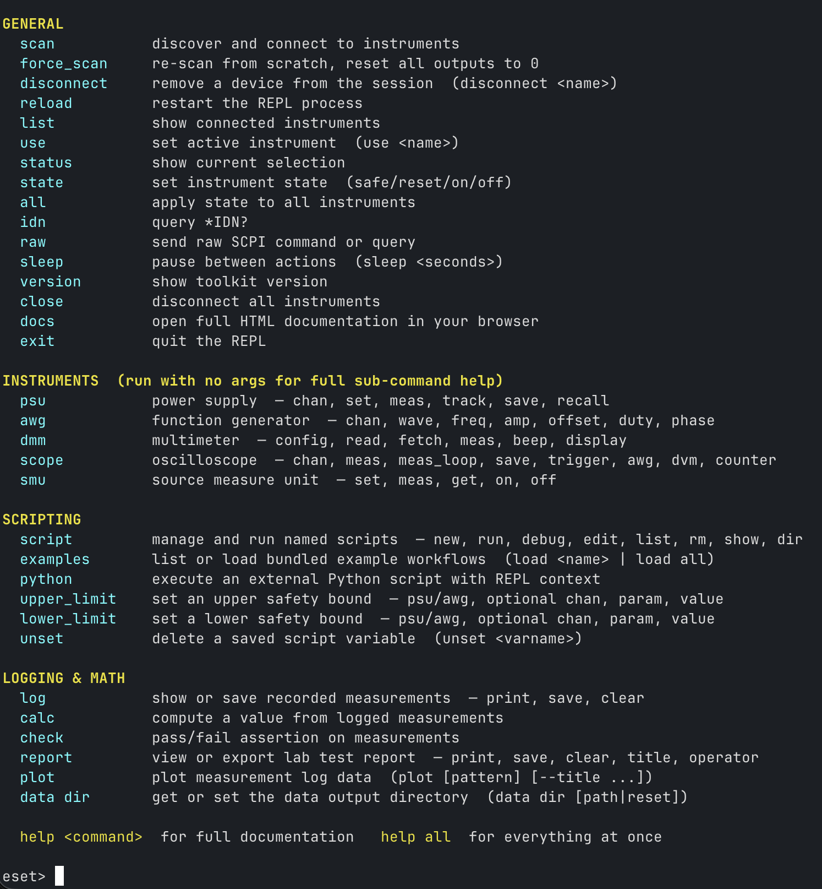
Check: 'help' Lists ev2300 Commands
Type 'help' at the eset> prompt.
Under INSTRUMENTS you should see:
ev2300 scan / read / write / probe (USB-to-I2C bridge)
For the full ev2300 sub-command list:
ev2300 (no args -> prints the sub-command help)
ev2300 info (prints VID/PID/serial of the connected bridge)

Slide 8
Check: BQ76920 Responds Over I2C
Power-on order (every time)
1. Bench PSU at 18 V -> BQ EVM.
2. USB cable -> STM32 bridge.
3. Press the BOOT button on the BQ EVM.
Read a known register from the BQ76920
ev2300 read_word 0x08 0x09
Expected: 0x0CE4 (3300) or similar - cell-stack voltage in millivolts.
Never 0x0000 or 0xFFFF. If you see those, repeat the power-on order above.
Quick 'is the chip alive?' check (scans all 256 registers)
ev2300 scan 0x08

Slide 9
GUI (In Development)
A minimal Tk-based GUI is planned for students who prefer point-and-click over the REPL.
Planned panels
Connection status - VID/PID/serial of the bridge, BQ online/offline LED.
Register browser - read/write any BQ76920 register, with name + hex + decimal.
Live monitor - pack voltage, cell voltages, current, temperature, stream to CSV.
Logger - start/stop logging to the same log file the REPL uses.
Status: not in current release. Track progress on the GitHub issue tracker.

Slide 10
Reading from the BQ (Python)
Use the toolkit's Python API when you need repeatable measurements.
Minimal example
from lab_instruments.api import Session
with Session() as s:
ev = s.ev2300
ev.wait_for_bq(timeout_s=30) # block until BQ answers
v_pack = ev.read_word(0x08, 0x09) # pack voltage, mV
cc_cfg = ev.read_byte(0x08, 0x0B) # coulomb-counter cfg
print(f"V={v_pack} mV, CC_CFG=0x{cc_cfg:02X}")
Why wait_for_bq?
The STM32 bridge retries BQ init every 2 s after a failed startup; wait_for_bq polls CC_CFG (reg 0x0B) on both possible addresses until the IC is live.

Slide 11
Writing to the BQ (Python)
Write a register, then read back to verify.
from lab_instruments.api import Session
with Session() as s:
ev = s.ev2300
ev.wait_for_bq()
ev.write_byte(0x08, 0x04, 0x10) # SYS_CTRL1 = 0x10
actual = ev.read_byte(0x08, 0x04)
assert actual == 0x10, f'write failed: got 0x{actual:02X}'
Safety
Some BQ registers will brick the chip if you write wrong values (e.g. OTP cmds).
Always check the BQ76920 datasheet register table before writing unfamiliar regs.

Slide 12
Reading from the BQ (LabVIEW)
The toolkit ships a LabVIEW bridge VI set in docs/labview.md.
Wiring to read a BQ register
1. Place SCPI Open.vi - target = 'ev2300'.
2. Wire into SCPI Read Word.vi with i2c_addr = 0x08, register = 0x09.
3. Output (U16) is the raw register value; display in hex + decimal indicators.
4. Close with SCPI Close.vi.
TODO: embed the 'ev2300_read_word.vi' front-panel screenshot when it is committed to docs/img/labview/.

Slide 13
Writing to the BQ (LabVIEW)
Mirror of the read flow with SCPI Write Word.vi / SCPI Write Byte.vi.
Pattern
1. Open -> Write -> Read (verify) -> Close, in a single sequence frame.
2. Wire an error-in/error-out chain so a failed write halts the test.
3. For block writes, use SCPI Write Block.vi with a U8 array input.
TODO: embed the 'ev2300_write_byte.vi' screenshot once available.

Slide 14
Reading / Writing to the BQ (TestStand)
TestStand calls the same LabVIEW VIs shown on slides 10-11.
Sequence skeleton
Step 1: LabVIEW Action - SCPI Open.vi (target = 'ev2300').
Step 2: Numeric Limit Test - SCPI Read Word.vi, compare to expected pack voltage.
Step 3: LabVIEW Action - SCPI Write Byte.vi (config register).
Step 4: Numeric Limit Test - SCPI Read Byte.vi, assert the write took effect.
Step 5: Cleanup - SCPI Close.vi (Post Action on any step failure).
One REPL connection = one TestStand sequence call. Do not open the adapter twice.

Slide 15
Troubleshooting Quick Reference
Symptom -> first fix to try
'device error (0x46)' on a read/write
Press BOOT on the EVM, then 'disconnect ev2300' + 'scan' in the REPL.
'connect failed' during scan
Close BQ Studio / bqStudio - only one program can hold the HID handle.
ev2300 is not in the 'found instrument' list
Unplug the USB cable, wait 3 s, plug it back in, then 'scan'.
read_word returns 0xFFFF or 0x0000
EVM is unpowered or the BOOT button was not pressed. Redo the power-on order.
Bridge enumerates as 'bootloader mode'
Firmware is not flashed. Hand the unit to a TA (see TA Guide Ch. 12).

Slide 16
Notes for TAs: Adding New Bench Equipment
Adding support for a new instrument is a four-file PR.
1. Driver: lab_instruments/src/<inst>.py (follow the SCPI Driver Contract).
2. REPL handler: lab_instruments/repl/commands/<inst>.py.
3. Tests: tests/test_<inst>_driver.py + tests/test_<inst>_commands.py.
4. Docs: docs/<inst>.md and an entry in mkdocs.yml.
For STM32-bridge-specific work (firmware, hardware build)
See TA Developer Guide, Chapter 12 - full BOM, soldering photos, firmware-flash and verification checklist.
General new-driver walkthrough
TA Developer Guide, Chapter 3 - Adding a New Instrument Driver.

