Slide 1
Dashboard for analyzing the content in social media (Twitter)
Group:
2776
Students:
Ahmed Sahloli
Naif Albarqi
Supervisor:
Dr. Essa Ali Alhazmi

Slide 2
Abstract:
The content in social media have an impact on our society in many aspects including the spreading of abusive content ,fake news , misinformation.
In this project, we seek to build a dashboard that enables the user to track and analyze what is in trends at the current time, as well as analyze contents.
The dashboard will provide the user with detailed information. It will also provide high-level interactive charts and geographical maps.

Slide 3
Problem Statement:
The content in social media have an impact on our society in many aspects including the spreading of abusive content ,fake news , misinformation.
The need of monitoring and tracking of these contents is very a priority for many sectors.
Providing a dashboard for analyzing the contents and flexible to add features such as pre-trained machine learning models is our objective.
Analyzing the contents and understand their spreading are also very challenging and needs effective tools to monitor them.

Slide 4
Project Scope:
Artificial Intelligence, Natural Language Processing, Data Science, Software Engineering.
Applying pre-trained model to analyze the data on the Twitter platform.

Slide 5
Aims and objectives:
Building an interactive dashboard , where the user can search for specific content, such as (hashtag, user account, content) and review results about it.
Graphical representation of the analyzed data.

Slide 6
Project motivation:
Attempting to provide a unique dashboard that will benefit the user for providing knowledge about the specified content.
To apply what we learned during college.

Slide 7
Potential Benefits:
The user will be able to know the results of the content analysis interactively, as he will be able to know the following:
When did this abusive content start appearing.
The amount of interaction on this abusive content.
The percentage of abusive in this content.

Slide 8
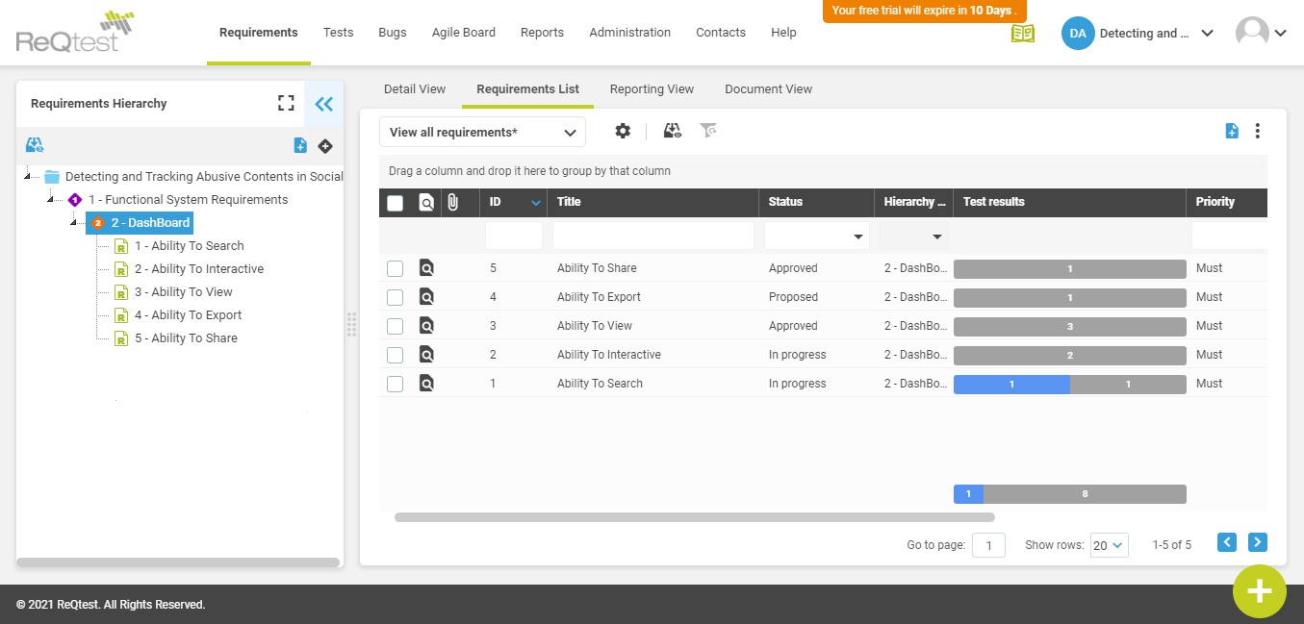
System Requirements Specification:

Slide 9
Project Methodology:
We use Incremental Model.
Incremental Model: is a process of software development where requirements are broken down into multiple standalone modules of software development cycle.
Incremental development is done in steps from analysis design, implementation, testing/verification, maintenance.

Slide 10
Project Methodology:
Characteristics of an Incremental module includes:
System development is broken down into multiple standalone modules.
Partial systems are successively built to produce a final total system.
Highest priority requirement is tackled first.

Slide 11
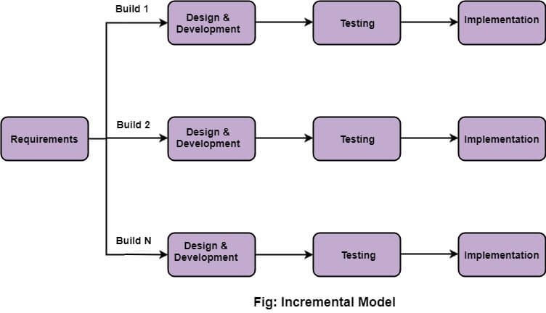

Slide 12
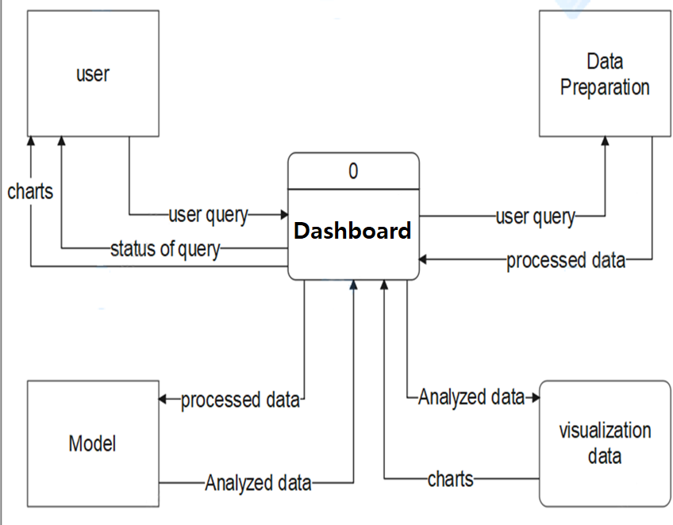
Data Flow Design

Slide 13
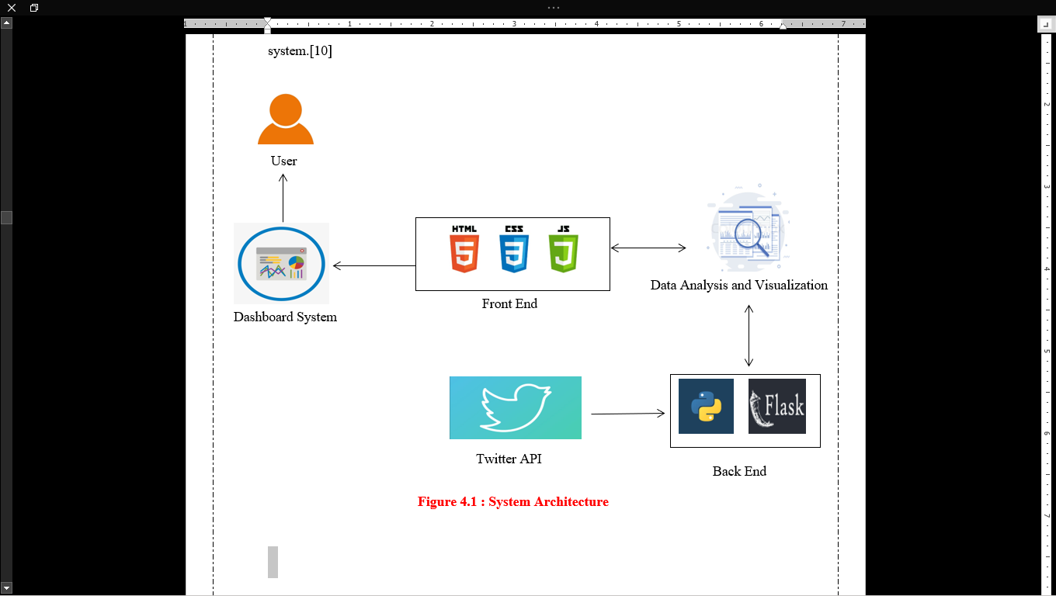
System Architecture

Slide 14
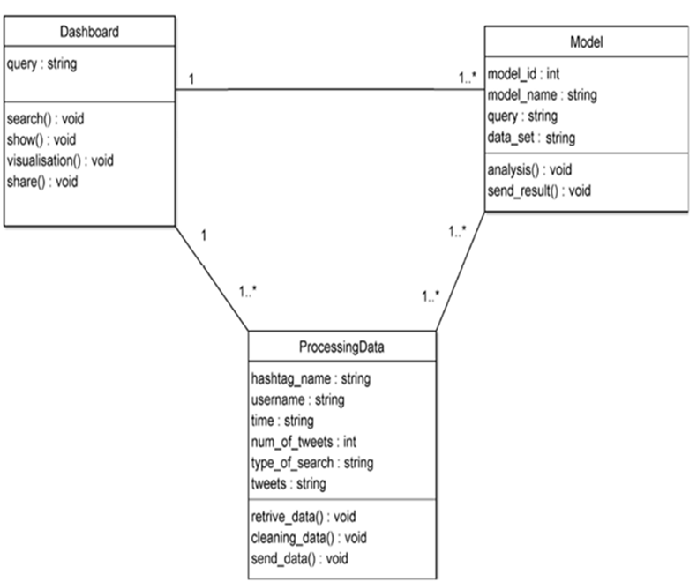
Class Diagram

Slide 15
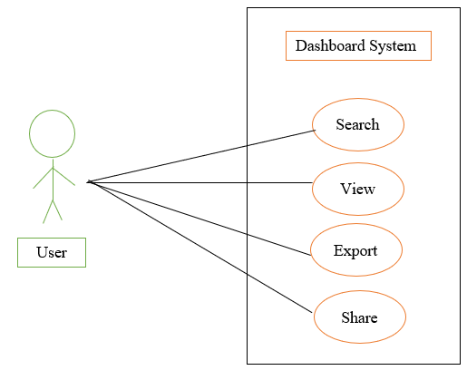
Use case Diagram

Slide 16
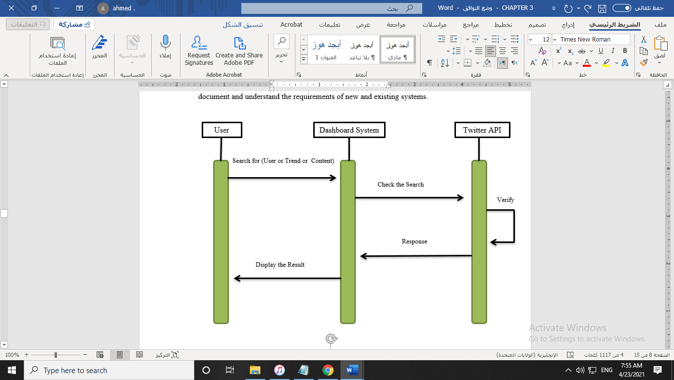
Sequence Diagram

Slide 17
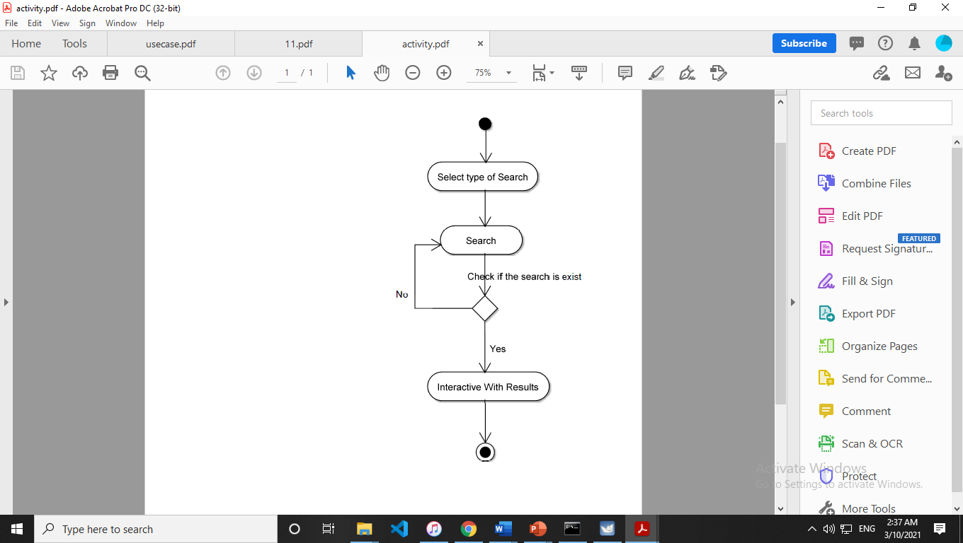
Activity Diagram

Slide 18
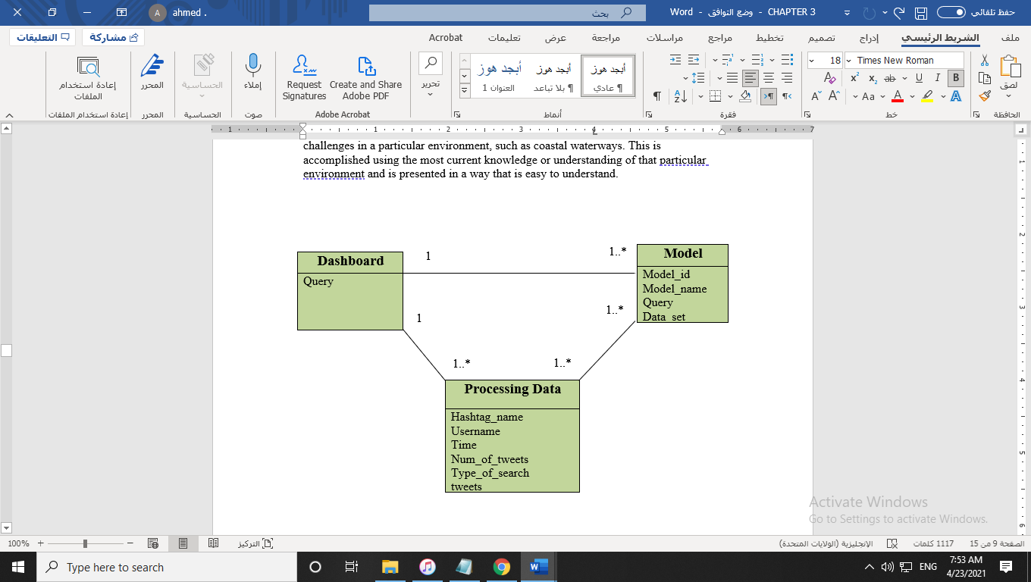
Conceptual Diagram

Slide 19
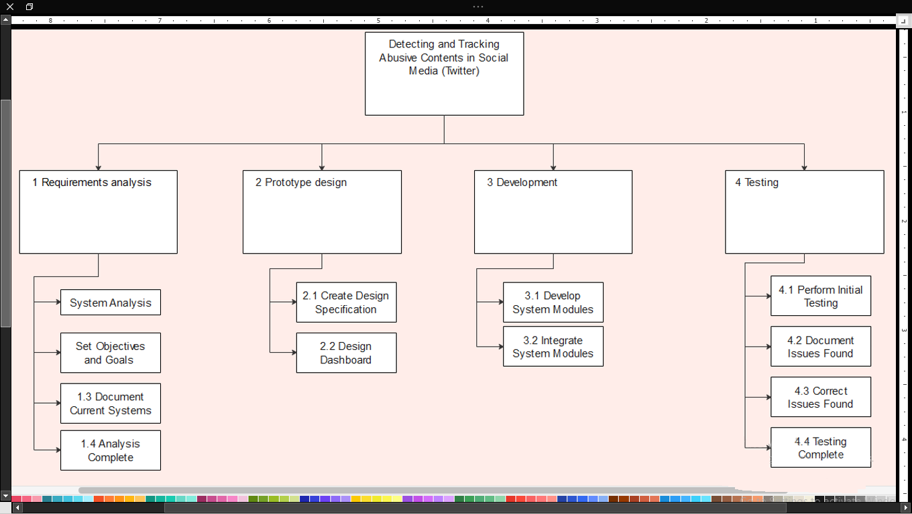

Slide 20
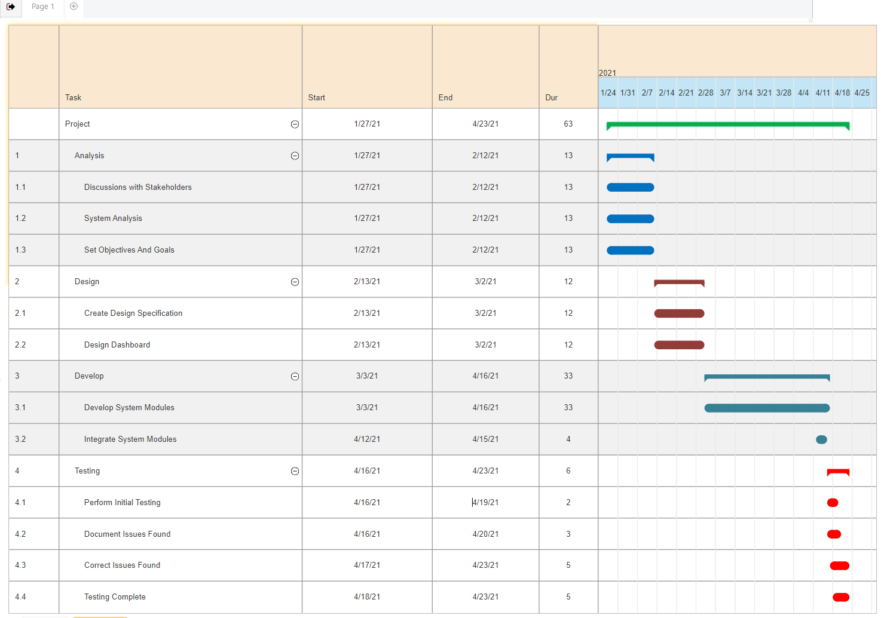

Slide 21
INFORMATION GATHERING
Brainstorming
Searching for similar Dashboards

Slide 22
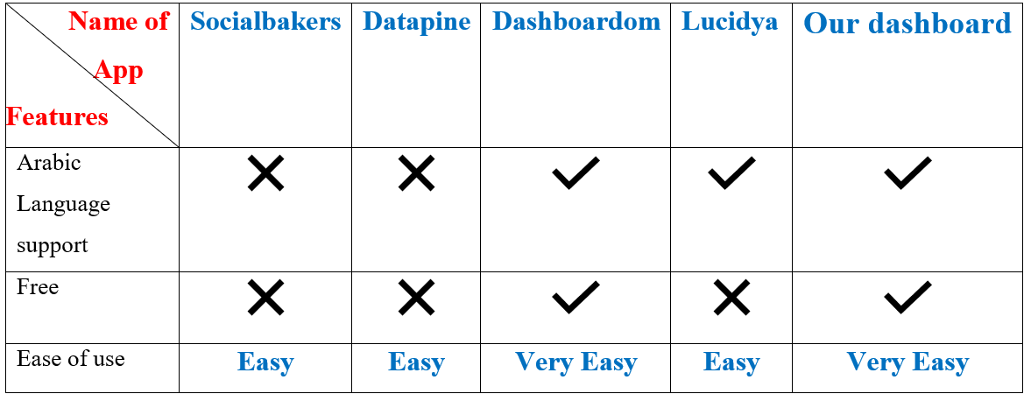
Analysis of Existing System :

Slide 23
Features of our application
Support Arabic language.
Provide interactive charts.
Provide Word Cloud Figures.
Provide Geo maps.
Ease of use.

Slide 24
Tools and techniques used:
Web Scraping.
Processing Data.
Data Visualization.
PyCharm.
Python.
Flask.
HTML.
CSS.
JavaScript.
Twitter API.
MapBox API.

Slide 25
System Implementation:
Required Hardware:
4 GB RAM minimum, 8 GB RAM recommended
20 GB hard disk space + at least 1 GB for caches
1024×768 minimum screen resolution
Software :
Python 2.7, or Python 3.5 or newer
IDEs and Code Editors for Python
Web Browser

Slide 26
Tools / Technologies used in Project:
Python
Web scraping
Flask
HTML/CSS
NLP
JS
Data Processing
Data Visualization
APIs

Slide 27
System Implementation:
Implementation Process:
Front End
Back End
Receiving and processing data
Data Visualization
Detecting abusive contents

Slide 28
System Implementation:
Front End
The front end of a website is the part that users interact with. Everything that you see when you’re navigating around the Internet, from fonts and colors to dropdown menus and sliders, is a combo of HTML, CSS, and JavaScript being controlled by your computer’s browser.
we use HTML for the basic structure of webpages , CSS to designing and styling of the structure or html elements, JavaScript to making the webpages interactive. Plotly.js to create high-level interactive charts.

Slide 29
System Implementation:
Back End
The back end refers to parts of a computer application or a program's code that allow it to operate and that cannot be accessed by a user. Most data and operating syntax are stored and accessed in the back end of a computer system. Typically, the code is comprised of one or more programming languages. The back end is also called the data access layer of software or hardware and includes any functionality that needs to be accessed and navigated to by digital means.
For Back-End we used Python(Flask).And we do not use database because our web application is originally based on Twitter API, we take the data, process it, and then display it.

Slide 30
System Implementation:
Receiving and processing data
To receive data like tweets ,trends, whatever on twitter, we use twitter API, also we use Mapbox API to get custom online maps.
After receiving data, we process it for analysis and visualization.

Slide 31
System Implementation:
Data Visualization
After we have cleaned the data, we define the elements that we are going to Visualize, and at this phase we use plotly.js library, which provides interactive charts.
Also, we use Mapbox API to provide a geo maps.
We have chosen Mapbox for the following reasons:
Free API up to 50,000 monthly loads.
Customization of maps is easy.
Easy to integrate.

Slide 32
System Implementation:
Detecting abusive contents
Unfortunately, after the decision to submit the study was issued, the time became very short and we were not able to complete this stage, as it is a stage that requires a lot of time and effort, for example: If we want to build an AI model to track the offending content, it is necessary to provide a huge number of data to train the model on it in order to achieve Acceptable or almost high accuracy in classifying content.

Slide 33
SYSTEM TESTING:
Unit Testing
Integration Testing
Performance testing
User acceptance testing
Test Cases

Slide 34
SYSTEM TESTING:
Unit Testing

Slide 35
Test Case No. | 1
Test Data | HTML search field in the index page.
Possibilities of defect | No data: Check system response when no data is submitted. Invalid data: Check system response when Invalid test data is submitted. Illegal data format: Check system response when test data is in an invalid format.
How was the defect resolved? | Name of Defect: No data Patching Steps: By make the search element as required Snippet code: <input type="search" name="search" placeholder="Search ..." required>
 | Name of Defect: Invalid data & Illegal data format Patching Steps: Redirect the user to the errors page.

Slide 36
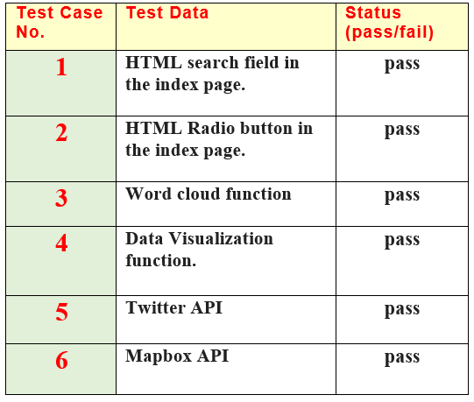
Unit Testing Summary

Slide 37
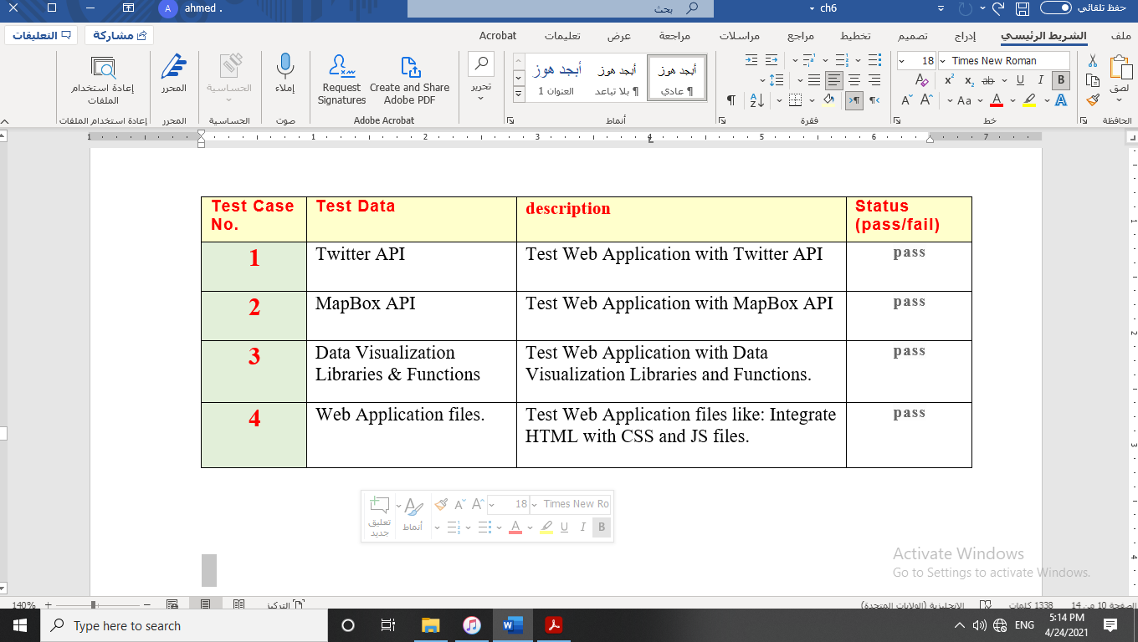
SYSTEM TESTING:
Integration Testing Summary

Slide 38
SYSTEM TESTING:
Performance testing Summary
We have not deployed the system to an external server yet, so if we perform a performance test in the current situation, the result will be inaccurate.

Slide 39
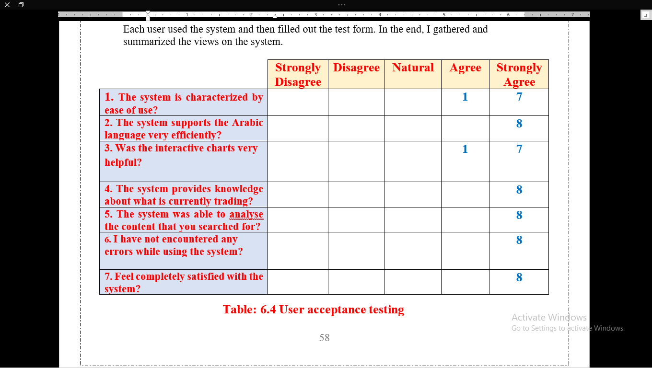
SYSTEM TESTING:
User acceptance testing Summary

Slide 40
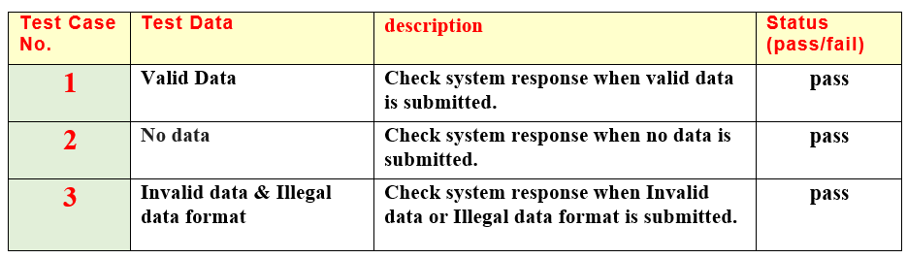
SYSTEM TESTING:
Test Cases Summary

Slide 41
SYSTEM DEMONSTRATION :
System Screen Flow
System Screens snapshots

Slide 42
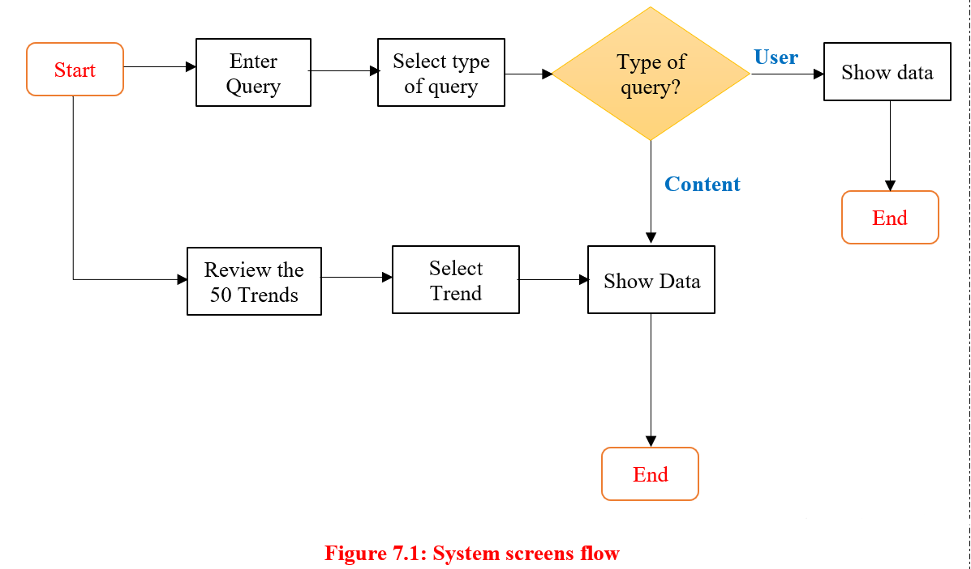
SYSTEM DEMONSTRATION :
System Screen Flow

Slide 43
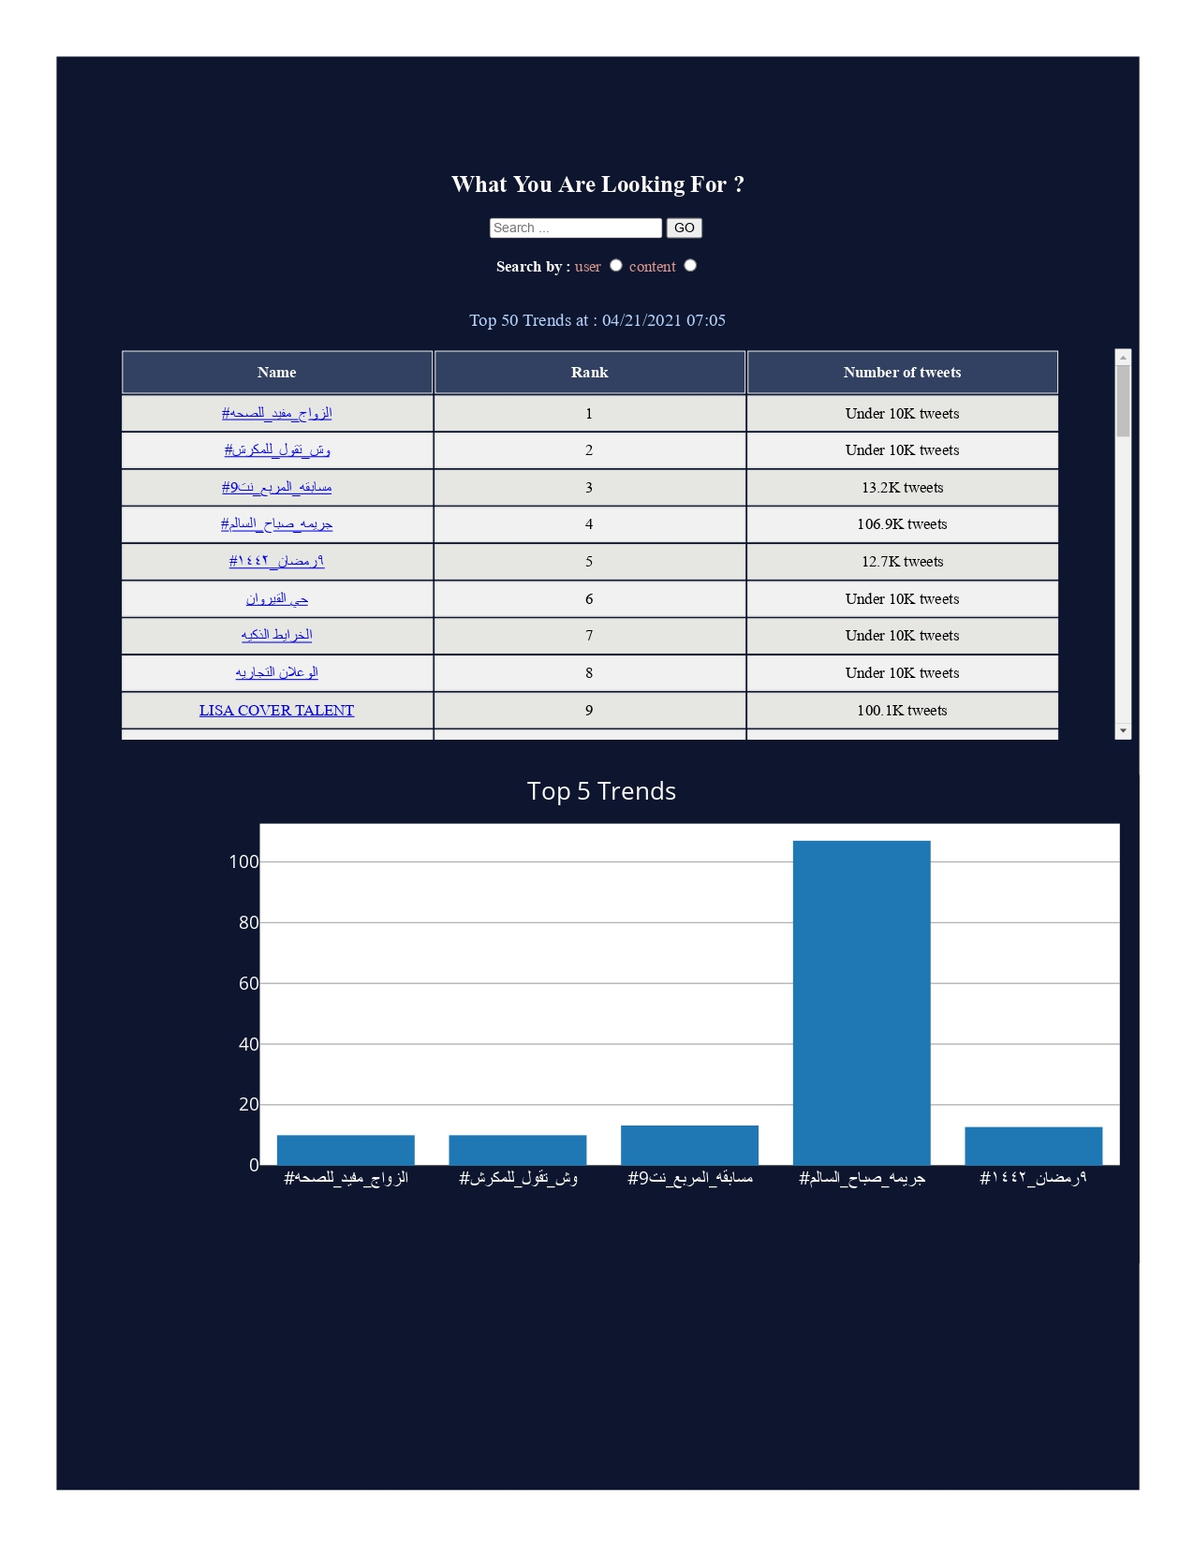
Index page

Slide 44
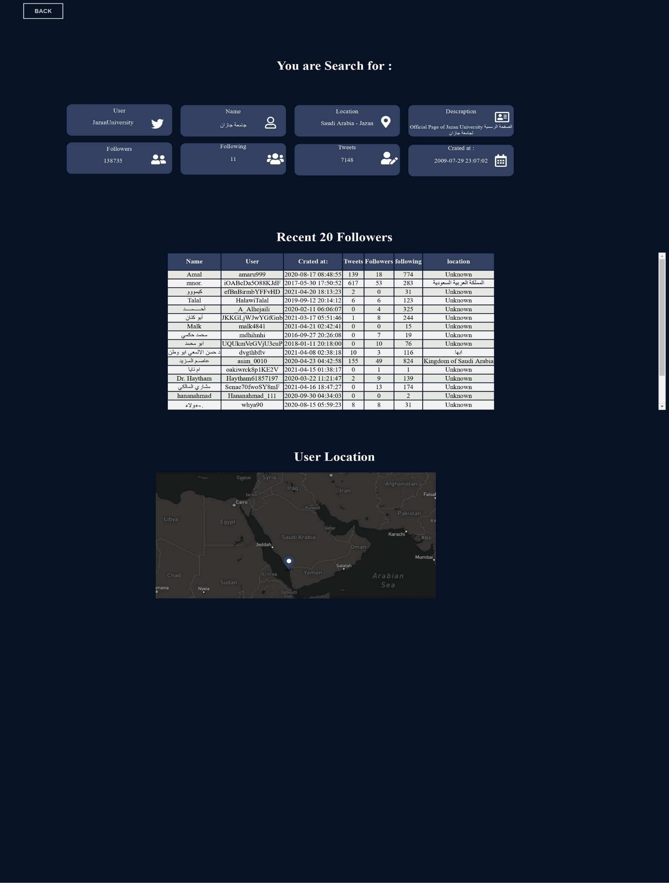
User page

Slide 45
Conclusion :
Summary
Impact of the project on society
Limitations and Future Work
Lessons Learned

Slide 46
Conclusion :
Summary
We have developed an analytical web application that is characterized by its full support for the Arabic language, and it also makes it easier for users to see the details of the latest trends at the real time, as it provides interactive charts for the user and also provides geographical maps, with this application the user will be able to know the most prominent words Which is circulating in the trends, as it will be known in the form of a word cloud, and it will also be able to know the number of tweets also mentions and the type of devices that have been tweeted from as well as a geographical map of the location of the users if they were allowing that.

Slide 47
Conclusion :
Impact of the project on society
The users will be able to search for content and users on the Twitter platform, in more detail and easily, and he will see charts that provide many analyzes, which helps in understanding more easily.

Slide 48
Conclusion :
Limitations
The biggest challenge we faced was to complete the project on time, as a full month of project time was deducted because of the decision issued to submit the study.
Twitter API has a rate limit of 900 requests/15-minutes. This hinders the process of analyzing all trends content.
Combining words with symbols or numbers, and when we perform the process of cleaning the data, these symbols will be deleted and thus the words become meaningless.

Slide 49
Conclusion :
Future Work
We recommend that there be more than one artificial intelligence model to classify the contents, whether in the classification of offensive content or the classification of feelings.

Slide 50
Lessons Learned:
1- We learned how to be full stack developer , we learned the techniques and programming languages use in the front-end and Back-End.
Front-End like : HTML, CSS, JavaScript.
Back-End like : Python , flask, APIs.
2- many libraries in python such as : pandas , tweetpy, requests and many, as we mentioned.
3- we learned how to visualize data.
4- How clean and processing and analysis data .
5- we learned how to be testing applications and handle errors.
6- Managing projects.
7- We developed the skill of working in a team, and using popular tools using in this field such as Slack.

Slide 51
References
1- https://www.imindq.com/uses/brainstorming
2- https://www.socialbakers.com/company
3- https://www.datapine.com/about-us
4- https://www.dashboardom.com/
5- https://lucidya.com/2020/03/19/10-social-media-analytics-tools-you-should-be-using-for-your-brand/
6- https://www.guru99.com/what-is-incremental-model-in-sdlc-advantages-disadvantages.html
7- https://www.visual-paradigm.com/guide/uml-unified-modeling-language/what-is-use-case-diagram/
8- https://www.geeksforgeeks.org/unified-modeling-language-uml-sequence-diagrams/
9- https://ozcoasts.org.au/conceptual-diagrams/
10- https://softwareengineering.stackexchange.com/questions/343643/software-architecture-vs-system-architecture-vs-class-diagrams
11- https://www.visual-paradigm.com/guide/data-flow-diagram/what-is-data-flow-diagram/
12- https://www.visual-paradigm.com/guide/uml-unified-modeling-language/uml-class-diagram-tutorial/
13- https://www.udacity.com/blog/2014/12/front-end-vs-back-end-vs-full-stack-web-developers.html

Slide 52
Any Questions?

