Slide 1
Obesity Predictors
Terence Henriod
Undergraduate, Community Health Science
University of Nevada, Reno

Slide 2
Abstract
Americans are continually becoming more overweight and obese, resulting in numerous negative health outcomes and increased healthcare costs. Using factor analyses and a multiple regression model, data at the county level (n=3141) was analyzed to determine where health interventions targeting obesity are most likely to be effective. Based on the model, increasing average educational attainment, in years, results in by far the largest reduction in obesity. Following education, increasing the rate at which individuals participate in leisure time physical activity at least once a month, followed by whether or not individuals on average have at least 5 servings of fruits and vegetables per day will result in the largest reductions in obesity prevalence.

Slide 3
Background
The prevalence of obesity has rapidly increased in the U.S. (and some other developed nations), now starting to affect younger populations than ever
Obesity is seemingly a simple issue, but when viewed as a social issue, it increases in complexity
While some study genetics and epigenetics to explain obesity, others retort that the problem has exploded MUCH faster than changes in the genome, and therefore solutions do not lie in genetics
Studying behavioral and social factors are much more likely to yield important information concerning obesity

Slide 4
Data
Health Data: Community Health Status Indicators Report 2009
  Compiled from federal data and calculations, from Department of Health and Human Services sanctioned sources, “to present a broad set of metrics”
    BRFSS

Slide 5
Data (cont.)
    Education Data: USDA Economic Research Service – American Community Survey 2010 (www.ers.usda.gov/data/education/#list)
    Income Data: 2010 American Community Survey (census.gov)
This data included as many as 3141 cases (counties), but as few as 712

Slide 6
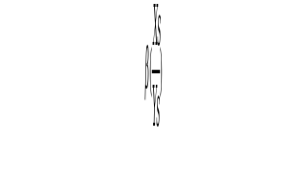
Method
Multiple regression with OLS
Use of scale variables: Health Disadvantaged Populations and Proactive Health Behaviors (not related to obesity)
Comparison of standardized regression coefficients

Slide 7
Research Question: Where should obesity interventions be targeted to be effective (in terms of negative health behaviors)? Should attitudes towards health in general be targeted? Or just factors related to Obesity?
Finding: Rates of non exercisers are the best health factor for decreasing obesity prevalence; education is the best absolute factor

Slide 8
Relevant Prior Research
Will All Americans Become Overweight or Obese? Estimating the Progression and Cost of the US Obesity Epidemic
  Wang et al
Identifying Risk for Obesity in Early Childhood
  Nader et al

Slide 9
Research seems to be focused on children, genetics and costs. This study will look at how to effectively change community factors related to obesity.
I intend to explore what factors are significantly related to obesity to aid in the design of obesity reduction interventions

Slide 10
Sample
Data was collected at the county level
CHSI data was collected from random samples of participants in participating counties
Educational and income data were collected through the U.S. Census
Data was likely collected as clusters at data collection sites
  Certainly most of the health data was clustered, I would imagine Census data collection is not evenly distributed either

Slide 11
Problems with Data
Creating an adequate model was difficult
The CHSI data had ~200 variables accompanied by confidence intervals and peer comparisons. Difficult to sort through.
CHSI data included many unintuitive variables that seemed promising, but were likely not worth the effort of including, i.e. Relative Health Importance Indicators
There were many kinds of data I wish I had

Slide 12
The health and income data were missing LARGE amounts of data
Some data had to be converted to more easily used forms, i.e. percent rates instead of per 100,00
Variables that I hoped to use had large P values that made them unusable (Example: Median Income, P>0.901)
Altogether 712 cases with complete data

Slide 13
Dependent Variable
Obesity Rate: The calculated percentage of adults at risk for health problems related to being overweight, based on body mass index (BMI). A BMI of 30.0 or greater is considered obese. To calculate BMI, multiply weight in pounds by 703 and divide the result by height (in inches) squared.

Slide 14
Predictor Variables
Health Disadvantage: A scale variable composed of variables that likely put an individual at disproportionate risk to poor health outcomes, including obesity
Prevalence of Diabetes: The percentage of adults who responded “yes” to the question, “Have you ever been told by a doctor that you have diabetes?”
Disability Medicare Enrollment Rate: Percentage of individuals enrolled in Medicare by county of residence

Slide 15
Medicare Enrollment Rate: Percentage of individuals enrolled in Medicaid by county of residence
  Both disability and elderly enrollments are included
Prevalence of High Blood Pressure: The percentage of adults who responded yes to the question, “Have you ever been told by a doctor, nurse, or other health professional that you have high blood pressure?”
Prevalence of Major Depression: Estimate of individuals 18+ who experienced a major depressive episode in the previous year
Severe Work Disability Rate: Rate of individuals who are unable to maintain employment due to disability

Slide 16
Unemployment Rate: Rate of individuals who are available for employment and have made specific efforts to gain employment, but remain unemployed
Proactive Health Behaviors: A scale composed of factors that suggest and individual is concerned about their health, but not related to obesity. Meant to represent general health proactivity
Mammogram Rate: Percentage of females aged 50+ who received a mammography in the last 2 years
Pap Smear Rate: Percentage of females 18+ who have had a pap smear in the last 3 years

Slide 17
Sigmoidoscopy Rate: Percentage of adults aged 50+ who have ever had a sigmoidoscopy or colonoscopy
Average Years of Education: A composite measure of the mean educational attainment of the county based on degree completion criteria
Rate of Low Fruit and Vegetable Consumption:The percentage of adults reporting an average fruit and vegetable consumption of less than 5 servings per day
Rate of “No Exercise”:The percentage of adults reporting of no participation in any leisure-time physical activities or exercises in the past month

Slide 18
 | Health Disadvantage Rate
 |  | 1 | 2 | 3 | 4 | 5 | 6 | 7
1 | Diabetes Rate | 1
2 | Disability Medicare Enrollment | 0.51 | 1
3 | Elderly Medicare Enrollment | 0.2 | 0.31 | 1
4 | High Blood Preassure Rate | 0.58 | 0.56 | 0.35 | 1
5 | Major Depression Rate | -0.08 | 0.19 | 0.14 | 0.03 | 1
6 | Severely Work Disabled Rate | 0.29 | 0.49 | 0.05 | 0.29 | 0.16 | 1
7 | Unemployment Rate | 0.28 | 0.26 | 0.04 | 0.21 | 0.03 | 0.12 | 1
Factor | Eigenvalue
Factor1 | 2.06
Factor2 | 0.3306
Factor4 | 0.0095
Factor5 | -0.17
Factor6 | -0.191
Factor7 | -0.222

Slide 19
 | Proactive Health Behaviors (Not Related to Obesity)
 |  | 1 | 2 | 3
1 | Mammogram Rate | 1
2 | Pap Smear Rate | 0.6386 | 1
3 | Proctoscopy Rate | 0.6196 | 0.5092 | 1
Factor | Eigenvalue
Factor1 | 1.63782
Factor2 | -0.09203
Factor3 | -0.18657

Slide 20
Data Cleaning
A lot of recoding to eliminate missing data
Some recoding to make useable or wieldy variables
  Recoding dichotomous variables to be 0 and 1
  Turning integer numbers of people into proportions
  Converting some rates into more wieldy ones (rates of per 100,000 to per 100)
  Average rate of education composite (taking rates of various education levels and combining them into a single measure)

Slide 21
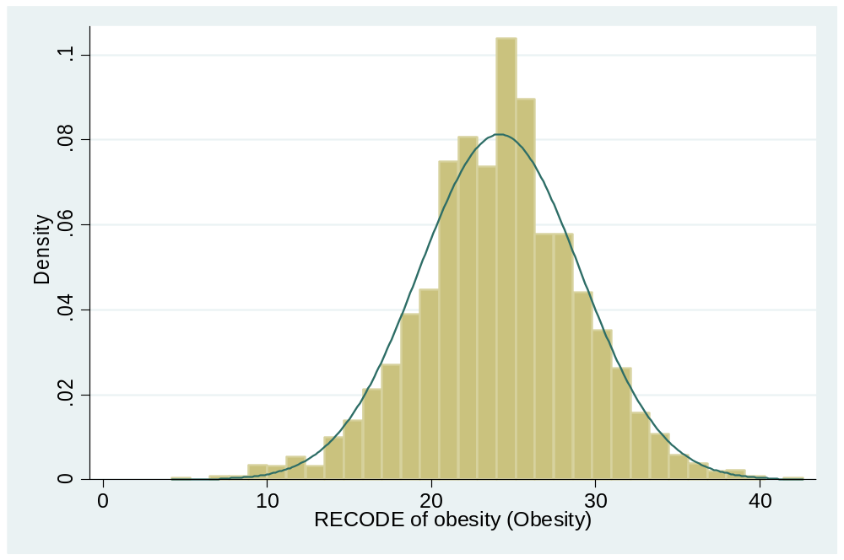
Obesity Rate by County

Slide 22
Summary Statistics
Variable | Obs | Mean | Std. Dev. | Min | Max
Obesity_Rate | 2224 | 24.14519 | 4.904128 | 4.2 | 42.6

Slide 23
Variable | Obs | Mean | Std. Dev. | Min | Max
Health Disadvantage | 3141 | 2.923261 | 2.092249 | 0.0199191 | 8.697025
Prevalence of Diabetes | 2719 | 7.810188 | 2.764576 | 0.5 | 20.8
Disability Medicare Enrollment Rate | 3109 | 0.025782 | 0.0124414 | 0.0026052 | 0.1447788
Medicare Enrollment Rate | 3110 | 0.1421634 | 0.047393 | 0.0009465 | 0.6592854
Prevalence of High Blood Pressure | 1522 | 26.48095 | 5.436607 | 7.2 | 47.1
Prevalence of Major Depression | 3141 | 0.0605982 | 0.0065543 | 0.0400477 | 0.0825921
Severe Work Disability Rate | 3113 | 0.0291298 | 0.0169596 | 0.0069566 | 0.6205065
Unemployment Rate | 3133 | 0.0261743 | 0.007194 | 0.0105662 | 0.0770953

Slide 24
Variable | Obs | Mean | Std. Dev. | Min | Max
Proactive Health Behaviors | 1579 | 73.50993 | 11.02039 | 7 | 98.2
Mammogram Rate | 894 | 80.03255 | 5.912998 | 58.3 | 95.9
Pap Smear Rate | 1548 | 82.00956 | 5.353611 | 58.9 | 98.2
Sigmoidoscopy Rate | 904 | 43.14535 | 9.156328 | 7 | 66.3

Slide 25
Variable | Obs | Mean | Std. Dev. | Min | Max
Average Years of Education* | 3138 | 13.22943 | 0.648944 | 11.678 | 16.375
Rate of Low Fruit and Vegetable Consumption | 1904 | 78.92316 | 5.160923 | 63.1 | 96.4
Rate of “No Exercise” | 2206 | 26.50839 | 6.695863 | 8.3 | 52.4
* Average years of education were computed assuming the average HS drop-out had 10 years, HS completers had 12 years, college drop-outs and Associate’s degree holders had 13.5 years, and the average college graduate (including Masters and Doctorates) had 18 years

Slide 26
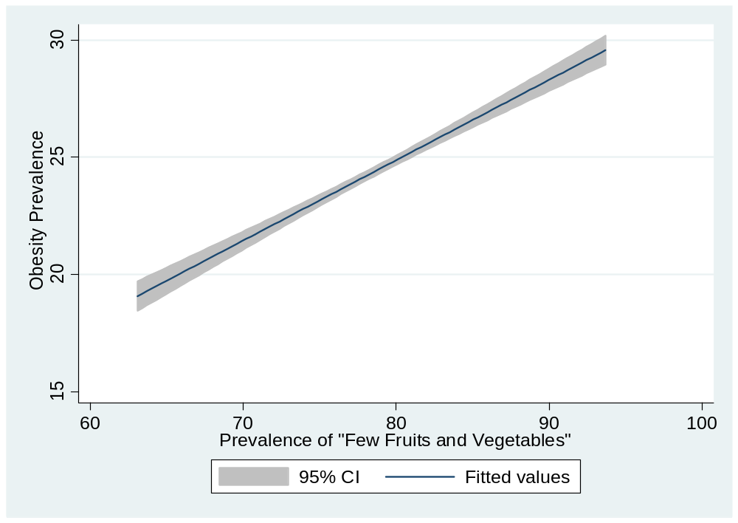

Slide 27
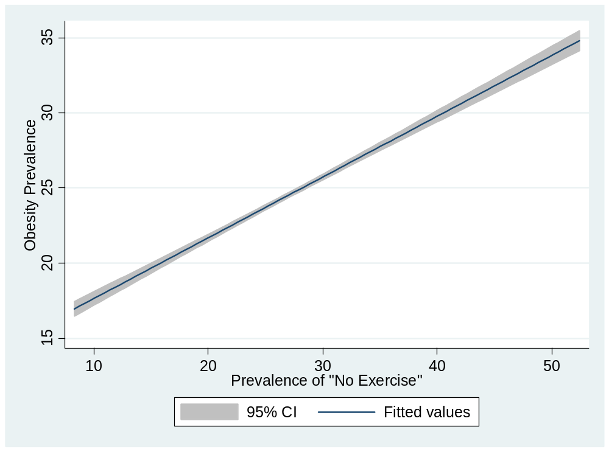

Slide 28
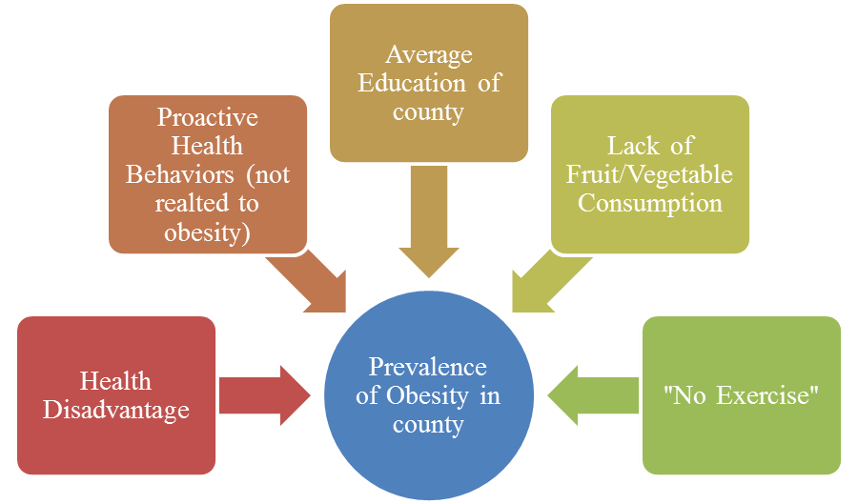
The Model
Prevalence of Obesity = β0 + β1Health Disadvantage + β2Proactive Health Behaviors + β3Average Education + β4Lack of Fruit/Vegetable Consumption + β5 “No Exercise” + εi

Slide 29
OLS Regression
Obesity Rate | Coef. | Std. Err. | t | P>t | [95% Conf. | Interval]
Health Disadvantage | 0.369977 | 0.0610942 | 6.06 | 0.000 | 0.2501344 | 0.4898196
Proactive Behavior | 0.0600725 | 0.00798 | 7.53 | 0.000 | 0.044419 | 0.0757261
Average Years of Education | -2.798964 | 0.1916455 | -14.6 | 0.000 | -3.174897 | -2.423032
Prevalence of Few Fruits/Vegetables | 0.1537528 | 0.0193852 | 7.93 | 0.000 | 0.1157269 | 0.1917788
Prevalence of “No Exercise” | ~0.164000 | 0.0191267 | 8.56 | 0.000 | 0.1261635 | 0.2012015
Constant | 39.60452 | 3.695907 | 10.72 | 0.000 | 32.35462 | 46.85442
 |  |  |  |  | Adj R-squared = | 0.5399
Notes:
1.64E-01

Slide 30
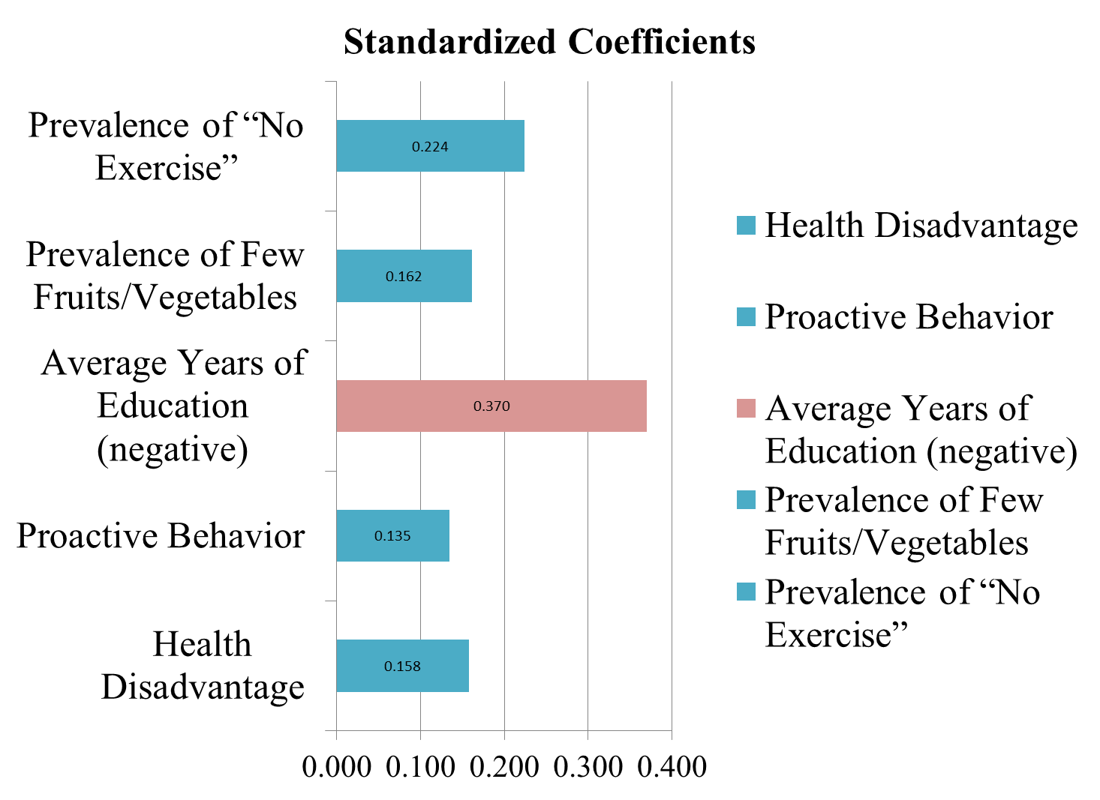
Based on the standardized coefficients, “No Exercise” appears to have greater effects on obesity than when previously compared to Few Fruits/Vegetables

Slide 31
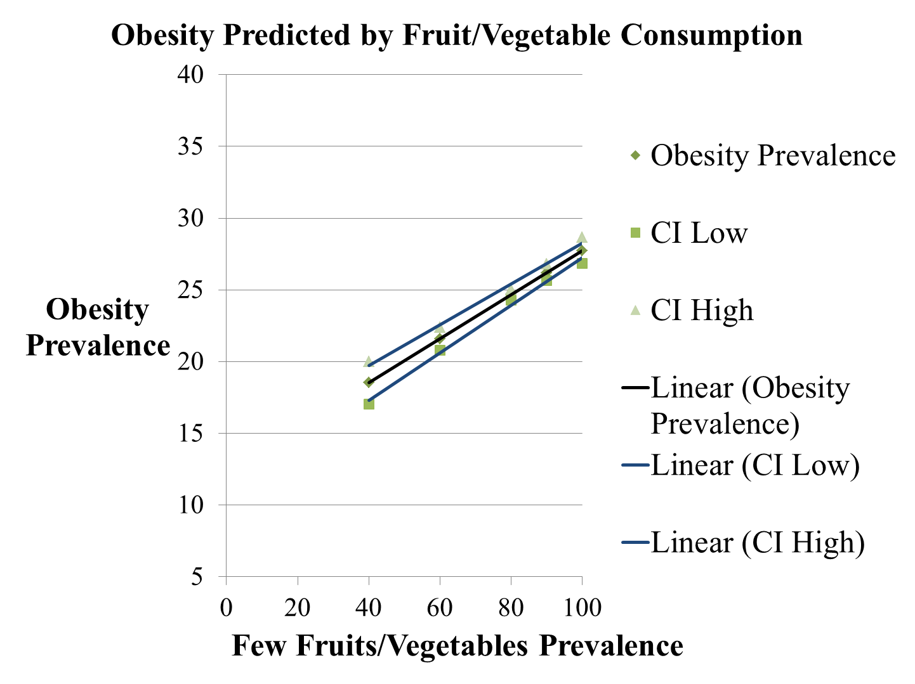

Slide 32
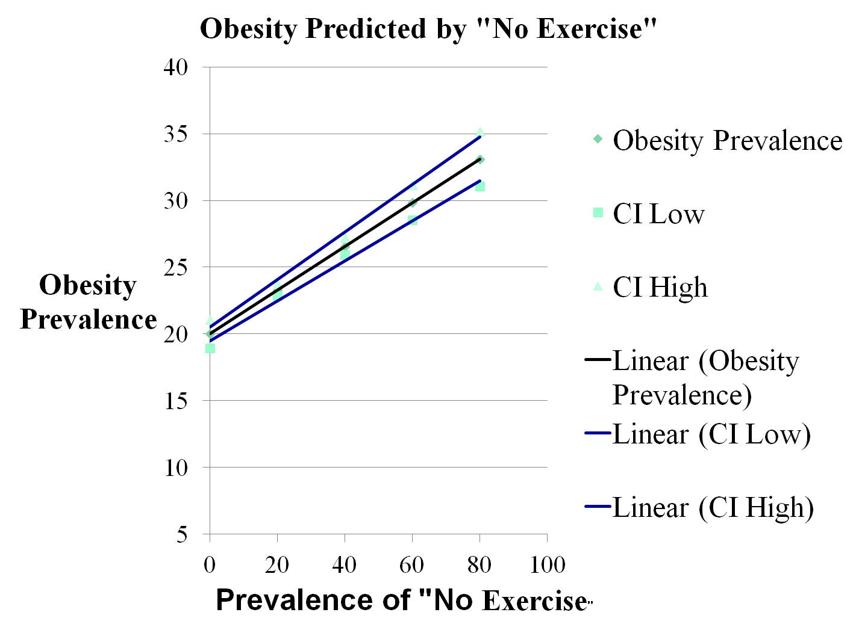

Slide 33
Discussion
Where should interventions be targeted to effectively reduce the prevalence of obesity?
Based on this data, average education level of the county is the best predictor of the prevalence of obesity in the county
From a public health standpoint, interventions designed to people to exercise even once a month in their leisure time would likely be more effective than interventions designed to get people to eat more fruits and vegetables or get them to check in with their doctor
In terms of reducing the prevalence of obesity This is NOT to say that these factors should not be addressed in conjunction

Slide 34
Limitations of this model include:
  Missing data
  Paucity of variable selection
    Variables related to obesity
    Reliable data related to social determinates
  Lack of analysis of interaction effects

Slide 35
This research will provide limited aid in determining targets for public health interventions intended to reduce the prevalence of obesity
Future research on the subject might expand model to include variables that represent how equipped a county is to facilitate physical activity such as community park numbers or areas or number of commercial or public exercise facilities present in the county
Further research might also investigate the interaction effects between factors, such as those involving average education level and other variables of interest, to better guide intervention designers as to what populations in what settings they should target

