Slide 1
American attitudes towards human embryonic stem cell research
MDR Evans
University of Nevada, Reno
Jonathan Kelley
International Survey Center and University of Nevada, Reno
Nature Biotechnology (Volume 29 Number 6 June 2011:484-488)

Slide 2
Americans' attitudes toward cloning and stem cell research depend on the goals. They strongly support research that aims to cure serious diseases, have mixed feelings about research directed towards minor diseases or economic gains, and oppose most other uses. More detail: descriptive analyses, factor analyses, and SUR analyses of a 2009 survey by the ISC (N=2295) show that curing serious diseases like cancer by therapeutic cloning (using the patient's own genes) or by the use of embryonic stem cells from spare IVF embryos (the most usual procedure), are strongly supported, by 4 or 5 to 1. The public do not distinguish morally between stem cells created in these two ways, although they distinguish sharply between reproductive and therapeutic cloning. Biologists have recently found that modified adult cells may be an alternative (induced pluripotent stem cells, iPS). This technique has been hailed as an ethical panacea, since no embryos are destroyed, a matter of great concern to the Catholic church and many ethicists. Public support is indeed high, but not appreciably higher than for other stem cell sources. For the public, iPS cells do not offer any substantial ethical advantage.

Slide 3
Background
Although scientifically promising, research using human embryonic stem cells has roused political controversy
  widespread debate for nearly two decades
  sharp differences between policies in different nations
In the USA, repeated changes in NIH funding guidelines over the years.
  Recently NIH yet again revised their guidelines removing some onerous restrictions imposed during the previous administration
  retaining restrictions, notably a ban on stem cells derived from nuclear transfer, a promising approach sometimes called therapeutic cloning.
Arguments for this ban largely turn on:
  general religious and ethical principles
  together with unsubstantiated claims about public opinion
  NIH did invite interested parties to comment voluntarily, but that is not a reliable way of assessing public opinion ||

Slide 4
Who should decide?
Prohibitions against the establishment of religion preclude that.
Universally shared philosophical principles sound attractive, but few are widely shared among our diverse citizenry
  and the philosophical weakness of deriving ethical specifics from general principles has been evident since Hume.
Corporatist governance by elites is common in Europe, but is contrary to the American democratic tradition.

Slide 5
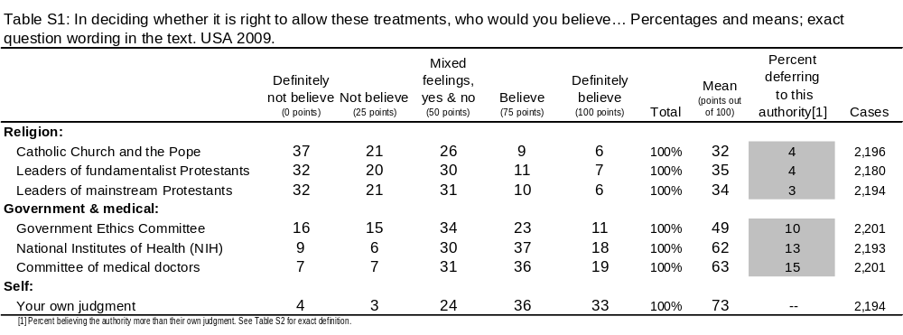
Americans want to decide for themselves
While Americans could delegate the right to decide to religion, to government, to ethicists, or to medical experts, but they do not.
Instead, the vast majority say "in deciding whether it is right to allow these treatments" they would follow their own judgment
US opinion data: "in deciding whether it is right to allow these treatments“, who would you believe? …

Slide 6
Survey data gives good evidence on citizens’ views
Survey research is an appropriate tool to ascertain citizens' decisions.
We provide rigorous estimates of the American public's views based our large national sample survey conducted in May 2009 by the International Social Science Survey/USA
Self-completion, internet based questionnaires.
  Good sample is obtained this way
Compared to telephone, face-to-face, or mail:
  reliability is about the same
  better for sensitive topics, worse for open-ended questions
Funding acknowledgement:
Great Basin Foundation for Biomedical Research||

Slide 7
Measurement
Prior work suggests that attitudes toward stem cells vary on half a dozen separate dimensions
We focus on the two most important:
  the nature of the procedures
  and the seriousness of the disease to be treated,
  we use examples that are important in current research.
We defer for future analysis a number of important issues:
  the chances of achieving a cure,
  the number of embryos destroyed,
  distinctions between treatment and research,
  differences between general policy and personal involvement. ||

Slide 8
Measurement: Question introduction
Scientists can now make clones – baby animals that are exact genetic copies of an adult. This is how it works:
· BEGIN with a fertilized egg. For humans this is likely to be a spare embryo from an IVF program which would otherwise be thrown away.
· REMOVE the original genes.
· REPLACE them with genes from the person to be cloned.
· GROW the fertilized egg in the lab for a few days into an early embryo, little ball of cells.
· IMPLANT the embryo in the womb of a surrogate mother where it develops into a baby. The baby is the donor’s identical twin, except for the difference in age.

Slide 9
Measurement: 1st questions, cont.
Do you approve of...
Cloning endangered animals?
  Definitely yes [100 points]
  Yes [ 75 points]
  Undecided, mixed feelings [ 50 points]
  No [ 25 points]
  Definitely not [ 0 points]
Cloning the best farm animals to improve breeding stock – for example, cloning a superb dairy bull?
Cloning a child killed in a traffic accident?
Cloning a child that is a copy of its father or mother? ||

Slide 10
All measure a single underlying attitude?
Do these questions all measure a single underlying attitude,
  or several attitudes,
  or nothing at all?
The classical psychometric measurement model requires that the answers to questions on a single factor be…
  highly correlated with each other,
  have similar correlations with other variables, and
  high loadings on a single factor||

Slide 11
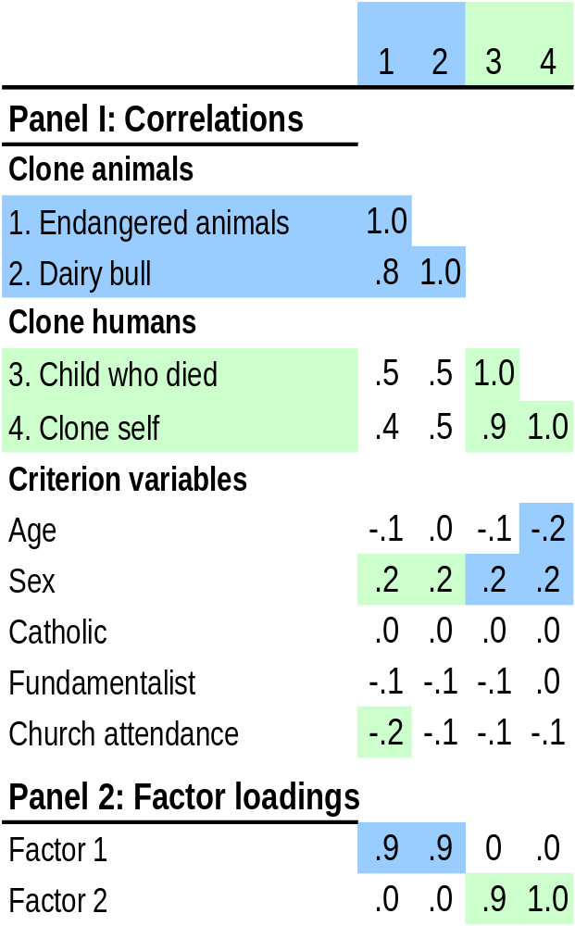
Answer…
attitudes toward cloning animals reflect a single underlying factor
Similarly, attitudes toward cloning humans reflect another single factor.
But, as in Australia, the two factors are distinct.
Since they are distinct, changing attitudes toward one has no strong implications for the other, no "slippery slope" ethical arguments||

Slide 12
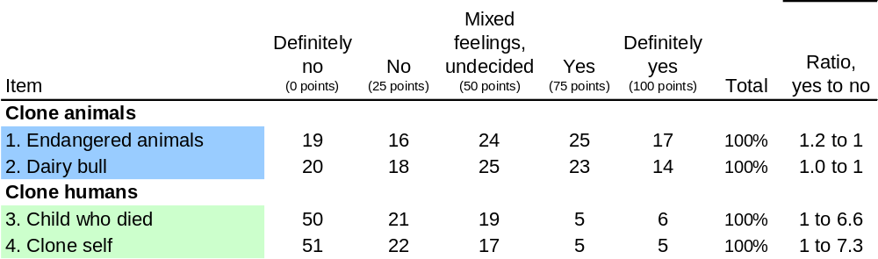
Cloning animals…
The public has mixed feelings about cloning animals, about as many supporting as opposing. ||

Slide 13
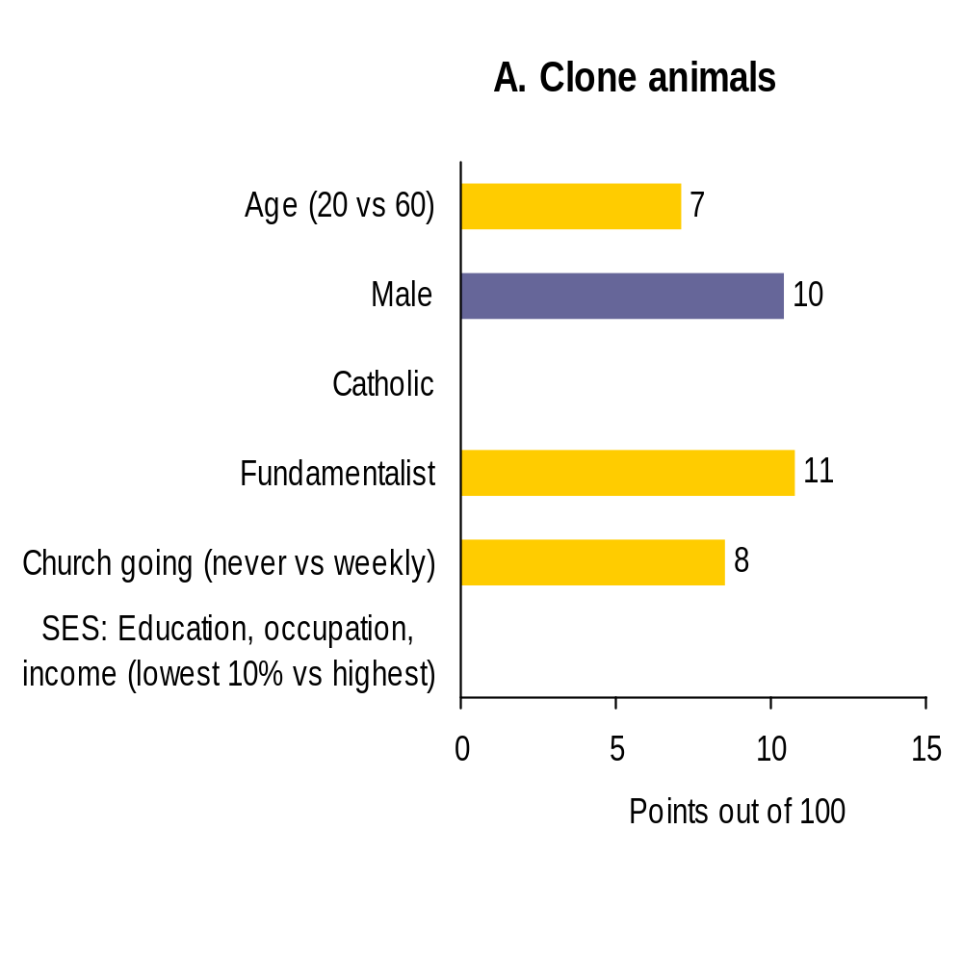

Who supports cloning animals?
People often use multiple heuristics ("frames") when developing attitudes about science-related issues, so multivariate analysis is needed to disentangle them.
Regression analysis shows that support is
  greater among men
  lower among the old
  lower among regular churchgoers and fundamentalists. ||

Slide 14
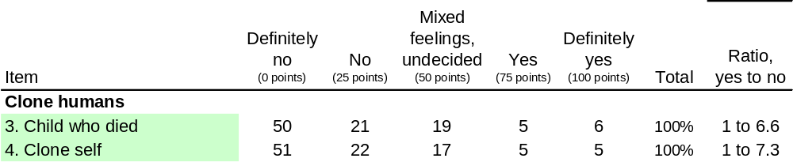
Cloning humans…
Cloning humans gets very little support, with 6 or 7 citizens against it for every one in favor. ||

Slide 15
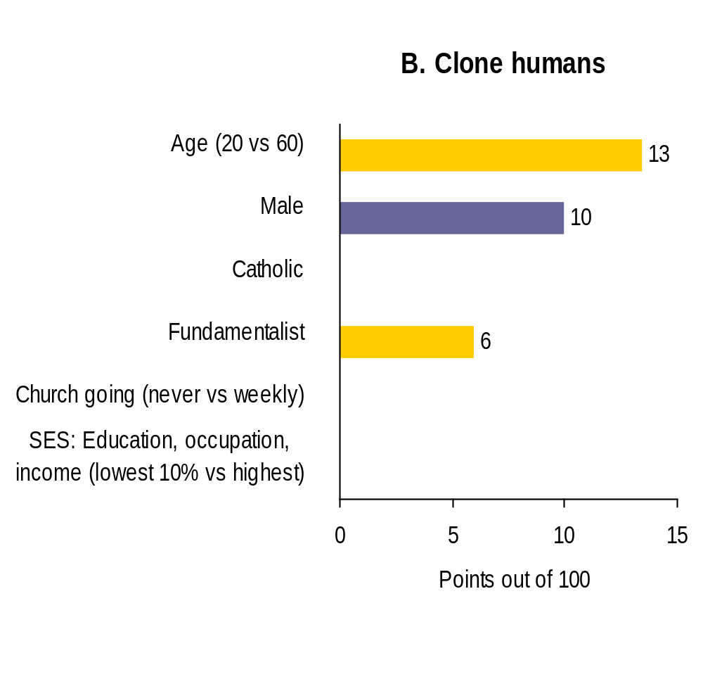
Who supports cloning HUMANS?
Support is greater among men and lower among regular churchgoers, fundamentalists, and the elderly
But even at the extreme, teenaged boys who never darken a church's door are opposed, with a mean of just 41 points.
Thus, NIH guidelines banning funding for human reproductive cloning are in agreement with public opinion.||

Slide 16
Question introduction
Cloning can be used to grow stem cells to cure patients with cancer or other serious diseases. Today nearly all stem cell therapies are new and highly experimental. Cures are a hope for the future, not yet a reality. But these stem cells are amazing; they can be grown into blood cells, or brain cells, or anything else. A great advantage of cloning is that there is no risk of the cells being rejected, because they are grown from the patient's own genes.
· BEGIN with a fertilized egg, usually a spare embryo from an IVF program.
· REMOVE the original genes.
· REPLACE them with genes from the patient.
· GROW the fertilized egg in the lab for a few days into an early embryo, a little ball of cells.
· DESTROY it and remove the stem cells growing inside it.
· GROW the new cells in the laboratory, making lots of the type needed.
· TRANSPLANT the new cells into the patient, to cure them. ||

Slide 17
Question, cont.
Would you approve using stem cells cloned this way... ]
To replace cells destroyed in a heart attack, for a patient dying of heart disease?
  Definitely yes [100 points]
  Yes [ 75 points]
  Undecided, mixed feelings [ 50 points]
  No [ 25 points]
  Definitely not [ 0 points]
To replace cancerous cells, for a person dying of blood cancer – approve?
To cure severe dust and pollen allergies – approve?
How about using cloned cells to create new skin, to restore someone’s youthful appearance? ||

Slide 18
Another question...
These questions fit the classic measurement model for a single factor
except for one thing: they are also as highly correlated with a second set of questions about embryonic stem cells extracted from the inner cell mass,
  that is the most usual procedure
  it is allowed by NIH guidelines ||

Slide 19
The other questions...
Here are the other questions:
Scientists can also grow stem cells without cloning...
BEGIN with a fertilized egg, usually a spare embryo from an IVF program.
GROW the embryo in the lab for a few days until it is a little ball of cells.
DESTROY it and remove the stem cells growing inside it.
GROW the new cells in the laboratory, making lots of the type needed.
TRANSPLANT the new cells into the patient, which may cure them.
UNFORTUNATELY the patient's body sometimes rejects these cells because they have someone else's genes. If that happens, the patient is not cured.
Would you approve using stem cells cloned this way... [same questions as before] ||

Slide 20
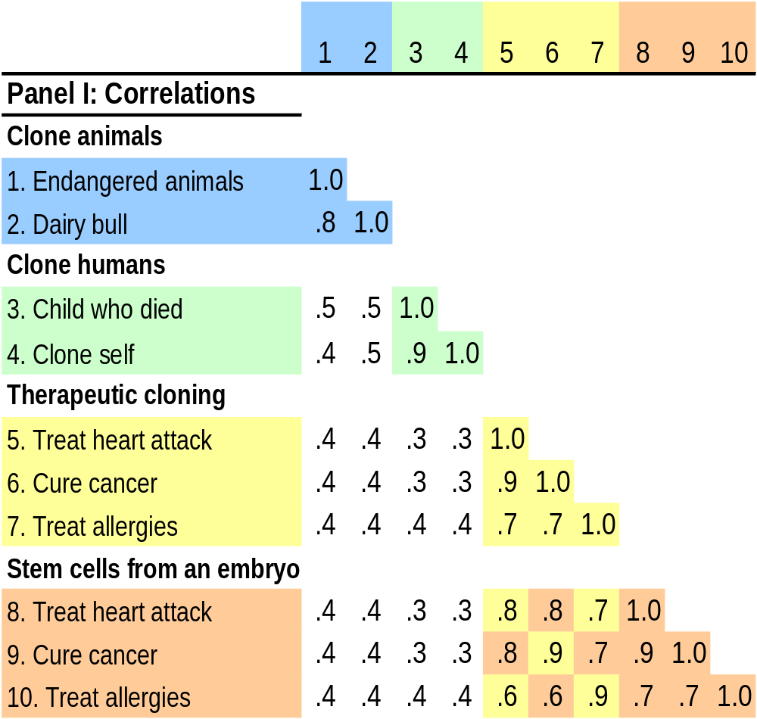
Answer…
These results fit the classical measurement model for a single factor encompassing both cells from therapeutic cloning and embryonic stem cells extracted from the inner cell mass,
both are distinct from reproductive cloning (so no "slippery slope" between them).
The public, unlike NIH, does not make a moral distinction between embryonic cells created in these two ways. ||

Slide 21
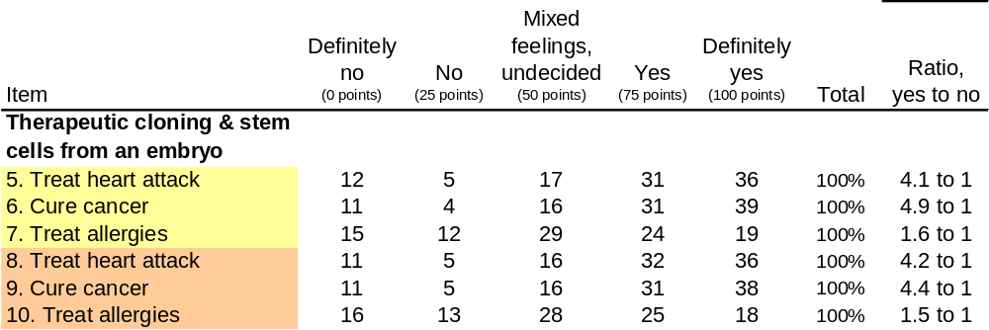
Cloning…
Americans strongly approve of stem cells created by therapeutic cloning.
Using cells extracted from the inner cell mass attracts equal (but not greater) support.
Thus for the public, these methods are not controversial when used to treat serious diseases. ||

Slide 22
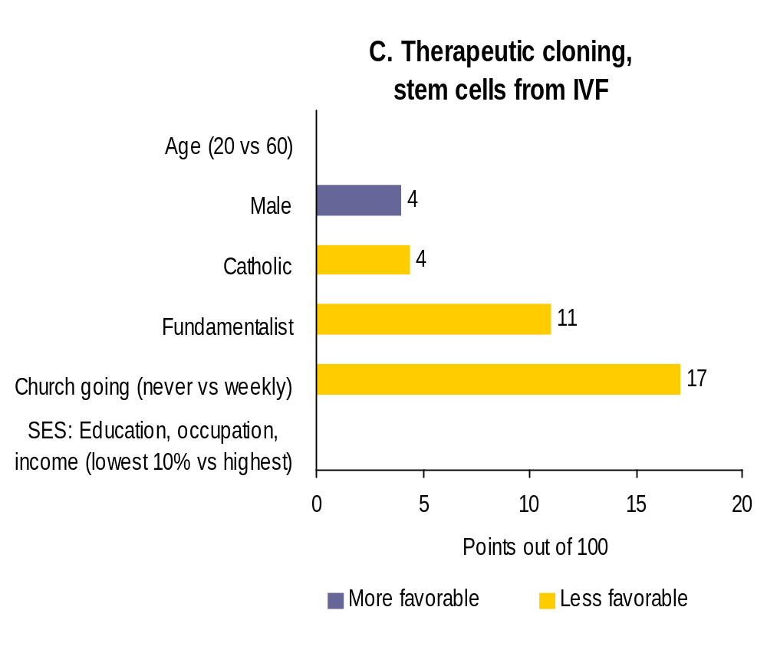
Who supports these two sorts of cloning?
Approval of stem cells obtained in these ways is just as high among the elderly as among the young, …
a little higher among men, and
fractionally lower among fundamentalists.
Despite the Catholic church's firm opposition, support is as high among the Catholic laity as among Protestants and the irreligious.
The big difference is that churchgoers of all denominations are much less keen.
But that is only a matter of degree: even church-going fundamentalist women are in favor, averaging 54 points. ||

Slide 23
Induced pleuripotent stem cells, iPS
Recent scientific developments suggest that modified adult cells may be an alternative (induced pleuripotent stem cells, iPS). The questions on the survey:
Recently, scientists have learned how to take cells from an adult and reprogram them to act much like stem cells from an embryo. They do this by inserting copies of three or four particular genes in an adult cell, which triggers a whole series of changes. This is very promising. But it is also very new, not well understood, and occasionally the new cells become cancerous.
Would you approve using stem cells cloned this way... [same questions as before] ||

Slide 24
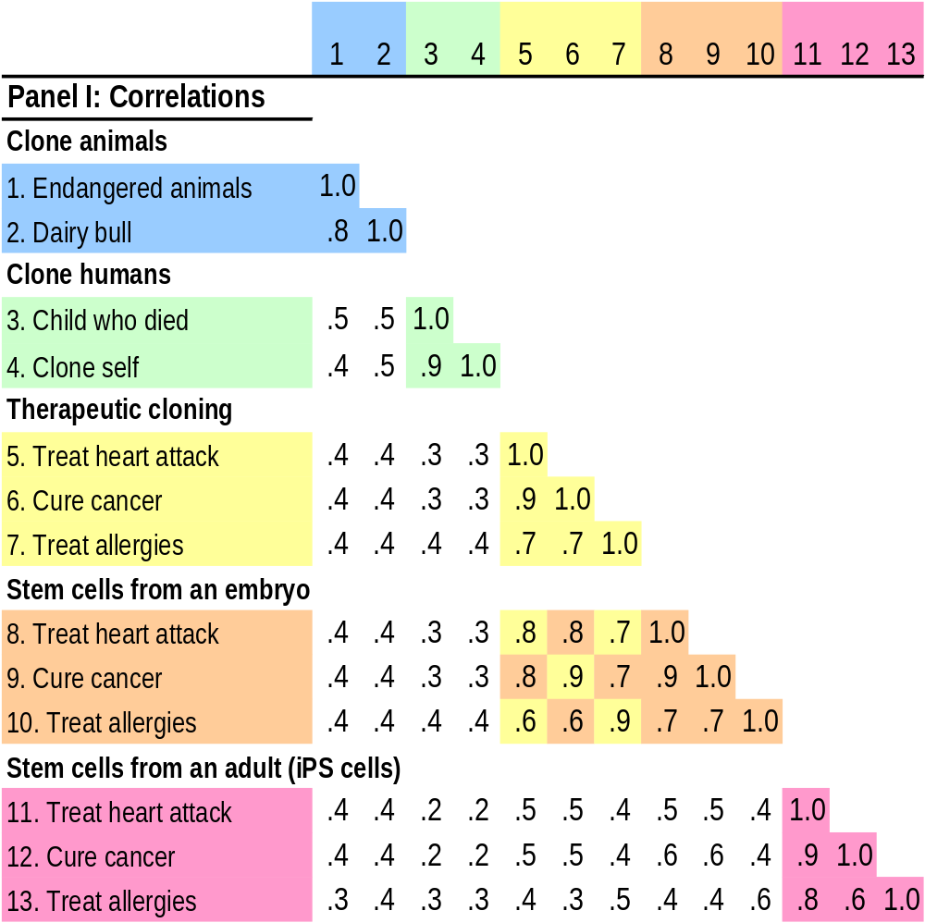
iPS cells: a single distinct concept
Questions on the use of iPS cells to cure serious diseases measure a single distinct concept ||

Slide 25
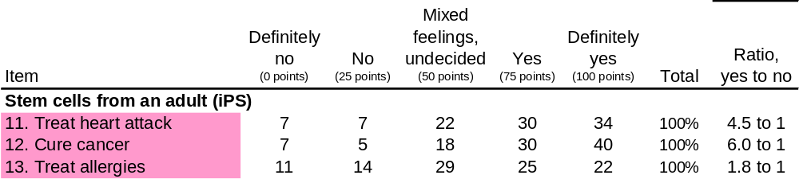
Support for use of iPS cells
Public support for use of iPS cells is high, supporters outnumbering opponents by 6 to 1 for treating cancer and almost that for heart disease.
However this is no ethical panacea.
  The average level of support, 73 points out of 100, is not appreciably higher than for other methods of getting stem cells, only 2 points greater
This is despite the fact that no embryos are destroyed, a matter of great concern to the Catholic church and some ethicists.
So for the public, iPS cells do not offer any substantial ethical advantage.
As usual, men are a little more supportive while fundamentalists and regular church goers are a little less. Although regular churchgoers are less supportive, the difference is small.||

Slide 26
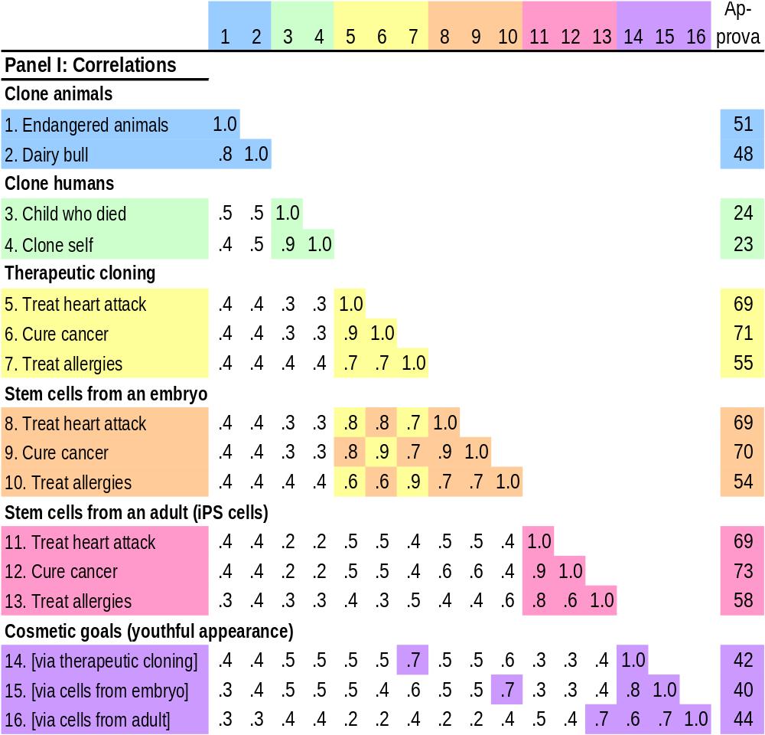
Cosmetic goals
attitudes to the use of stem cells for cosmetic reasons are distinctive. Creating new skin to restore someone’s youthful appearance reflects two dimensions:
  (a) the method of obtaining the cells and
  (b) the goal.
Cosmetic treatments are not popular, with opponents outnumbering supporters by almost 2 to 1.||

Slide 27
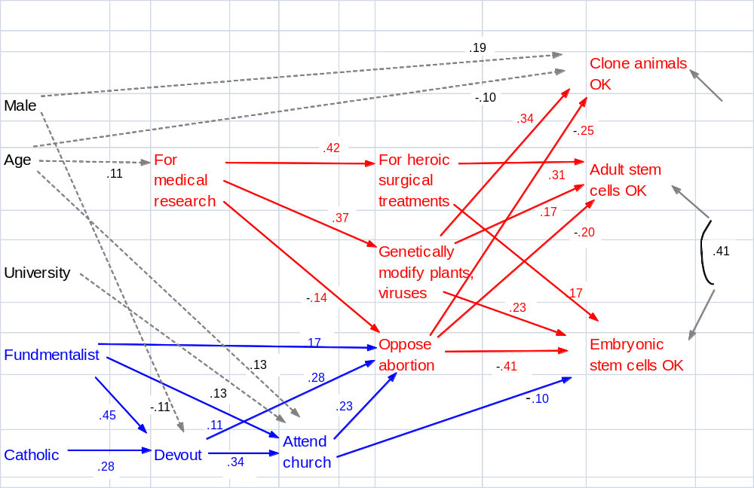

Slide 28
Policy implications
Under the previous Bush administration, NIH banned, with a few exceptions, funding for research on embryonic stem cells extracted from the inner cell mass of "spare" IVF embryos.
Current public opinion makes such a ban unnecessary.
Indeed, by deferring to objections from a small minority and limiting research that has so much therapeutic promise, the ban may well be ethically dubious.
For the same reasons, NIH's present policy of banning therapeutic cloning is equally unnecessary and may be equally dubious on ethical grounds. ||
[end]

