Slide 1

Individual Project: website supporting a business need
COSC 412: Software Engineering
Turhan Kimbrough

Slide 2

Client background information
Works for Visiting Angels
Works as a client services representative
Trying to reach a larger customer base
Notes:
Visiting Angels logo: https://www.google.com/url?sa=i&url=https%3A%2F%2Fwww.caring.com%2Fsenior-care%2Fflorida%2Fpalm-beach-gardens%2Fvisiting-angels-of-the-palm-beaches&psig=AOvVaw3XyMDN8xkGa2xAwntrdbHO&ust=1606176300144000&source=images&cd=vfe&ved=0CAMQjB1qFwoTCIDLlKCvl-0CFQAAAAAdAAAAABAk

Slide 3
Client needs
Simplified personal website
Describe popular services
Describe types of care offered
List contact information

Slide 4
What is my role?
Develop the website
offer training/information on website maintenance

Slide 5



Technologies used
WordPress (.org)
Namecheap (hosting and domain)
ZeroSSL (SSL certificate)
Notes:
Wordpress logo: https://www.google.com/url?sa=i&url=https%3A%2F%2Fwordpress.org%2Fabout%2F&psig=AOvVaw3vTO6bSRiGFzmevYnoL8j1&ust=1606175956915000&source=images&cd=vfe&ved=0CAMQjB1qFwoTCNCty-ytl-0CFQAAAAAdAAAAABAD
Namecheap logo: Namecheap Offers Free 20 Minute Virtual Class On Internet Basics for Students & Online Novices
ZeroSSL logo: Free SSL Certificates and SSL Tools - ZeroSSL

Slide 6



Useful WordPress plugins
UpdraftPlus: backup solution
WPForms: contact form generator
Elementor: page builder
Notes:
UpdraftPlus logo: Moreton Bay Websites
WPForms: https://www.google.com/url?sa=i&url=https%3A%2F%2Fwww.wpcrafter.com%2Freview%2Fwpforms%2F&psig=AOvVaw3AwpTU_1pj_jAP7B82DeK6&ust=1606176099177000&source=images&cd=vfe&ved=0CA0QjhxqFwoTCNCCq7Oul-0CFQAAAAAdAAAAABAD
Elementor logo: https://www.google.com/url?sa=i&url=https%3A%2F%2Fwww.theme-junkie.com%2Fbest-elementor-wordpress-themes%2F&psig=AOvVaw0LU3XEiNiwUZtvb7E9QCrr&ust=1606176164584000&source=images&cd=vfe&ved=0CA0QjhxqFwoTCOCwqdOul-0CFQAAAAAdAAAAABAD

Slide 7
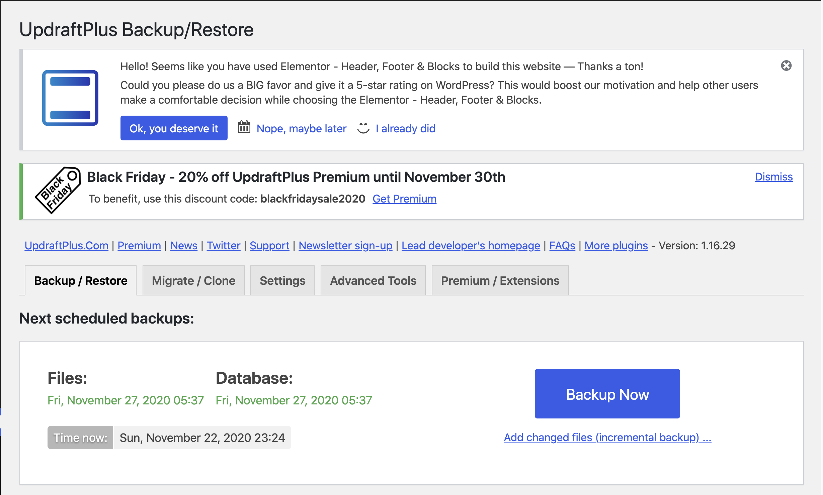
UpdraftPlus

Slide 8
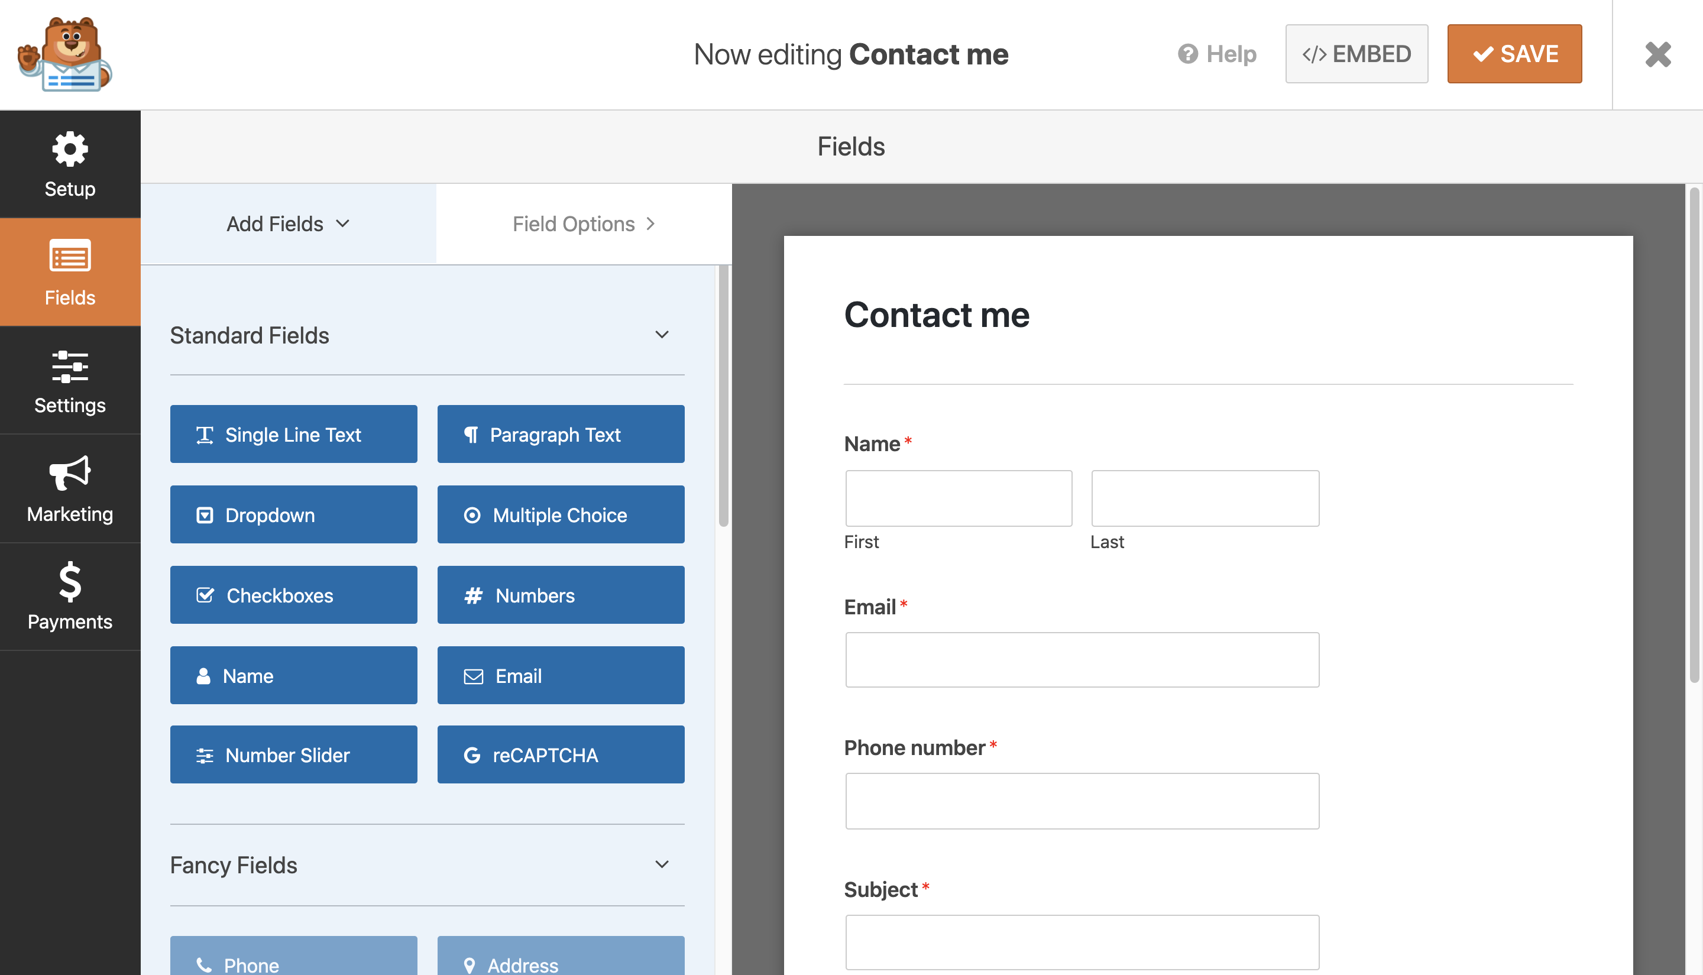
WPForms

Slide 9
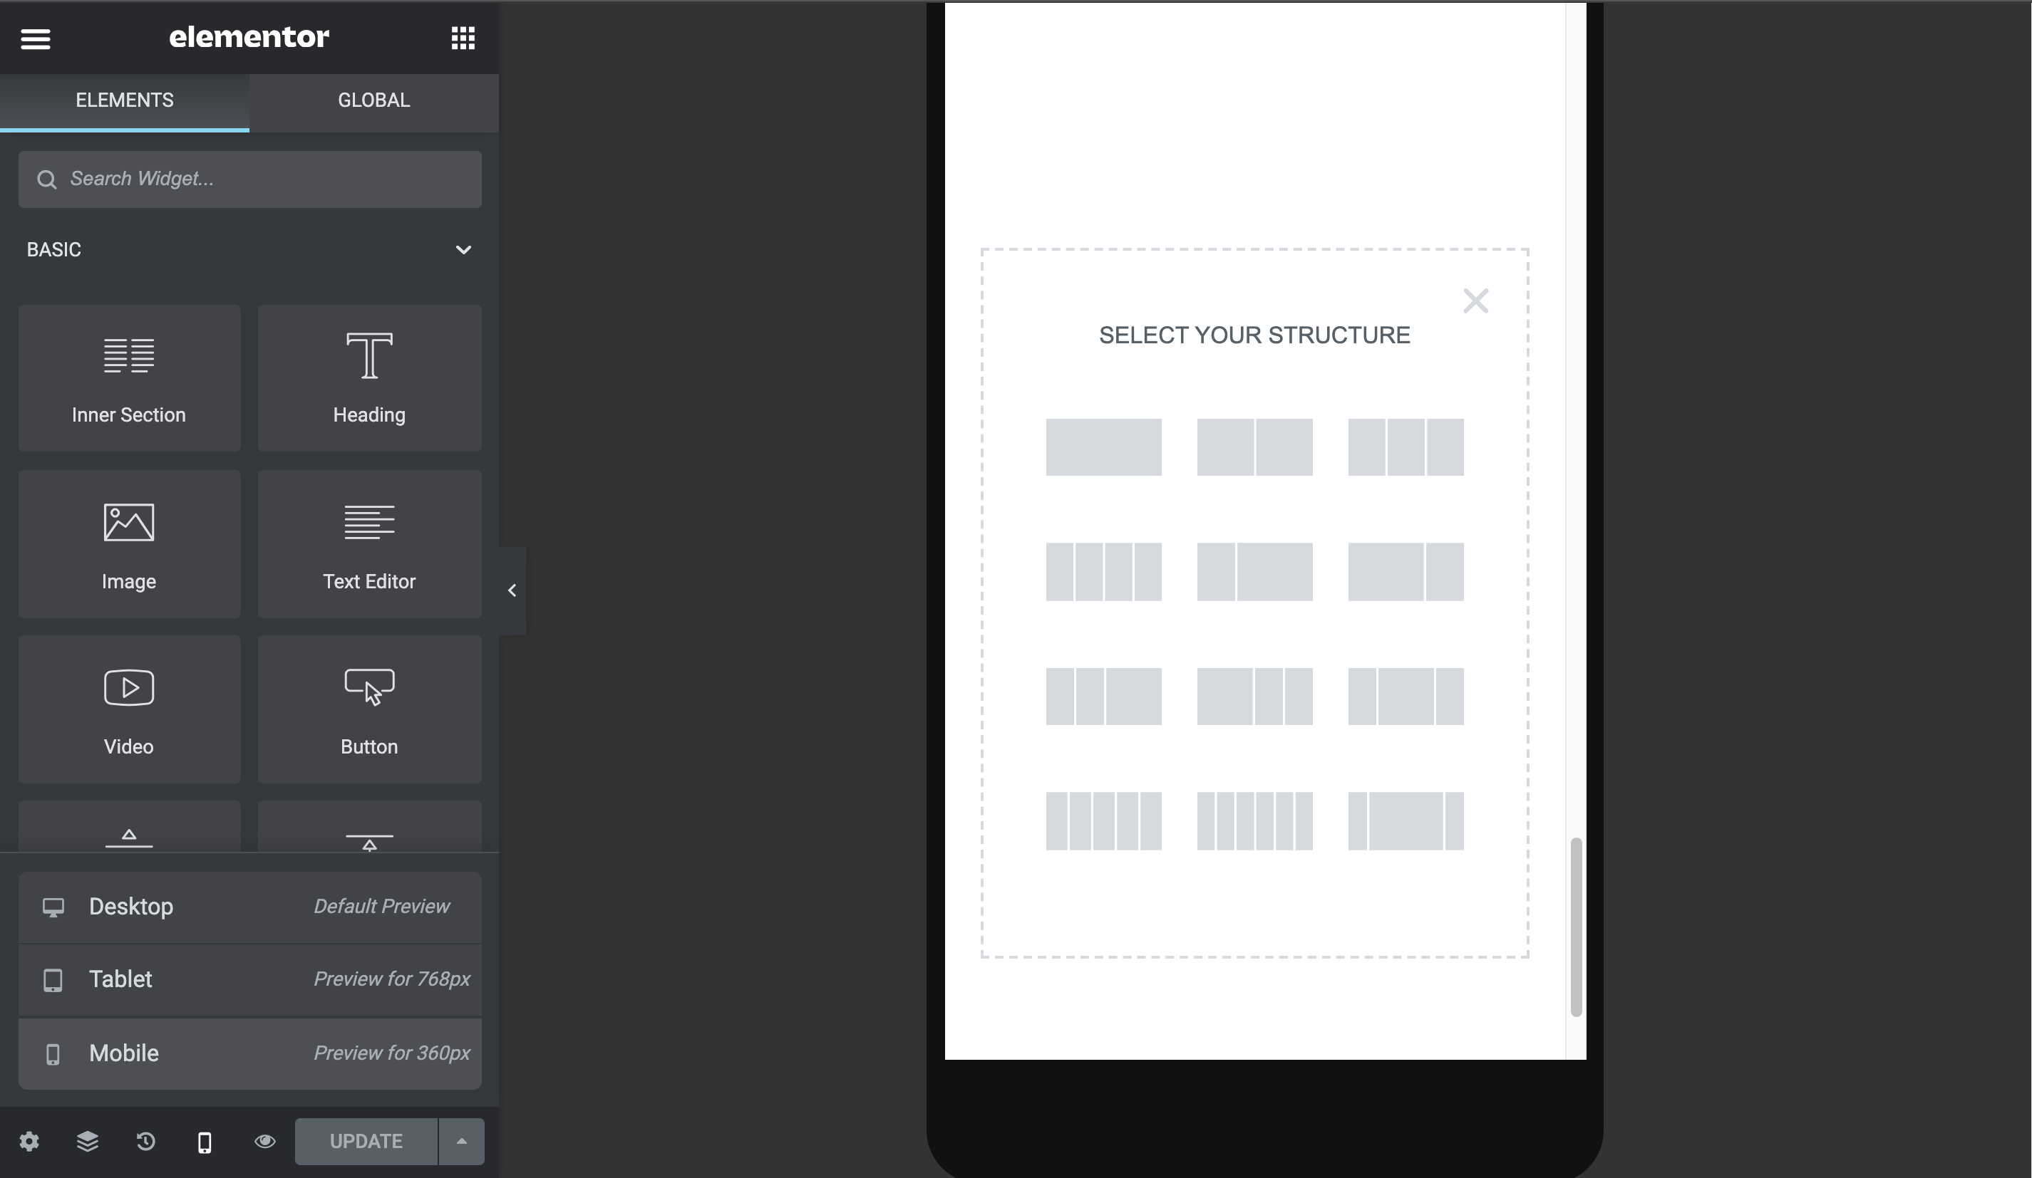
Elementor

Slide 10

Live demo time!

