Slide 1


Project name: Audio book

Slide 2


Submitted to :
Dr Md. Abdul Momen
AssociateProfessor,
Department of Business Administration
Submitted by:
DM Rafiun
2019-3-60-137
Md Tahsin
2020-2-60-112
Md. Shafayet Khan
2021-2-10-129
Mahmudul Islam Partho
2019-3-60-027
Navid Zaman
2020-2-60-044
Nusrat Jahan Prachi
2021-1-10-006
Md. Salauddin Sakib
2021-1-80-006

Slide 3

What is audio book?
An online platform where we can listen books without reading
A recording, Typically a novel
less effort and is more convenient
Focused on native culture
Highly customisable

Slide 4
How to use?
online audio book is a website, and easy to use it.
Step 1: On your Android phone or tablet, open Google and search “audio book”.
Step 2: Tap Library.
Step 3: At the top, tap book types
Step 4: Tap the book you want to listen to. It will start playing.
Other Books | Educational books (Class 1 to 12th) | Undergraduate books | Graduate books
Comate books | Pradeep's New Course Chemistry for Class 12 | Managerial finance Besley & Brigham (14th edition)
novels

Slide 5
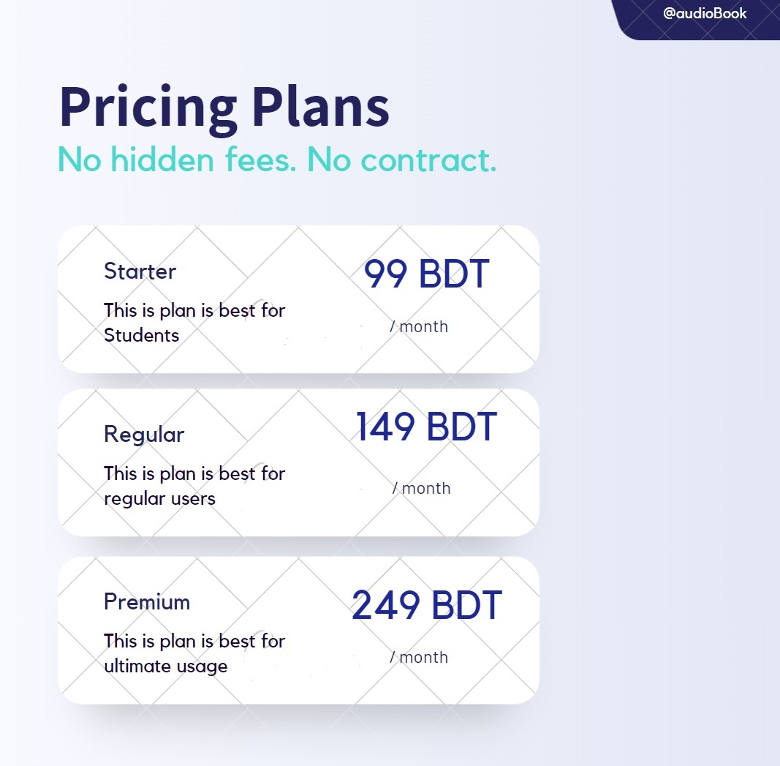


Slide 6

Our Goal
Easy access to listen with creative freedom
Cultural recognition to the world

Slide 7

our marketing strategy
Four Pillars
Target market
Customer needs
Integrated marketing
Profitability through customer satisfaction

Slide 8
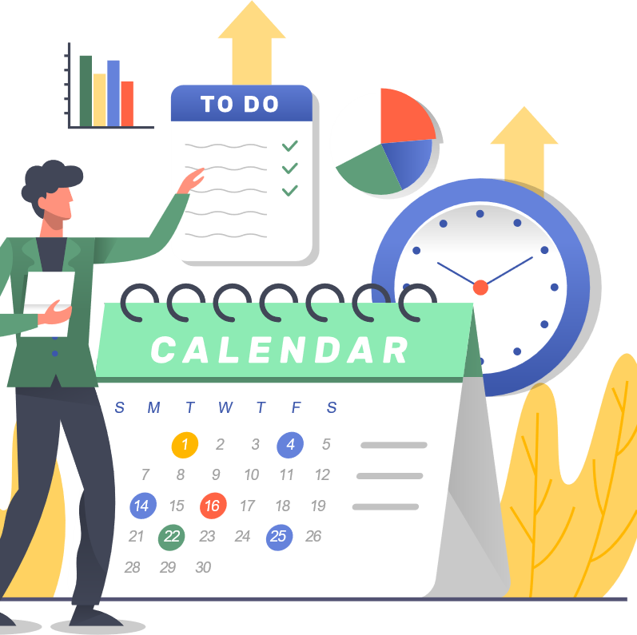
Market Competition

Slide 9
Audio Book analysis
Strengths
Unique & creative business solution
Diverse culture and heritage
No strong competitor in this region
Weakness
Consumers’ acceptance & reliability
Lack of brand awareness
Budget issues
Opportunities
Amazing platform for hobbyist musicians
Unique face value in the global market
Direct collaboration
Threats
High maintenance cost
Trust & reliability from artists’ perspective
Security

Slide 10


Objectives
First Year Objective
Acquire 10,000 consumers
Second Year Objectives
Share revenue
Acquire 20,000 consumers
Third Year Objective
Establish our own studio

Slide 11






Communication Strategy
As our target groups are mainly available on social media, our main communication platforms will be-
Facebook and Instagram ads
Google and YouTube ads
Sponsors & Influencers
Own YouTube channels & Blogs
Public relations

Slide 12
Action Plan
Website
-Blogs & SEO
Facebook
- Post & Updates
- Organic Reach
- Ad campaign
YouTube
-Approach local & international creators
(Nadir on the Go,
Jubaer Talukdar,
Dihan Chowdhury,
Peter Mackinnon, Danniel Schiffer)

Slide 13
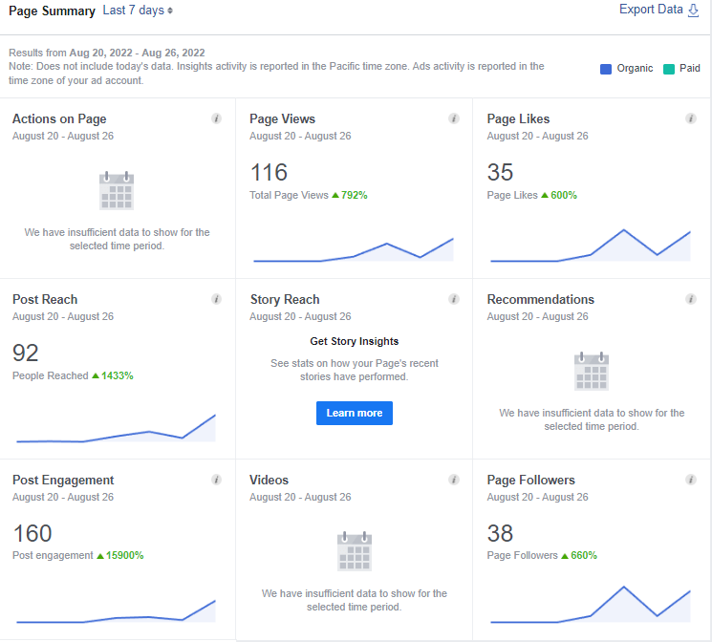

FaceBook page and Web site progress

Slide 14

Conclusion
Upgrading with the digital market, we dream to expand our thoughts and bring more regions and genres and make an effective, friendly community for both our consumers and artists.
Web- https://sites.google.com/view/audiobookbd/home
Fb- https://www.facebook.com/audiobooksAtoZ/?ref=pages_you_manage
Thank you!

