Slide 1
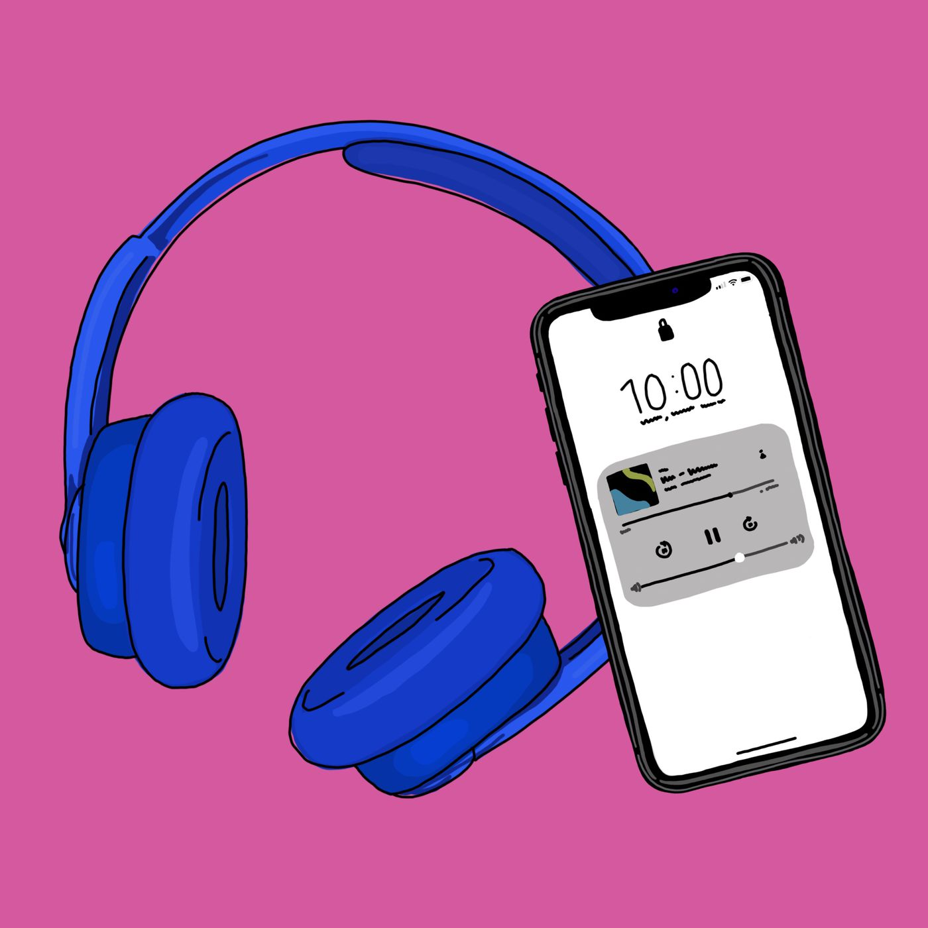
Presentation
AUDIO BOOK
Prepared by
DM Rafiun Bin Masud (2019-3-60-137)
Md Tahsin (2020-2-60-112)
Md. Shafayet Khan (2021-2-10-129)
Mahmudul Islam Partho (2019-3-60-027)
Navid Zaman (2020-2-60-044)
Nusrat Jahan Prachi (2021-1-10-006)
Md. Salauddin Sakib (2021-1-80-006)
To
Dr Md. Abdul Momen
AssociateProfessor,
Department of Business Administration

Slide 2

What is AUDIO BOOK?
An online platform where we can listen books without reading
A recording, Typically a novel
less effort and is more convenient
Focused on native culture
Highly customizable

Slide 3

What are we Bringing for audience?
Storyteller
Meditation music
Podcast

Slide 4

What we need for producing an Audio?
Voice artist (male and female)
Narrator and director
Production and sound design
executive producer
Poster design

Slide 5

How to use?
online audio book is a website, and easy to use it.
Step 1: On your Android phone or tablet open Google and search “audio book”.
Step 2: Tap Library.
Step 3: At the top, tap book types
Step 4: Tap the book you want to listen to. It will start playing.

Slide 6

Our Marketing strategy
Four Pillars
Target market
Customer needs
Integrated marketing
Profitability through customer satisfaction

Slide 7

Market Competition
Battle between similar Business that sells similar product
Marketing Mix
Controllable tools 4P’s
Product
Price
Promotion
Place

Slide 8
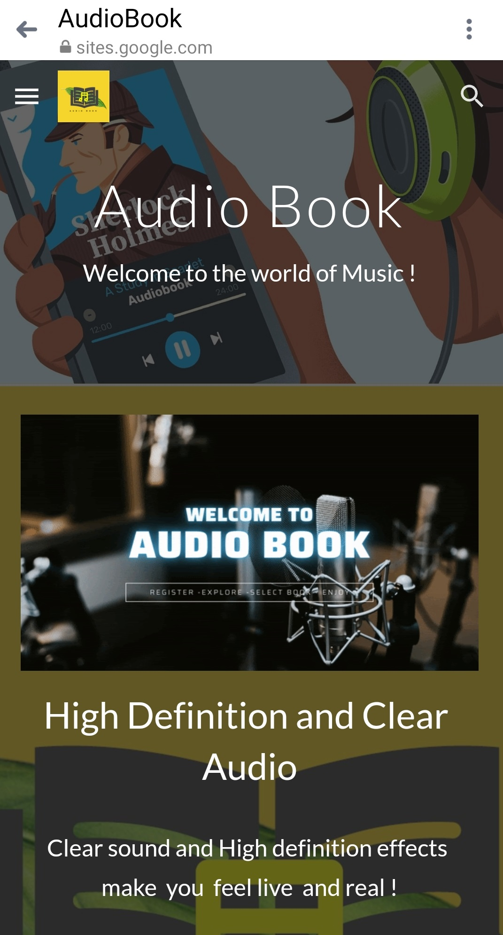

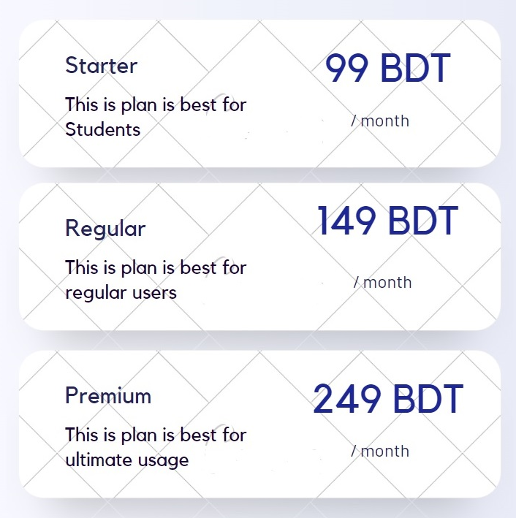
Pricing Plans

Slide 9

Objectives
First Year Objective
Acquire 10,000 consumers
Second Year Objectives
Share revenue
Acquire 20,000 consumers
Third Year Objective
Establish our own studio

Slide 10






Communication Strategy
As our target groups are mainly available on social media, our main communication platforms will be
Facebook and Instagram ads
Google and YouTube ads
Sponsors & Influencers
Own YouTube channels & Blogs
Public relations

Slide 11

OUR GOALS
Easy access to listen with creative freedom
Cultural recognition to the world

Slide 12
Action PLan
Website
Blogs & SEO
Facebook
Post & Updates
Organic Reach
Ad campaign

Slide 13
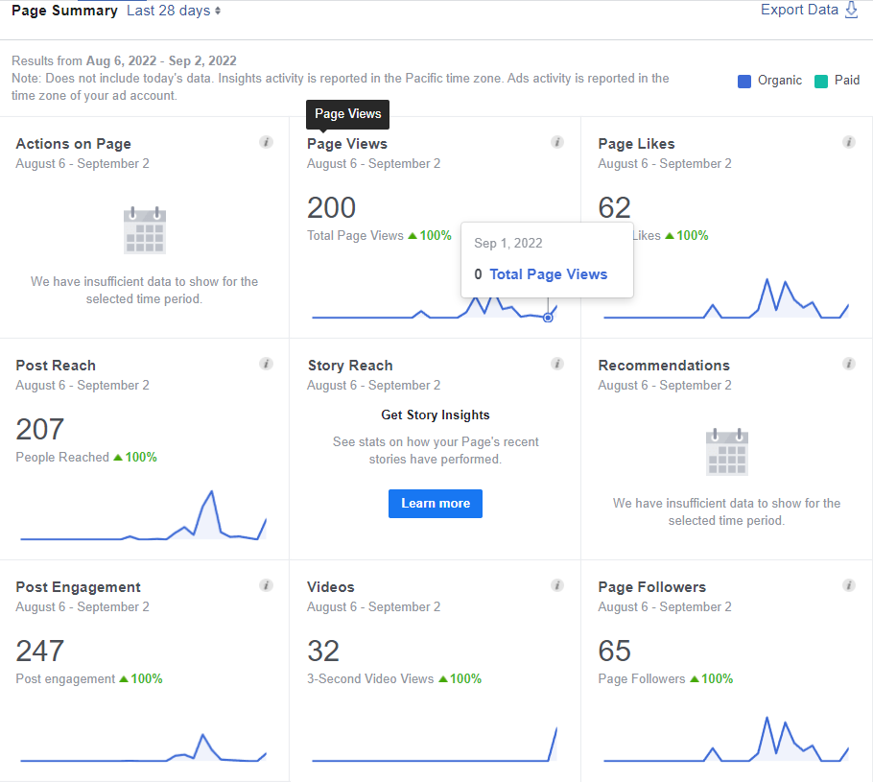
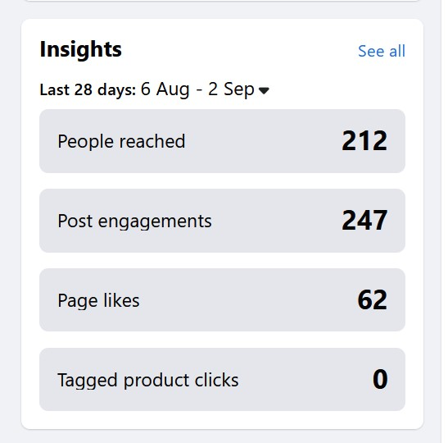
faceBOOk Page
https://www.facebook.com/audiobooksAtoZ

Slide 14
Conclusion
Upgrading with the digital market, we dream to expand our thoughts and bring more regions and genres and make an effective, friendly community for both our consumers and artists.
Web- https://sites.google.com/view/audiobookbd/home
Fb- https://www.facebook.com/audiobooksatoz

