Slide 1






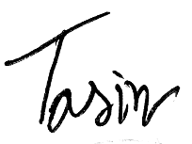
CERTIFICATE
OF COMPLETION
proudly presented to
A. K. M Mahmud - Ul - Hasan
For Successfully Completing the Course
ANSYS Fluent (CFD & Heat Transfer)
Issuing date:
14.11.2021
Certificate ID:
SSBDCE202504011
Sultan Mahmud
Simulation Support BD-SSBD
Md Tasin Rahman Rakib
Instructor
Assistant Manager

