Slide 1
English Letter Recognition

Slide 2
The Dataset was compiled from:
20,000 images of Upper Case letters
20 different fonts
distorted pixels on different letters
Most are 45 X 45 pixels

Slide 3
Features
The attributes (before scaling to 0-15 range) are: 1. The horizontal position, counting pixels from the left edge of the image, of the center of the smallest rectangular box that can be drawn with all "on" pixels inside the box. 2. The vertical position, counting pixels from the bottom, of the above box. 3. The width, in pixels, of the box. 4. The height, in pixels, of the box. 5. The total number of "on" pixels in the character image. Taken from Reference 1 . (Frey and Slate , 1991 , 163-164)

Slide 4
Features
6. The mean horizontal position of all "on" pixels relative to the center of the box and divided by the width of the box. This feature has a negative value if the image is "left- heavy" as would be the case for the letter L.
7. The mean vertical position of all "on" pixels relative to the center of the box and divided by the height of the box.
8. The mean squared value of the horizontal pixel distances as measured in 6 above. This attribute will have a higher value for images whose pixels are more widely separated in the horizontal direction as would be the case for the letters W or M.
9. The mean squared value of the vertical pixel distances as measured in 7 above.
10. The mean product of the horizontal and vertical distances for each "on" pixel as measured in 6 and 7 above. This attribute has a positive value for diagonal lines that run from bottom left to top right and a negative value for diagonal lines from top left to bottom right.
Taken from Reference 1 . (Frey and Slate , 1991 , 163-164)

Slide 5
Features
11. The mean value of the squared horizontal distance times the vertical distance for each "on" pixel. This measures the correlation of the horizontal variance with the vertical position.
12. The mean value of the squared vertical distance times the horizontal distance for each "on" pixel. This measures the correlation of the vertical variance with the horizontal position.
13. The mean number of edges (an "on" pixel immediately to the right of either an "off“ pixel or the image boundary) encountered when making systematic scans from left to right at all vertical positions within the box. This measure distinguishes between letters like "W" or "M" and letters like 'T' or "L."
14. The sum of the vertical positions of edges encountered as measured in 13 above. This feature will give a higher value if there are more edges at the top of the box, as in the letter "Y."
15.The mean number of edges (an "on" pixel immediately above either an "off" pixel or the image boundary) encountered when making systematic scans of the image from bottom to top over all horizontal positions within the box.
16. The sum of horizontal positions of edges encountered as measured in 15 above.
Taken from Reference 1 . (Frey and Slate , 1991 , 163-164)

Slide 6
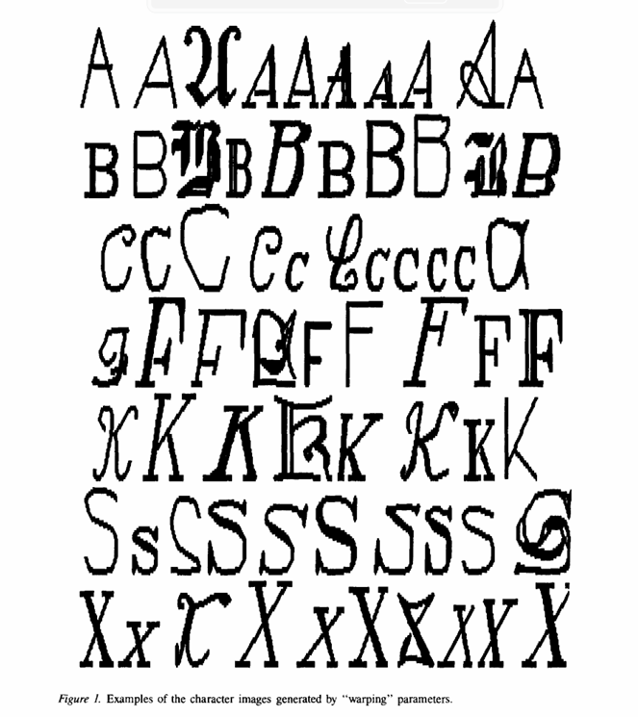
Image Examples
Taken from Reference 1 . (Frey and Slate , 1991 , 164)

Slide 7
DATA FRAME ANALYSIS
# PRINT THE DIMENSIONS
print(df.shape)
>(20000, 17)
# PRINT THE COLUMNS
print(df.columns)
> Index(['letter', 'xbox', 'ybox', 'width', 'height', 'onpix', 'xbar', 'ybar',
'x2bar', 'y2bar', 'xybar', 'x2ybar', 'xy2bar', 'xedge', 'xedgey',
'yedge', 'yedgex'],
dtype='object')

Slide 8
DATA FRAME ANALYSIS
# PRINT THE QUANTITY OF EACH LETTER (LABELS)
print(df.groupby('letter').letter.count())
> letter
A 789 B 766 C 736 D 805 E 768 F 775 G 773 H 734 I 755 J 747 K 739 L 761 M 792 N 783 O 753 P 803 Q 783 R 758 S 748 T 796 U 813 V 764 W 752 X 787 Y 786 Z 734
Name: letter, dtype: int64

Slide 9
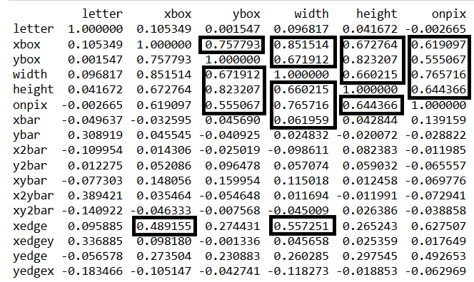
Data Frame Analysis
Theres a high amount of correlation in features. Ignore these columns to make a simpler model.
print(df2.corr())
Part of the
Correlation
Matrix
y = df.iloc[:,0]
X = df.iloc[:,7:]

Slide 10
Test / Train
Most of the data in the analysis uses 20 % test data for testing the models.
train_X,test_X,train_y,test_y = train_test_split(X,y,test_size=0.2,random_state=0)

Slide 11
Models
The methods I will use for classification are :
1. Decision Tree Classifier
2. K-Nearest Neighbors
3. Random Forest Classifier
4. Support Vector Classifier

Slide 12
1. Decision Tree Classifier
Here are the results :
DECISION TREE CLASSIFIER TEST DATA ACCURACY SCORE (criterion='gini')
0.893
DECISION TREE CLASSIFIER TEST DATA ACCURACY SCORE (criterion='entropy')
0.89825
DECISION TREE CLASSIFIER TEST DATA ACCURACY SCORE (criterion='log_loss')
0.89825

Slide 13
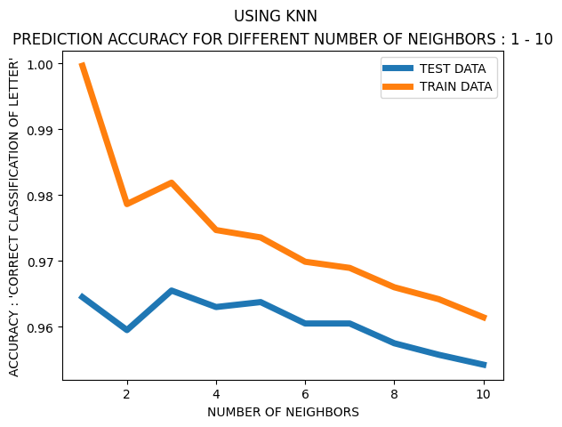
2. KNN

Slide 14
2. KNN
I found that the n_neighbors=3, weights='distance' "Near neighbors have a greater effect " provided higher accuracy.
KNEIGHBORS CLASSIFIER TEST DATA ACCURACY SCORE (n_neighbors=3,weights='distance')
0.9675
KNEIGHBORS CLASSIFIER TRAIN DATA ACCURACY SCORE (n_neighbors=3,weights='distance')
0.999625

Slide 15
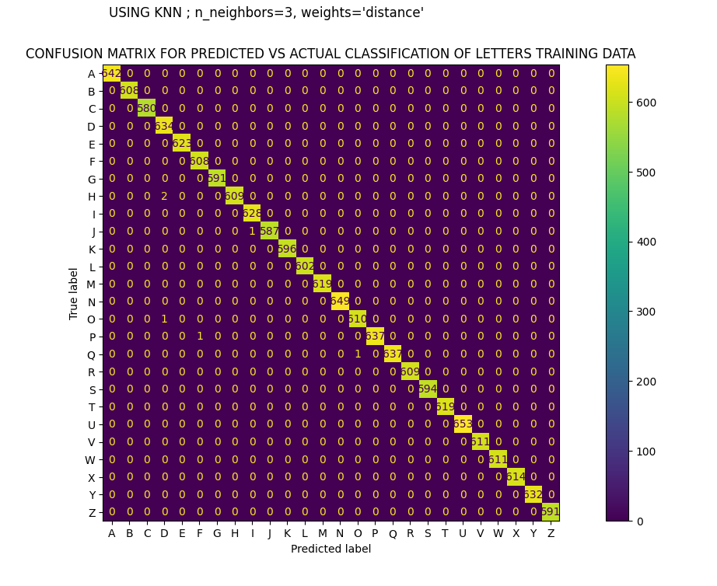
2. KNN
TRAINING

Slide 16
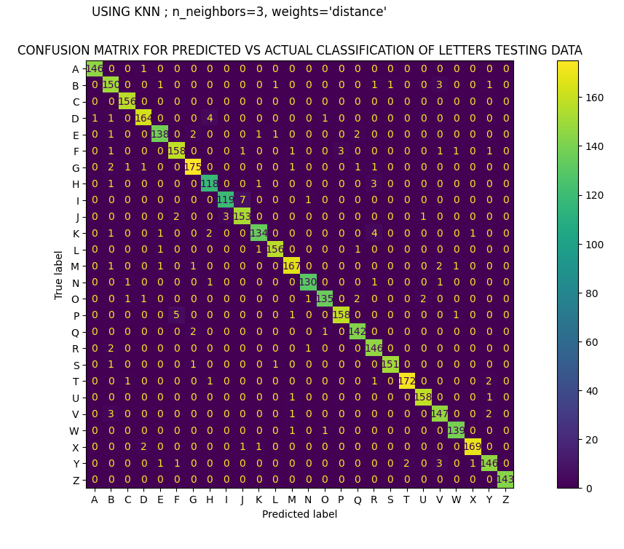
2. KNN
TESTING

Slide 17
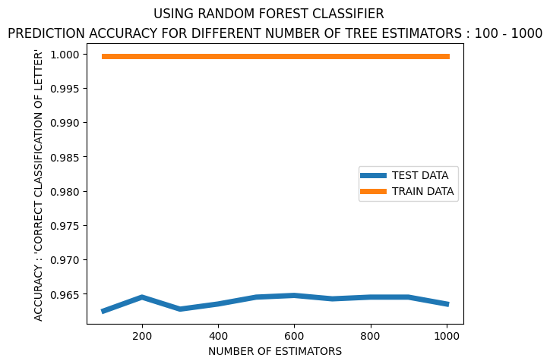
3. Random Forest Classifier

Slide 18
3. Random Forest Classifier
There are a lot of parameters to consider , so I will use a GridSearch . The parameters being tested are the {n_estimators 'increments of 100’, criterion}
Parameters = {'n_estimators':np.arange(100,1000,100),'criterion':['gini','entropy','log_loss’]}
Best estimator : RandomForestClassifier(n_estimators=np.int64(600), random_state=0)
-------------------------------------------------------------------------------------------------------------------------------------
After using these parameters :
RANDOM FOREST CLASSIFIER TEST DATA ACCURACY SCORE (criterion='gini',n_estimators=600)
0.96475
RANDOM FOREST CLASSIFIER TRAIN DATA ACCURACY SCORE (criterion='gini',n_estimators=600)
0.999625

Slide 19
4. Support Vector Classifier
THESE ARE THE ACCURACIES FOR TEST AND TRAIN FOR SUPPORT VECTOR CLASSIFIER
SVC LINEAR KERNEL : parameters are default
TEST DATA
0.8025
TRAIN DATA
0.8036875
SVC POLY KERNEL : parameters are default
TEST DATA
0.926
TRAIN DATA
0.9410625
SVC RBF KERNEL : parameters are default
TEST DATA
0.90725
TRAIN DATA
0.907375

Slide 20
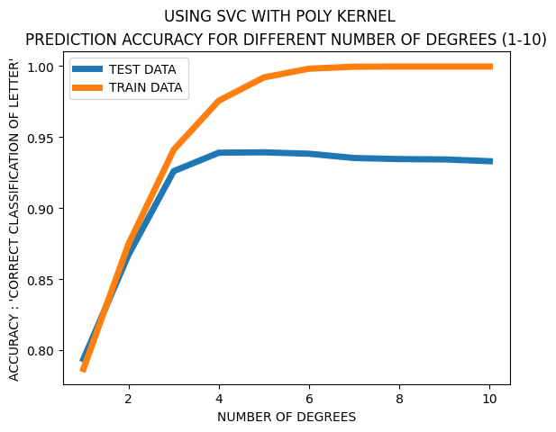
4. Support Vector Classifier
Polynomial with
Degrees 1-10

Slide 21
Conclusion
The best results for the Test Data Classification Rate came from the random forest classifier 0.96475 and the KNN 0.9675 . The worst results for the Test Data Classification Rate came from the Decision Tree Classifier 0.89825 . Somewhere in between was the SVC with poly kernel 0.93925.
The confusion matrix for KNN shows ‘F’ and ‘P’ being the most mistaken. (5 samples). Data representing a fully connected shape vs a disconnected shape could improve this.
The models seem to generalize decently as there remains a high rate of accuracy among different test data sizes :
‘Next Slide’

Slide 22
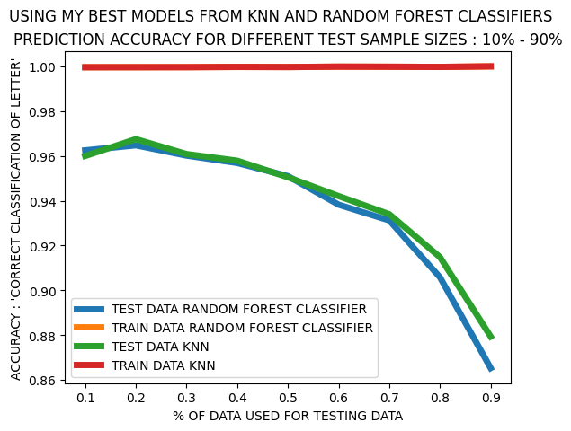
Conclusion
Different test data % sizes shown for the best performing models.

Slide 23
References
1. P. W. Frey and D. J. Slate. "Letter Recognition Using Holland-style Adaptive Classifiers". Machine Learning 6(2), 1991
Frey, P.W., Slate, D.J. Letter recognition using Holland-style adaptive classifiers. Mach Learn 6, 161–182 (1991). https://doi.org/10.1007/BF00114162

