Slide 1

Final year Project Space infinity war presented by: Md.Taufiqul islam ------- #ID:173 039 038 Johora Islam Ema ------- #ID173 054 038 Sathy Akter --------------- #ID143 127 038 Sohanur Rahman -------- #ID172 017 038 Luna Akter------------------- #ID173 013 039 Department of Electrical and Computer Science and Engineering.
Presidency university

Slide 2
Presentation Flow.
Introduction
Digital Games for Children’s
Workflow Diagram
Menu Design
Graphics Design
Playing Strategy
Each level achievement and difficulties
Demonstration
Conclusion

Slide 3
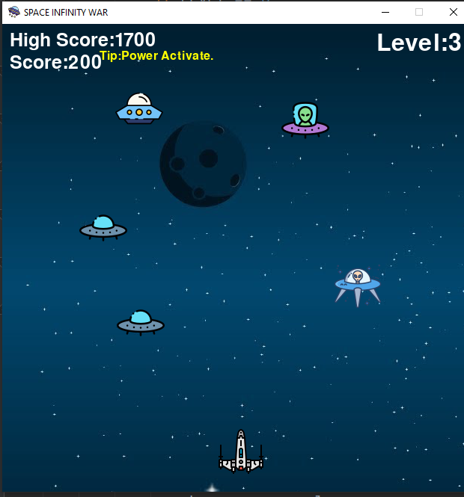

Introduction:
A game is a structured form of play, usually undertaken for entertainment or fun, and sometimes used as an educational tool. Often, part of the entertainment for children playing a game is deciding who part or their audience is and who is a player. Key components of games are goals, rules, challenge, and interaction.
Space infinity war
Pygame

Slide 4



Digital Games for children's
.
Learning
Education
Problem solve

Slide 5
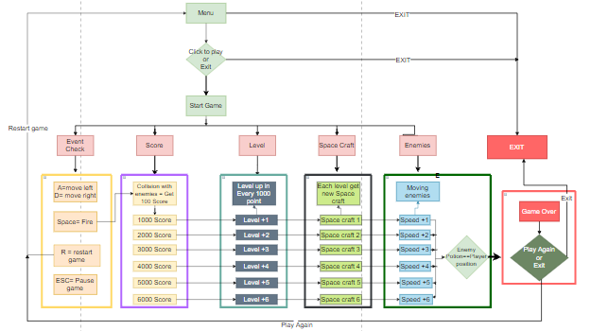
Workflow Diagram

Slide 6
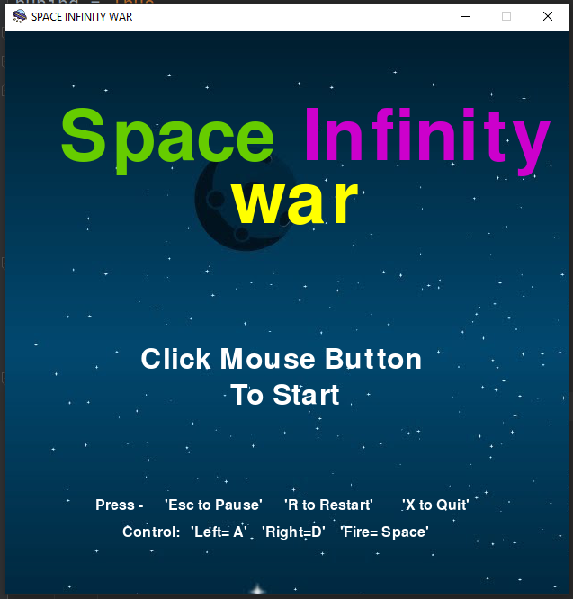
Menu Design
A menu is a very common part of video games. it tells us about the game, the game will more understandable to the user, it describes how to use this game. A beautiful and user-friendly menu can attract users to play the game. No one wants a complex menu where users can get confused and lose their motivation to play the game.

Slide 7
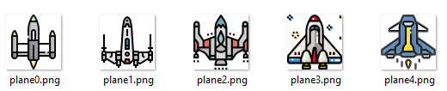





Graphics Design
Graphics are an important measure of a game's worth because of the power of images and art to influence perception, emotion, and, ultimately, immersion in a game world--it's not just about good looks. Good graphic design makes games more trusted and more pleasurable to play and when done right, fades into the background so players can focus on the game. So we chose 2D png images for our game.
The images are:
Player Spacecraft images
Bullet images
Enemy Spaceship images
Meteor images
Background image
Title image

Slide 8
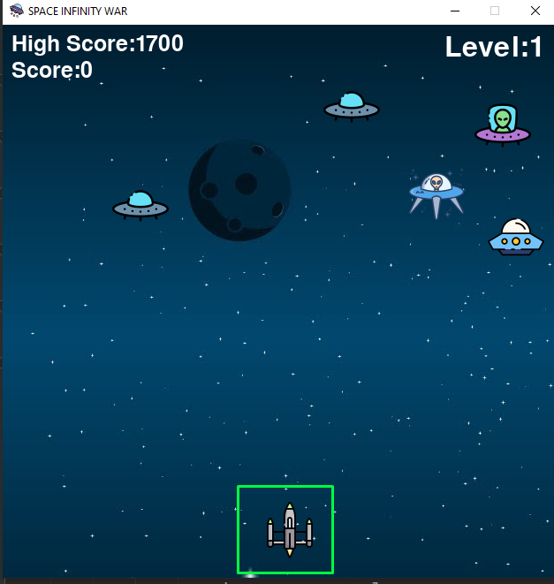
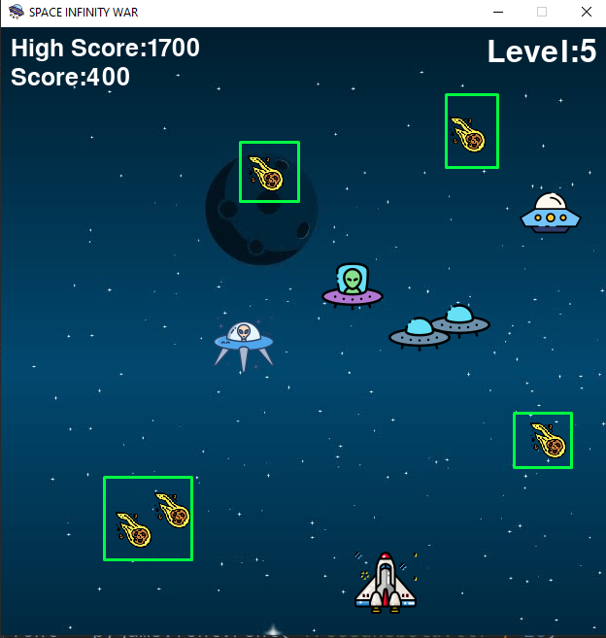
Playing strategy
The playing strategy of “Space infinity war” is very simple and straightforward.

Slide 9
Each level achievement and difficulties
A game without difficulties and achievements is Valued less. After overcoming the obstacle of a game, a reward is a must. And it makes a player feel proud, and more interested to face new difficulties and get new achievements. Space infinity war has also difficulties and achievements:
Achievements
Difficulties

Slide 10
Demonstration
Lest go…..

Slide 11
Conclusion
In this project, we developed a Space invader game for children. We want to create a game that has a very interesting mix of inputs. In order to ensure that the game is fun, we want the difficulty of the game to scale linearly with the length of time/ skill of the player. We also want to ensure that we have as many enemies on screen as possible by the end. We hope that once the dust settles, we won’t have just a barebones game, but a fun and challenging experience that lives up to the name of the classic Space Invaders.

Slide 12
Thank you for your attention
The end.

