Slide 1


Rajalakshmi Engineering College
ECHO
AI-Powered Personal Memory Assistant
Presented by : Shreenidhi T
Register Number : 240701503
Domain : Artificial Intelligence

Slide 2
Problem statement
ECHO - AI-Powered Personal Memory Assistant
ECHO addresses the problem of people forgetting important information stored in medicine labels, receipts, warranty cards, and other documents. Important dates and expiry details may be overlooked, leading to inconvenience or financial loss. Therefore, a smart system is needed to automatically extract, organize, and store this information while providing timely reminders to help users manage their important details efficiently.

Slide 3
Proposed Solution
  ECHO is an AI-powered personal memory assistant that extracts text from images using OCR.
  It uses Machine Learning to classify the extracted information into categories.
  It stores the information digitally for easy access.
  A rule-based reminder system identifies important dates and helps users keep track of them.

Slide 4
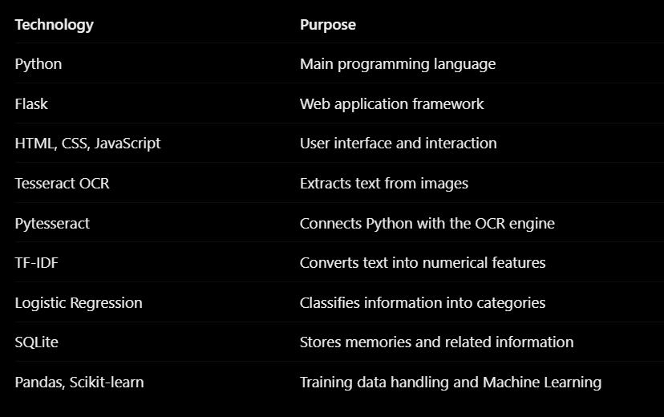
Technologies Used

Slide 5
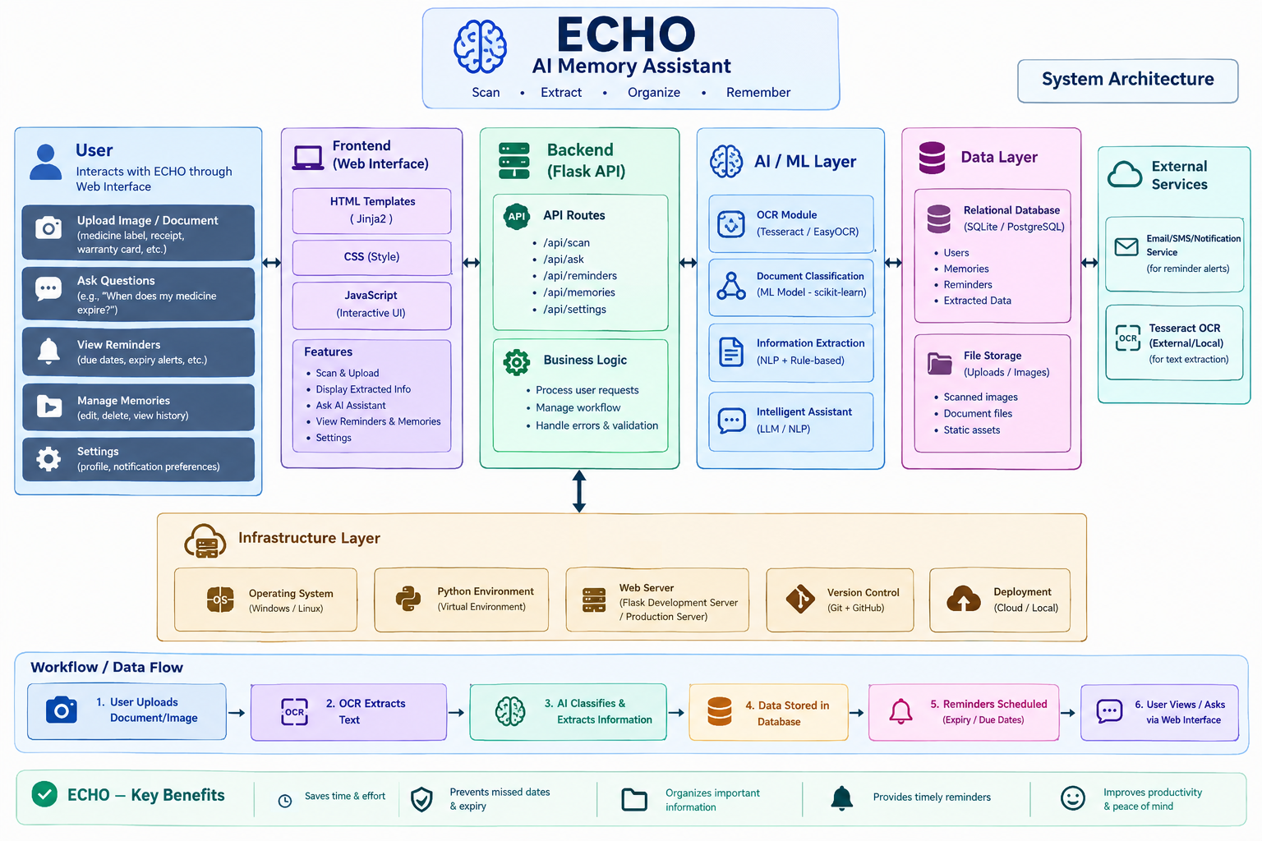
System Architecture

Slide 6
Implementation
  Image Upload: The user uploads an image containing important information.
  Text Extraction: OCR reads and extracts text from the uploaded image.
  Text Classification: TF-IDF converts text into numerical features, and Logistic Regression predicts its category.
  Data Storage: The extracted information and relevant details are stored in the SQLite database.
  Reminder Generation: Rule-based logic checks relevant dates and displays reminders through the application.

Slide 7
Feasibility and Impacts
Feasibility
Impacts
  Technical: Built using Python and commonly available open-source libraries.
  Economic: Uses free development tools and open-source technologies.
  Operational: Provides a simple web interface for uploading and managing information.
  Practical: Can run locally on a computer without requiring a cloud server.
  Reduces the effort needed to manually record information.
  Makes stored information easier to find.
  Helps users keep track of important dates.
  Supports better organization of personal documents.

Slide 8
Future Enhancements
  Add voice-based interaction for easier access.
  Introduce multilingual OCR for regional languages.
  Add email or mobile notifications for upcoming reminders.
  Integrate cloud storage and secure synchronization across devices.
  Improve date extraction and automatic identification of important events.
  Add authentication, encryption, and stronger privacy controls.

Slide 9
References
  Tesseract OCR Documentation — Optical character recognition.
  Scikit-learn Documentation — TF-IDF and Logistic Regression.
  Flask Documentation — Web application development.
  Python Documentation — Python programming.
  SQLite Documentation — Database management.
  Pytesseract — Python OCR Wrapper — Integrating Tesseract with Python.

Slide 10
THANK YOU

