Slide 1

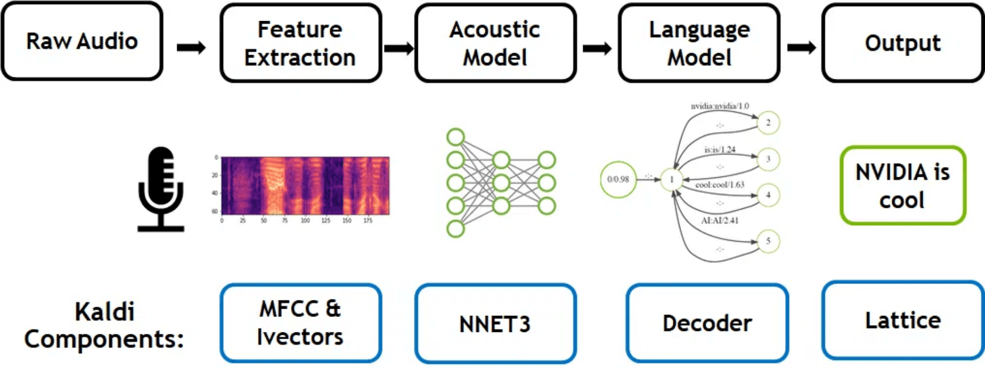
ASR Pipeline: From Signal to Features
Manual Implementation of Digital Signal Processing (DSP) Algorithms
By T07A, Mahmoud

Slide 2

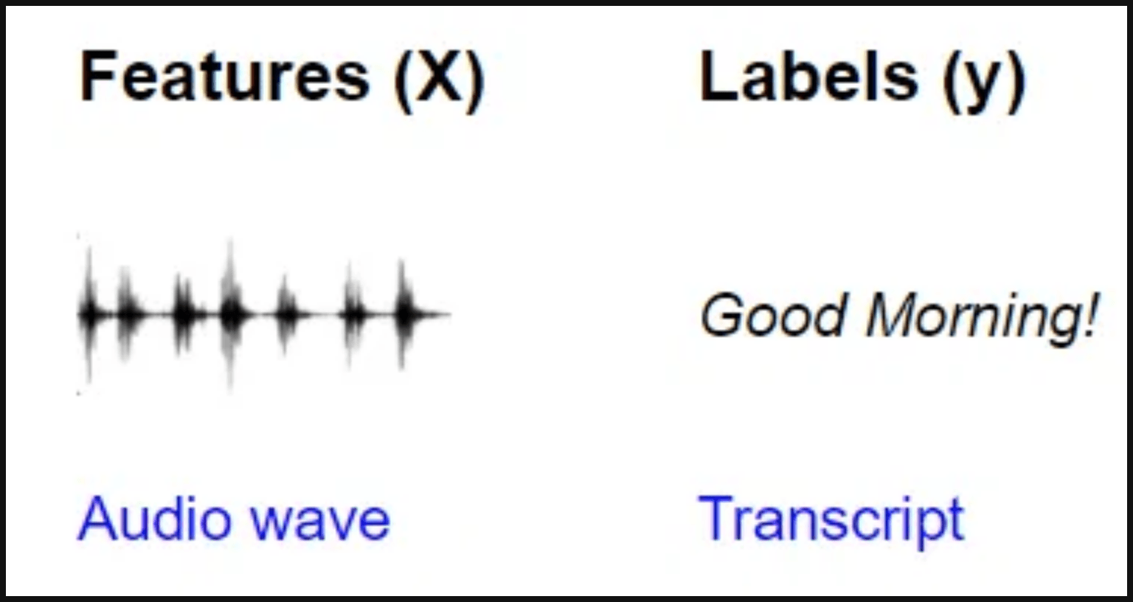
Stage 3 - Feature Extraction: Creating the Audio Fingerprint
The Computational Challenge
The Four Core DSP Steps
■
Problem:Raw audio is high-dimensional, redundant, and computationally prohibitive for AI models.
Pre-emphasis: Spectral Balancing
■
Requires excessive resources and training time if used directly.
Framing & Windowing: Localizing the Signal
FFT: Time-to-Frequency Conversion
The Feature Engineering Solution
Mel-Filtering (Implicit): Perceptual Compression
■
Solution: Transforms the raw signal into a compact, informative, and perceptually relevant representation.
■
This critical step makes the AI task tractable.
Analogy: Forensic Fingerprint
■
Extracting the unique, stable characteristics—the audio fingerprint—that define the sound.

Slide 3

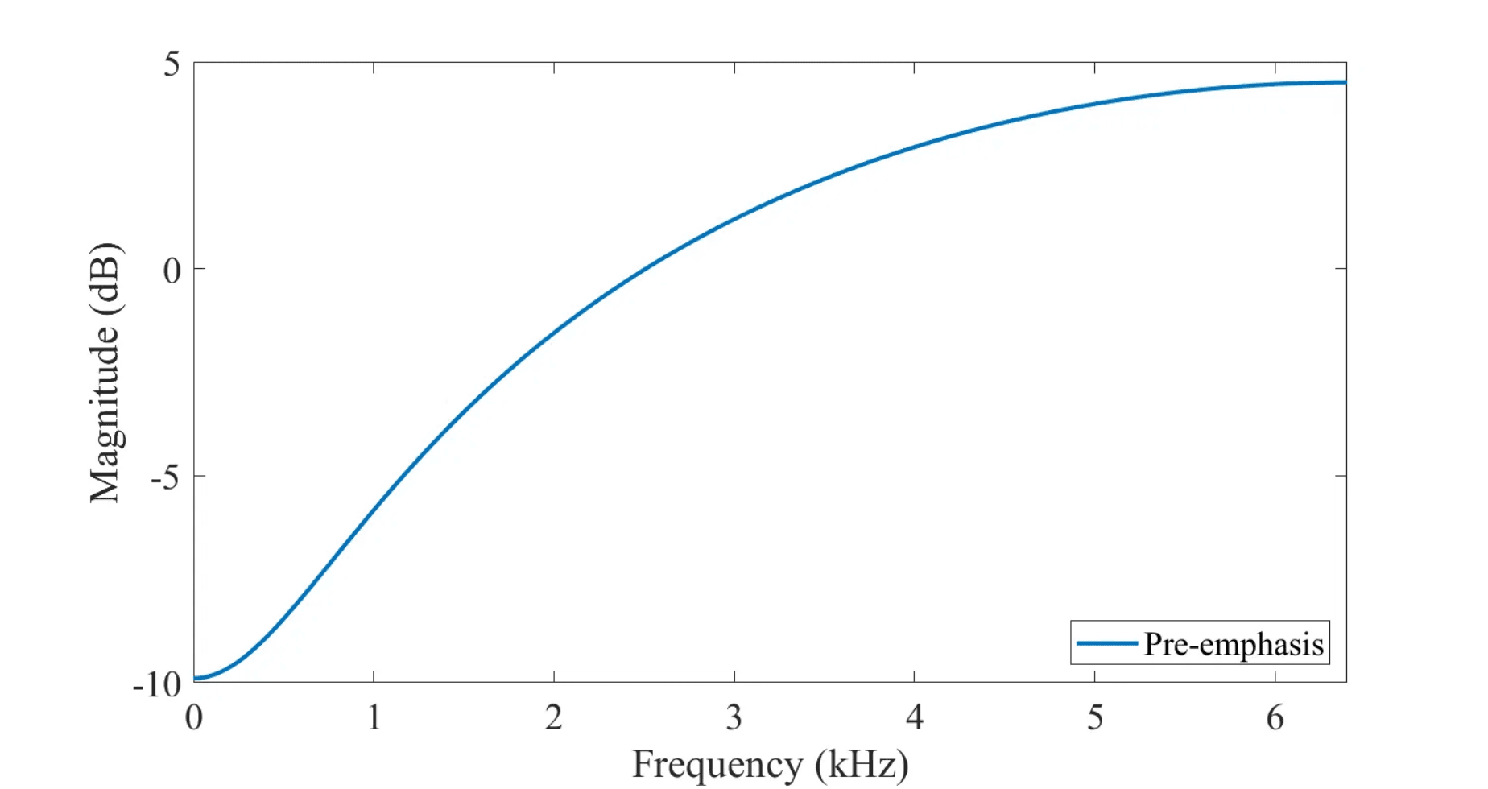

Pre-emphasis: Mitigating Spectral Tilt and Glottal Effects
■
Mitigates Spectral Tilt: Balances the spectrum by compensating for the natural low-frequency bias in human speech.
■
Boosts High Frequencies: Acts as a high-pass filter to improve the signal-to-noise ratio for subsequent analysis.
First-Order Difference Equation (alpha = 0.97)
$y[n] = x[n] - 0.97 \times x[n-1]$
NumPy Implementation Logic
# y[n] = x[n] - 0.97 * x[n-1]
emphasized[n] = signal[n] - 0.97 * signal[n-1]

Slide 4

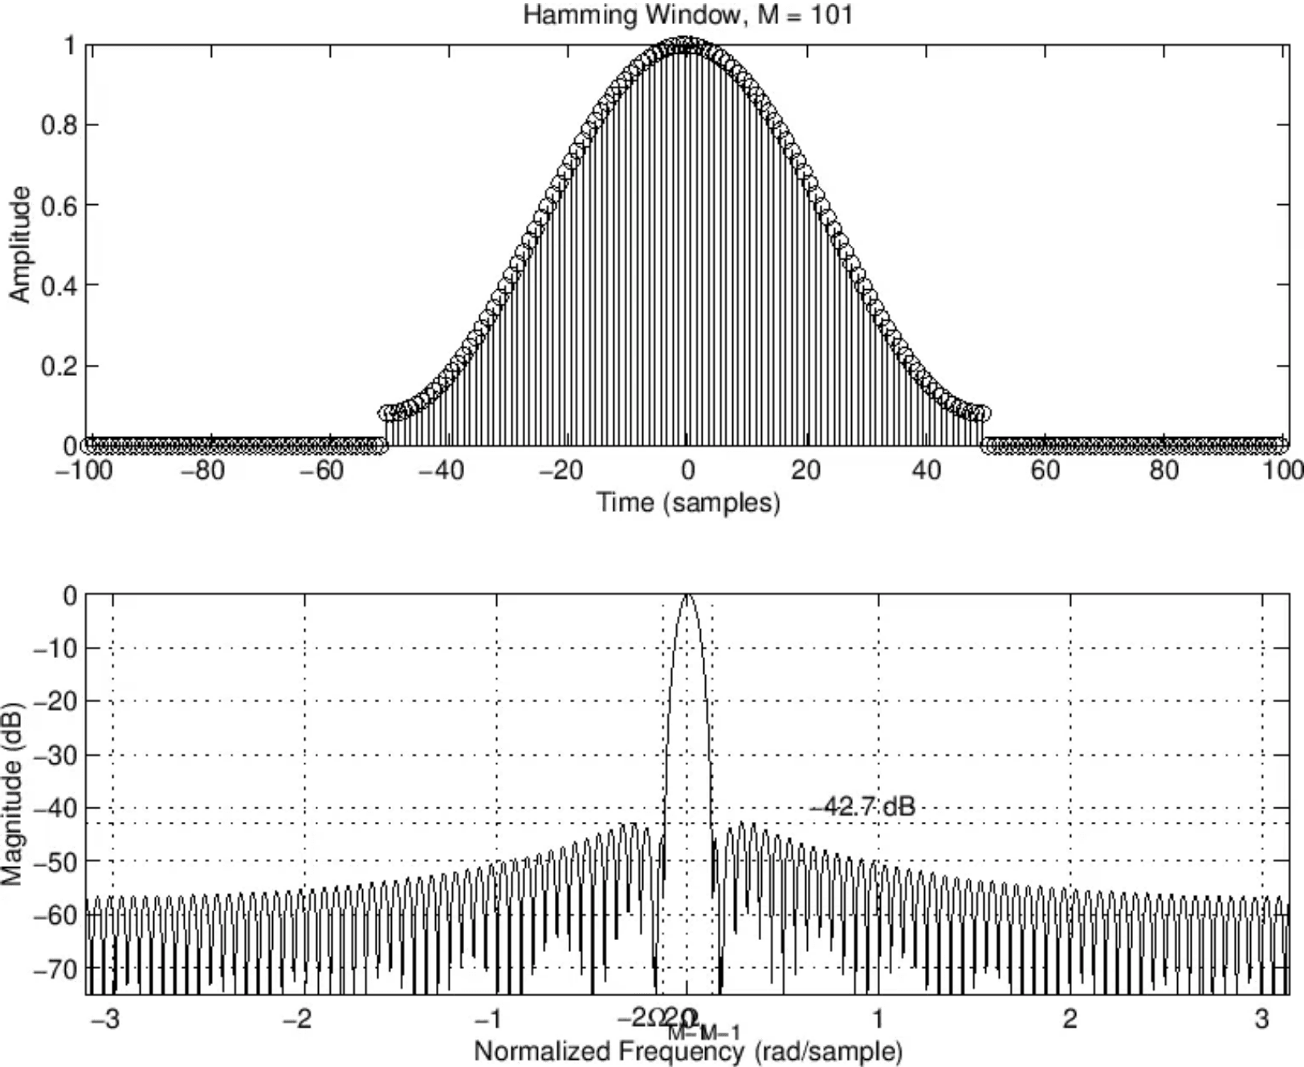
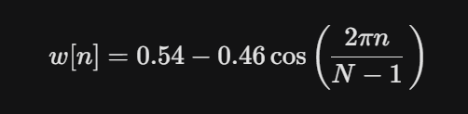
Framing & Hamming Window: Ensuring Short-Term Stationarity
Framing: Quasi-Stationary Segments
■
Quasi-Stationary: Speech is treated as stable over short intervals.
■
Segmentation: Audio is split into short, overlapping frames (e.g., 25ms frame, 10ms overlap).
The Windowing Problem: Spectral Leakage
■
Problem: Abrupt frame truncation causes discontinuities at the edges.
■
Result: This introduces spurious high-frequency components, known as Spectral Leakage.
The Hamming Solution: Smooth Tapering
■
Solution:The Hamming window smoothly tapers the signal to zero at the frame boundaries.
■
Effect: Minimizes discontinuities and prevents Spectral Leakage.
$$w[n] = 0.54 - 0.46 \cos\left(\frac{2\pi n}{N-1}\right)$$

Slide 5

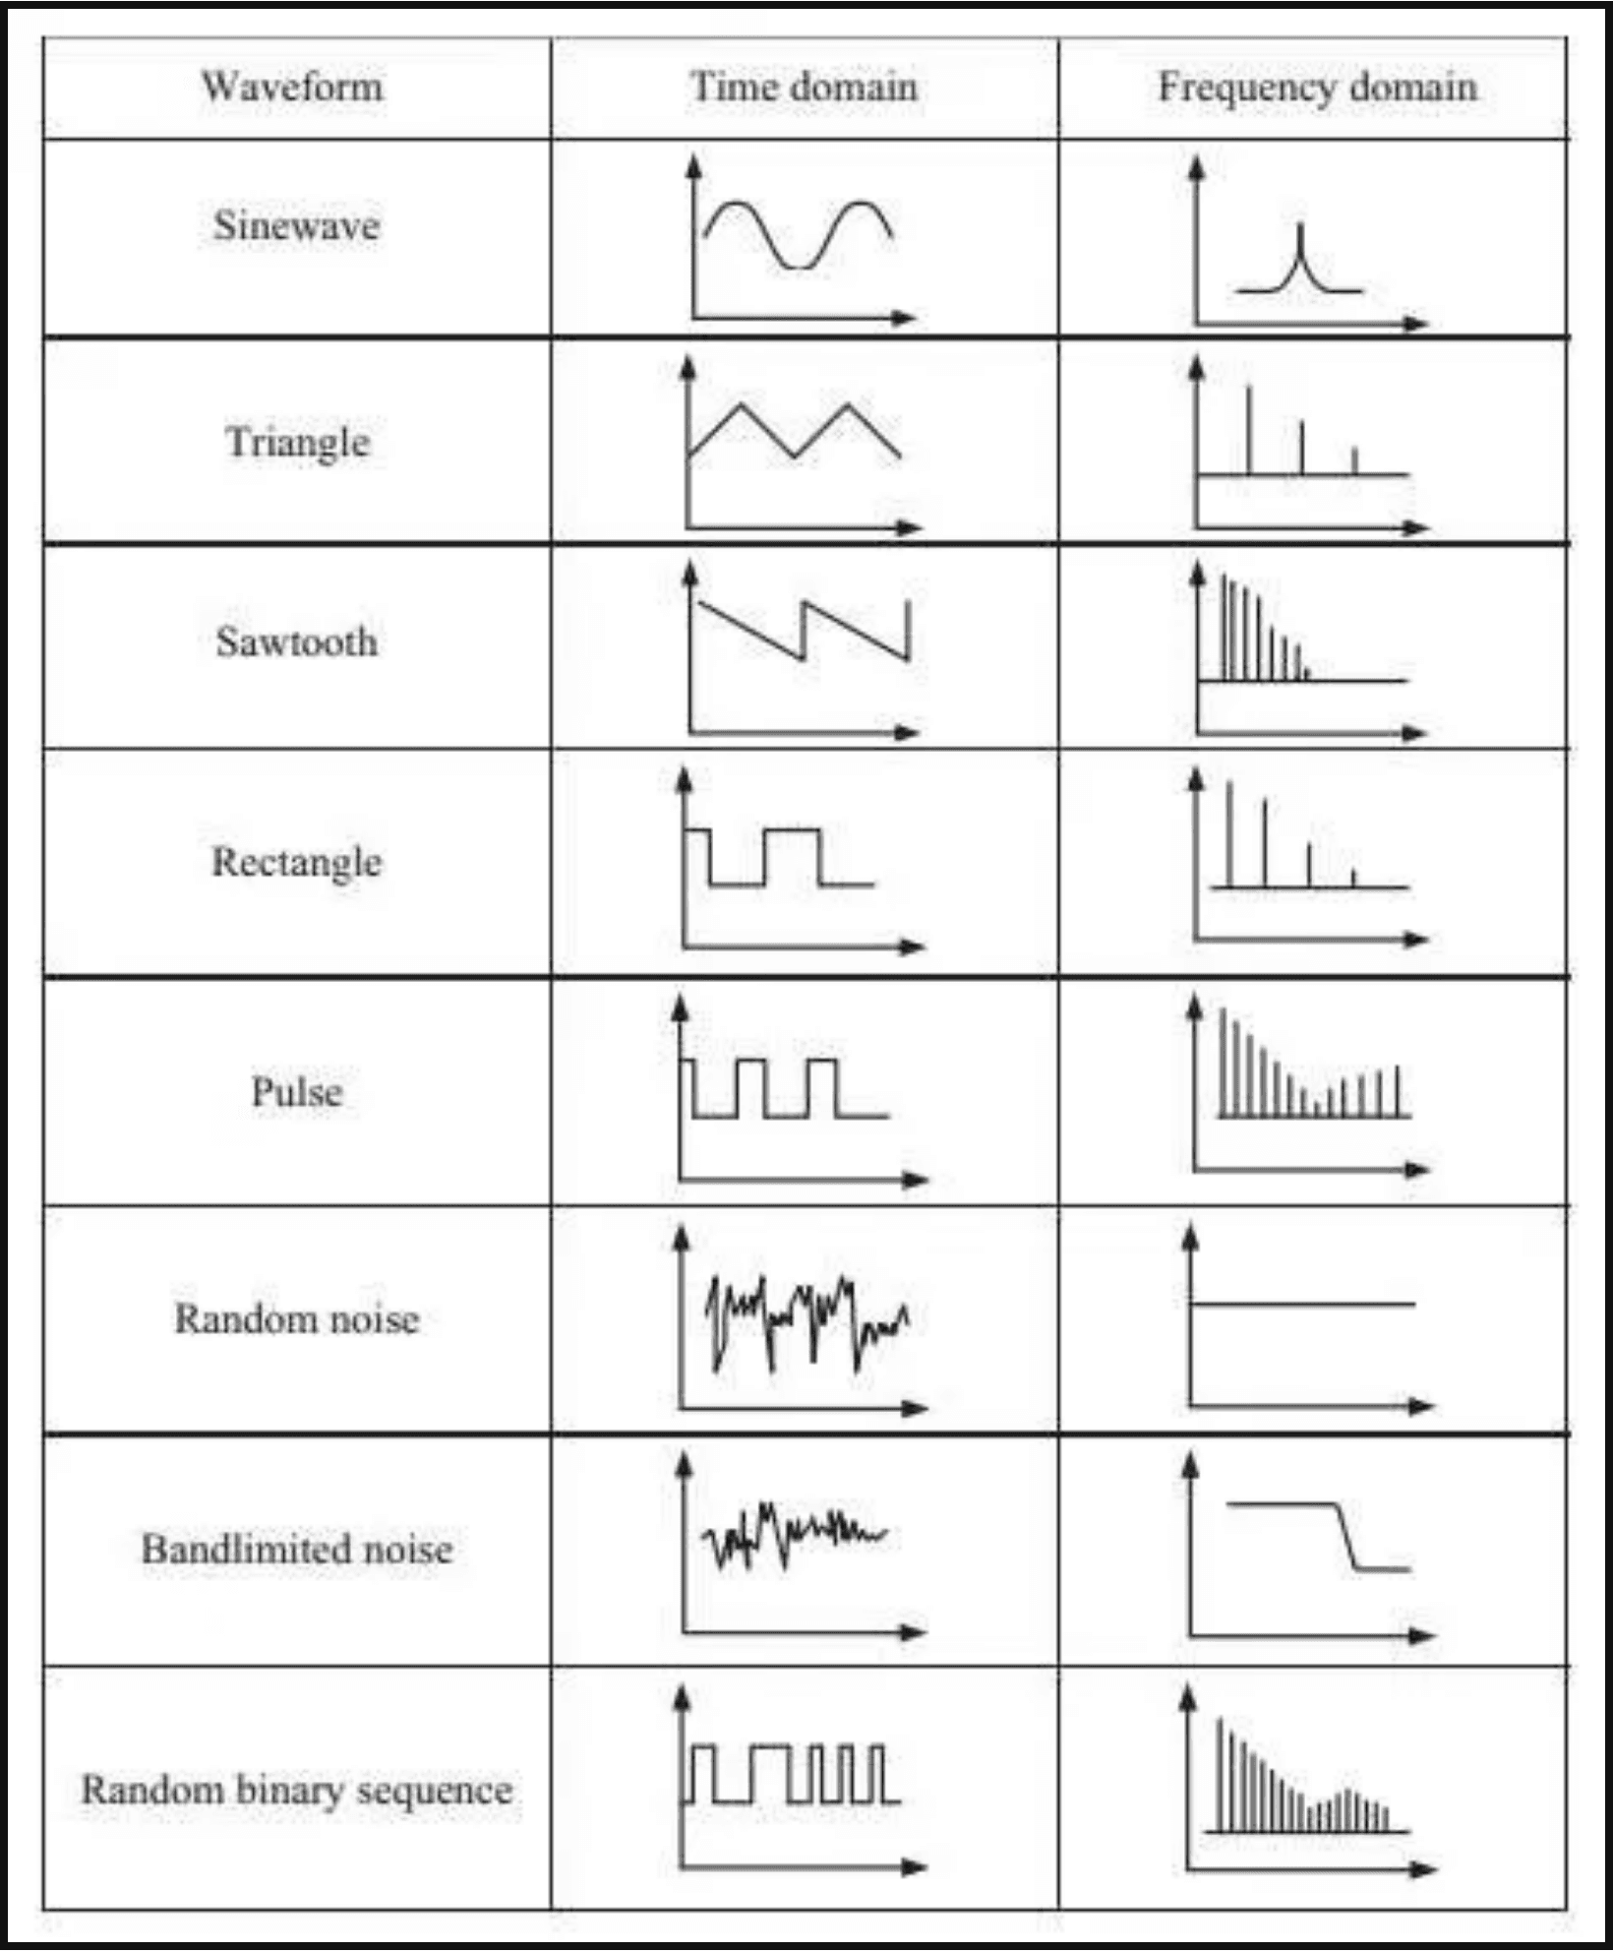
FFT: Converting Time-Domain Energy to Frequency-Domain
Concept: Domain Transformation
■
FFT converts the time-domain signal of each frame into the **frequency domain.
■
Reveals the underlying spectral content and energy distribution of the sound.
Tool Choice: Optimized Real FFT
■
Manual implementation uses `np.fft.rfft` (Real FFT).
■
Optimization: Computes only non-redundant positive frequency components (input is real-valued).
■
Significantly reduces computation time and memory usage.
Output: Power Spectrum & Spectrogram Foundation
■
Output: The Power Spectrum (energy at each frequency bin).
■
Result: A matrix of (Frames × Frequencies), the foundation of a Spectrogram.
■
This is the final output of the manual NumPy implementation.

Slide 6

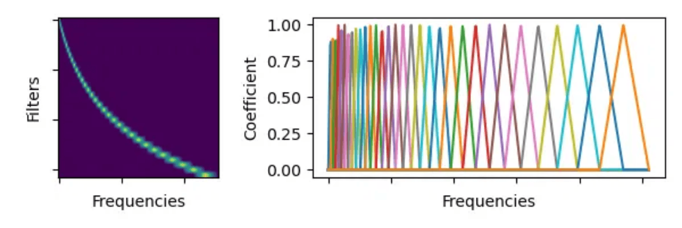
Theoretical Next Steps: MFCCs for Production Systems
Mel-Filter Bank: Perceptual Compression
Implemented a manual bank of 40 triangular filters spanning 0 Hz to 7350 Hz (Nyquist) to mimic human ear perception.
Log Energy: Loudness Mimicry
Applied Natural Logarithm (np.log) with stability epsilon (1e-10) to compress dynamic range.
Discrete Cosine Transform (DCT): Decorrelation
Performed manual Type-II DCT to extract the top 13 MFCC Coefficients, resulting in a final feature shape of (60960, 13).

Slide 7

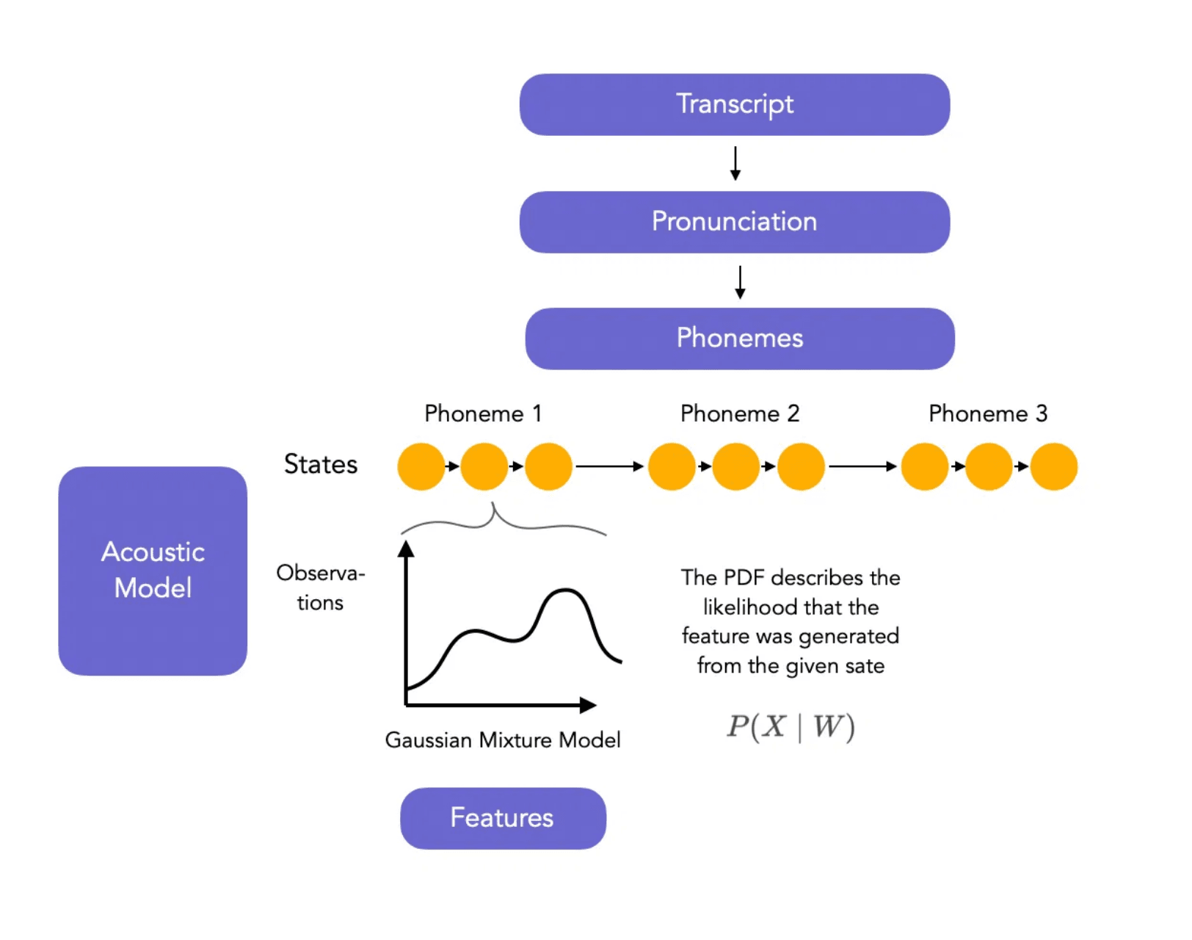
Stage 4: Modeling - The Neural Network Core
■
Paradigm Shift: Transition from deterministic DSP to probabilistic, data-driven Neural Networks.
■
Input: Robust feature vectors from Stage 3 are fed into the AI models for inference.
The Acoustic Model (AM)
■
Function: Maps feature vectors (e.g., MFCCs) to Phonemes (basic sound units).
■
Output: Probability distribution over possible phonemes for each time-step.
The Language Model (LM)
■
Function: Applies grammar, syntax, and context to form a coherent sentence.
■
Role: Resolves ambiguities and ensures the output is linguistically plausible.

Slide 8

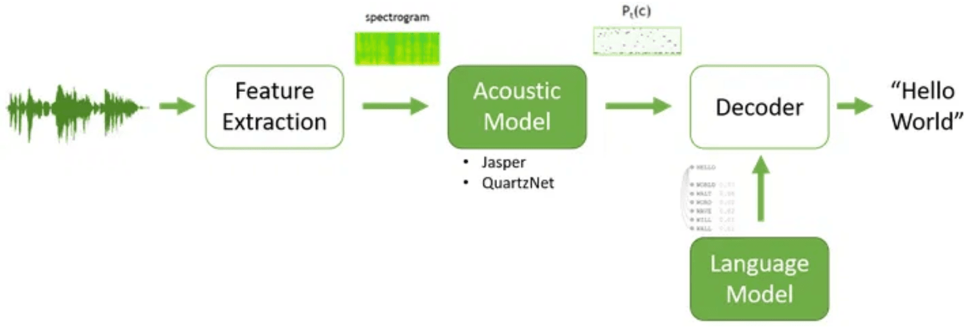
The Language Model: Resolving Ambiguity and Context
■
Challenge of Homophones: AM output can correspond to multiple valid word sequences.
■
LM's Role: Statistical/Neural Network model that calculates the probability of a word sequence occurring in a given language.
The Classic Ambiguity Example
Acoustic Model Output (Phonemes): "reh - cog - nize - speech"
Possible Word Sequences:
1. "Wreck a nice beach" (Low probability)
2. "Recognize speech" (High probability)
LM's Decision: The LM selects the sequence with the highest linguistic probability, ensuring the output is coherent and contextually appropriate.

Slide 9

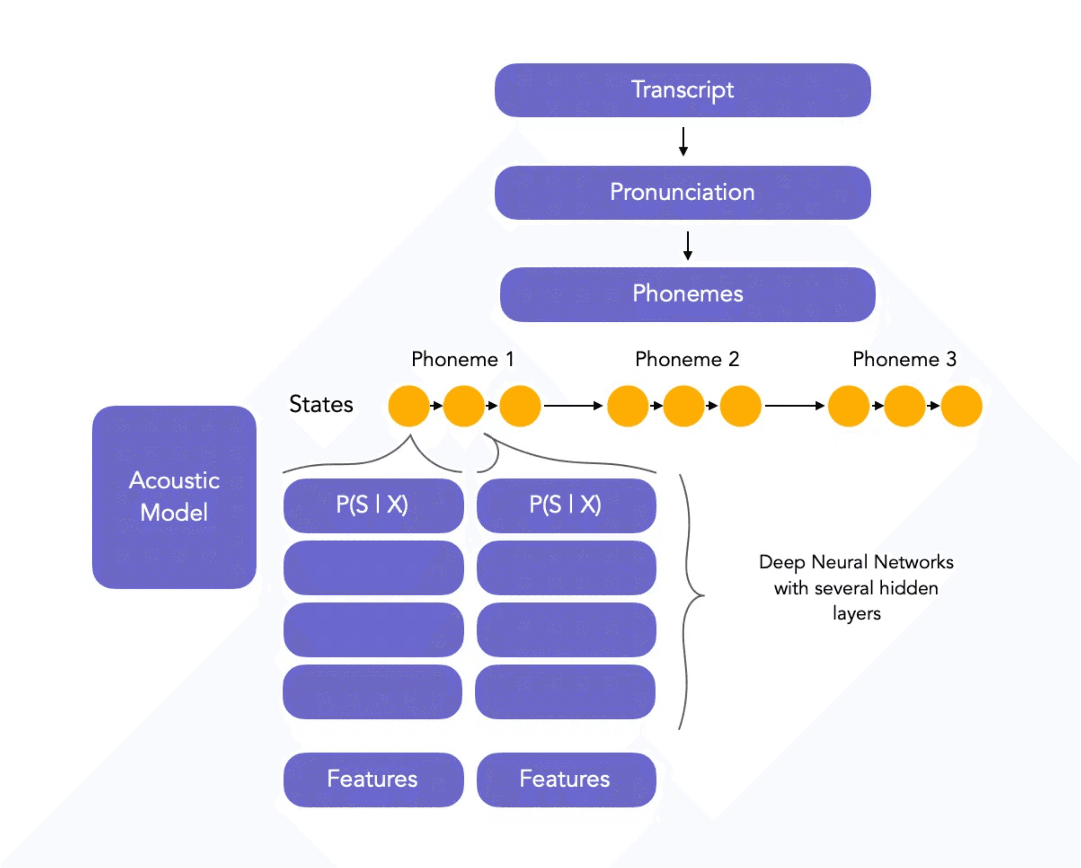
The Final Flow: From Audio Wave to Final Text
The entire ASR pipeline is a cascade of transformations, each step reducing dimensionality and increasing the information density of the signal.
The manual DSP script successfully bridges the gap, providing the compact, robust features that enable the deep learning models to perform their task efficiently.
Audio Wave
Pre-processing
FFT Features
Acoustic Model
Final Text

Slide 10

Key Takeaways and Q&A
■
Hybrid System: ASR is a powerful hybrid of classical DSP (Feature Engineering) and modern AI (Modeling).
■
Feature Engineering is Foundational: The manual DSP steps (Pre-emphasis, Framing, Windowing, FFT) are the critical bridge that makes the AI task computationally tractable.
■
Two Brains: The Acoustic Model handles sound-to-phoneme mapping, while the Language Model ensures linguistic coherence and resolves ambiguity.
Thank you. Questions?

