Slide 1
NVIDIA Stock Market Prediction
Leveraging Historical Data & Machine Learning to Forecast Stock Returns
Data Period: January 1999 – Present | OHLCV Dataset
1 / 18

Slide 2
Agenda
Project Objective & Business Context
Data Overview & Quality Assessment
Exploratory Data Analysis (EDA)
Feature Engineering & Statistical Testing
Machine Learning Model Development
Model Performance & Comparison
Key Insights & Recommendations
2 / 18

Slide 3

Business Need
These Machine Learning models
(Random Forest and XGBoost) help
maximize profits and reduce
financial risks by predicting Nvidia’s
future price trends. They find
complex patterns in past price and
volume data to provide data-driven
answers. Using metrics like RMSE
and R^2, they show investors
exactly when it is most effective to
take action in the market.
2 / 18

Slide 4
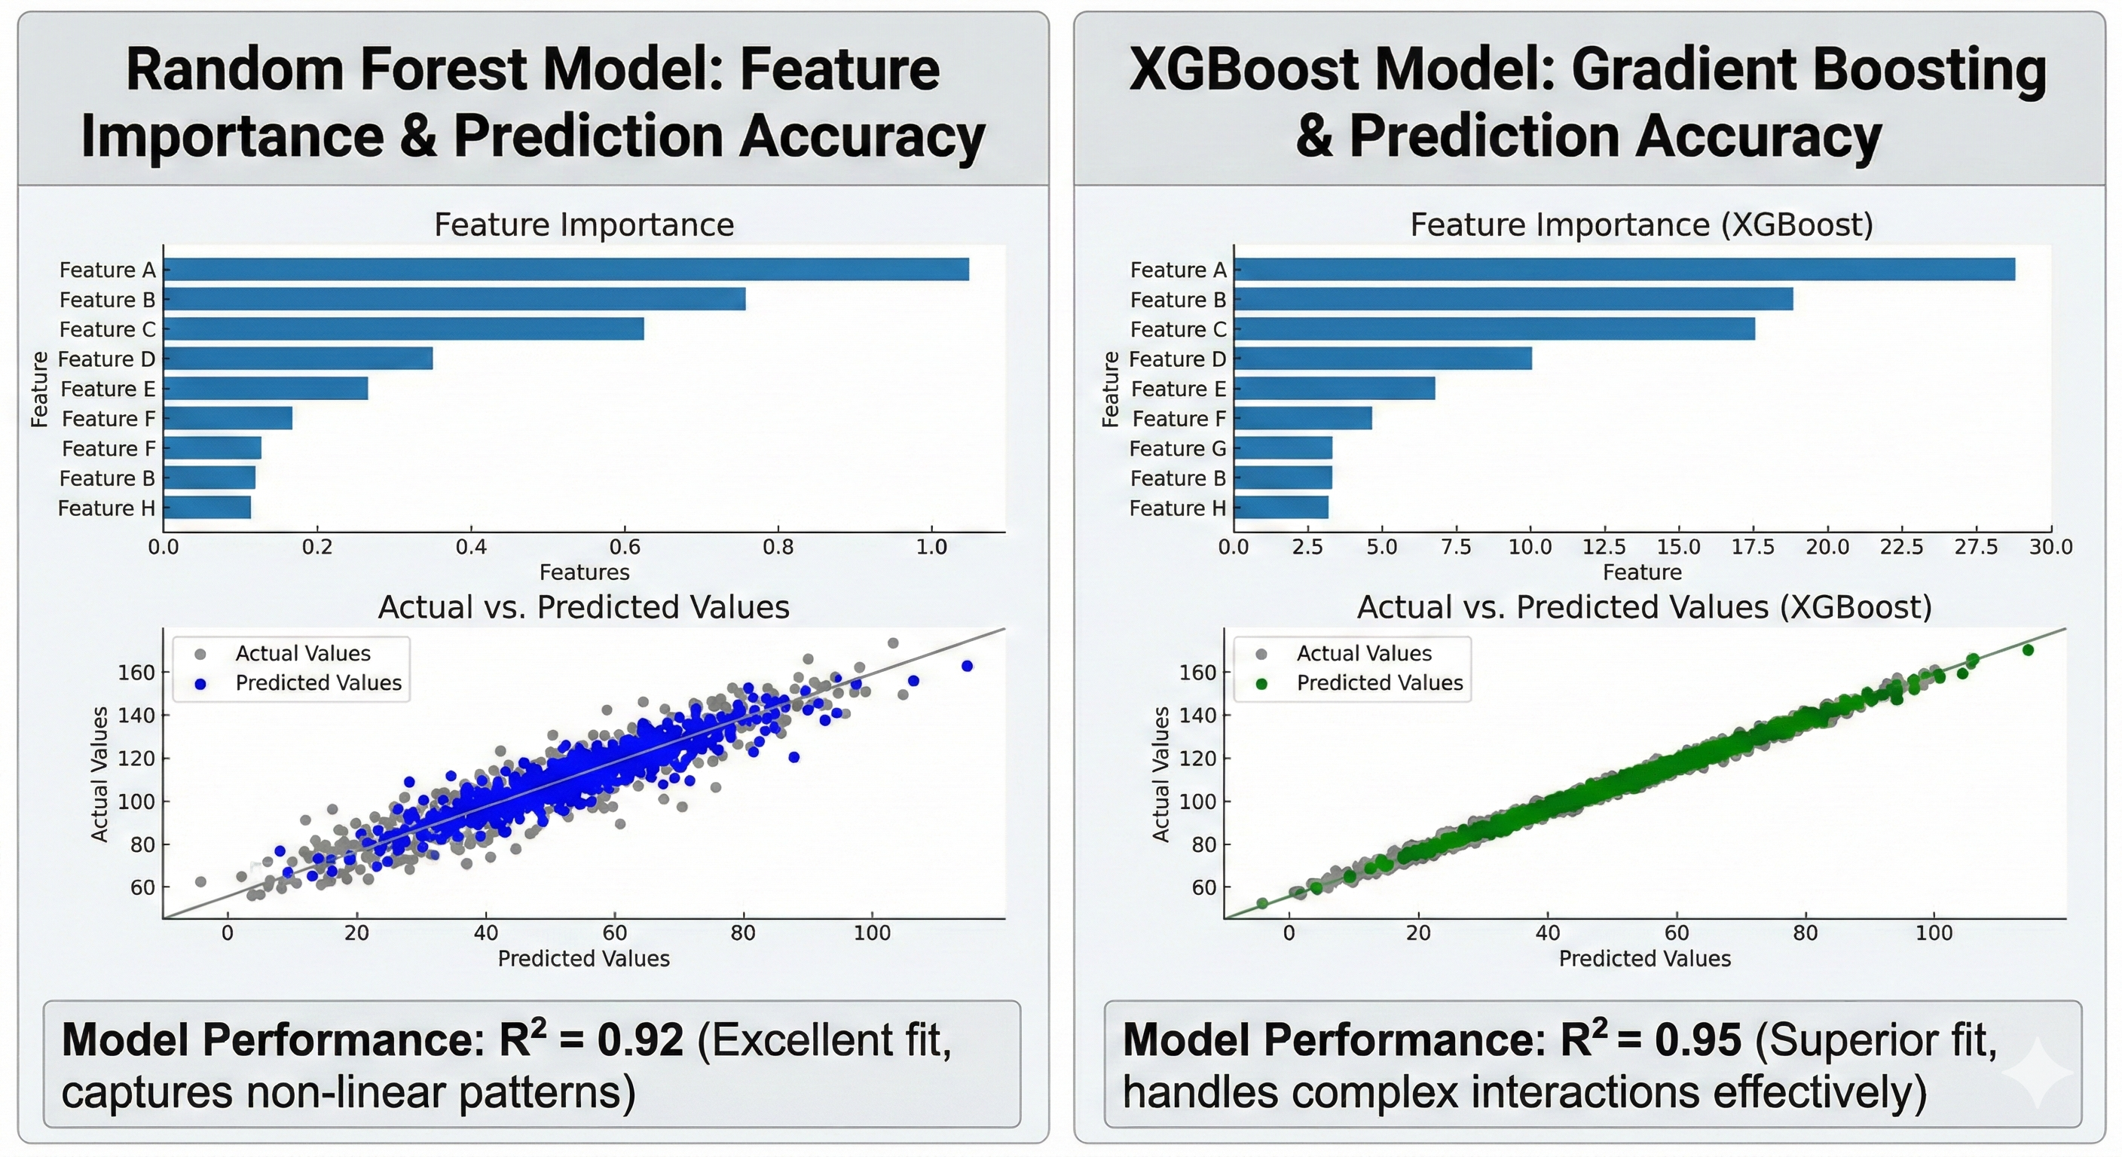
Project Objective
Predict next-day NVIDIA stock log-returns using ML
Evaluate if historical price patterns contain exploitable signals
Compare ensemble methods: Random Forest vs. XGBoost
Provide data-driven foundation for investment decisions
3 / 18

Slide 5
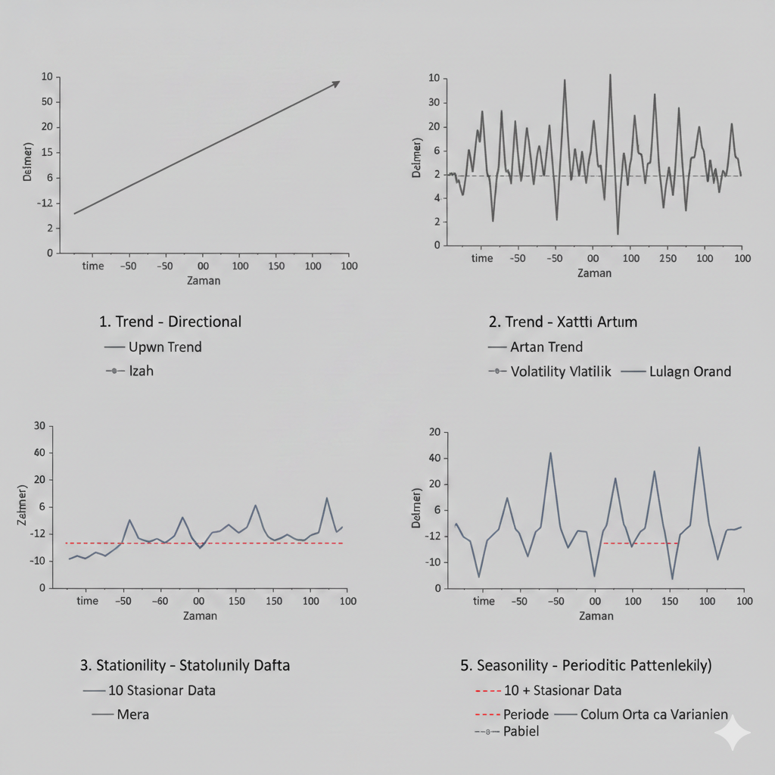
Dataset Overview
Source: NVIDIA historical stock data (1999–Present)
Features: Open, High, Low, Close, Volume (OHLCV)
~6,500+ daily trading records spanning 25+ years
No missing values or duplicates – clean dataset
Prices reflect adjusted values including stock splits
TrendThe long-term increase or decrease in the data.
VolatilityThe degree of variation (variance) of price series over time.
StationarityA property where mean and variance remain constant over
SeasonalityPeriodic fluctuations that repeat at regular intervals.
4 / 18

Slide 6
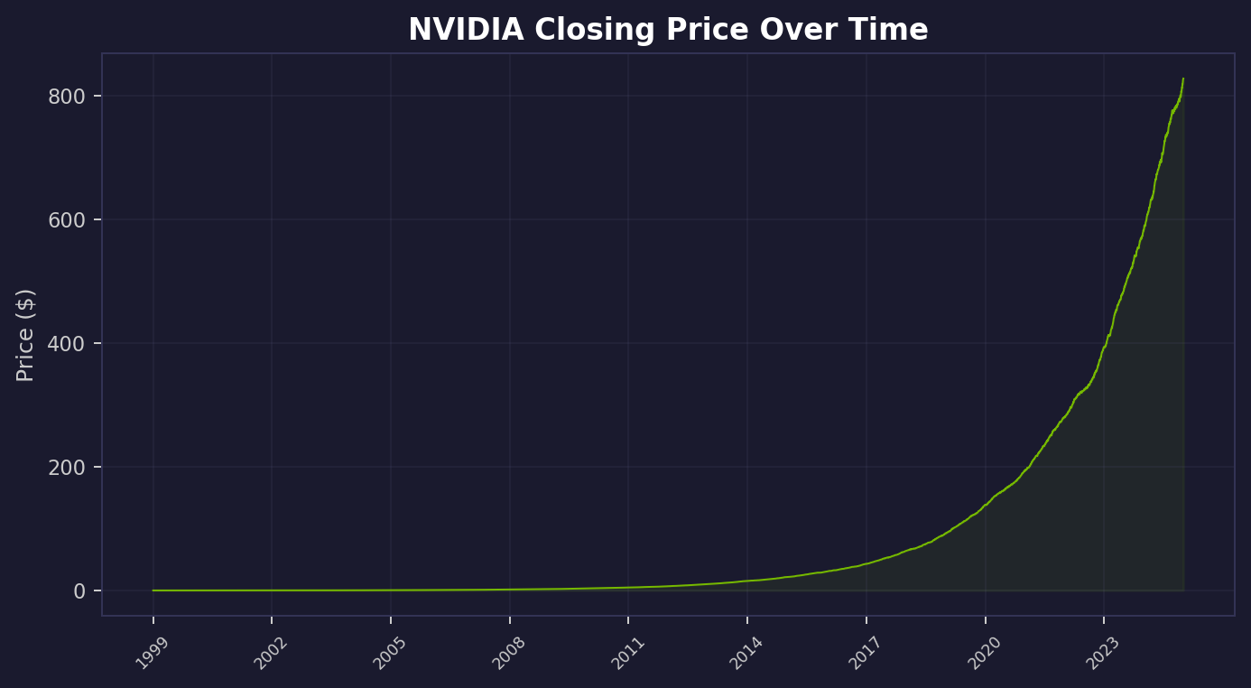
NVIDIA Historical Price Trend
Exponential growth from ~$0.04 to highs
Major acceleration post-2016 (AI/GPU boom)
Price distribution heavily right-skewed
5 / 18

Slide 7
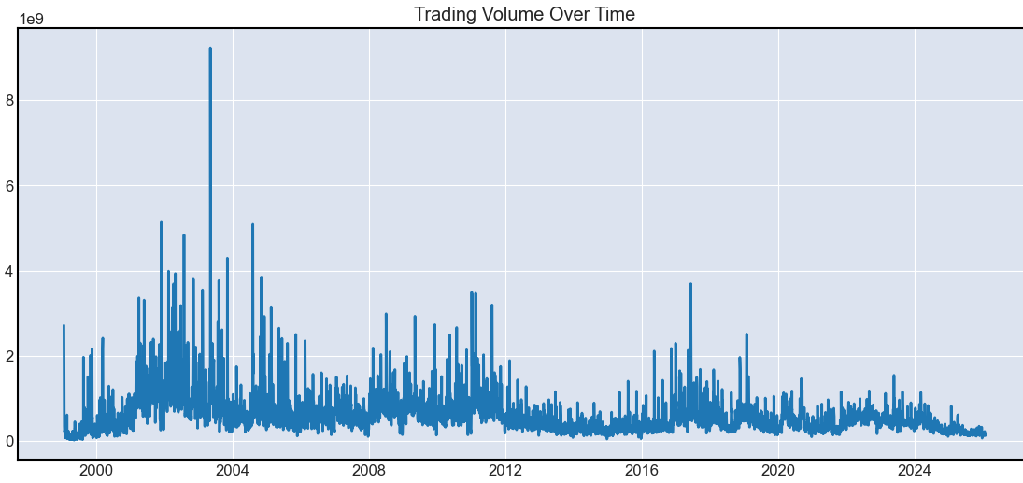
OHLC & Volume Analysis
OHLC prices move in tight formation
Volume spikes at key market events
IPO-era and AI-boom show highest activity
6 / 18

Slide 8
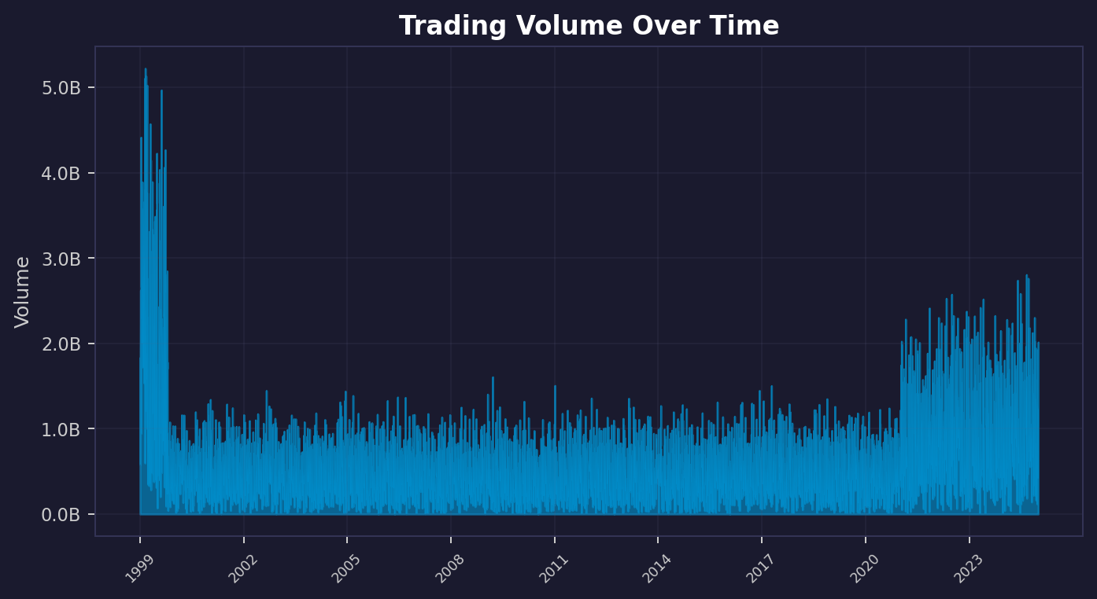
Trading Volume Over Time
Significant spikes during major events
Higher volume = price inflection points
Volume provides supplementary signals
7 / 18

Slide 9
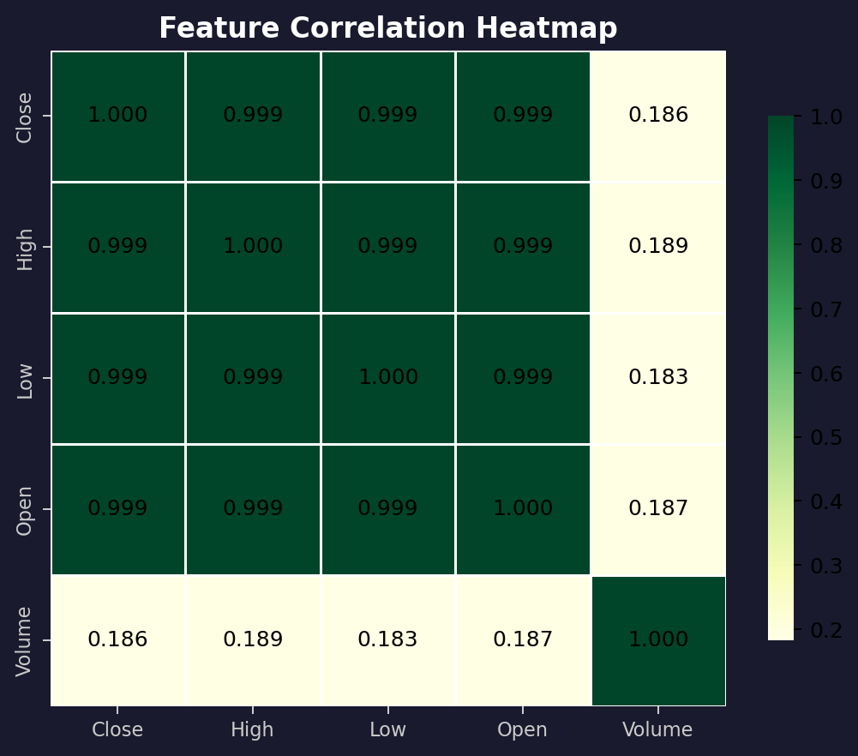
Feature Correlations
OHLC features: > 0.99 correlation
Volume weakly correlated with price
Multicollinearity → use log returns
8 / 18

Slide 10
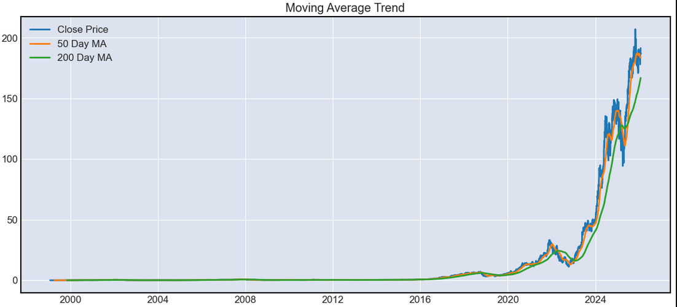
Trend Analysis: Moving Averages
50-day & 200-day MA as trend indicators
Golden Cross = bullish momentum
Death Cross = bearish pressure
9 / 18

Slide 11
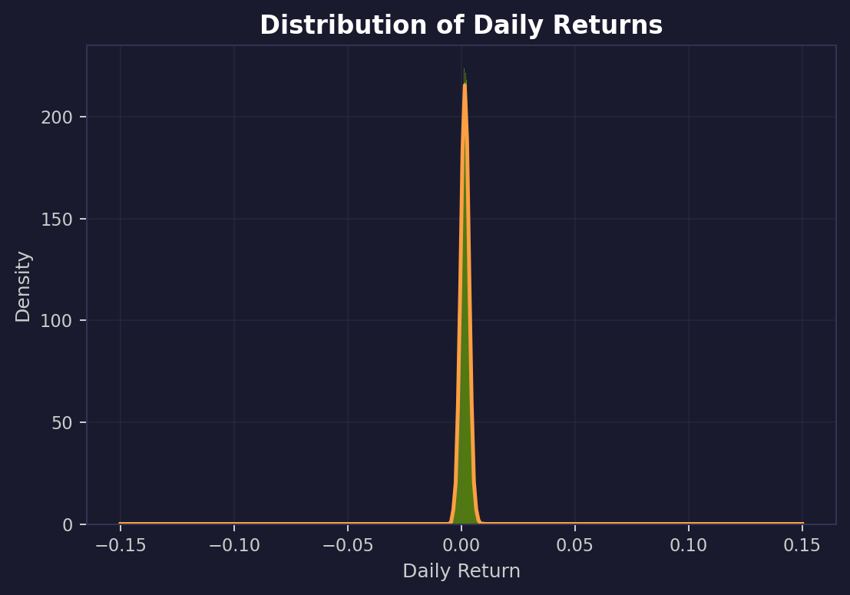
Volatility & Daily Return Distribution
Returns centered near zero (normal dist.)
Volatility clustering observed
Fat tails indicate extreme movements
10 / 18

Slide 12
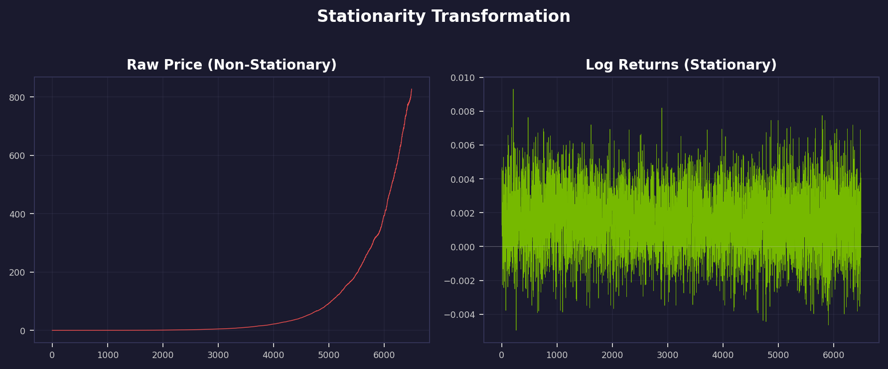
Stationarity Test (ADF)
Raw prices: non-stationary (trending)
Log returns: stationary confirmed
ADF Statistic: -13.95
p-value: 4.69e-26 (<< 0.05)
Stationary data = reliable modeling
11 / 18

Slide 13
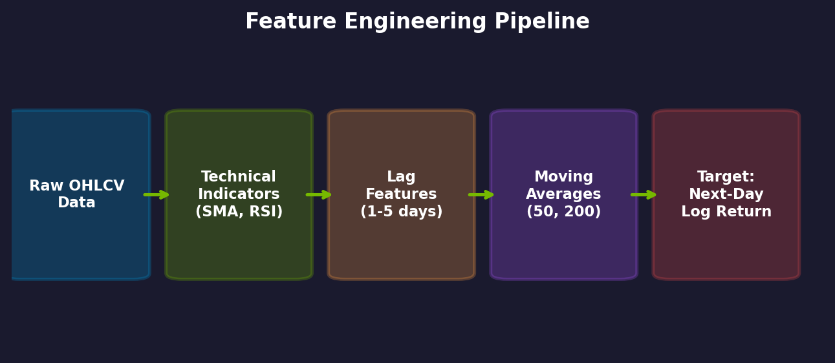
Feature Engineering Pipeline
Technical Indicators: SMA-20, RSI
Lag Features: 5 lagged log-return values
Moving Averages: 50-day & 200-day MA
Target: Next-day log return
12 / 18

Slide 14
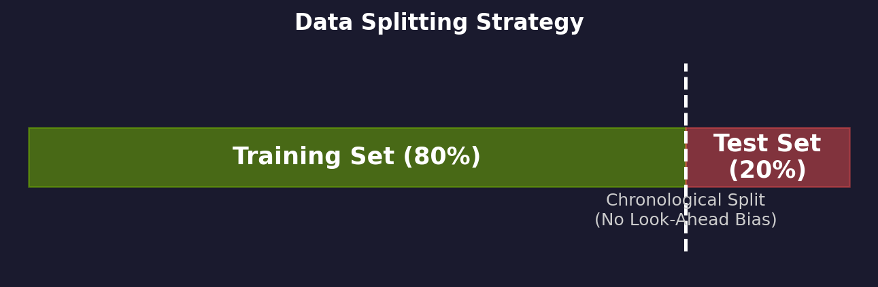
Data Preparation Strategy
Chronological 80/20 split (no look-ahead bias)
RobustScaler – resistant to outliers
Scaler fitted on train only, applied to test
13 / 18

Slide 15
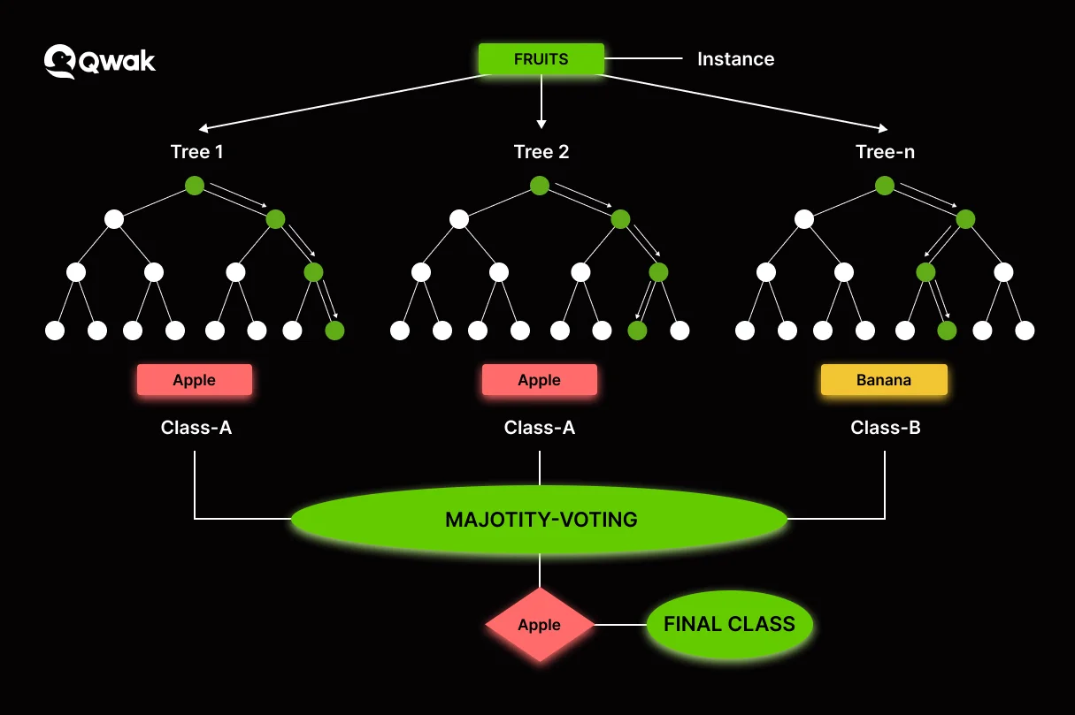
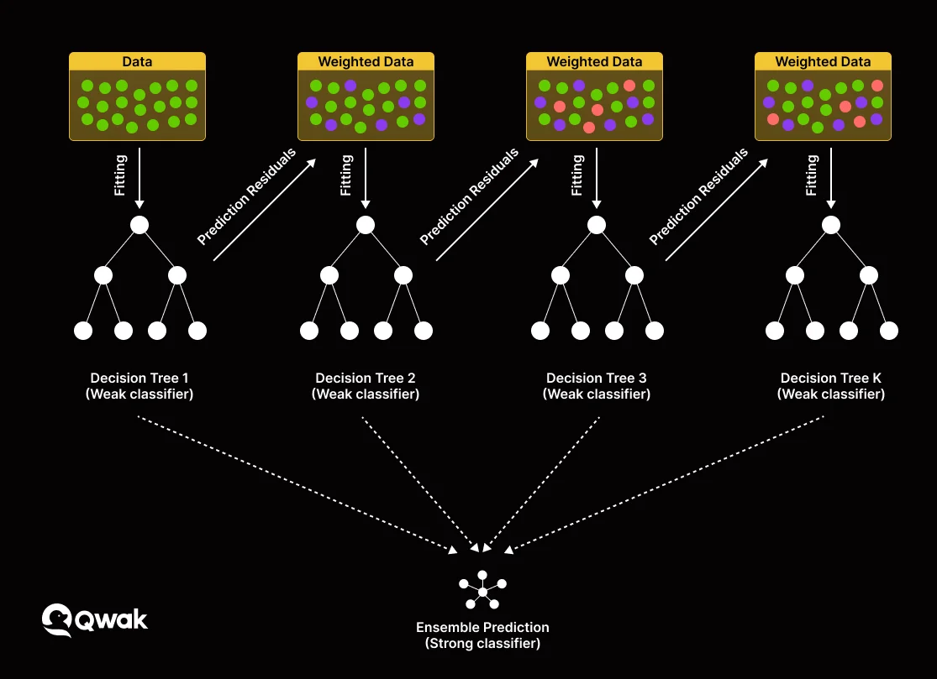
Models Deployed
Random Forest Regressor
100 decision trees (ensemble)
Captures non-linear patterns
Built-in feature importance
XGBoost Regressor
Gradient Boosting (sequential)
Squared-error objective
Top performer on tabular data
14 / 18

Slide 16
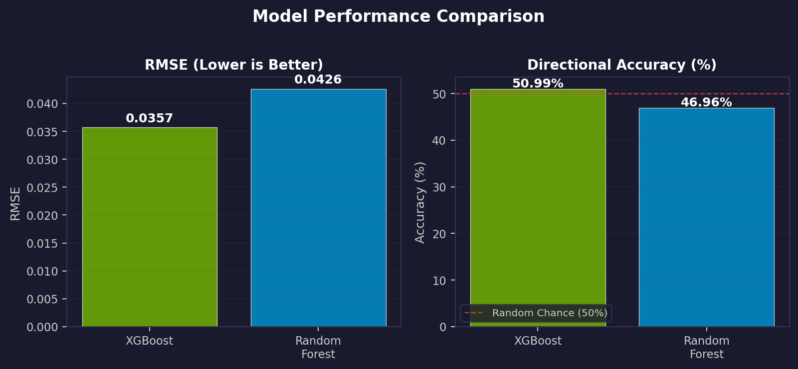
Model Evaluation Results
Model | RMSE | Directional Accuracy
XGBoost | 0.0357 | 50.99%
Random Forest | 0.0426 | 46.96%
XGBoost outperforms on both RMSE and directional accuracy
~51% directional accuracy – marginally above random (50%)
Low RMSE reflects small-magnitude log returns
15 / 18

Slide 17
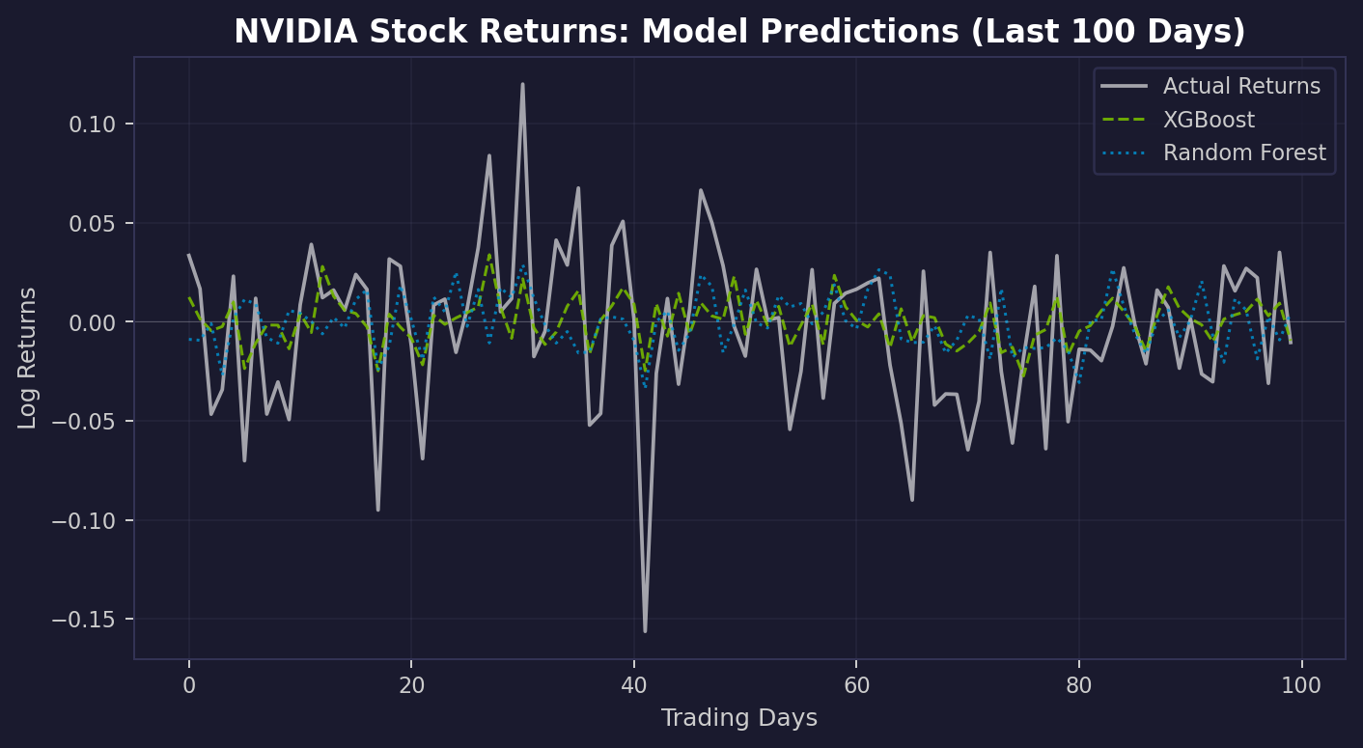
Actual vs. Predicted Returns (Last 100 Days)
XGBoost tracks actual returns more closely
Random Forest shows wider deviation
Both struggle with extreme spikes
Predictions cluster near zero
16 / 18

Slide 18
Key Takeaways
NVIDIA: extraordinary 25+ year growth trajectory
Log return transformation essential for valid modeling
XGBoost: best performer (lower RMSE, better direction)
~51% accuracy → market is highly efficient short-term
Feature engineering adds modest but real predictive value
Models provide quantitative baseline for advanced strategies
17 / 18

