Slide 1
Where AI news says AI is changing industries
Topic, entity and sentiment evidence from 125K de-duplicated AI news articles, 2022–2026
Chiyang (Tom) Chen · ADSP 32018 Next-Gen NLP · University of Chicago

Slide 2
Executive summary
Three research questions, one number each
50%
+0.89
67%
of AI news discusses software & IT
net framing for manufacturing
setback rate when regulation is the barrier
Among sectors adopting AI, media (16%), government (9%) and healthcare (8%) get the most coverage.
vs. +0.21 for media; a separately trained entity sentiment model ranks industries alike (ρ = 0.96).
vs. 26% for all adoption stories; talent and integration barriers sit below it.
2

Slide 3
Why industry impact is uneven
The brief: identify impacted industries and companies, how they are impacted, and what makes adoption succeed
Exposure estimates
Moravec's paradox
What this project adds
• Goldman Sachs (2023): about a quarter of work tasks in the US and Europe could be automated by AI.
• Exposure is uneven: office and administrative work, legal, architecture and social sciences above 30%; construction, installation and building maintenance largely unaffected.
• Abstract reasoning is easier to automate than sensorimotor skill.
• Implies cognitive, text-heavy sectors are more exposed than physical ones.
• Evidence from 125K AI news articles: which sectors coverage links to AI, in which direction, through which mechanism, and under what conditions adoption stalls.
3

Slide 4
Three questions about AI's industry impact
Measured on news coverage, which reflects what is reported, not realized economic effects
1 Which industries?
2 Which direction, and how?
3 What makes adoption work?
• Share of articles that discuss each industry, from an LLM-labeled random sample
• Change in share before ChatGPT vs. the last 12 months, on the full corpus
• Supply side (software, chips) separated from adopting sectors
• Article-level framing of AI's effect on the industry
• Entity-level sentiment from a fine-tuned roberta-large classifier
• Mechanisms: automation, augmentation, cost, new offerings, workflow redesign
• Adoption outcome per article: deployed, pilot, setback, product launch
• Enablers and barriers named in the article
• Setback rate among adoption stories that cite each barrier
4

Slide 5
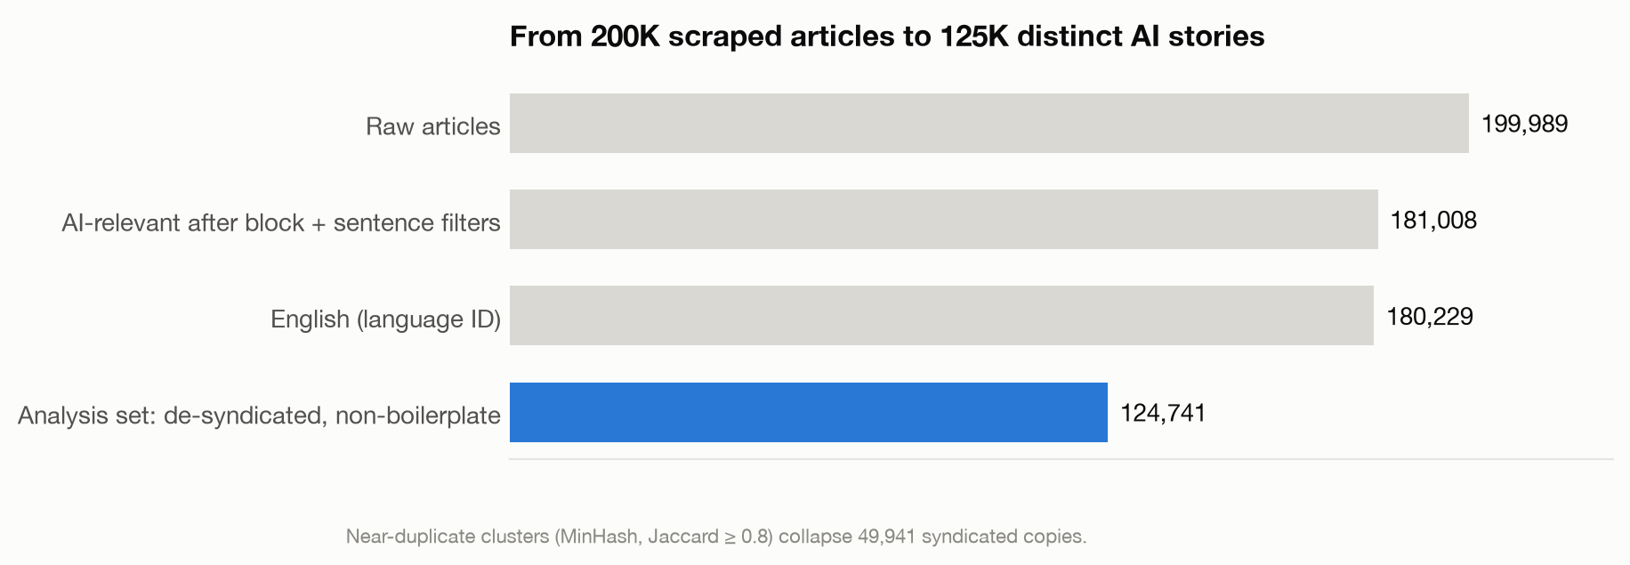
From 200K scraped pages to a de-duplicated analysis corpus
01
02
03
04
05
06
AI filter
De-duplicate
Topics
Entities
Sentiment
Industry
Block and sentence classifiers (DistilRoBERTa, DeepSeek labels) keep AI content
Language ID and MinHash LSH remove 49,941 syndicated copies
BERTopic on 401K blocks, GPU UMAP + HDBSCAN
GLiNER mentions, alias merge and LLM review of the top 15K entities
roberta-large scores 502K entity–context pairs
LLM labels on 15K sampled articles, classifier for the rest
LLM labeling: deepseek-flash, temperature 0, JSON output.
5

Slide 6
Cleaning and filtering: from web crawl to AI content
199,989 crawled articles → 181,008 with AI content → 124,741 distinct stories
0.86
0.96
49.9K
779
block classifier F1
sentence classifier F1
syndicated copies removed
non-English pages removed
DistilRoBERTa on 12,000 DeepSeek-labeled paragraphs (35% AI); threshold 0.58; keeps 1.18M AI paragraphs.
separates article content from boilerplate on 7,302 labeled sentences; rebuilds 732K clean paragraphs.
MinHash LSH on word 5-shingles (Jaccard ≥ 0.8); the earliest copy of each story is kept.
fastText language ID, although the source field labels every page English.
F1 on the validation split of the LLM labels, where the threshold was also chosen (02B, 02D).
6

Slide 7
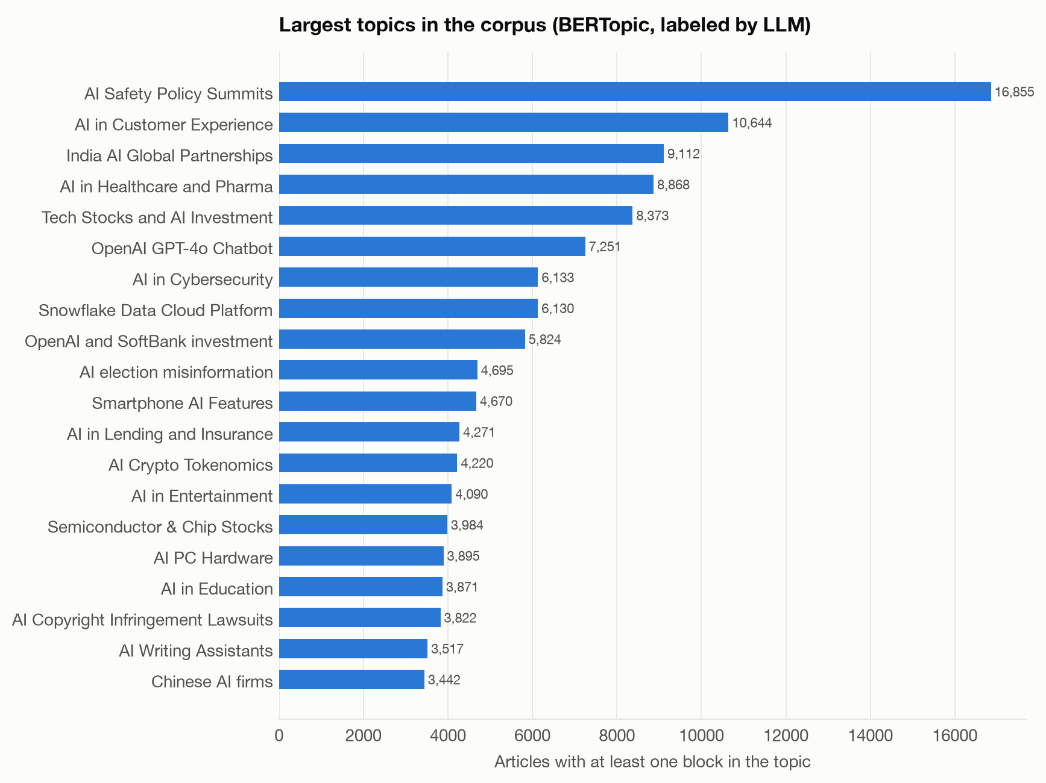
The largest single theme is AI policy; sector themes are smaller but distinct
• 79 topics over 400,662 paragraphs; labels written by the LLM from keywords and sample passages.
• Largest: AI Safety Policy Summits (16,855 articles), AI in Customer Experience (10,644), India AI Global Partnerships (9,112).
• Sector topics such as healthcare, lending, education and entertainment each hold 3–9K articles.
BERTopic with all-mpnet-base-v2 embeddings; an article counts toward every topic it has a paragraph in.
7

Slide 8
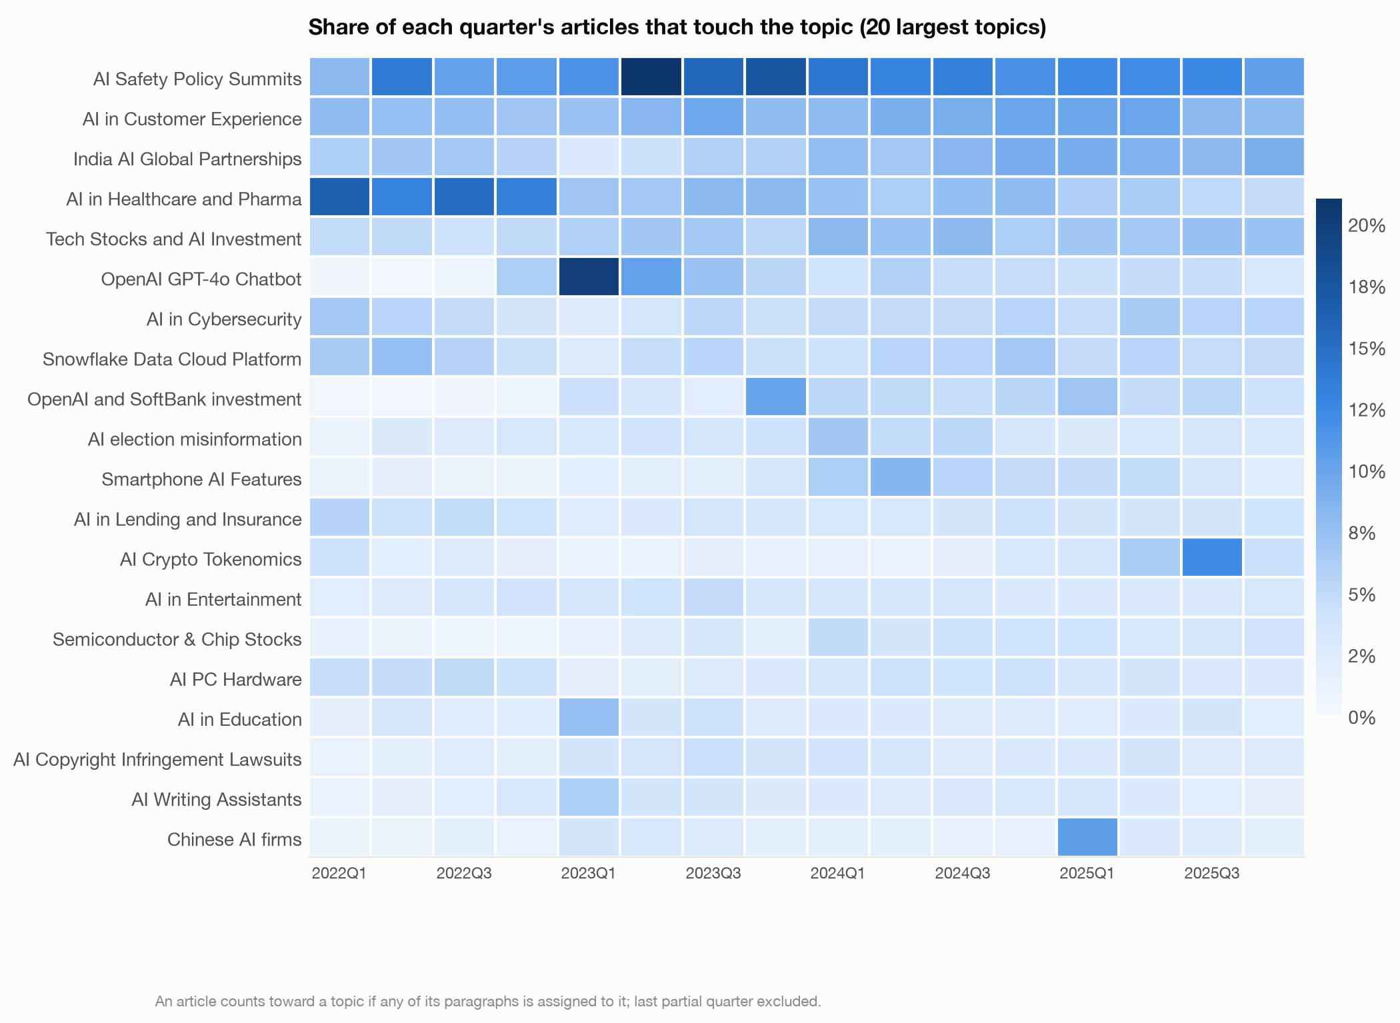
Healthcare led early AI coverage; chatbot and AI-investment topics grew after ChatGPT
• AI in Healthcare and Pharma: -9 pp of articles, 2022 Q1–Q3 vs. the last four full quarters.
• Largest gains: OpenAI and SoftBank investment (+5 pp), OpenAI GPT-4o Chatbot (+4 pp).
• The chatbot topic peaks in 2023 Q1, the quarter after ChatGPT's release.
Share of each quarter's articles with at least one paragraph in the topic.
8

Slide 9
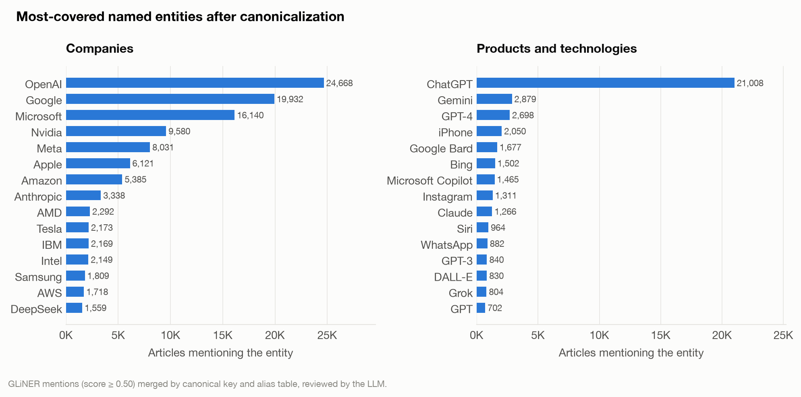
OpenAI, ChatGPT and Google lead entity coverage by a wide margin
• GLiNER (large-v2.1) finds 5.1M mentions; 2,305 canonical entities appear in 30+ articles.
• The LLM reviewed the 15K most-covered candidates and dropped 3,859 vague or broken ones.
• ChatGPT alone merges 21 spelling variants.
Article counts after canonicalization (suffix stripping, alias table, LLM review).
9

Slide 10
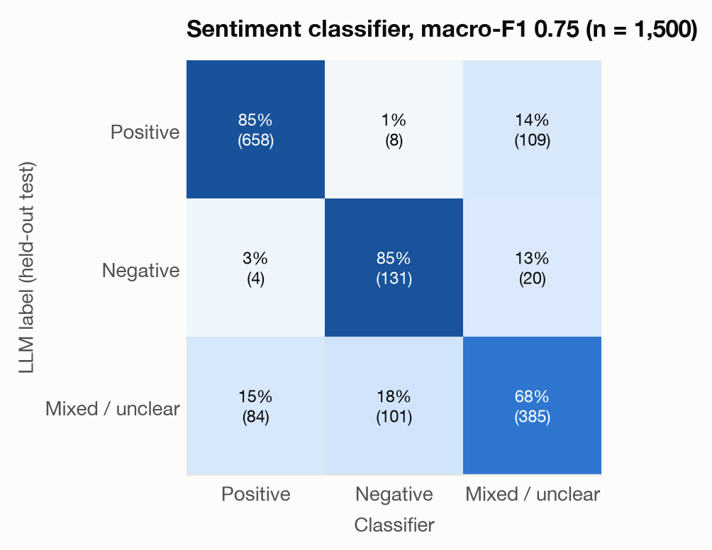
A fine-tuned roberta-large scores AI impact toward each entity in context
• Training data: 8,999 entity–context pairs labeled by DeepSeek (57% positive, 30% mixed, 13% negative).
• Input: target entity, type, title, source, instruction and a 1,400-character window; split by entity, so no entity is in both train and validation.
• Validation macro-F1 0.82; fresh test set 0.75. The model over-predicts negative (precision 0.55).
Classifier trained in 06B; test labels from deepseek-flash on pairs never used in training (06C).
10

Slide 11
How much to trust the labels
All model checks are against held-out LLM labels; there is no human-annotated gold set
0.75
86%
0.65
1.5%
sentiment macro-F1
labeler agreement
median industry F1
topic outliers
on 1,500 fresh entity–context pairs labeled by the LLM, never seen in training.
between deepseek-chat (06A labels) and deepseek-flash on 300 validation items (κ = 0.75).
of the embedding classifier vs. held-out LLM labels (range 0.49–0.84).
after embedding-based outlier reassignment (43% before).
11

Slide 12
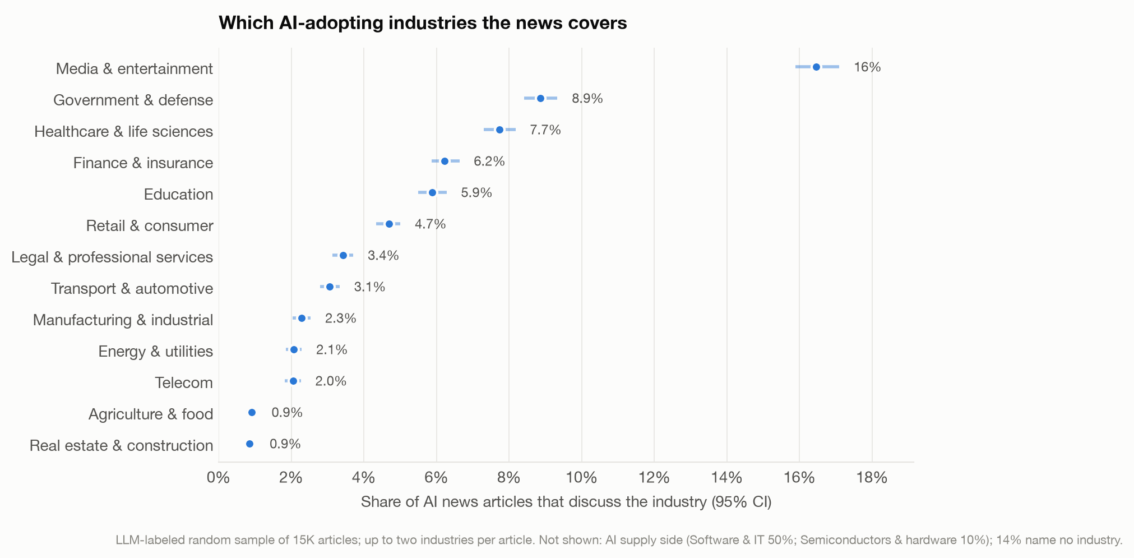
Among adopting sectors, media, government and healthcare get the most AI coverage
• Half of all AI articles (50%) are about software and IT; semiconductors add 10%.
• 14% of articles discuss AI without naming any sector.
• Excluding press releases moves no sector's share by more than 0.9 points.
LLM labels on a random sample of 15,001 articles; 95% bootstrap intervals.
12

Slide 13
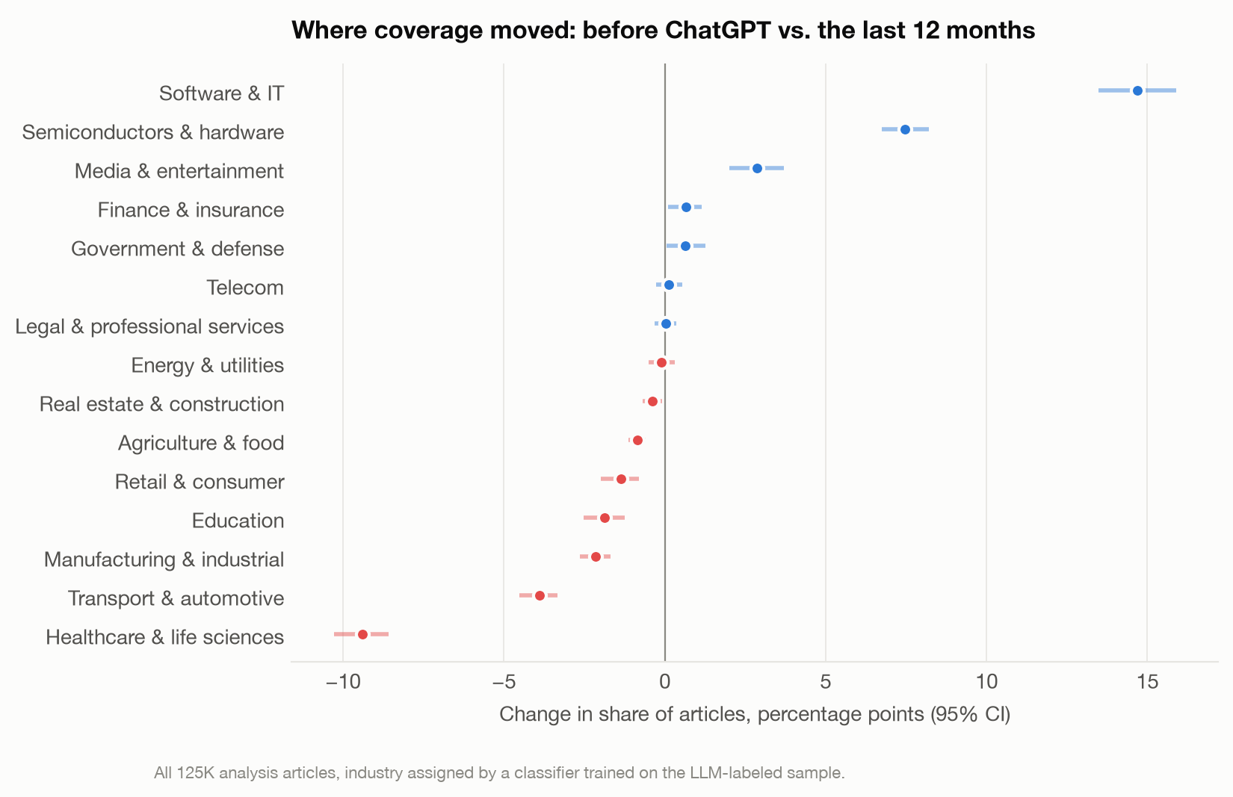
After ChatGPT, coverage moved to the AI supply side and away from healthcare
• Software & IT +15 pp and semiconductors +7.5 pp of all articles.
• Healthcare fell from 15% to 5%; transport and manufacturing also shrank.
• Shares, not volumes: the corpus grew several-fold after late 2022.
All analysis articles; industry from the embedding classifier. Pre-ChatGPT = before 2022-11-30.
13

Slide 14
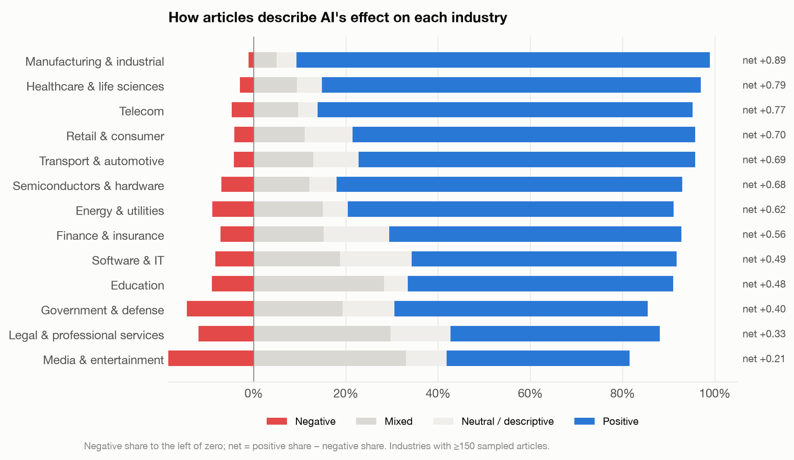
AI is framed most positively for manufacturing and healthcare, least for legal services and media
• Media & entertainment: 19% of articles negative, the highest of any sector; manufacturing: 1%.
• The entity-sentiment classifier (06C), a different model and unit, ranks industries the same way (Spearman ρ = 0.96).
• Neutral means the article reports facts without a stated effect.
Article framing from LLM labels; industries with at least 150 sampled articles.
14

Slide 15
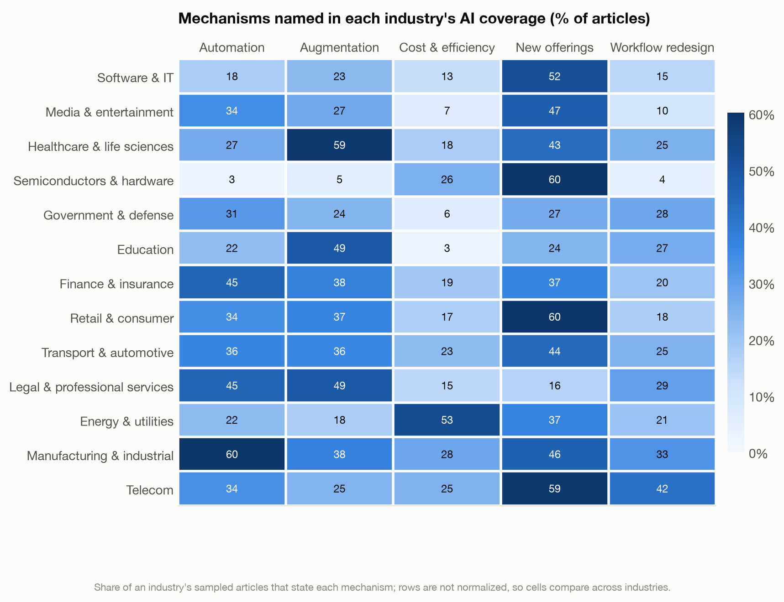
Automation outweighs augmentation in manufacturing, telecom and finance; augmentation leads in healthcare and education
• Across sector articles, new offerings are named most (46%), then augmentation (29%) and automation (25%).
• Automation exceeds augmentation by more than 5 points in 5 adopting sectors, the reverse holds in 2.
• Energy is the cost story: 53% cite cost or efficiency.
Share of each industry's sampled articles that state the mechanism; articles can name several.
15

Slide 16
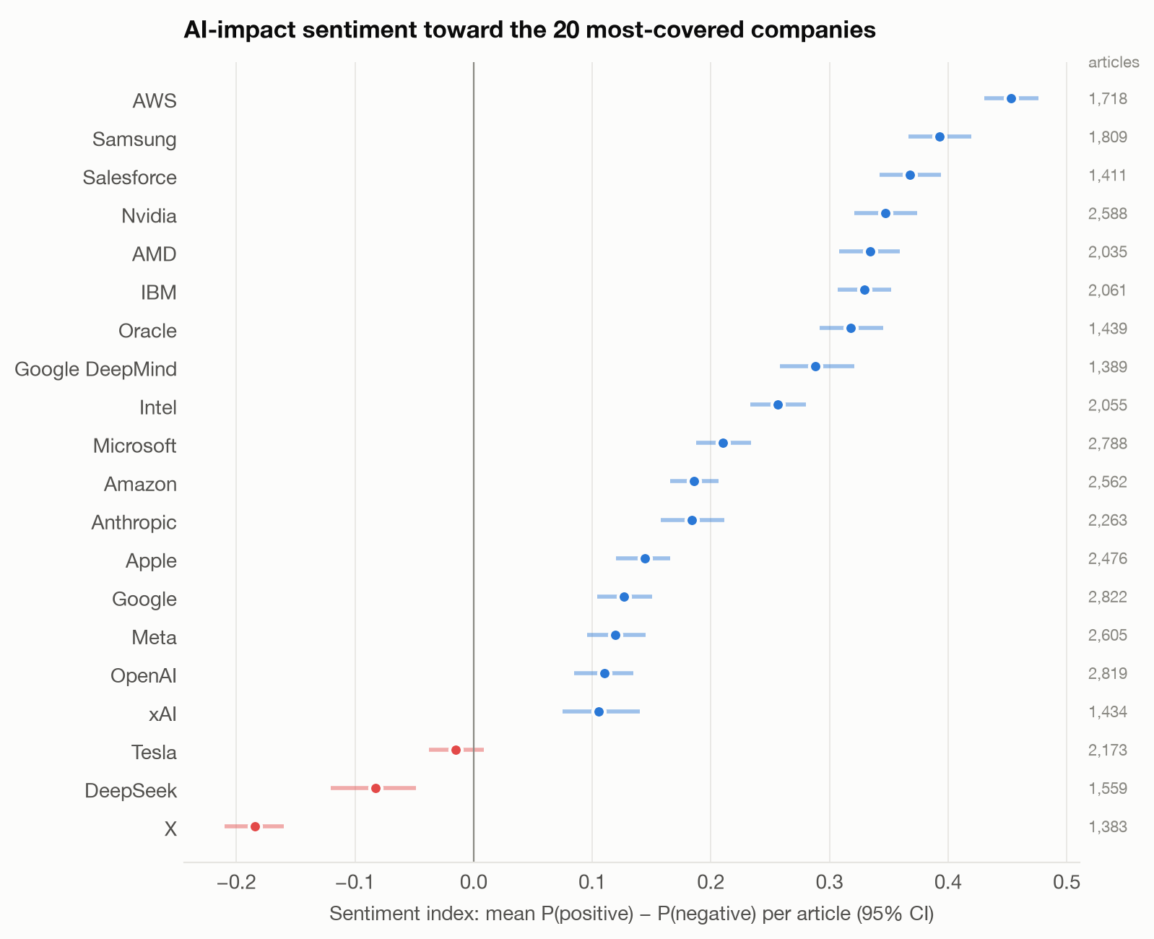
Infrastructure vendors get the warmest coverage; frontier labs and controversy-linked firms the coolest
• Highest: AWS, Samsung, Salesforce (index 0.45 to 0.37).
• OpenAI 0.11, Google 0.13: the most-covered firms sit near the bottom.
• Below zero: Tesla, DeepSeek, X.
Sentiment index = mean P(positive) − P(negative) per article; up to 3,000 random contexts per entity.
16

Slide 17
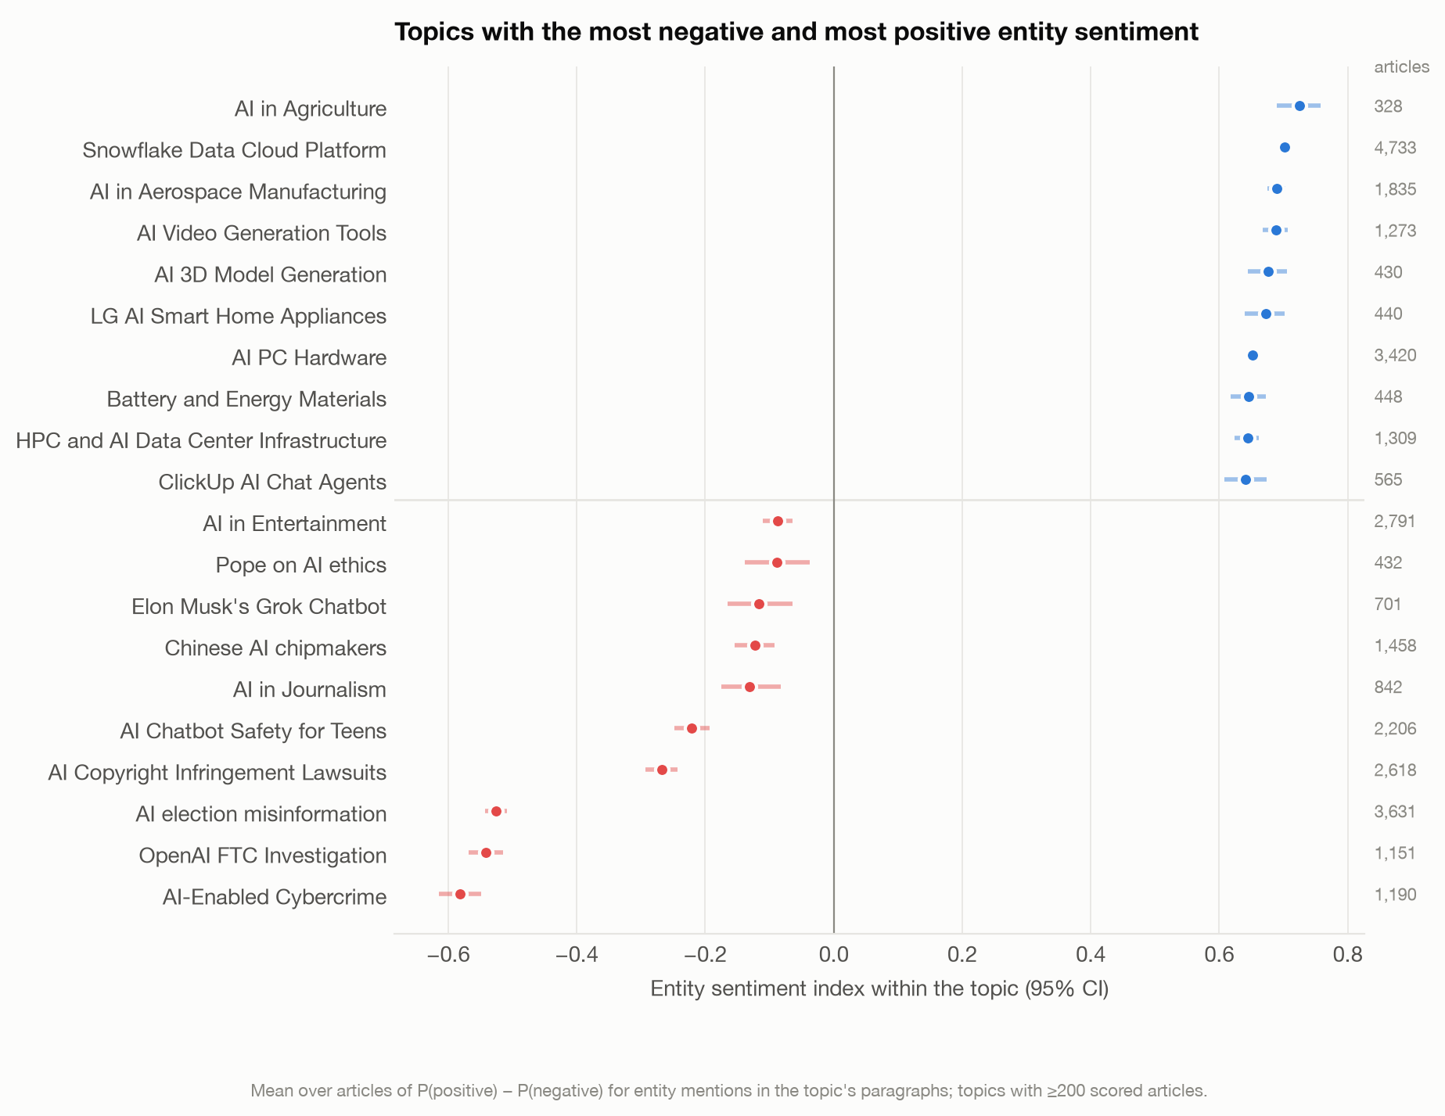
Security, misinformation and legal topics carry the most negative sentiment
• Most negative: AI-Enabled Cybercrime (-0.58), OpenAI FTC Investigation (-0.54), AI election misinformation (-0.53).
• Most positive: AI in Agriculture (0.73), Snowflake Data Cloud Platform, AI in Aerospace Manufacturing.
• 77 coherent topics with at least 200 scored articles.
Entity-level sentiment of mentions in each topic's paragraphs, averaged per article; 95% bootstrap intervals.
17

Slide 18
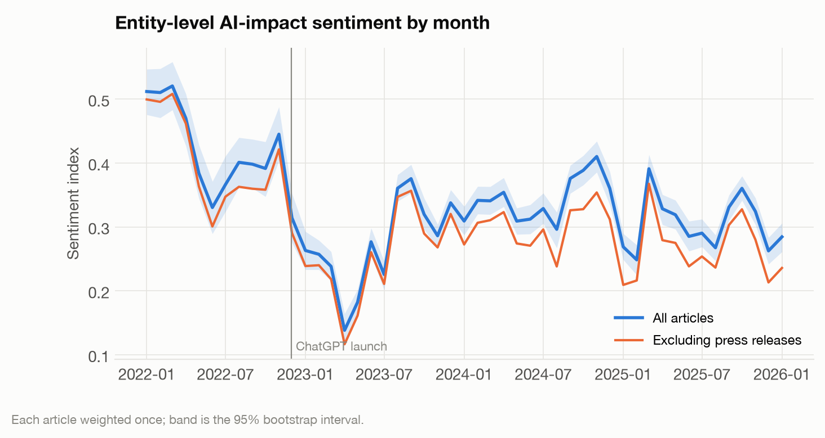
Entity sentiment dropped after ChatGPT's launch and has stayed below its 2022 level
• Article-weighted index: 0.41 in 2022, 0.27 in 2023, 0.31 in 2025.
• Press releases run slightly warmer, but excluding them does not change the pattern.
• Lowest month: 2023-04 (0.14).
Monthly mean over articles of entity-level sentiment; 95% bootstrap band.
18

Slide 19
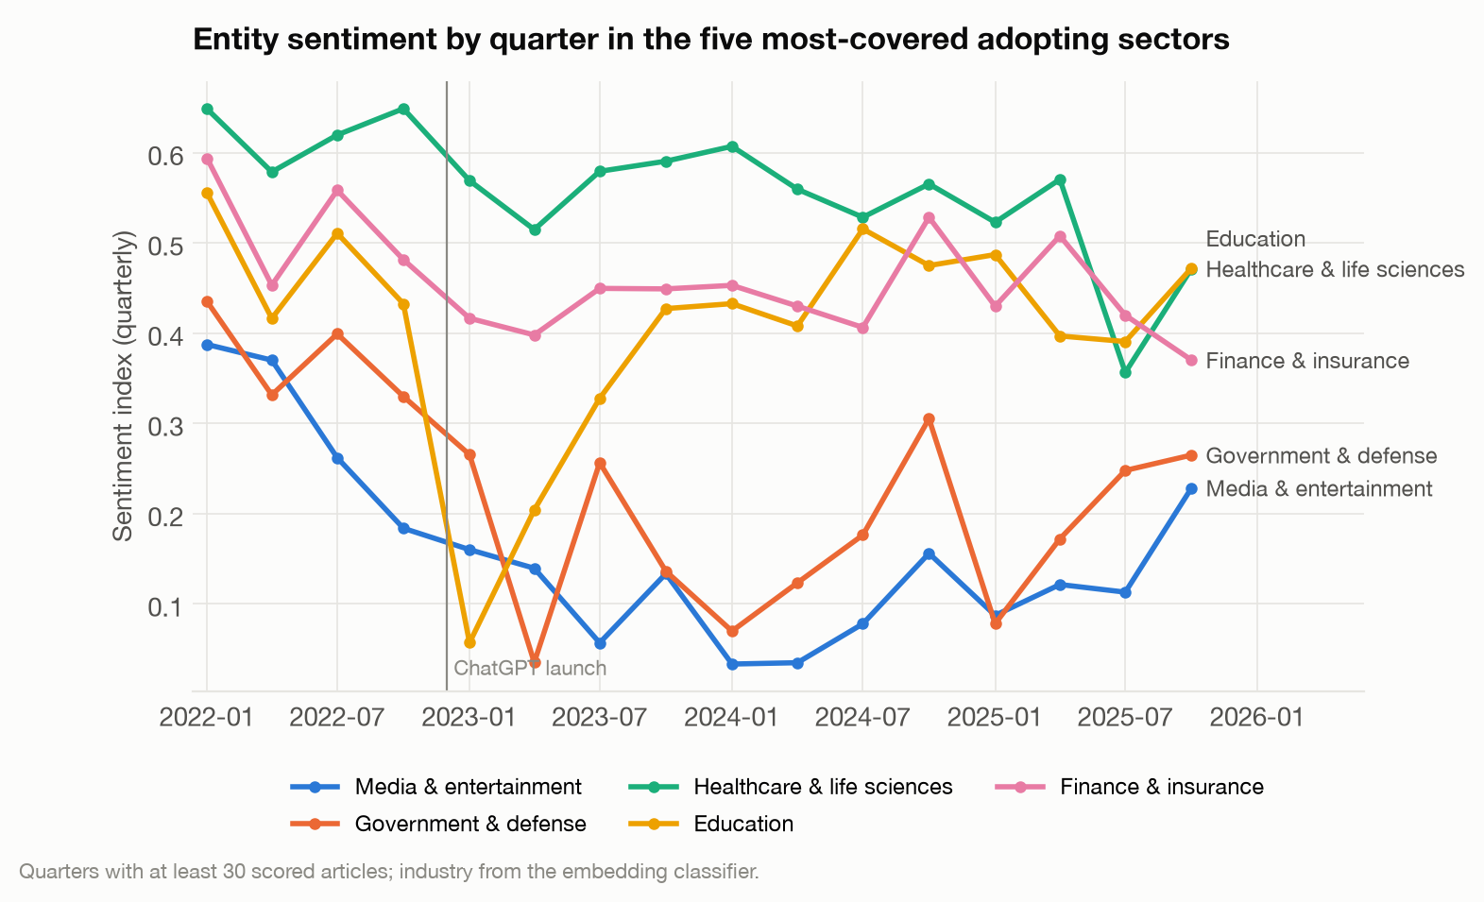
Education sentiment collapsed after ChatGPT and recovered; media sentiment slid until 2024
• Education fell from 0.43 to 0.06 in 2023 Q1, then recovered to about 0.44.
• Media slid from 0.39 in 2022 Q1 to 0.03 at its low and ends at 0.23.
• Healthcare stays the most positive sector through most of the period.
Quarterly article-level index; industry from the embedding classifier; quarters with ≥ 30 scored articles.
19

Slide 20
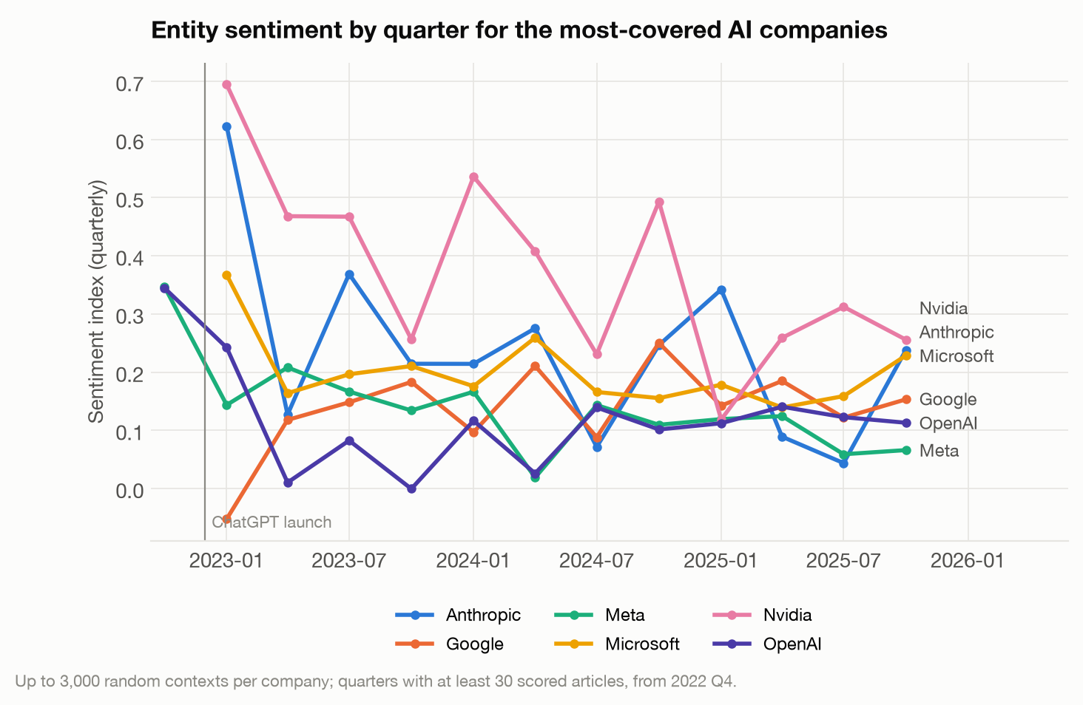
Among AI companies, Nvidia stays the most positive; OpenAI and Meta the least
• Average index since 2023: Nvidia 0.37, Anthropic 0.24, Microsoft 0.20, Google 0.14, Meta 0.12, OpenAI 0.10.
• Single quarters move by ±0.1 or more; compare averages rather than individual points.
Up to 3,000 random contexts per company; quarters with ≥ 30 scored articles.
20

Slide 21
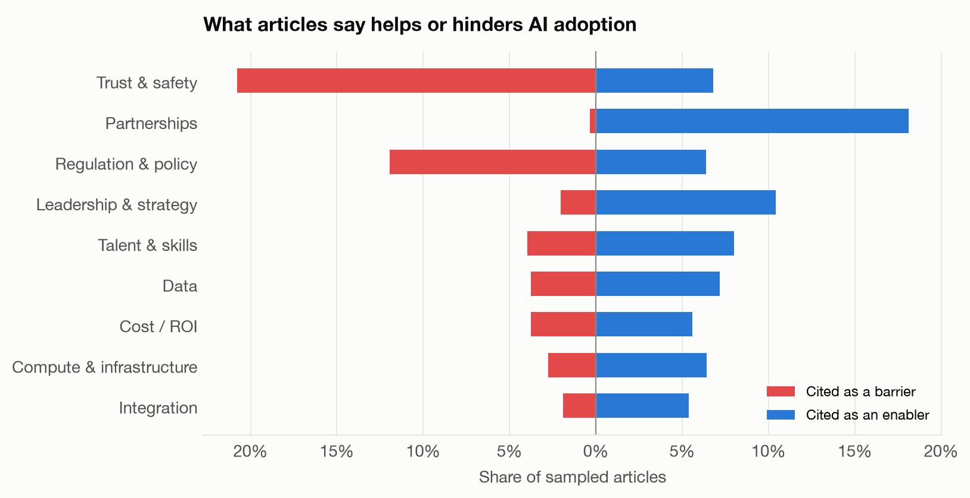
Trust & safety and regulation & policy are the most-cited barriers; partnerships the most-cited enabler
• Trust & safety is named as a barrier in 21% of articles, regulation & policy in 12%.
• Partnerships appear almost only as enablers (18%).
• Shares are of all 15,001 sampled articles; up to four factors per article.
LLM labels on the article sample; up to four factors per article.
21

Slide 22
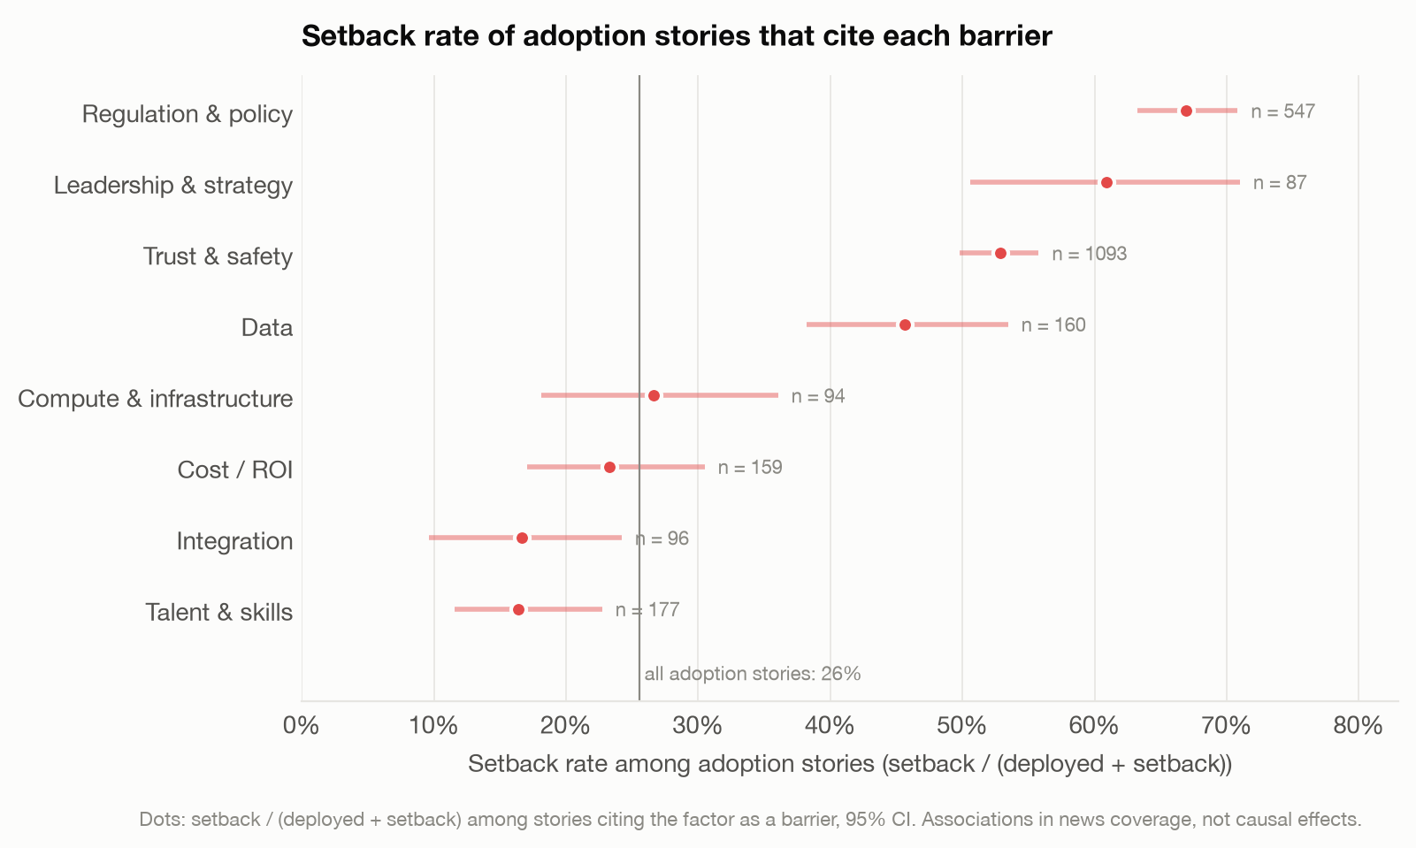
Barriers of regulation & policy, leadership & strategy, trust & safety and data coincide with setbacks; integration and talent & skills barriers do not
• Among adoption stories, 26% report a setback overall.
• When the barrier is regulation & policy: 67%; leadership & strategy: 61%.
• Integration and talent & skills barriers sit below the baseline: they are reported alongside deployments that go ahead.
Setback rate = setback / (deployed + setback). Associations in coverage, not causal effects.
22

Slide 23
Takeaways and limits
What the coverage shows
What it cannot show
• AI news is mostly about the AI industry itself; among adopters, media, government and healthcare lead.
• Framing is positive almost everywhere; media and legal services are the most contested sectors, followed by government.
• Setbacks coincide with regulation, leadership and trust barriers far more often than with skills or integration barriers.
• In line with Goldman Sachs and Moravec: legal coverage is automation-heavy (45% cite automation), while construction and agriculture are the least-covered sectors (under 1% of articles each).
• News reflects what is reported and promoted, not realized productivity or job effects.
• Labels come from one LLM family; model scores are agreement with it, not human judgment.
• Industry shares outside the labeled sample depend on a classifier (F1 0.49–0.84).
• The upstream AI filter keeps 91% of documents, so some off-topic text remains.
23

