Slide 1

Low-Power Redundant-Transition-Free TSPC Dual-Edge-Triggering Flip-Flop Using Single-Transistor-Clocked Buffer
Bharat Dhulgond IMT2023504 Vinay P Ramesh IMT2023541 R.Vaikunth IMT2023566 Surya Sumeet Singh IMT2023590 Pravin Kumar Dot V IMT2023595 Shudharshan A IMT2023602 Harshit Krishna IMT2023613

Slide 2
PROBLEM STATEMENT : Eliminating Redundant Transitions
Flip flops fail to make use of both clock edges.
Dual edge triggered (DET) flip flops double the throughput.
Same throughput with half clock frequency => double power efficiency.
Existing DET designs have redundant transitions in intermediate nodes, even when the input does not change => unnecessary wastage of power.
Proposed DET flip flop design eliminates such redundancies in transitions making it a power efficient dual edge triggered flip flop.

Slide 3
METHODOLOGY
The transistor level schematics of three different flip flops were implemented in Cadence Virtuoso. They are :
Floating Node C element DET (FNC_DET)
Fully Static True-Single-Phase-Clocked (FS_TSPC_DET)
Proposed Single Transistor Clocked DET (STC_DET)
Transistor sizes used are as given in the paper
PMOS: 600nm
NMOS: 300nm
Simulation and transient analysis were done. Waveforms and results were obtained for all the three flip flops.
Setup time was roughly estimated using the plots.

Slide 4
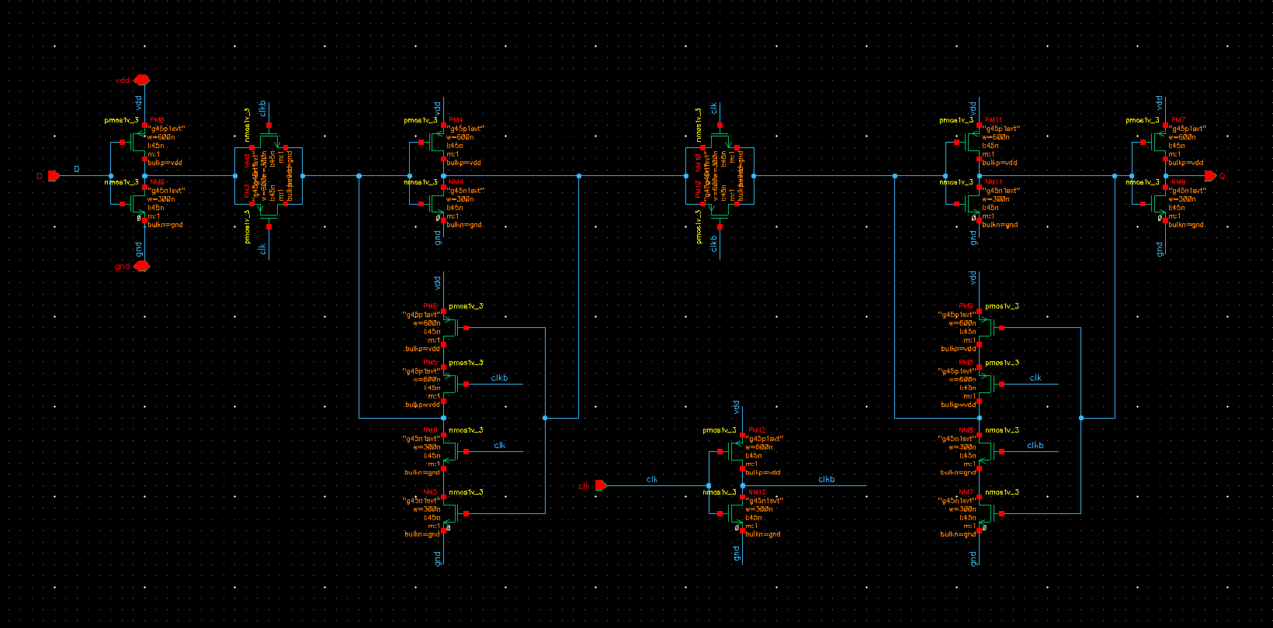
TGFF

Slide 5
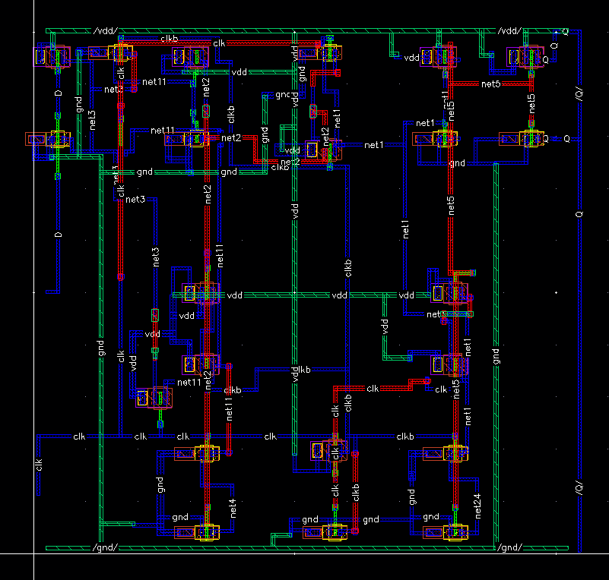
TGFF

Slide 6
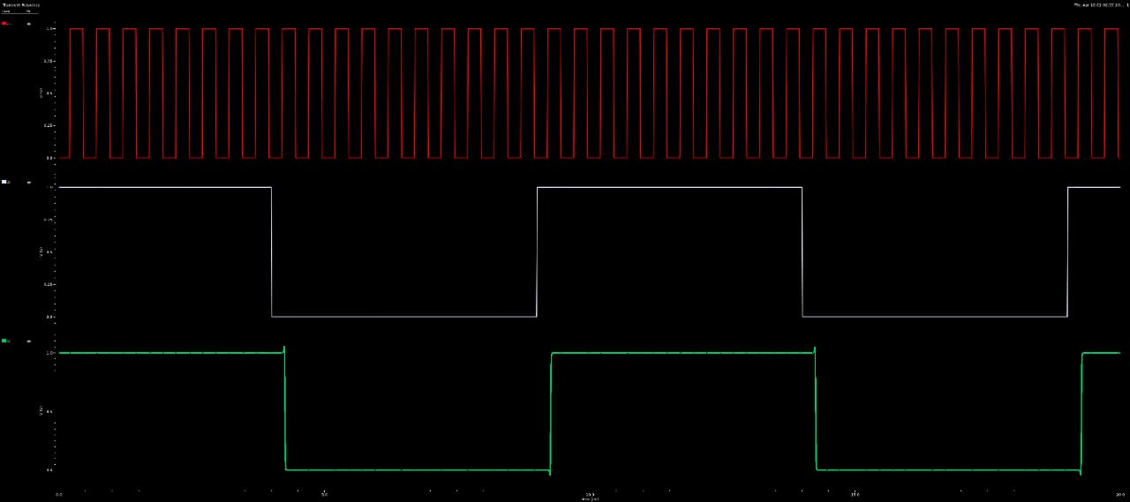
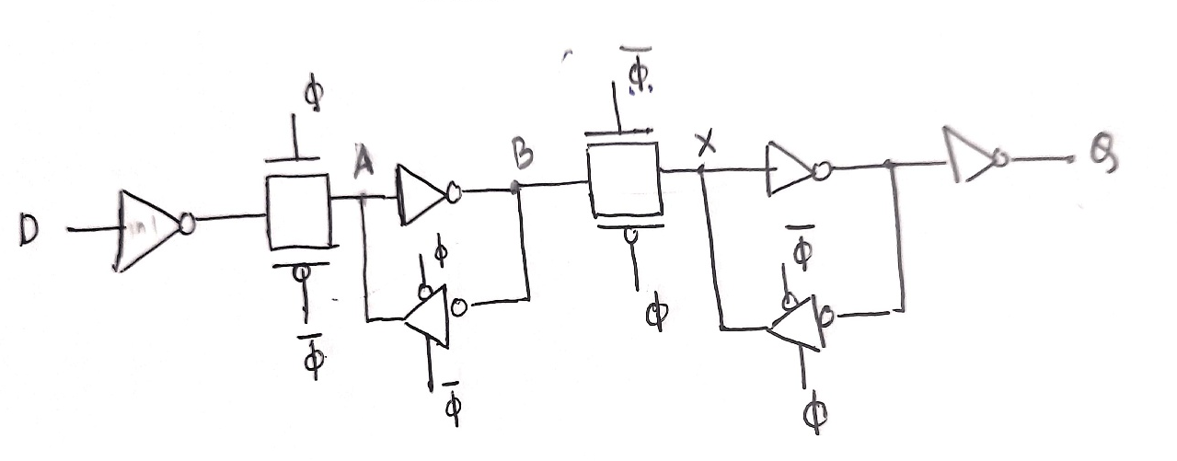
TGFF

Slide 7
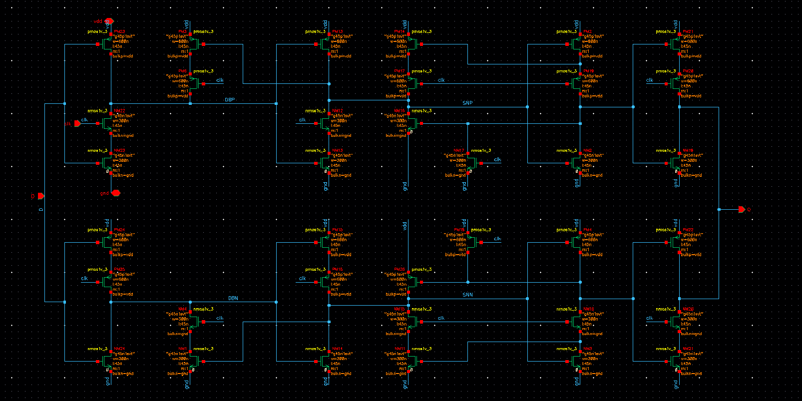
TSPC_DET

Slide 8
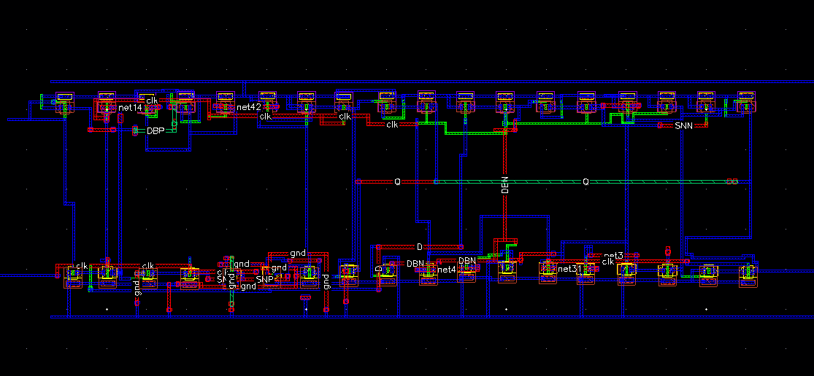
TSPC_DET

Slide 9
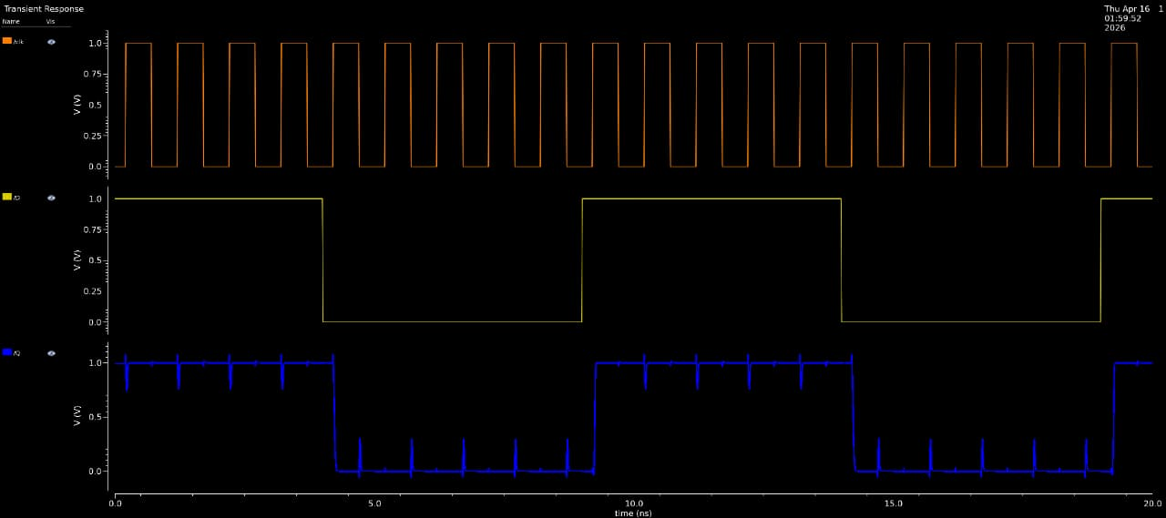
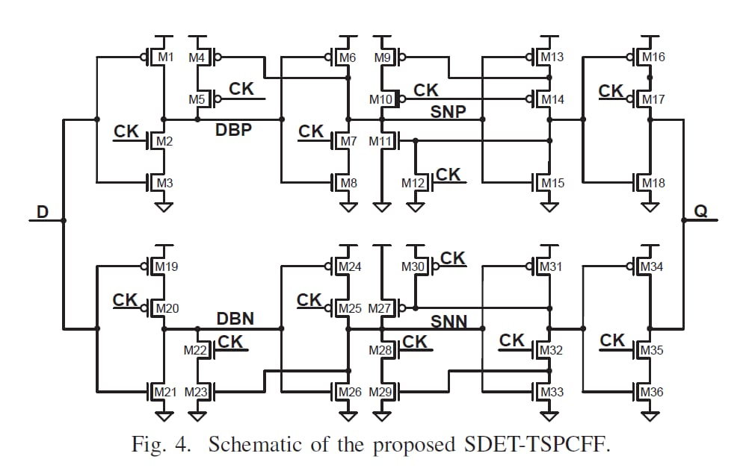
TSPC_DET

Slide 10
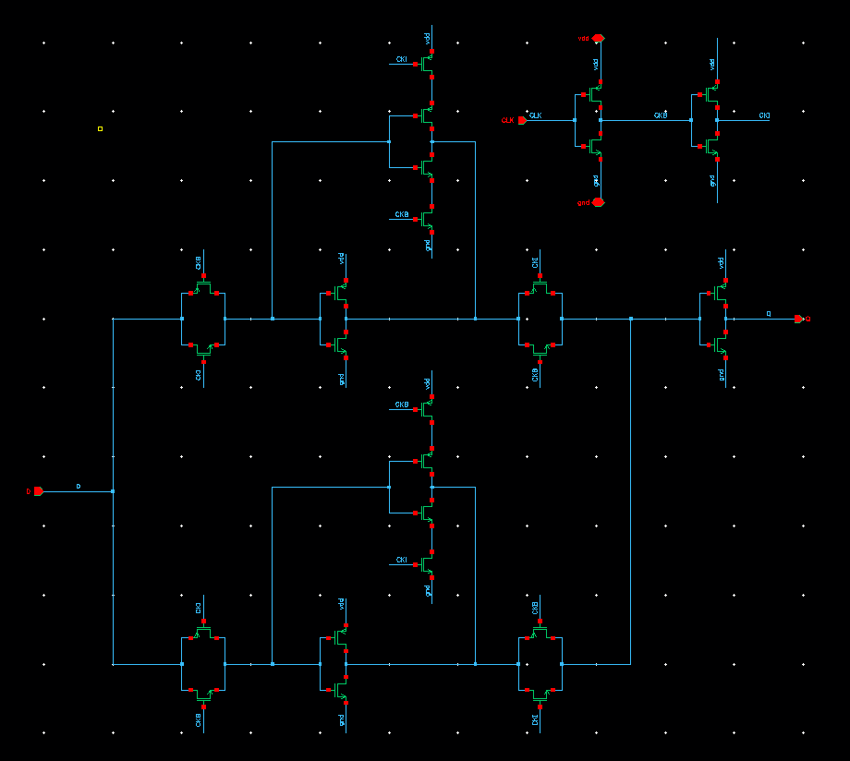
S_DET

Slide 11
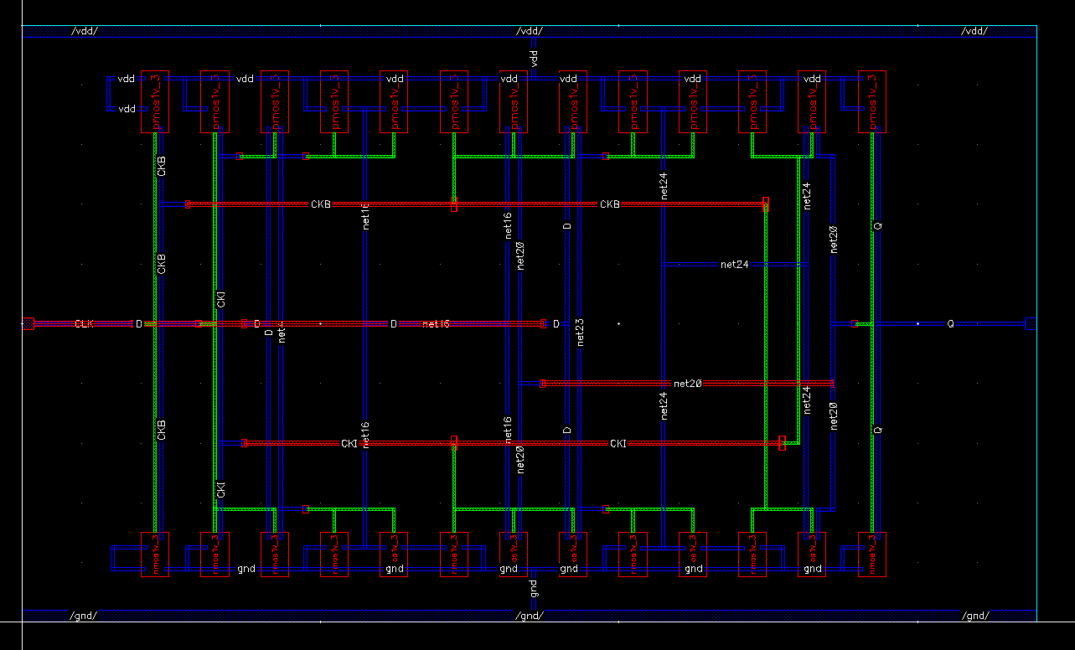
S_DET

Slide 12
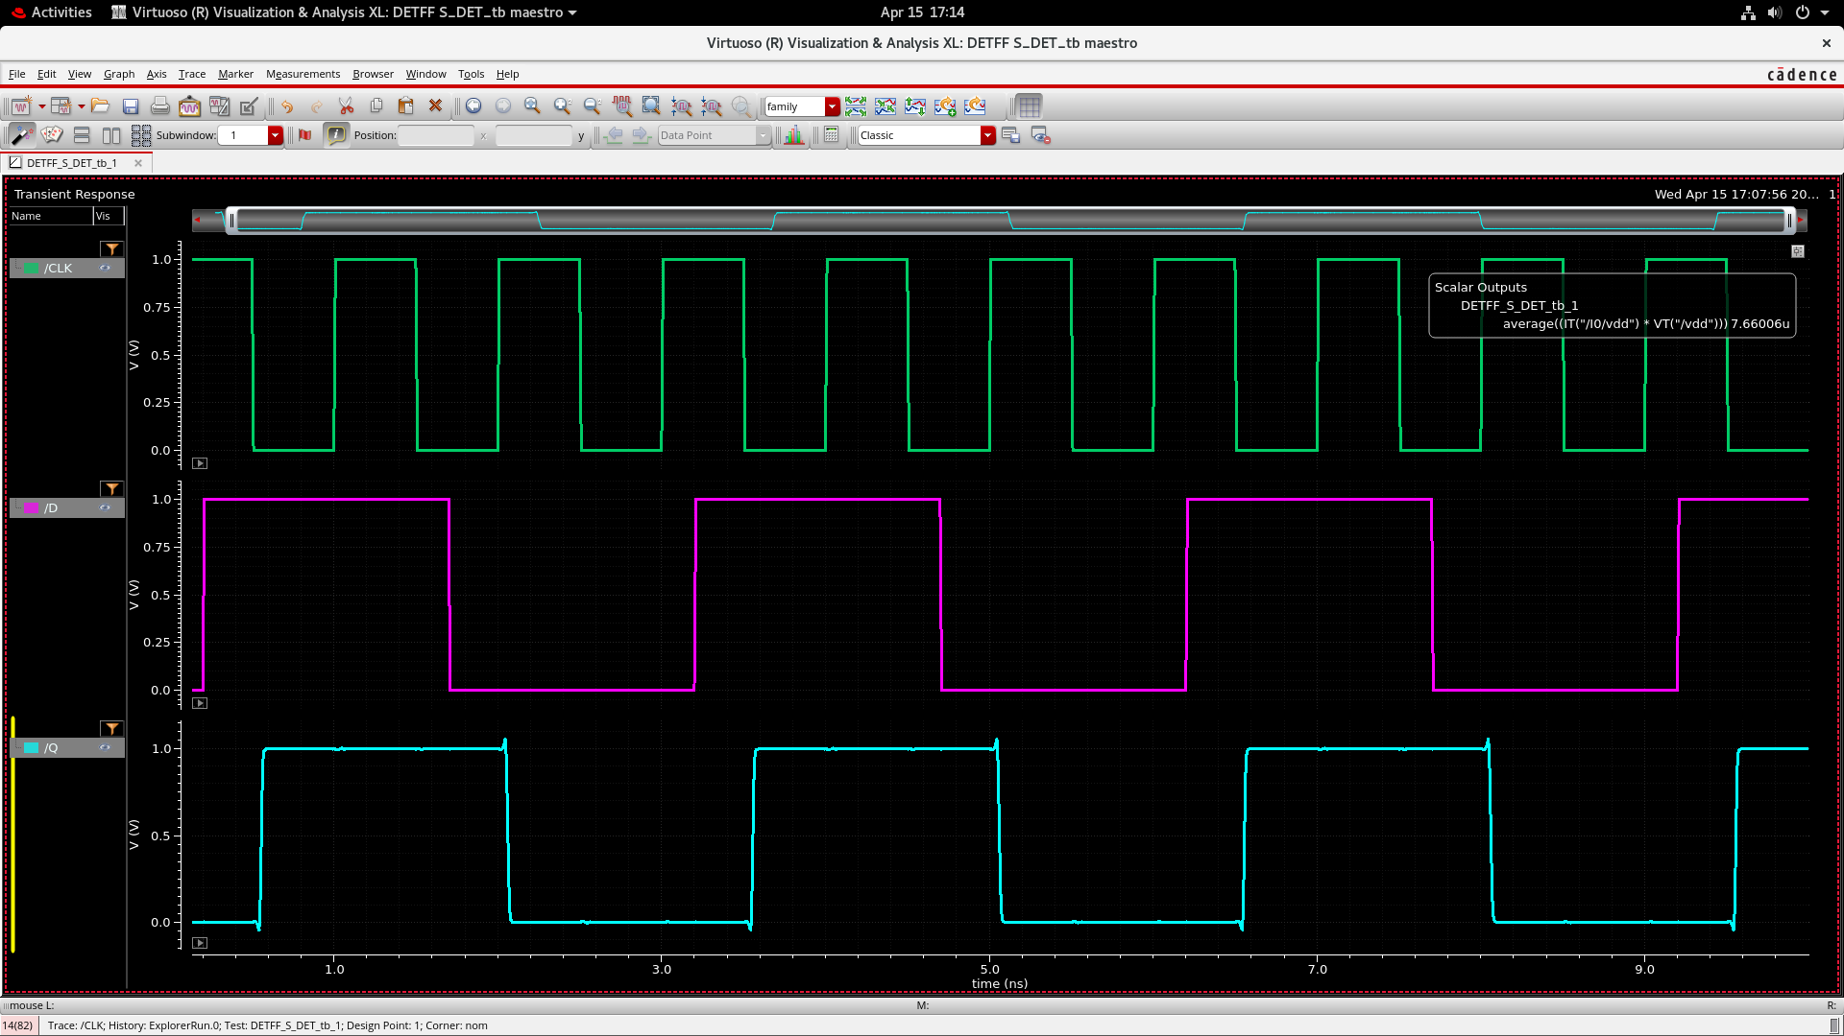
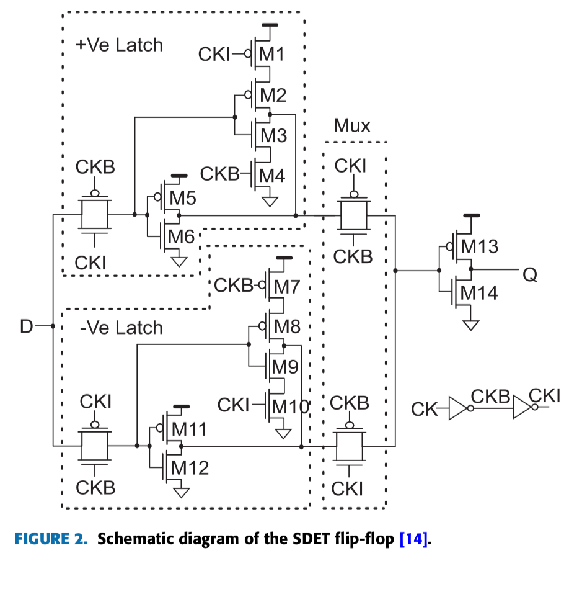

Slide 13
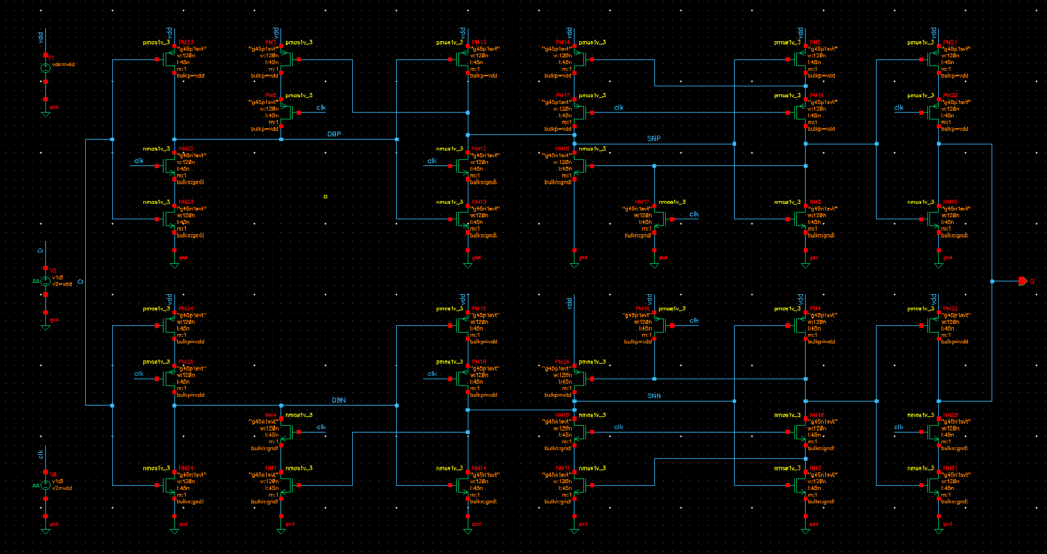
FS_TSPC

Slide 14
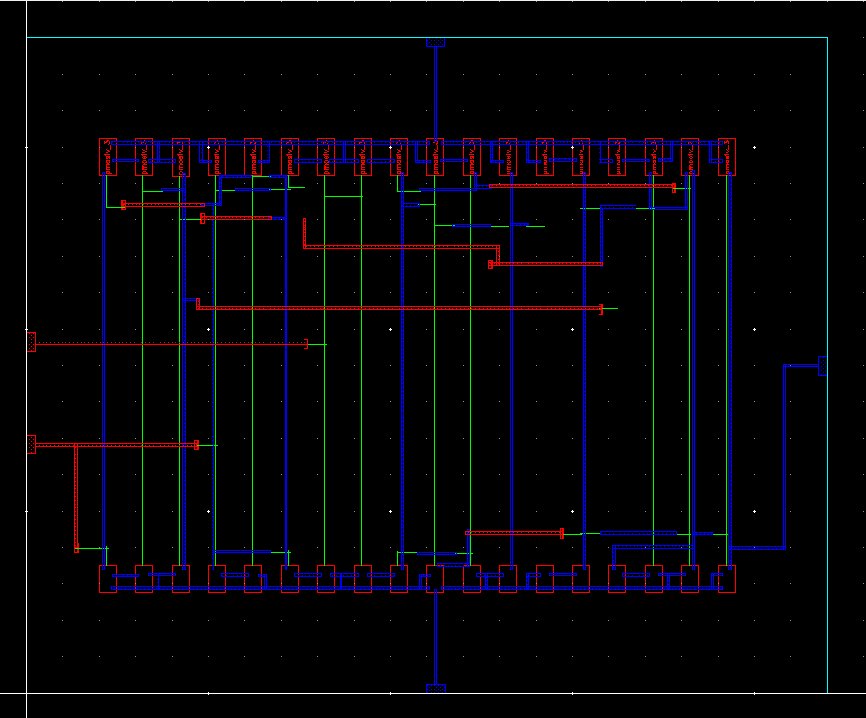
FS_TSPC

Slide 15
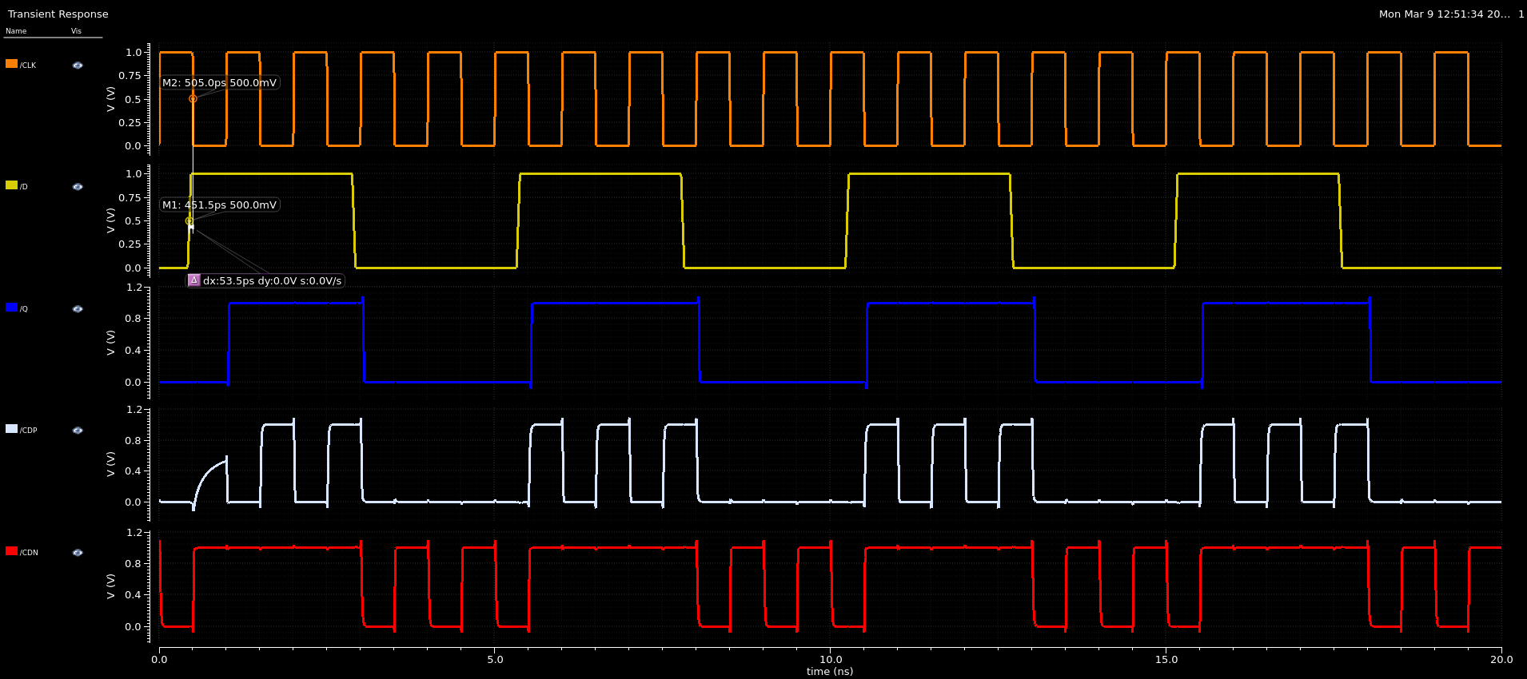
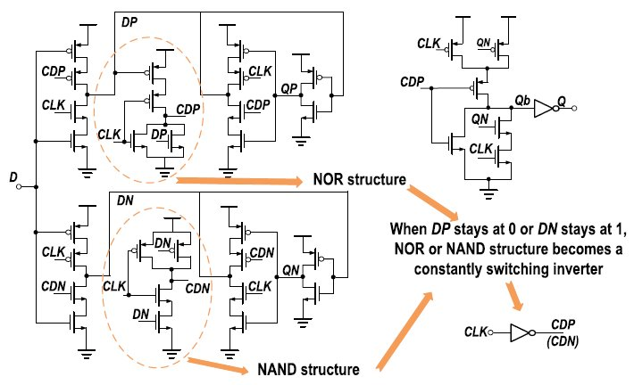
FS-TSPC_DET

Slide 16
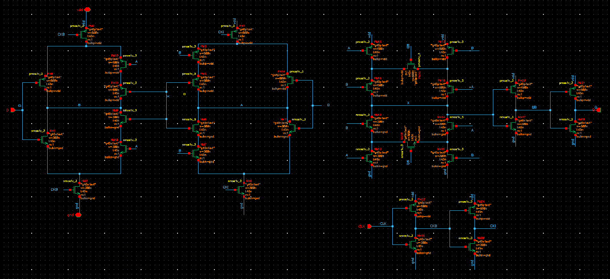
FN_C_DET

Slide 17
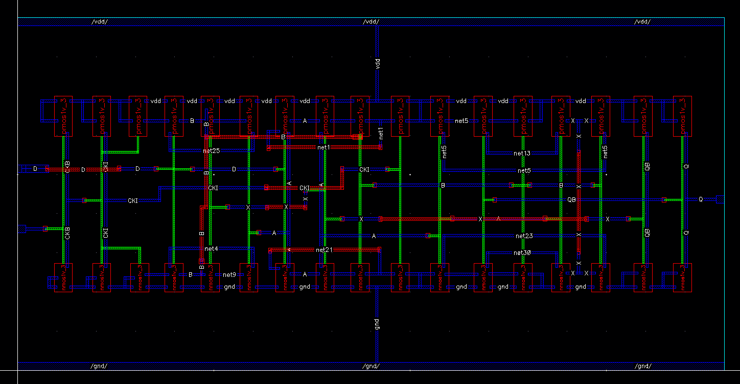
FN_C DET

Slide 18
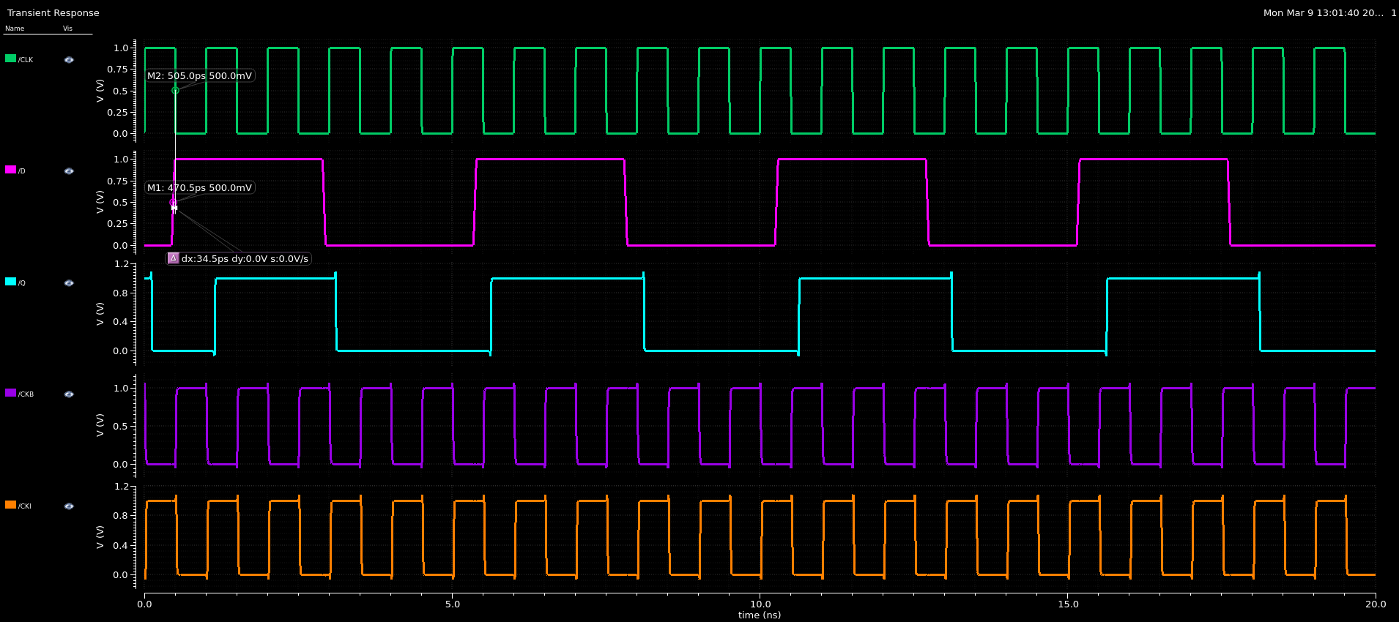
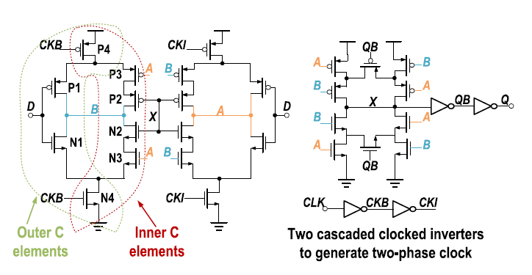
FN_C-DET

Slide 19
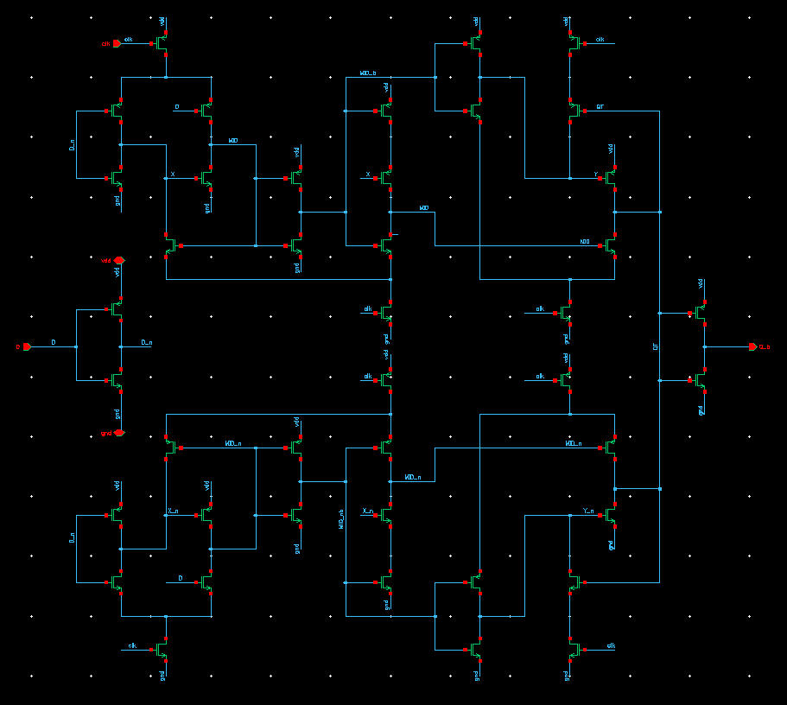
PROPOSED STC

Slide 20
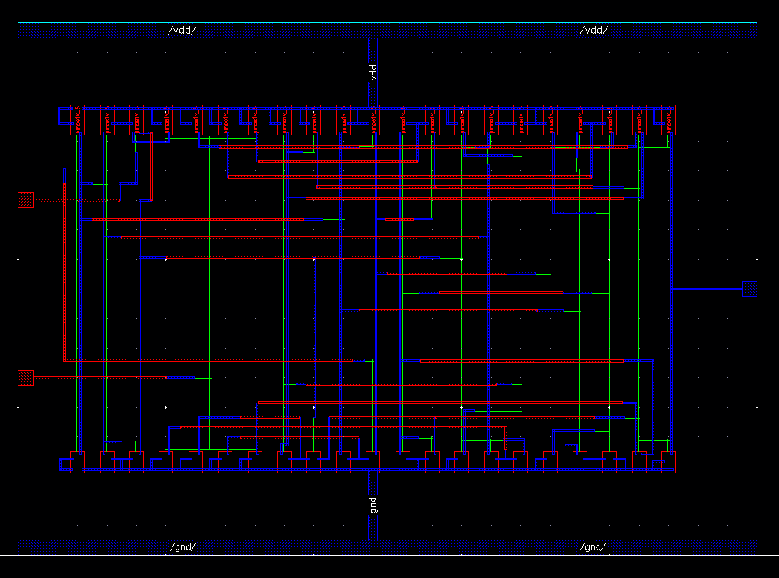
Proposed STC

Slide 21
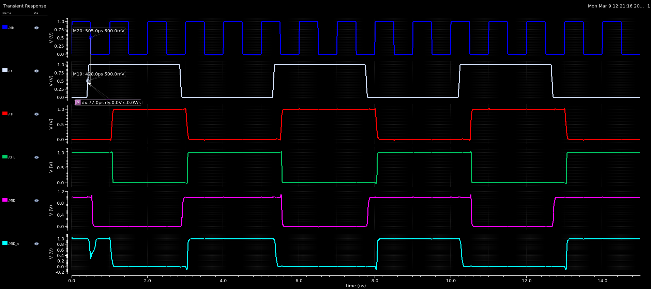
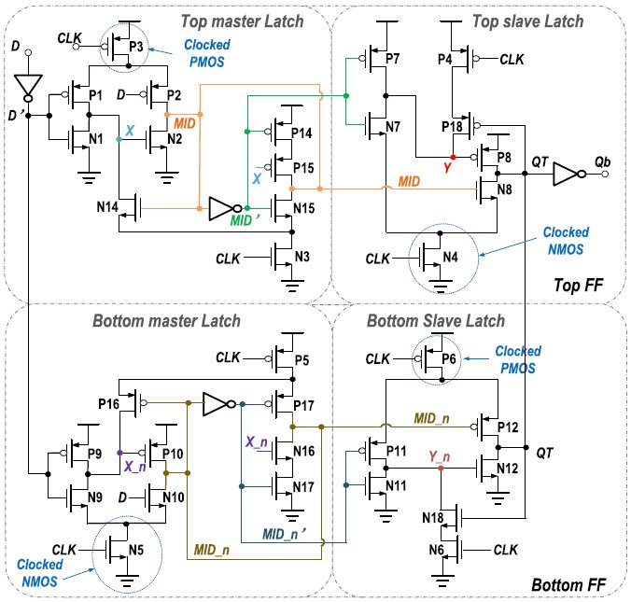
Proposed STC

Slide 22
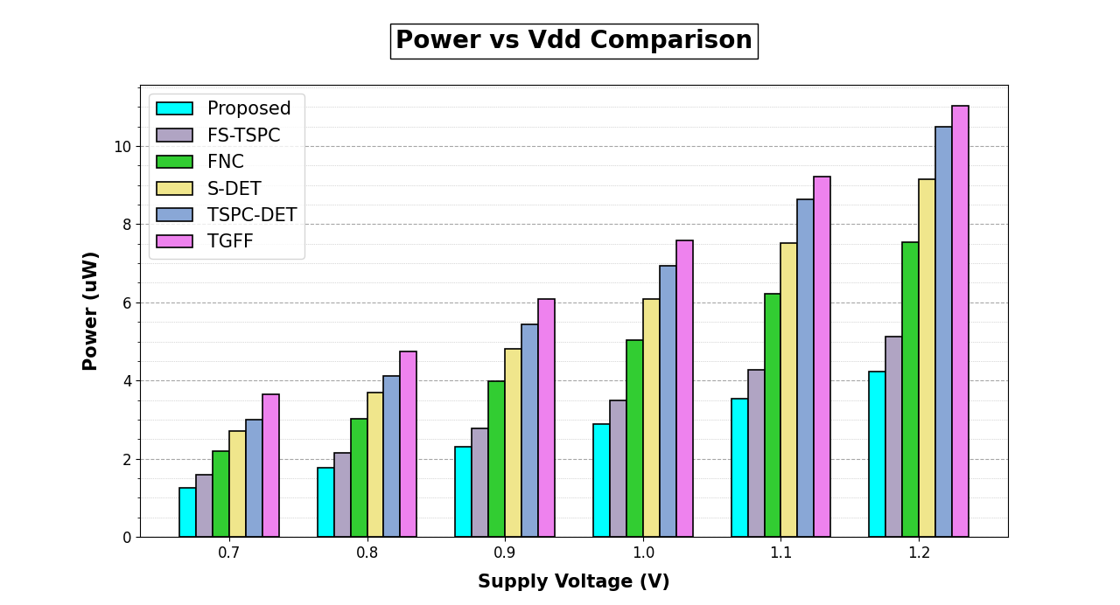

Slide 23
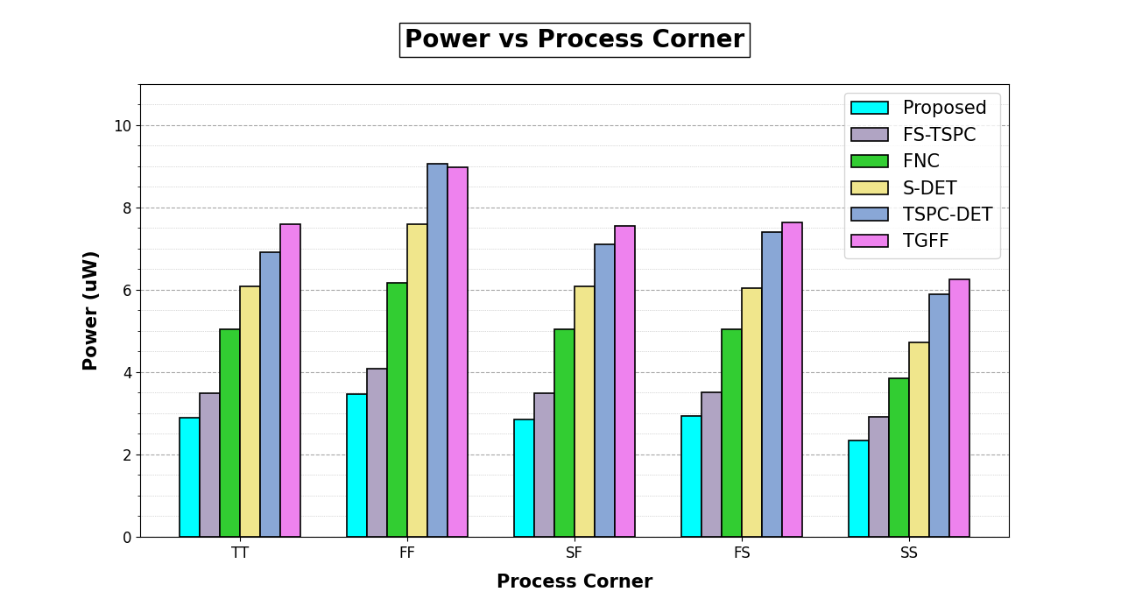

Slide 24
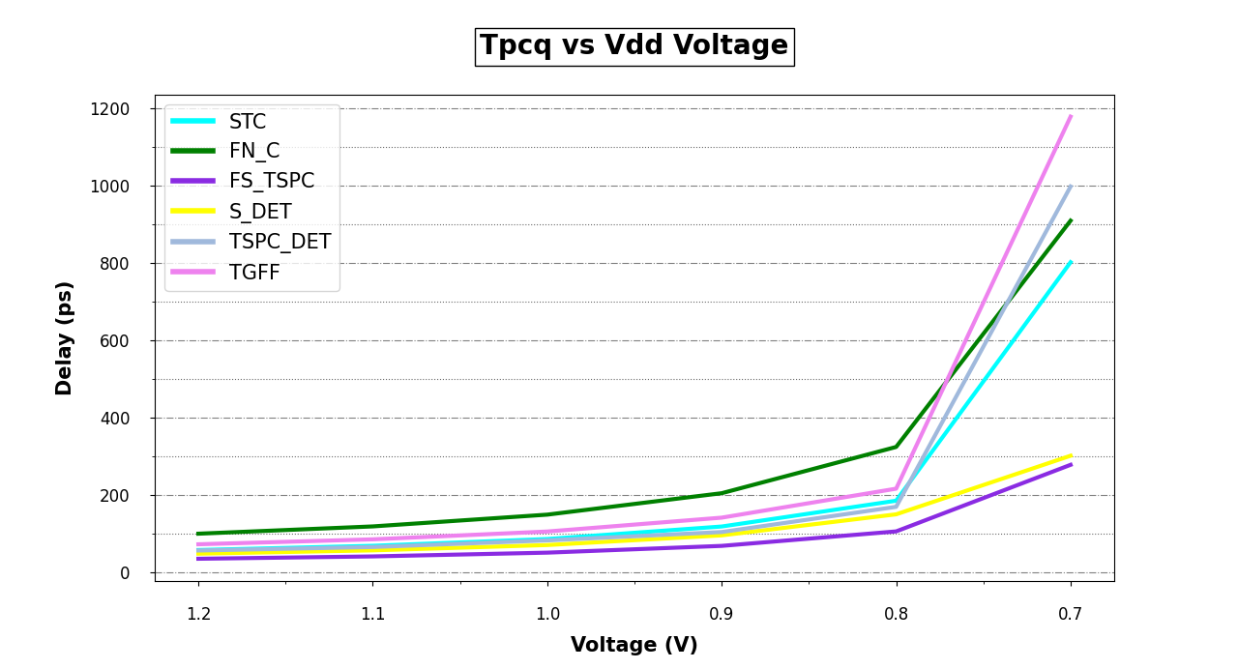

Slide 25
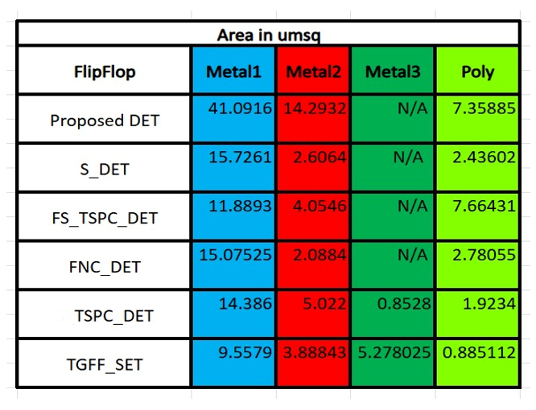

Slide 26
