Slide 1
Evaluating the Performance of Hyper-Heuristics
Ruitao Feng
Supervisor: Pietro Oliveto
Notes:
Would you like a quick introduction or a detailed one?
Okay, my project is called Evaluating the Performance of Hyper-Heuristics

Slide 2
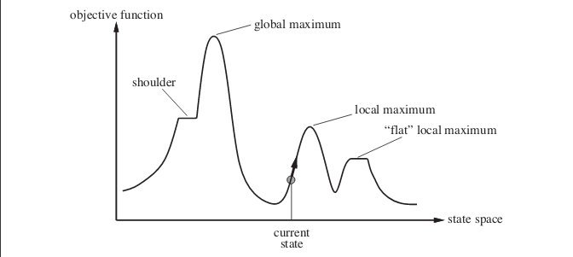
What are
Hyper-Heuristics?
High-level approaches to generate heuristics for a given problem
Could be classified into two types:
Generation Hyper-heuristics
Selection Hyper-heuristics
Notes:
They are Heuristics to generate metaheuristics.
The heuristics are different than exact algorithm in solving optimisation problem. They cannot guarantee to find the global optima but a probably good result within tractable runtime. Metaheuristics like evolutionary algorithm have already improved the efficiency of solving real world problems.
There are two types: selection or generation hyper-heuristics:
# generation hyper-heuristic: Generate new heuristic algorithm from the component of existing one.

Slide 3
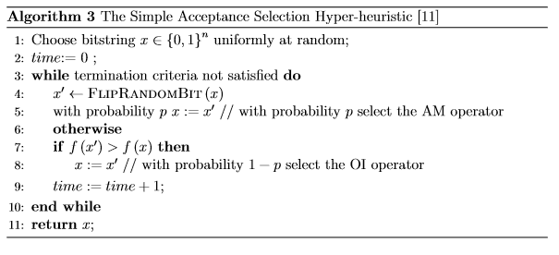
Selection Hyper-Heuristic for MultiModal Optimisation
Has been proven to escape local optima efficiently for toy benchmark like Cliff_{d}.
Requirement: verify the performance for a natural combinatorial optimisation problem.
Notes:
My project will focus on selection hyper-heuristic (for MultiModal Optimisation). selection hyper-heuristic: iteratively choose from a set of heuristics at the different stage of optimisation to form a new heuristic algorithm.
The algorithm will flip one bit in a bitstring randomly, and apply the AllMove(AM) operator with probability p or OnlyImprovement(OI) operator with probability 1−p.
The OnlyImprovement operator can only accept the mutation that improves in the fitness and AllMove operator will accept all kinds of mutations.
Has been proven to escape local optima efficiently for toy benchmark like Cliff_{d} when p=1/n or 2/n.

Slide 4
Benchmark problem: Max-Sat
Max-SAT is a generalisation of Boolean SATisfiability Problem (SAT)
Given a set of clauses, find the assignment for each variable that maximize the number of satisfied clauses.
SAT problem is the first to be proven as NP-complete, which means any NP problem could be reduced to SAT problem.
Examples:
(¬x₁ ∨ x₂ ) ∧ (¬x₁ ∨ x₃) ∧(¬ x₁ ∨ x₂ ∨ x₄) ∧ x₁ ∧ x₃
All problem instances tested in our project comes from SATLIB.
Notes:
So here we will use Max-SAT problem as our benchmark.
We choose it for it is the first to be proven as NP-complete, which means any NP problem could be reduced to SAT problem, and also means that it’s very hard. You solve this problem, you solve all NP problems.
For the example presented here, the global optima will be 5 and could be reached when all the variable equal to true since all 5 clause are satisfied.
# All problem instances tested in our project comes from SATLIB.

Slide 5
Success Rate of finding global optima within max_mutation step
max_mutation=10000
max_mutation=500000
max_mutation=1000000
Notes:
We designed experiments on SAT problem for 3 different problem size from SATLIB.
For each problem size, we ran 20 instances. And for each instance, we ran 20 times.
For p=0, the algorithm will only accept elistism strategy. It can find the global optima only if it’s lucky there are no local optima to escape from. and for p=1, the algorithm did the random search.
The success rate of finding global optima within max_mutation step are shown here. As you can see, algorithms with p=1/n and 2/n have much higher probability to reach the global optima.

Slide 6
Average runtime to find the best fitness
max_mutation=1000000
max_mutation=500000
max_mutation=10000
Notes:
Besides, we also collected the average runtime to find the best fitness.
Since the mixed operator, the one with probability equals to 1 over n or 2 over n, always find the global optima while the single cannot. The best fitness for mixed operators is larger than single operator.
However, Hyper-Heuristic with mixed operators could still find the best fitness much quicker than single operator.
# The performance difference between p=1/n and p=2/n is not clear.

Slide 7
Conclusion
The Hyper-Heuristcs which switches between elitism and non-elitism performs much better than elitism or non-elitism operator alone for the NP-complete Max-SAT problem instances.
Non-elitism contributes a lot in escaping local optima.
Notes:
Combining the results of our experiments, we could give conclusions that:
Besides, we could observe from the result of experiments that

Slide 8

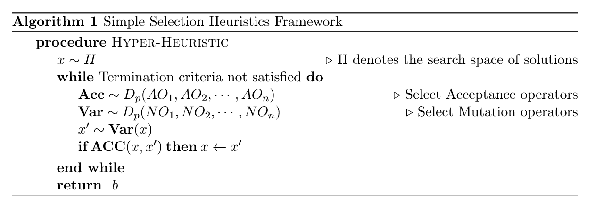
Extension: Selection Hyper-Heuristics Framework
Hot-Plugging Modules:
Benchmark Function and Mutation Operators
Acceptance Operators
Notes:
Despite works we have done, there are still some restricts in our algorithm.
Our hyper-heuristic can not generate all metaheuristic algorithms such as evolutionary algorithm, which should generate by the definition.
Besides, the algorithm can only test on 0-1 integer programming problems with flip random bit operator.
To improve our HH, we design the framework with two Hot-Plugging Modules: 1. Benchmark function 2. Acceptance Operators
For benchmark function, we created a virtual benchmark interface so any combinatorial optimization problem could be tested with our framework.

Slide 9
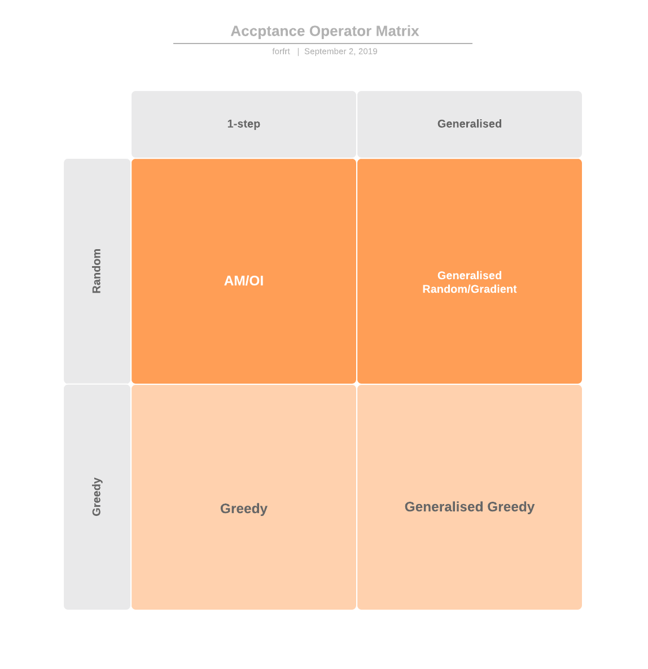
Extension: More Acceptance Operators
AllMove and OnlyImprovement
Greedy
Generalised Random/Gradient
Generalised Greedy
Notes:
And for Acceptance Operators, we added the Greedy operator that evaluate all mutation operators simultaneously (so it could generate population-based metaheuristics). We have also implemented the generalised version of AM, OI and Greedy operator.
# Their generalised version has also been added so the operator could run several steps with a iteration instead of only 1 step.
But we still need crossbreeding operator to generate evolutionary algorithm. I hope we could get enough time to add it.

Slide 10
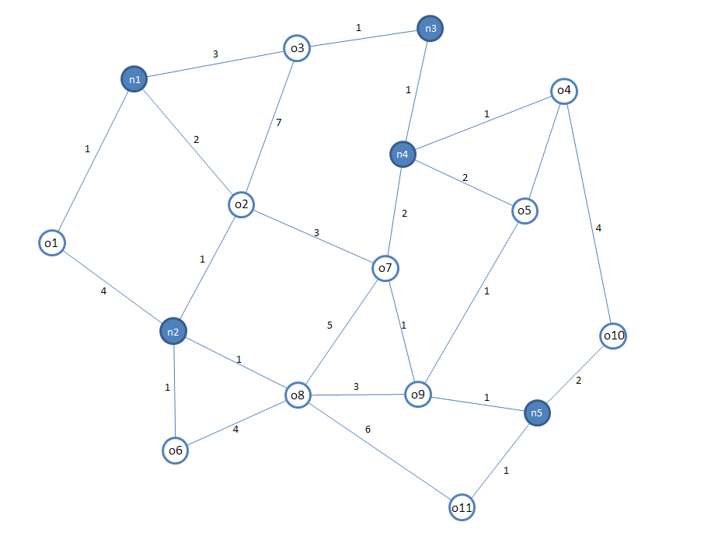
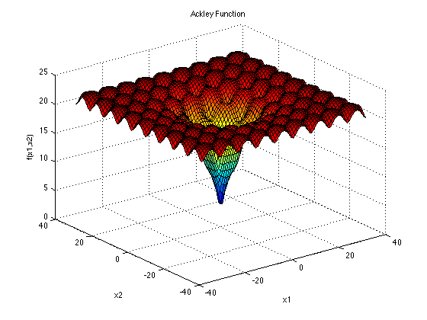
Thank you for your time
Notes:
That's all of my dissertation project. thank you for your time and I hope my presentation would be of benefit to you and academics.

