Slide 1
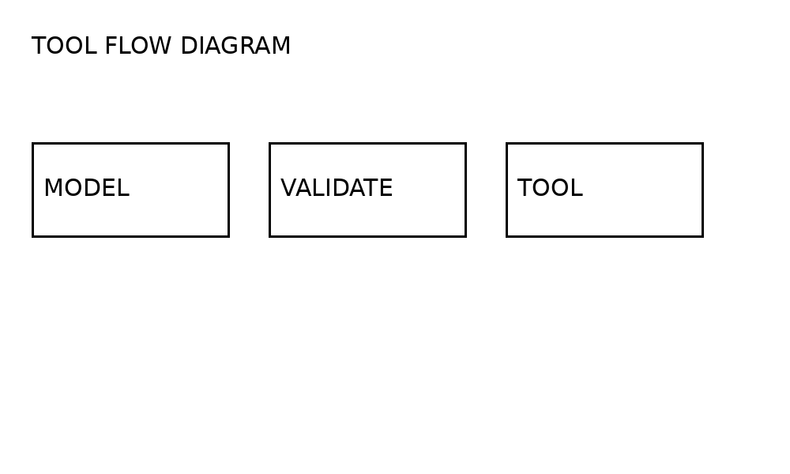
Calculator Agent Slide 1
TOOLS NEED VALIDATED ARGUMENTS
FAILURE RETURNS INVALID_ARGUMENT

Slide 2
Calculator Agent Slide 2
SUCCESS ADDS 12 AND 30 TO GET 42
FINAL PAGE REQUIRES API AUTHENTICATION
INPUT | RESULT
12 + 30 | 42

