Slide 1

Authentication Management
Tyler O’Riley
CSD370
08/09/2023

Slide 2
Option 1: SSO
Single Sign-On is one of the more popular forms of authentication for applications. The design of SSO is to allow a user to sign in with their credentials a single time to have access to multiple applications.
This method is used widely today by corporate businesses with remote work.

Slide 3
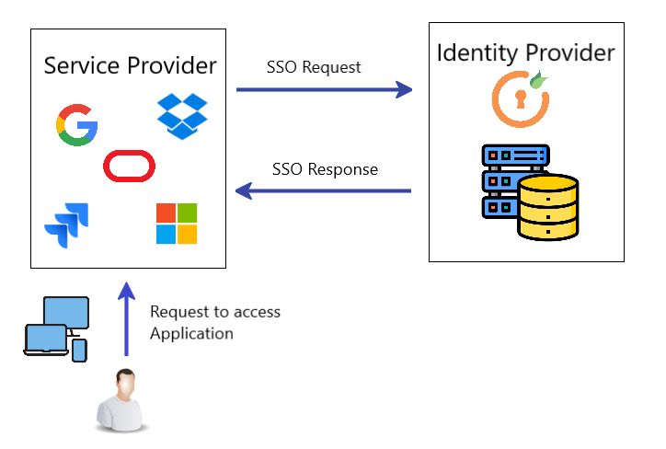
How does it work?
Since a user signs in a single time, a token system is utilized to track verification.
This token is tracked by all programs housed within the SSO
The user is not Individually tracked, rather they are referenced against an identity service every time they use a different program
IMG1

Slide 4
Advantages VS Disadvantages
Advantages
Strong Passwords – Since a single login is required, password structure is more complex to enhance complexity/strength
Multi Factor Authentication – Additional stipulations in addition to a password can be implemented. Biometric scans and one-time passcodes are good examples
Internal Management – Since the credentials are stored within a company database, IT divisions can better secure this data
Disadvantages
Maintenance – with a single credential needed for sign in, more resources are needed to periodically refresh the information to keep it secure
Exposure Risk – if additional authentication is not needed beyond the password and username, logins can be comprised easier if the credentials are ever exposed
Higher Cost – SSO is a business decision at its core. Since the method calls for internal usage, the cost for proprietary software is included

Slide 5
Option 2: OAuth
OAuth is an authorization resource that allows external clients access to your data to create a token using OAuth. This token allows the client to use your information as access on their service.
An example of this could be a social media site. Let’s say you want to create a twitter account. Twitter asks to use your google account to create your user rather than manually entering it. This allows twitter to obtain a token that grants it access to certain bits of your google information.

Slide 6
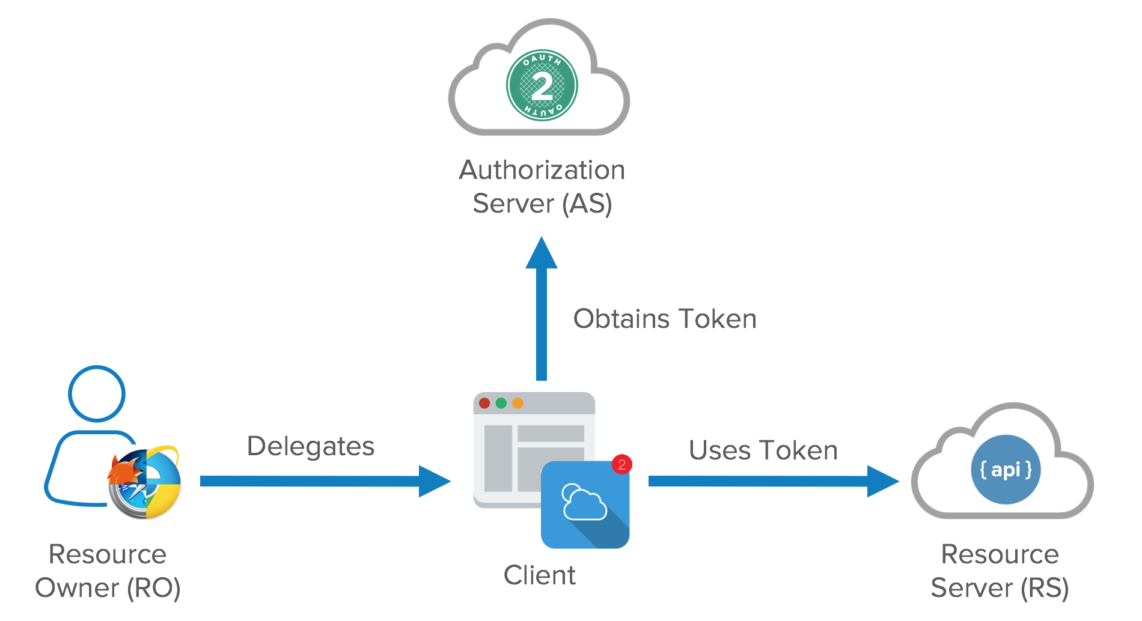
How does it work?
OAuth is not an API or service. It is an authorization standard that can be applied to any service. Instead of utilizing credentials or PII to create access to a service, OAuth creates delegated access by tokens that grants a client permission to your resource information.
As seen in the image to the left, this process uses the OAuth standard to produce a set of rules on what the client can and cannot access on the resource owner’s information. OAuth can then generate a token that grants the client access into the Resource Server where the owners account information is referenced.
IMG2

Slide 7
Advantages VS Disadvantages
Advantages
Ease of access – This standard allows for expedited account creation by allowing token usage of existing information rather than manually entering PII or login credentials
Ease of maintenance – these token are managed by the OAuth standard and permissions can be revoked depending on token type
Disadvantages
Token Risk – being that OAuth uses a token system to allow access to a user’s information, this poses a risk in itself. Should that token be accessed/stolen by 3rd parties while it is active, it would give them access to the user's personal information that the token has access to

Slide 8
Option 3: OpenID
OpenID is an extension of OAuth2.0 and aims to create an additional layer of authentication. With OAuth2.0, the initial authentication is given by the user to allow the client to utilize a token for access to their information.
OpenID is a framework to extend this process to authenticate to user each time this token is established. Each time the user is authenticated, the request for user information can be completed.

Slide 9
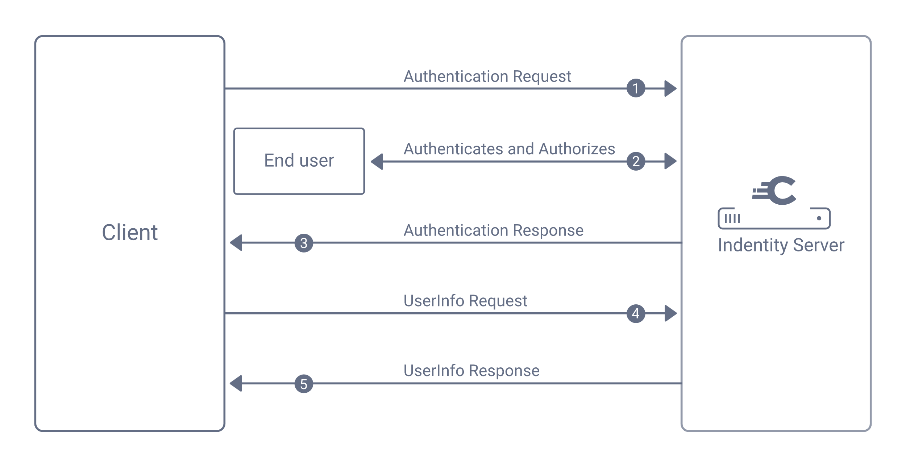
How does it work?
OpenID or OpenID Connect is a standard built to extend OAuth2.0. As discussed on the previous slide, this extension is to establish continued authentication to ensure security in that the authentication request is a user rather than an entity posing as the user.
This extension lays the groundwork for a service to setup its own authentication system they want to user to complete. When the user has completed this authentication, they can proceed with the services OAuth standard.
IMG3

Slide 10
Advantages VS Disadvantages
Advantages
Security – OpenID aims to add a additional layer with the standard for continuous authentication for the user
Disadvantages
User Experience – Adding the continuous authentication requires the user to authenticate every time or on a procedural basis.

Slide 11
References
IMG1: https://blog.miniorange.com/what-is-single-sign-on-sso/
IMG2: https://developer.okta.com/blog/2017/06/21/what-the-heck-is-oauth
IMG3: https://curity.io/resources/learn/openid-connect-overview/

