Slide 1

SOEN 6441: Advanced programming practices Instructor: Dr. Joey Paquet
Team 16
Koroosh Aziz-Nejad
Sandeep Swainch
Ranjitha Shetty
Mitra Azari-Sissi

Slide 2
Executive Summary
Character Creating and Editing
Map Editor
Map creation and edition
Map saving
Map loading
Verification of map correctness
Game Play
Startup phase
Reinforcement phase
Fortification phase
Programming process
Architecture Design
Software versioning repository
API documentation
Unit Testing
Coding Convension

Slide 3
Goal of the Build
Character creation/editing
Map creation/editing
Campaign creation/editing
Item creation/editing
Extreme Programming in practice
Implement a Design Pattern

Slide 4
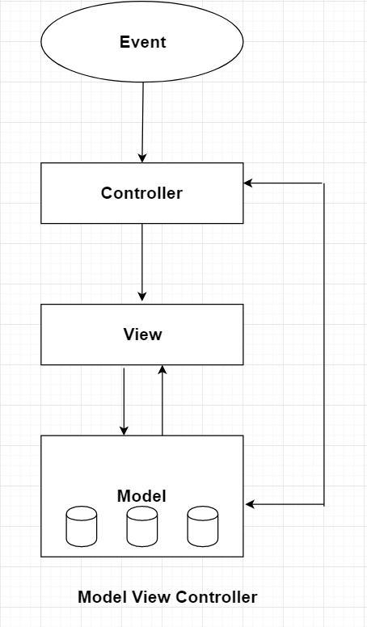
Architecture Design
The design of Game Risk is based on Software
Design Principles.
Modules are highly cohesive and least coupled.
MVC architecture is followed in the project.
MVC has 3 major parts:
Model (Logical Representation of Application)
View (Graphical Representation of Application)
Controller (Brain of Application)

Slide 5
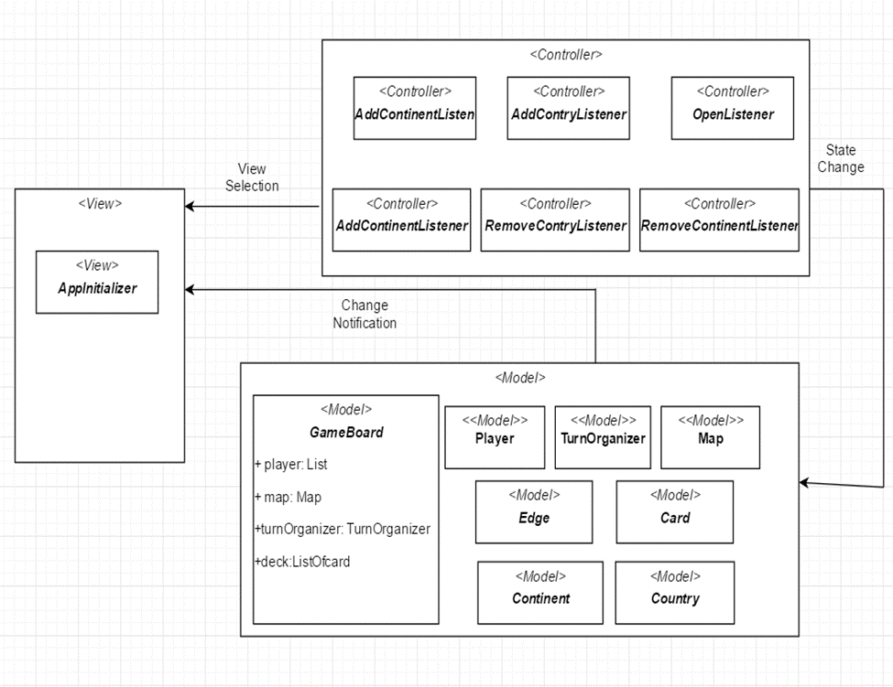
Model View Controller Architecture for Risk Game

Slide 6
Software versioning repository
Git has been used for the purpose of version controlling and has proved very useful.
Git is a distributed version control system.
A private repository is hosted on Github.
Repository Hosted at:
https://github.com/T16APP/riskGameApp
Master branch is being all shared team members(Collective Ownership) where as some team member work on their on branches.

Slide 7
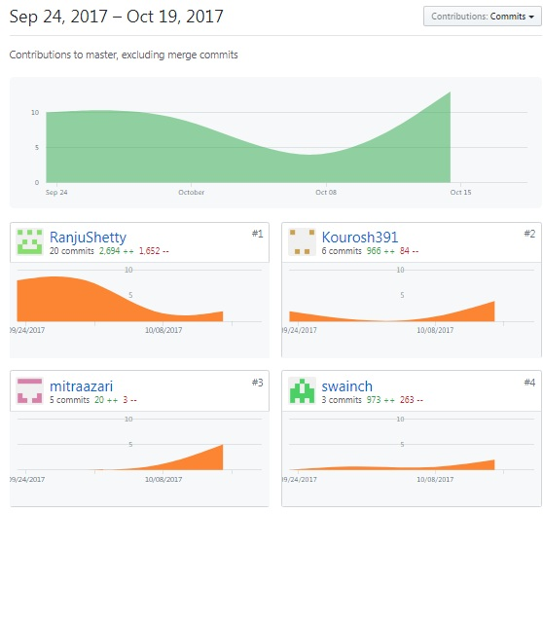
Software versioning repository

Slide 8
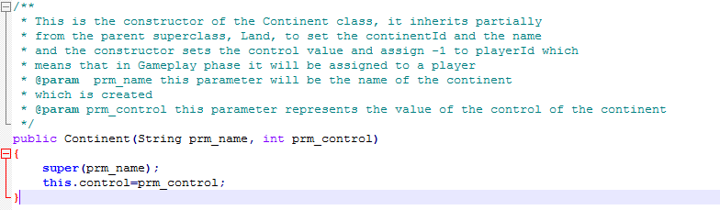
API Documentation
All Filles, Classes, and Methods are provided by JavaDoc.

Slide 9
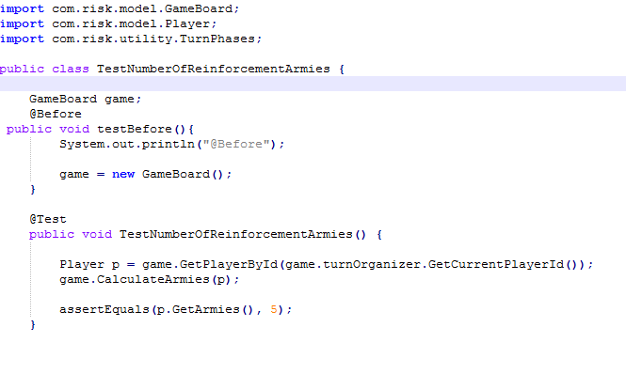
Unit Testing
In this project Junit 4 is used.
Junit 4 test is chosen as the latest and popular unit testing.
Junit Tests are written and executed.

Slide 10
Coding Standards
Identifier Type | Rules for Naming
Filename | First letter lower case character and second letter starts with upper case
Packages | Start with lower case
Classes | Start each word with upper case character
Methods | Start with upper case letters to separate words following Camel Script
Attributes | Use a lower-case letter and use underscore between word
Variables | Local variables are written entirely lower case without underscore
Constants | Use upper case letter with underscore between words
Parameters | Prm and name

