Slide 1
Simology
Created by:
Joseph Tanner
Sponsored by:
Dr. Erik Hom

Slide 2

MVP
Desktop application
Simulate micro-organisms in an environment
Use agent-based algorithms
Mimic real-world chemistry and biology
Implement a GUI

Slide 3
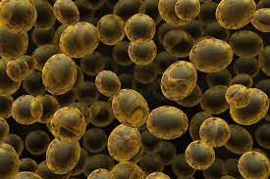
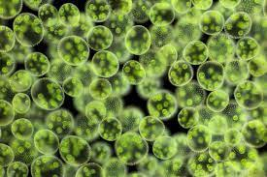
Goals
Support Dr. Hom research
  Can Yeast and Algae support each other?
  Are there others?
Expandable
Efficient

Slide 4



Rejected Project options
.net framework
  Popular
  Compiled
  Using c# OOP language
Unity/Unreal engine
  Could be used to make unique visualizations
  Requires more Resources
  Compiled
  OOP

Slide 5

Chosen Technology
Julia and Blink
  Sponsor recommended
  Interpreted (Python)
  Supports multi-threading
  Similar to python
  Designed for Science
  Similar to python (a language my sponsor knows)

Slide 6

Other Parts of the stack
HTML, CSS, and Javascript
  Stuck to the basic
  Other frameworks take more Resources
Database vs Save Files
  Access to loading is limited
  Unsure is client will have a DB installed
  Ultimately used Files

Slide 7
Real-world implementations
Chemistry
  Diffusion Coefficient
    X cm³/s
  Equilibrium functions
Cellular life
  Normal Distribution
  Accounts for PH
  Respiration (aerobic)
    Glucose + 6O₂ <=> 6CO₂ + 32atp

Slide 8
Data size Issues
For (1:10000:update)
  For (microbes)
    About 20 operations
  For (chemistry) size ^{(diffusion Coefficient)} ¹⁻¹⁰⁰⁰
    Thousands to millions of operations
Sudo code to show the data set size

Slide 9
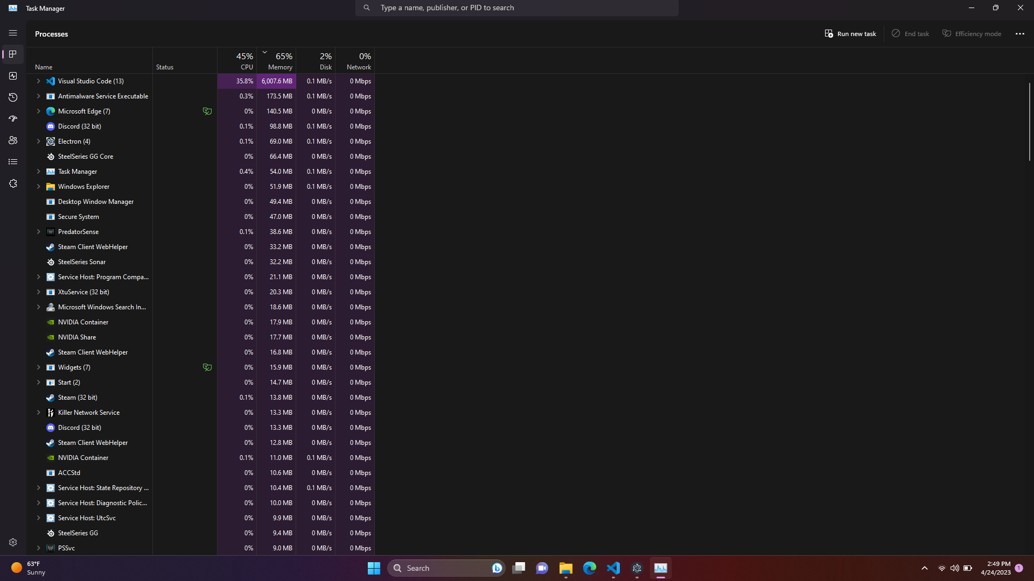
Performance

Slide 10
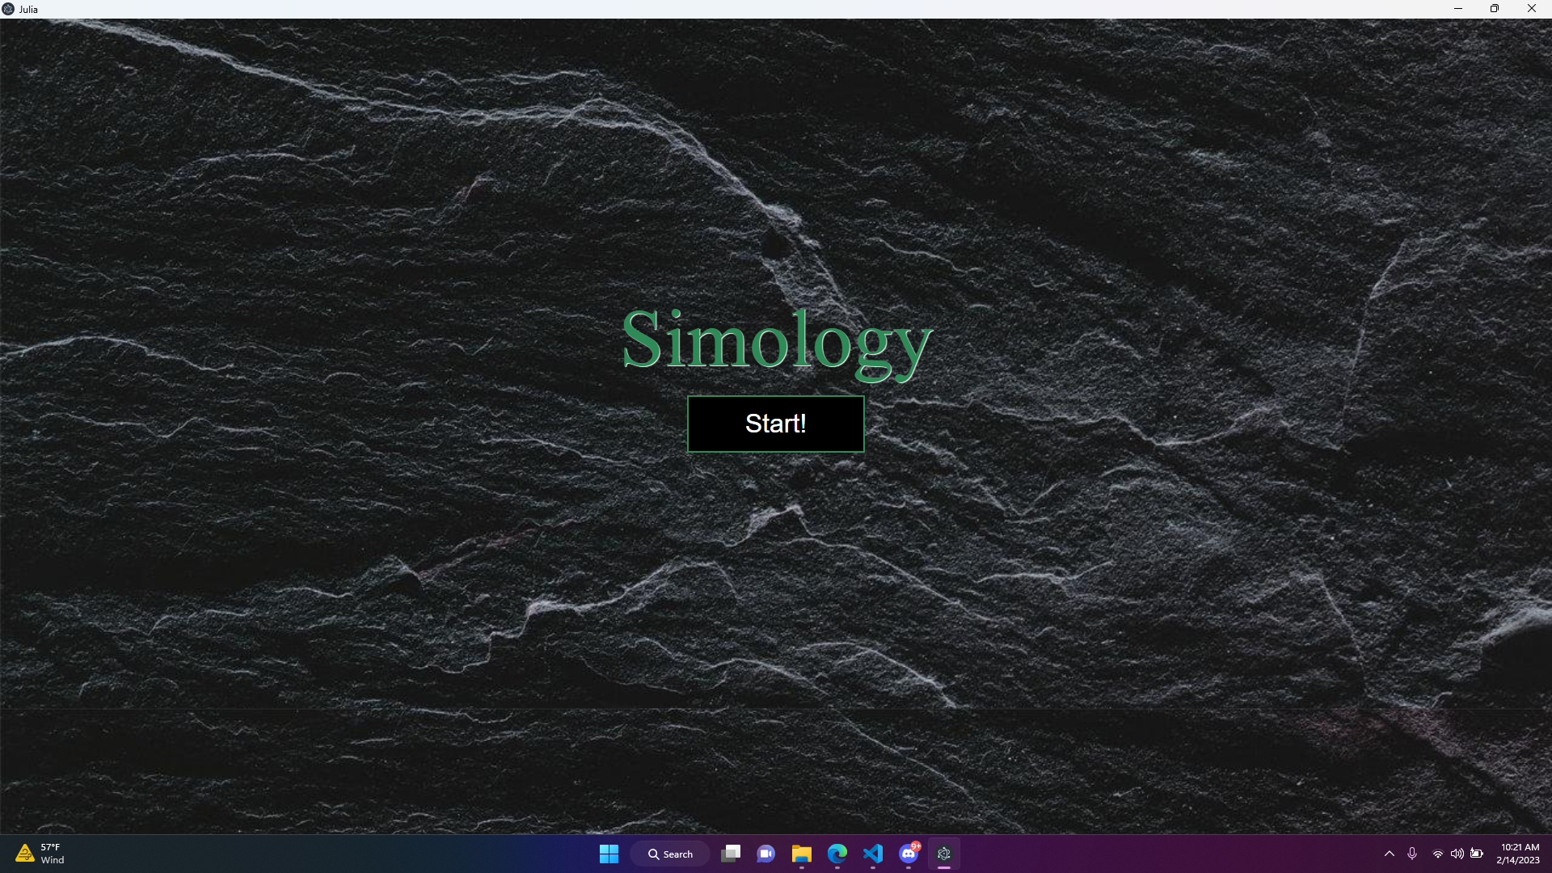
Demo!

Slide 11

Enhancements/Optimizations
Optimizations
  Better Chemistry and biology knowledge
  Better hardware or utilize cloud computing
  Possibly use a different language
Future Enhancements
  Adding 3-D
  Upgraded UI/ visualizations

Slide 12

Questions

