Slide 1
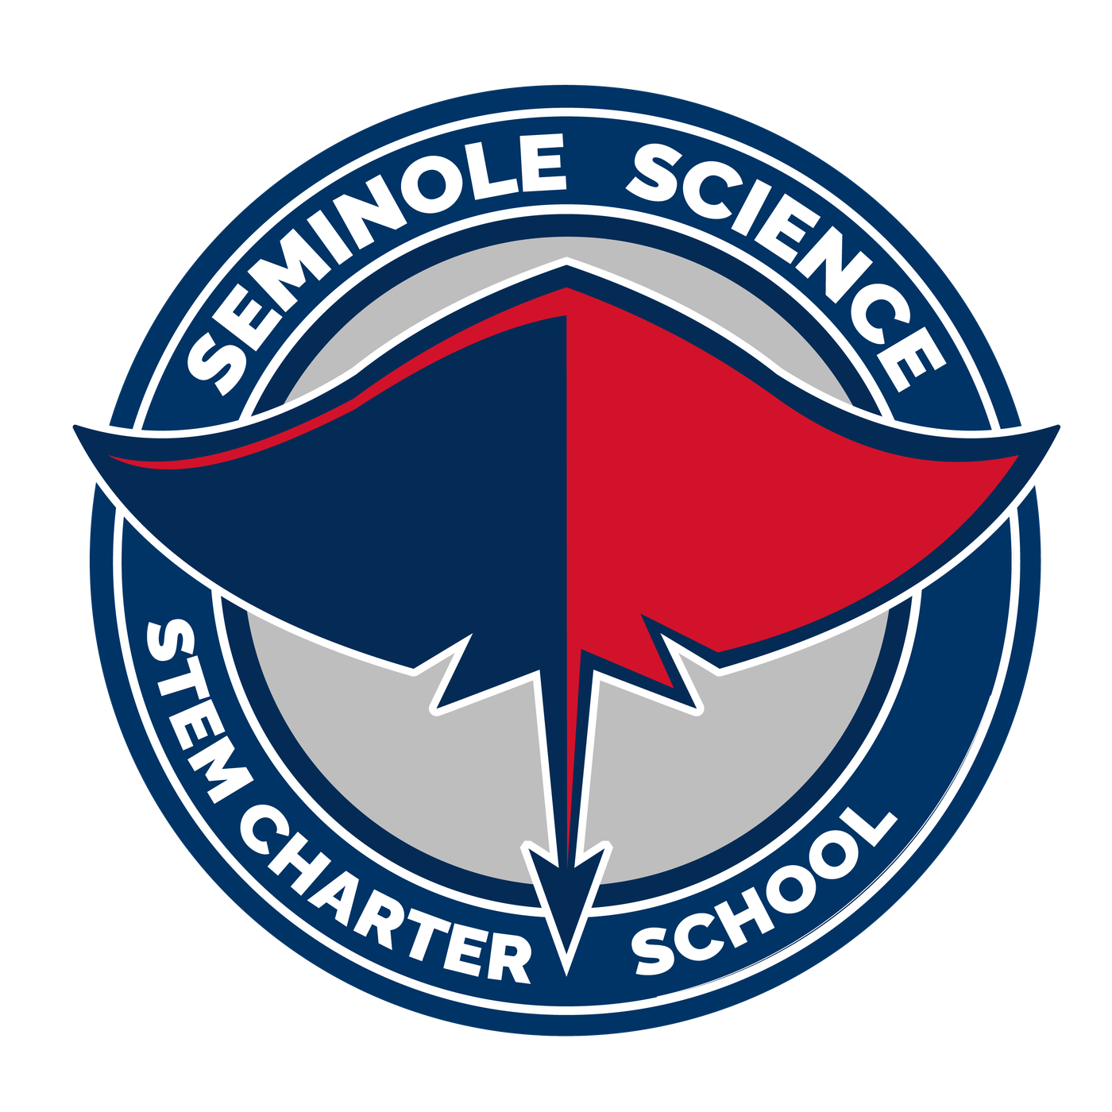
PROPOSED BRAND GUIDE
SEMINOLE SCIENCE CHARTER SCHOOL
HOME OF THE STINGRAYS
Prepared by Tim Livingston | October 2026
Notes:
COVER. A proposed brand guide for Seminole Science Charter School. Logo artwork by Tim Livingston. Nothing here is approved school branding yet.
The whole guide is set in one font, Montserrat. It is free under the SIL Open Font License and is in Google Slides under Font > More fonts.
All logo PNG files: https://drive.google.com/drive/folders/12I6X4qPKyHAG0oh1OoSHPk0NDSjnXlD_?usp=sharing

Slide 2
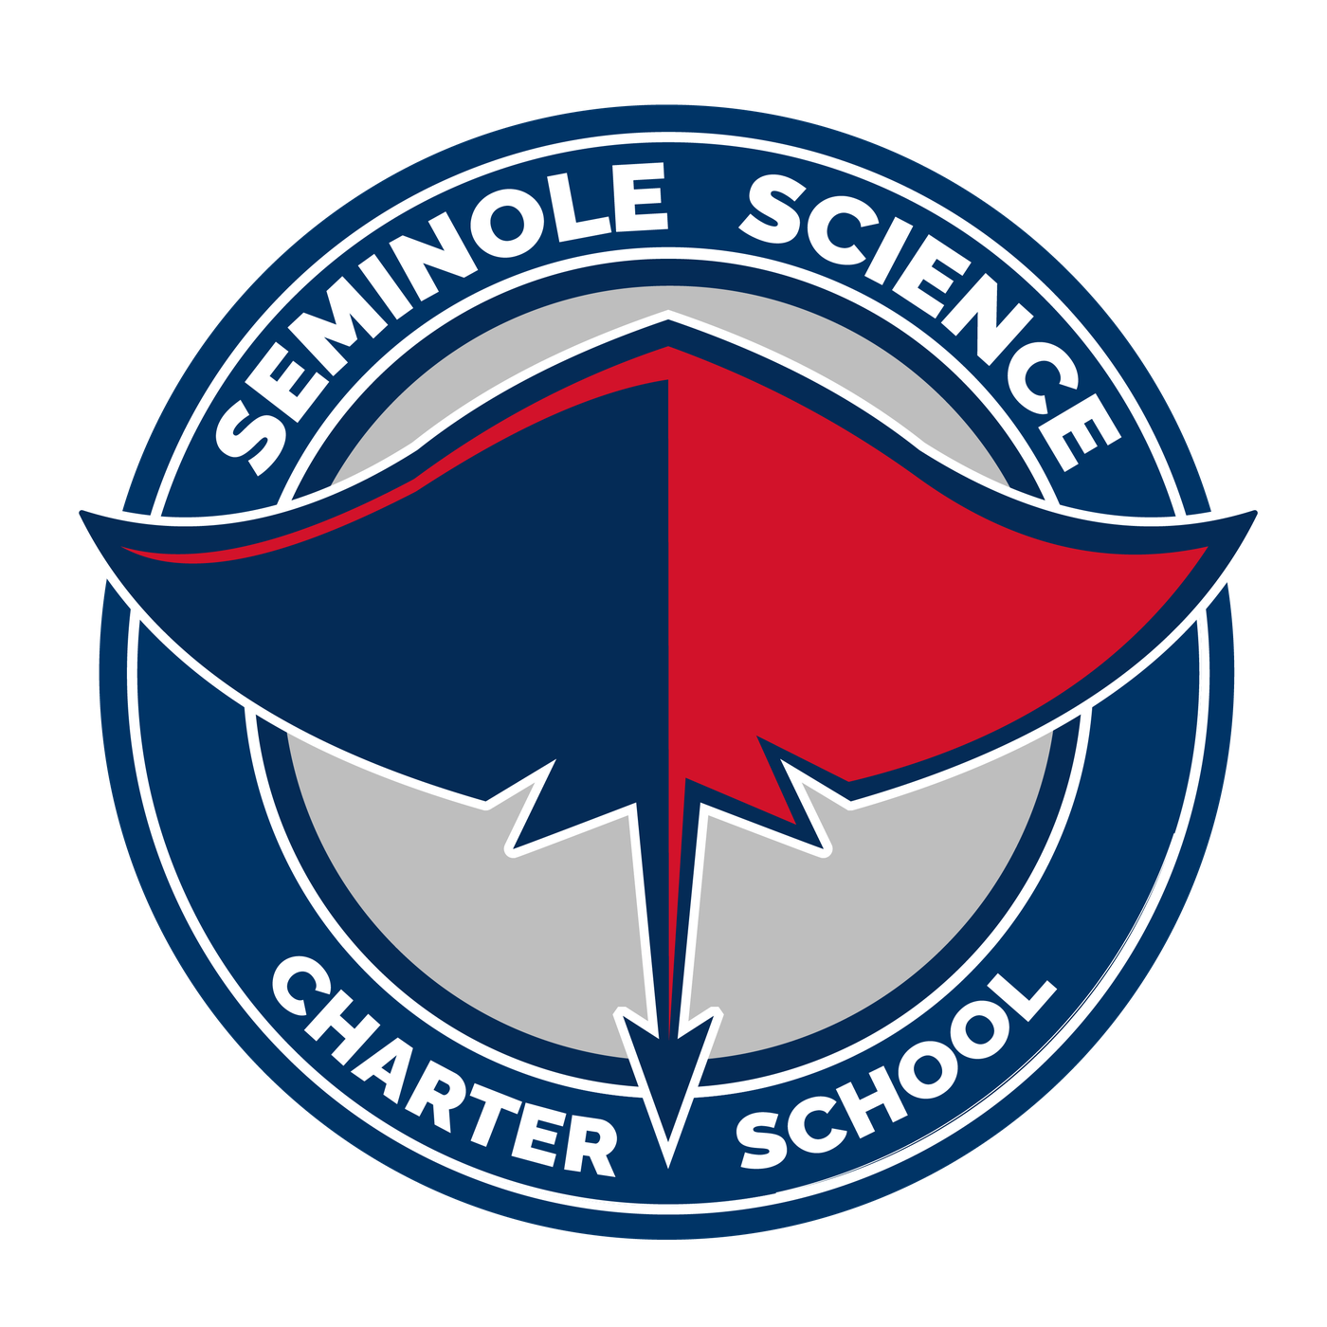
PRIMARY LOGO
STEM CHARTER SCHOOL
CHARTER SCHOOL
Notes:
PRIMARY LOGO. The circular seal, in two wordings. Same art, different ring text.
Left: "Seminole Science STEM Charter School". This matches the wording on the school's current seal and on the Orlando Science Schools seal.
Right: "Seminole Science Charter School". This matches the school name as used on the website.
One decision for leadership: which wording is official for the seal?
Color note: the seal files use slightly different values than the other logos. The seal samples at navy #003466 and #042B56 with red #D2122A. The stingray marks and long logos sample at navy #012F63 and red #DA152C. Match them in Illustrator before final export.

Slide 3
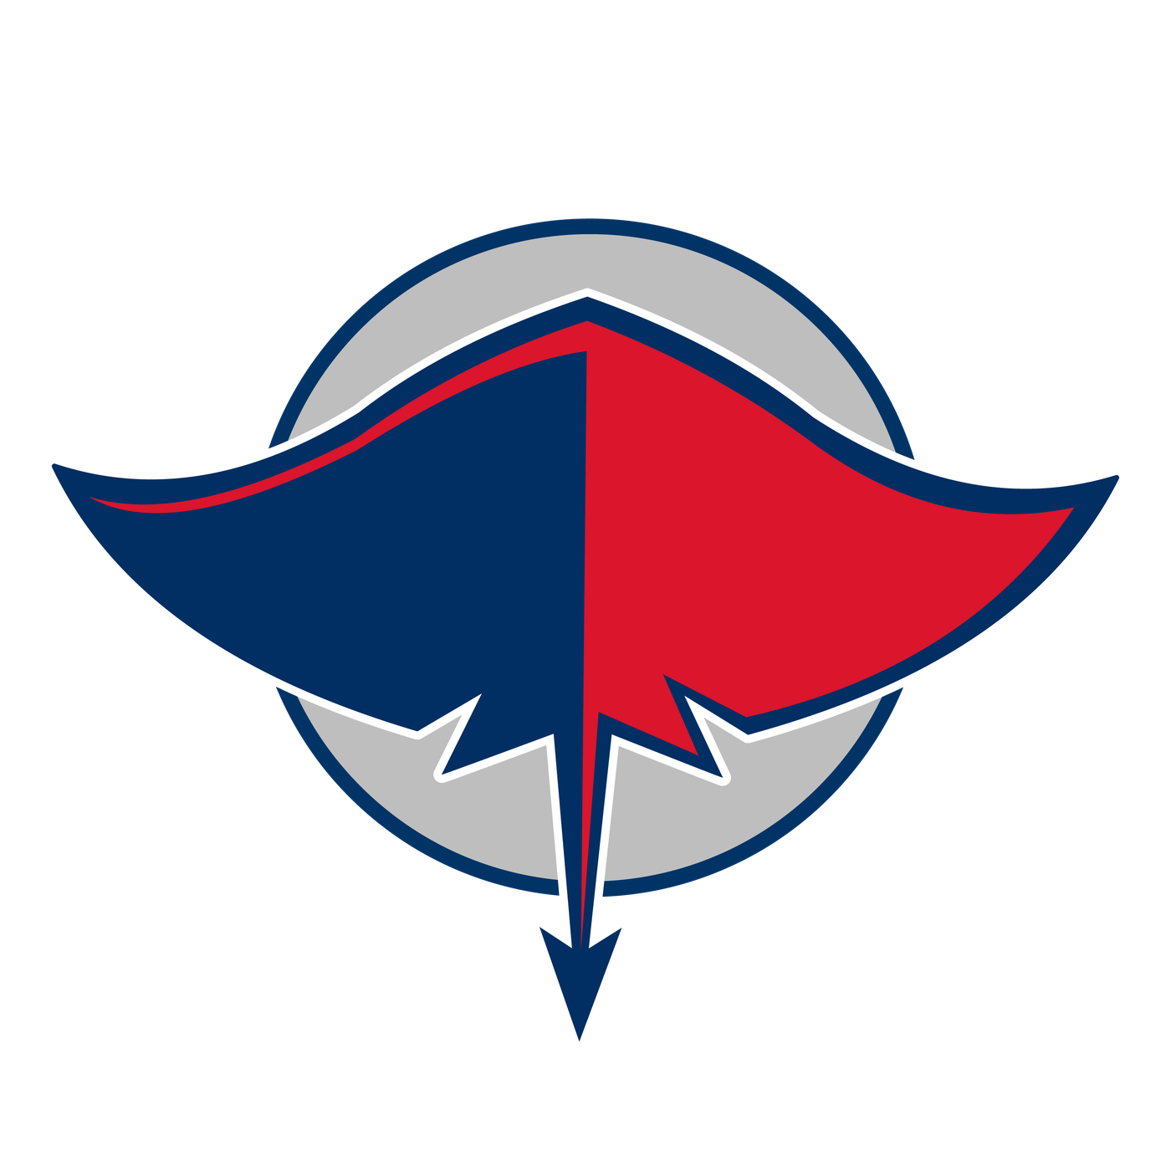
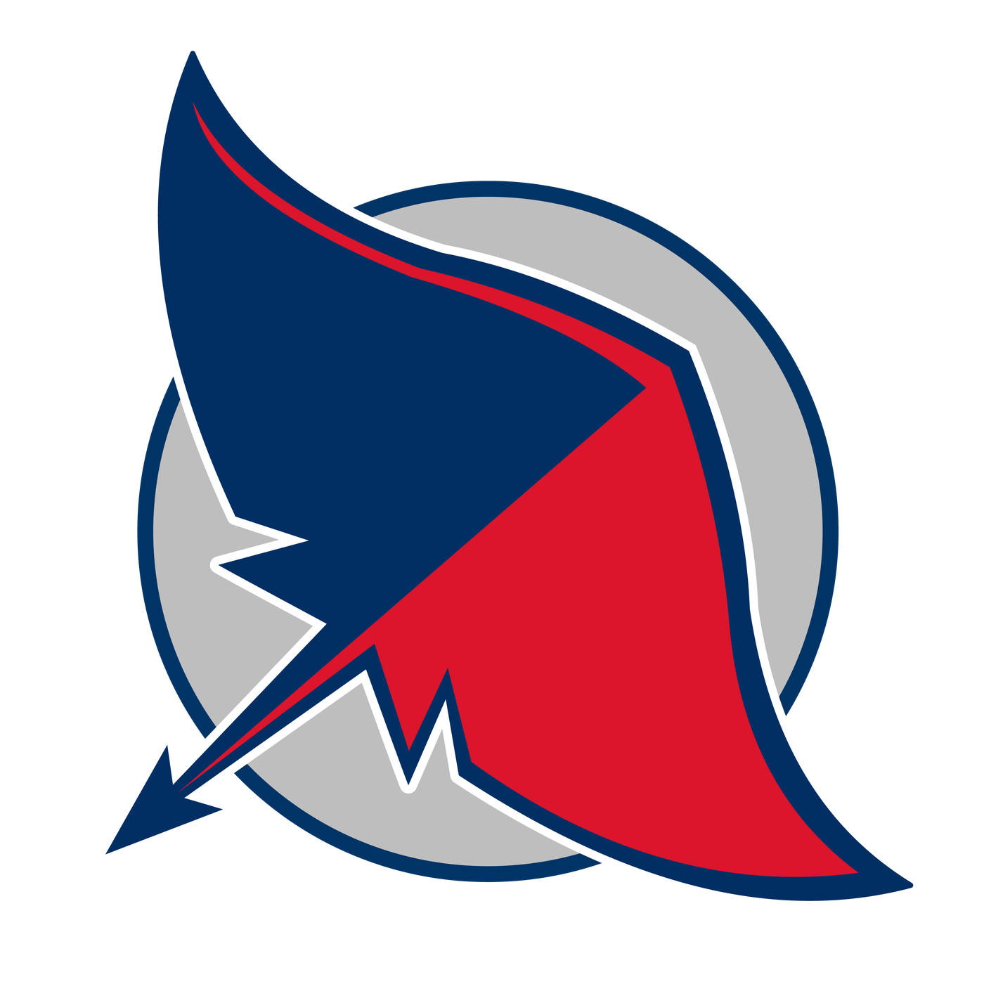
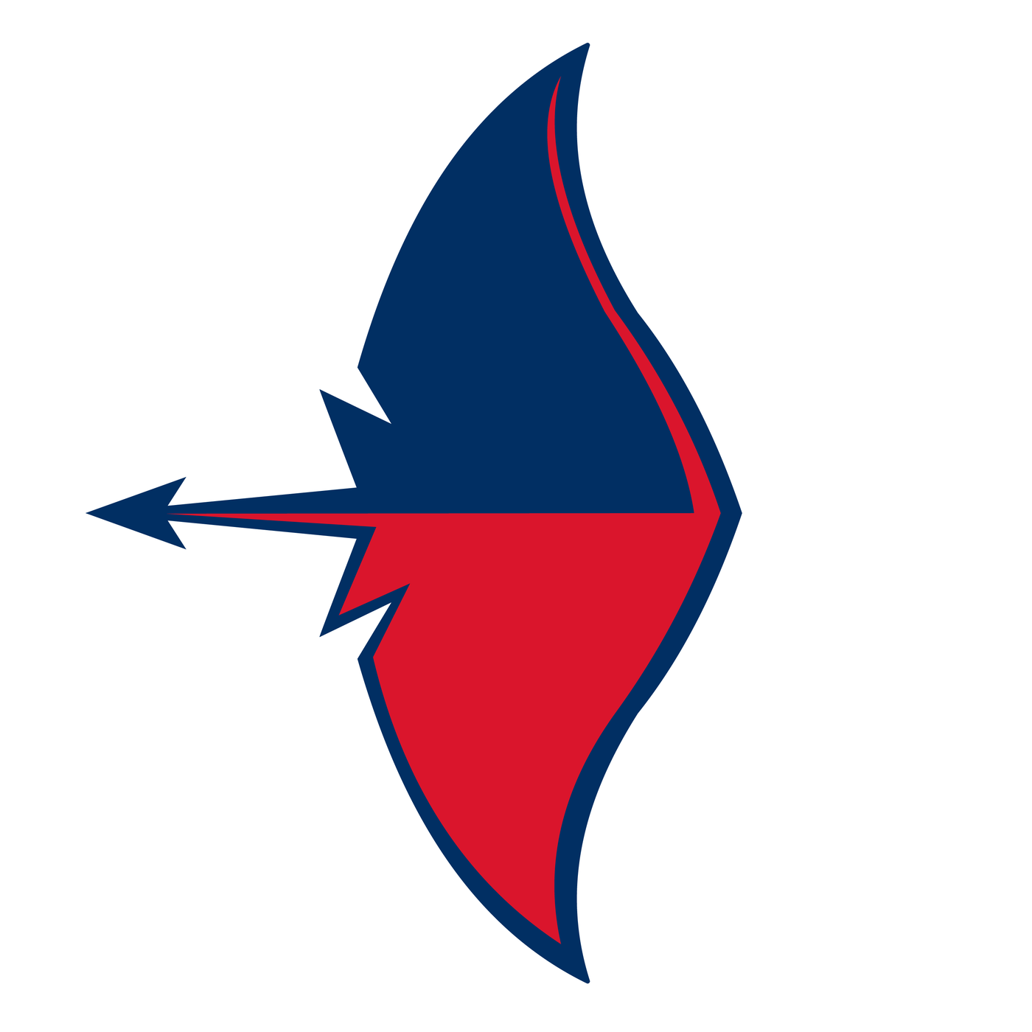
ALTERNATIVE LOGOS
STINGRAY AND CIRCLE
ANGLED STINGRAY
SIDE STINGRAY
Notes:
ALTERNATIVE LOGOS. Three marks without lettering, for places where the school name already appears or space is tight.
Stingray and circle: the stingray from the seal, without the ring text. Good for icons, social profile images, and spirit wear.
Angled stingray: the stingray at 45 degrees over the circle. More motion. Good for athletics.
Side stingray: the stingray alone, pointing left. Good as a small accent and in the long logos.
Each mark also comes in navy-background and grey-background versions. See the backgrounds slide and the Drive folder.

Slide 4
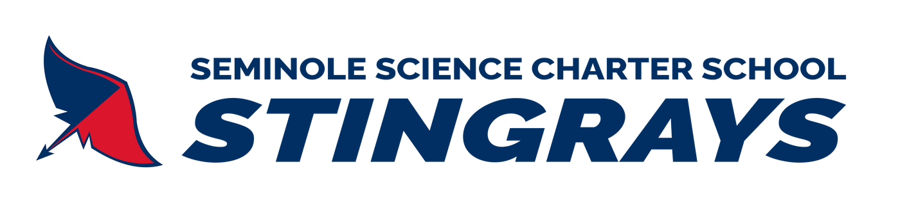
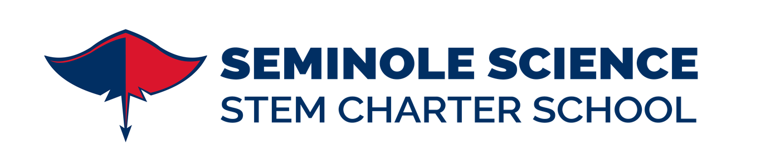
LONG LOGOS
Notes:
LONG LOGOS. Two horizontal versions for wide spaces: letterhead, website header, email signatures, banners.
Top: "Seminole Science Charter School STINGRAYS" with the side stingray. The spirit version.
Bottom: "Seminole Science STEM Charter School" with the front-facing stingray. The formal version. Its wording follows whichever seal wording leadership picks.
More long versions are in the Drive folder, including one on a navy background and one that reads "Seminole Science Charter School" with the angled stingray.

Slide 5

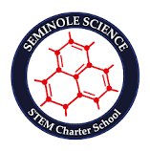

CURRENT LOGOS
OUR SYSTEM
OUR MAIN LOGO NOW
OUR WEBSITE LOGO
Notes:
CURRENT LOGOS. The starting point. The existing seal is the main logo in use today. The system logo and our website logo sit on the left. All three are shown exactly as found on seminolescience.org and orlandoscience.org.
These files are small web images and will look soft on a projector.
The Orlando Science Schools site lists six campuses, including Seminole Science. Both the system seal and our current seal read "STEM Charter School".
Ask first: does the system set brand rules we need to follow?

Slide 6
COLOR PALETTE
STINGRAY NAVY
STINGRAY RED
STINGRAY GREY
DEEP NAVY
SYSTEM BLUE
WHITE
#012F63
1, 47, 99
STINGRAY ARTWORK
#DA152C
218, 21, 44
STINGRAY ARTWORK
#BEBEBE
190, 190, 190
STINGRAY ARTWORK
#0D132E
13, 19, 46
SYSTEM LOGO
#315BA9
49, 91, 169
SYSTEM LOGO
#FFFFFF
255, 255, 255
NAVY, RED, AND GREY FROM THE STINGRAY. DEEP NAVY FROM THE SYSTEM.
The artwork's two near-identical navies merge into #012F63. Deep Navy comes from the Orlando Science Schools logo.
Notes:
COLOR PALETTE. Values are sampled from the files. None are approved print specifications yet.
Stingray Navy #012F63, Stingray Red #DA152C, and Stingray Grey #BEBEBE are sampled from the supplied logo PNGs.
Deep Navy #0D132E and System Blue #315BA9 are sampled from the Orlando Science Schools web logo. Ask the system for official values.
Grey is new in this draft. The logos use it for the circle behind the stingray and as a background option.
Clean-up for the art: the seal files use navy #003466 and #042B56 and red #D2122A. The other logos use #012F63 and #DA152C. Standardize on one navy and one red before final export.
Print values (CMYK, spot) are pending printer and profile verification. No Pantone match is given on purpose.

Slide 7
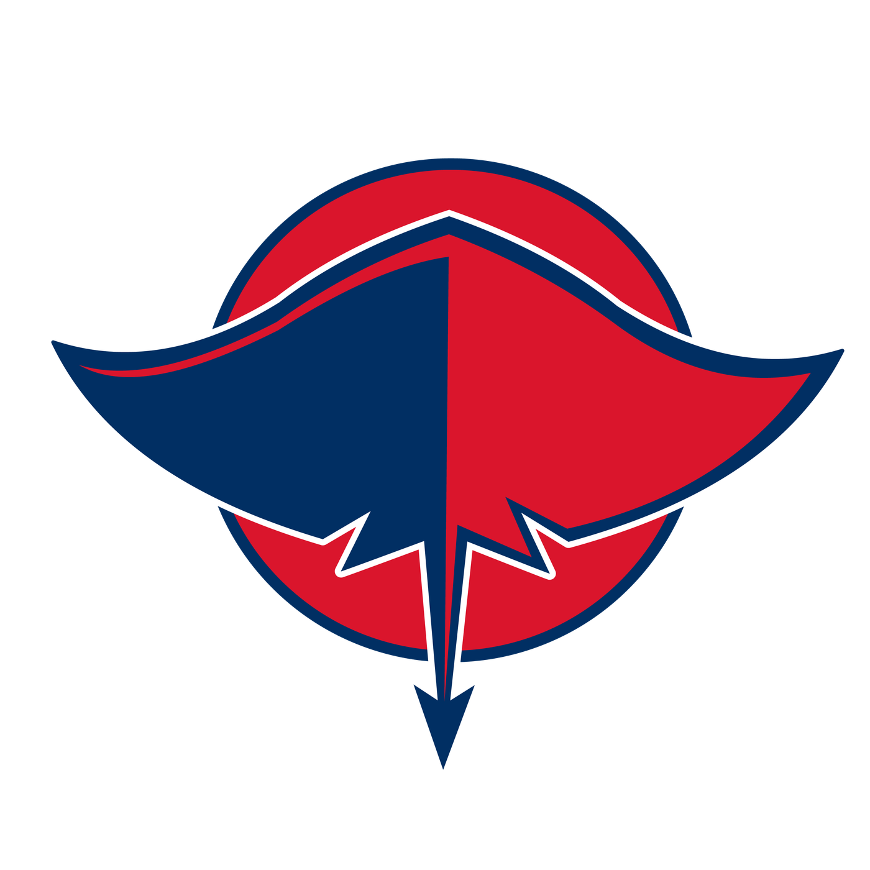

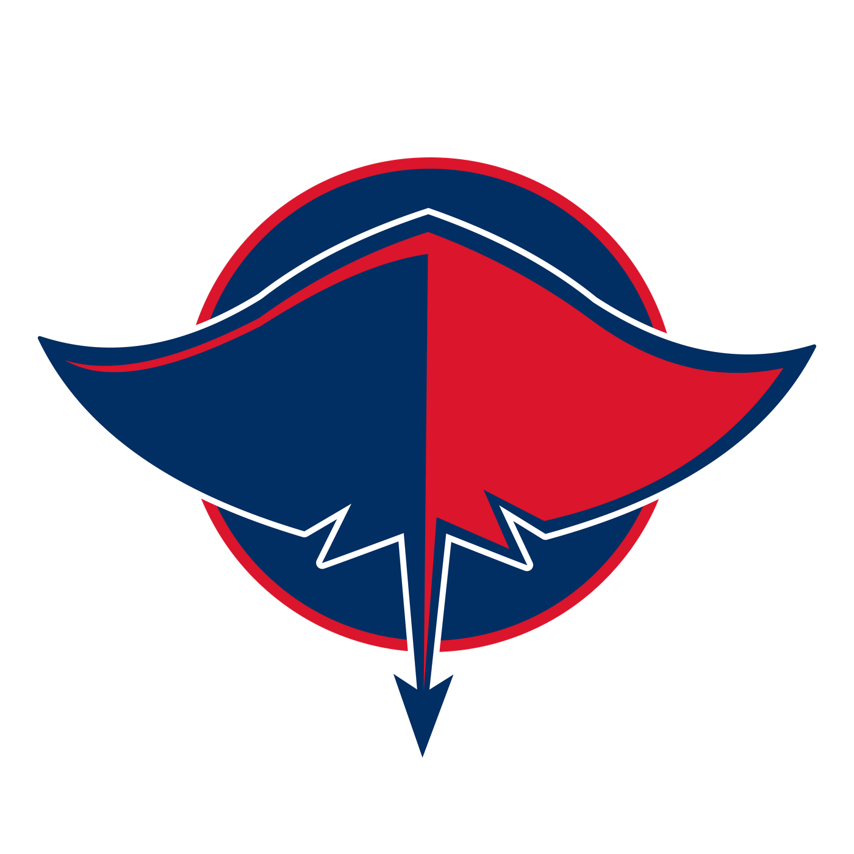

COLOR LAYOUTS
RED CIRCLE
WHITE CIRCLE
MAIN
GREY CIRCLE
NAVY CIRCLE
ON NAVY
Notes:
COLOR LAYOUTS. One main color scheme, highlighted, plus four alternates. Same stingray every time. Only the circle and background change.
MAIN. Grey circle with a navy ring. It matches the inside of the seal.
Alternates:
1. Red circle. Bolder. Less contrast between the red wing and the red circle.
2. White circle. Cleanest. The circle becomes a navy outline.
3. Navy circle with a red ring. Darkest. The navy wing blends into the circle.
4. On navy. The grey circle version on a navy background, with a white outline.
Each alternate also has navy-background and grey-background files in the Drive folder.
Staff should never recolor a logo themselves. They pick from the approved versions.

Slide 8


BACKGROUNDS
ON WHITE
ON NAVY
ON GREY
Notes:
BACKGROUNDS. Every mark is drawn for three backgrounds: white, Stingray Navy, and Stingray Grey. The angled stingray is shown here.
On navy and on grey, a white outline keeps the stingray from blending into the background. Use the file made for that background. Do not place the white-background file on a colored box.

Slide 9
AT A GLANCE
PROPOSED
COLORS
NAME | Seminole Science Charter School
MASCOT | Stingrays
SYSTEM | Orlando Science Schools
PRIMARY LOGO | Circular seal
LONG LOGO | Stingrays wordmark
FONT | Montserrat
STINGRAY NAVY #012F63
STINGRAY RED #DA152C
STINGRAY GREY #BEBEBE
DEEP NAVY #0D132E
SYSTEM BLUE #315BA9
CORE VALUES
LOGO FILES
We support each other, contribute to our community, and strive for excellence in all we do.
All PNGs in Google Drive
Notes:
AT A GLANCE. A one-page summary. Everything on it is proposed until leadership signs off.
Logo files (PNG): https://drive.google.com/drive/folders/12I6X4qPKyHAG0oh1OoSHPk0NDSjnXlD_?usp=sharing
Open items:
1. Seal wording: "STEM Charter School" or "Charter School".
2. Match the seal's navy and red to the other logos.
3. Official color values from the system, and print values from the printer.
4. Whether the system sets brand rules we need to follow.

