Slide 1
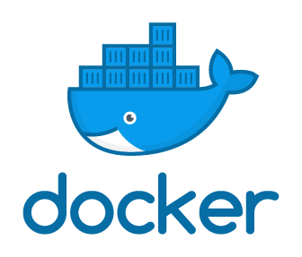
Docker
Objectives
Before Containers
What is Container?
What is Docker?
Container’s Advantages
Containers vs VM’s?
Docker Architecture
Images & Containers

Slide 2
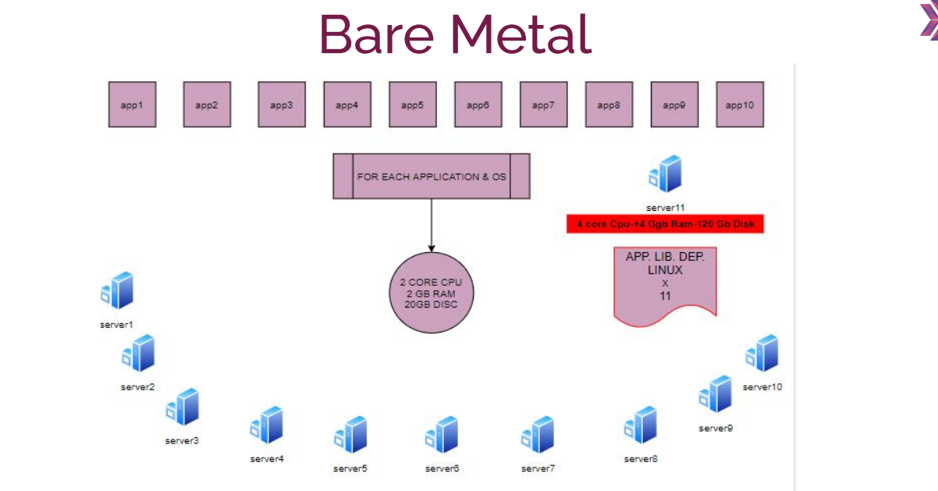
Before Containers

Slide 3
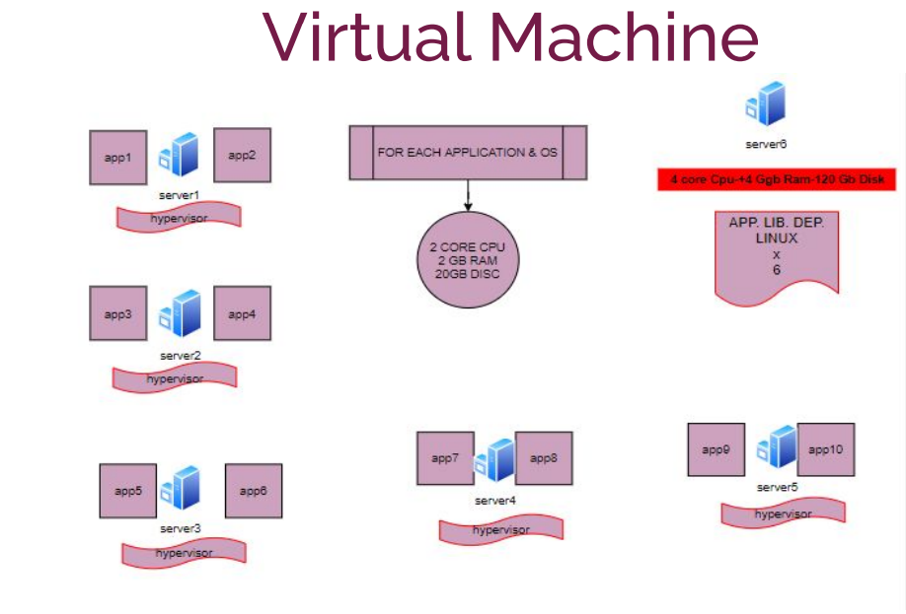
VM’s

Slide 4
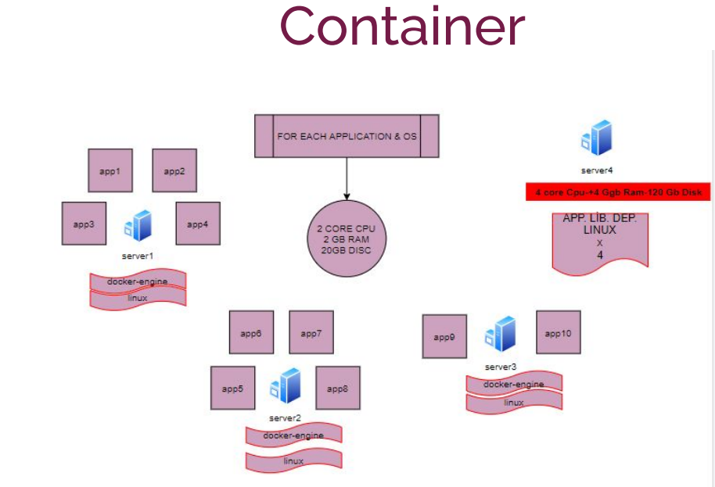

Slide 5
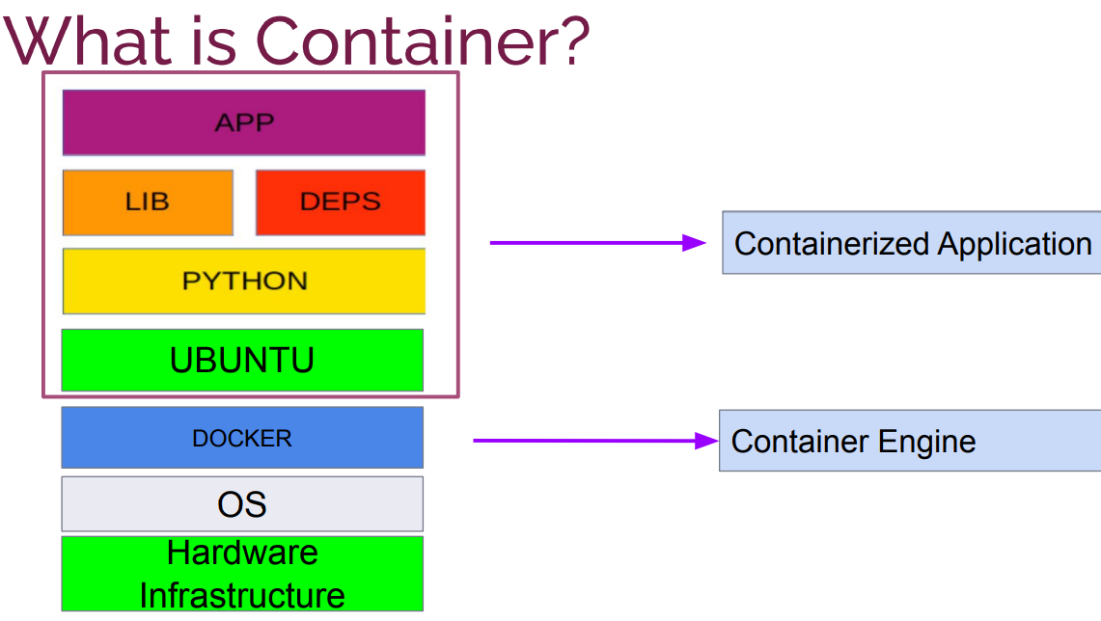

Slide 6
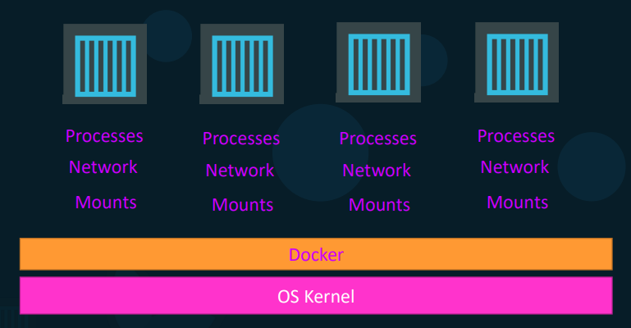
Docker Infrastructure

Slide 7
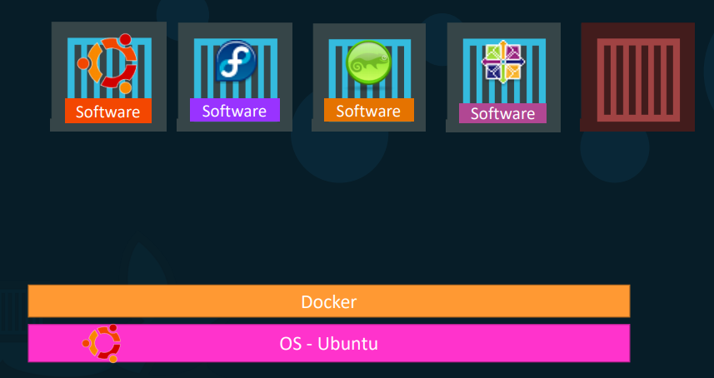
Sharing the kernel

Slide 8
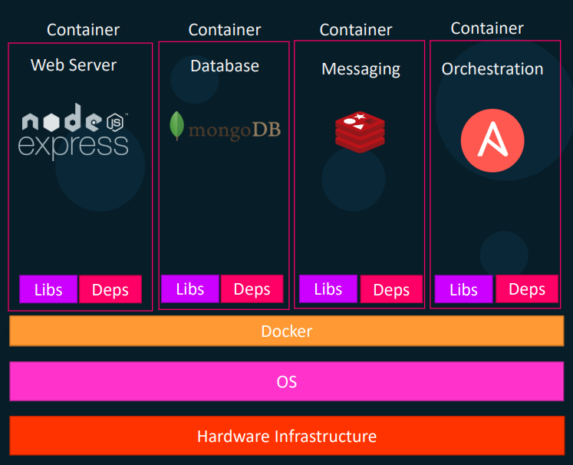
Container’s Advantages
• Containerize Applications
• All dependencies included, Works independently
• Run each service with its own dependencies in separate containers
• Container does not need any disk, memory or cpu allocation in advance. They only consume only amount of your application needs to run.
• Platform agnostic
• Isolation
• High availability
• More efficent

Slide 9
Deploy efficiently
● Containers are lightweight – Typical laptop runs 10-100 containers easily – Typical server can run 100-1000 containers
● Containers can run at native speeds

Slide 10
Why do you need docker?
Compatibility/Dependency
Long setup time
Different Dev/Test/Prod environments

Slide 11
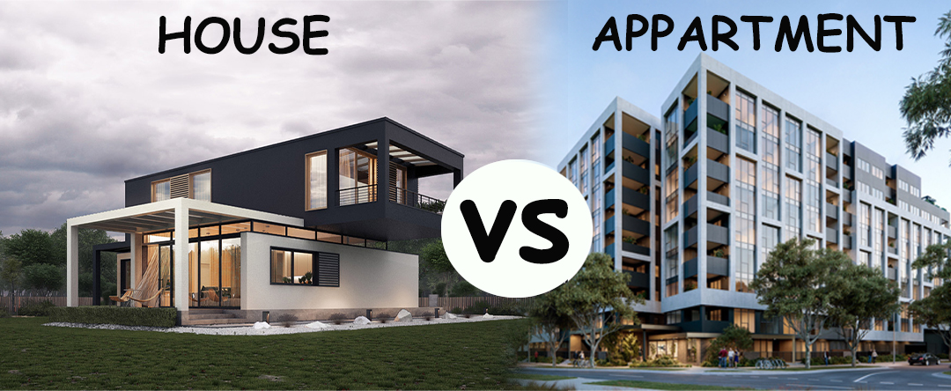
Virtual Machine vs Containers

Slide 12
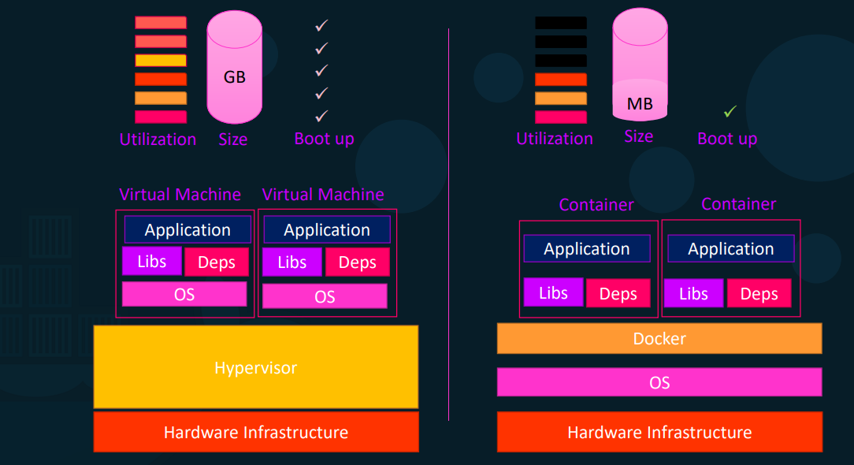

Slide 13
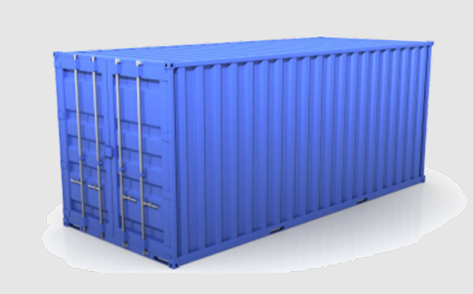
Docker Components
The core components that compose Docker:
The Docker client and server also called the Docker Engine.
Docker Images
Registries
Docker Containers
Because of high resource sharing, we can build Docker containers with a small footprint that makes application distribution easier and it makes container startup times faster.

Slide 14
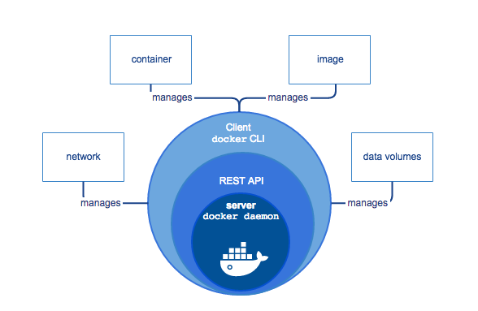
Docker’s Architecture

Slide 15
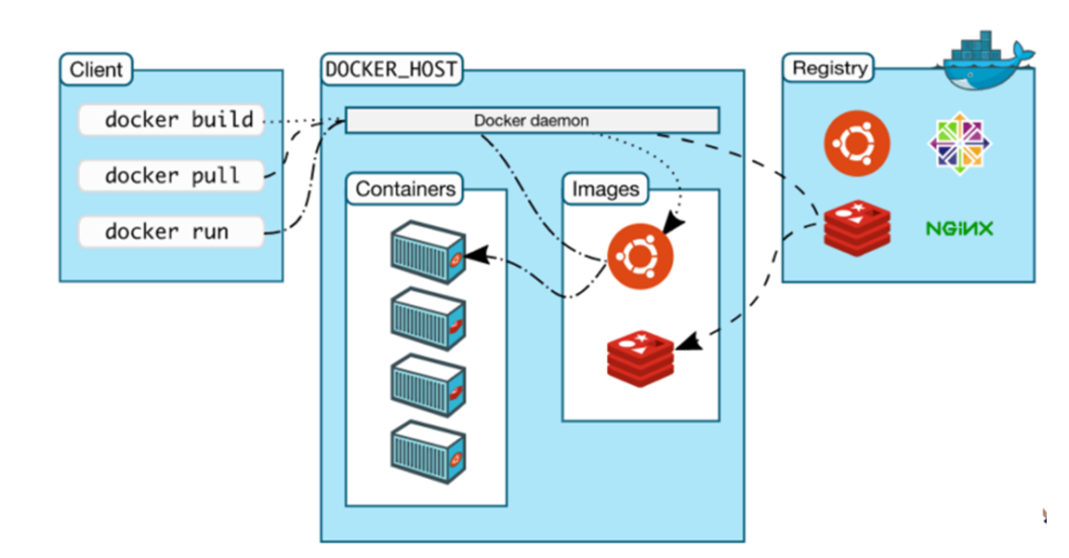
Docker’s Architecture

Slide 16
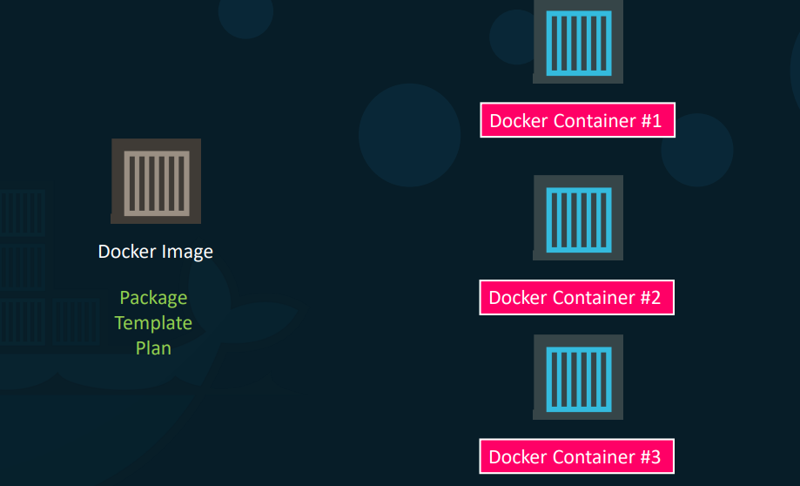
Docker Images

Slide 17
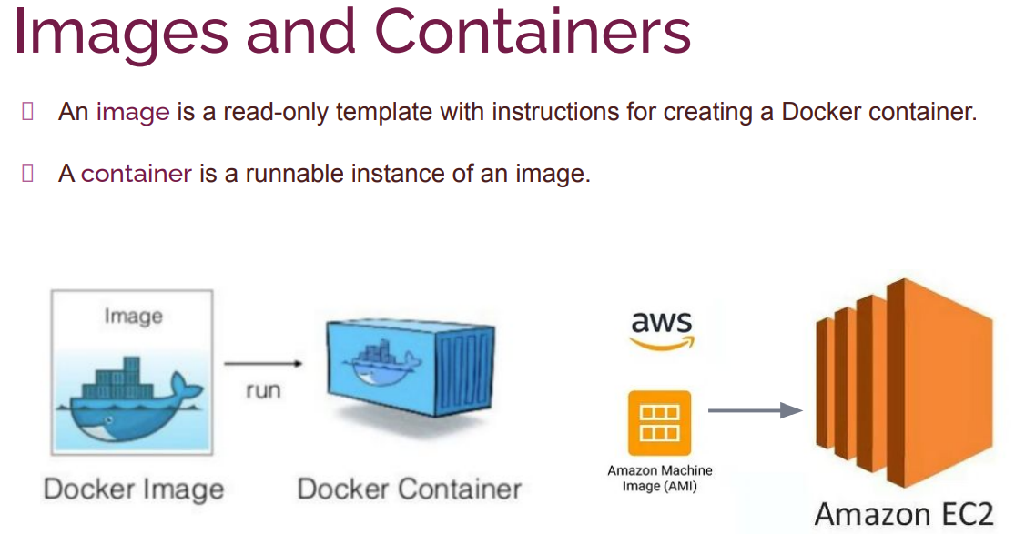

Slide 18
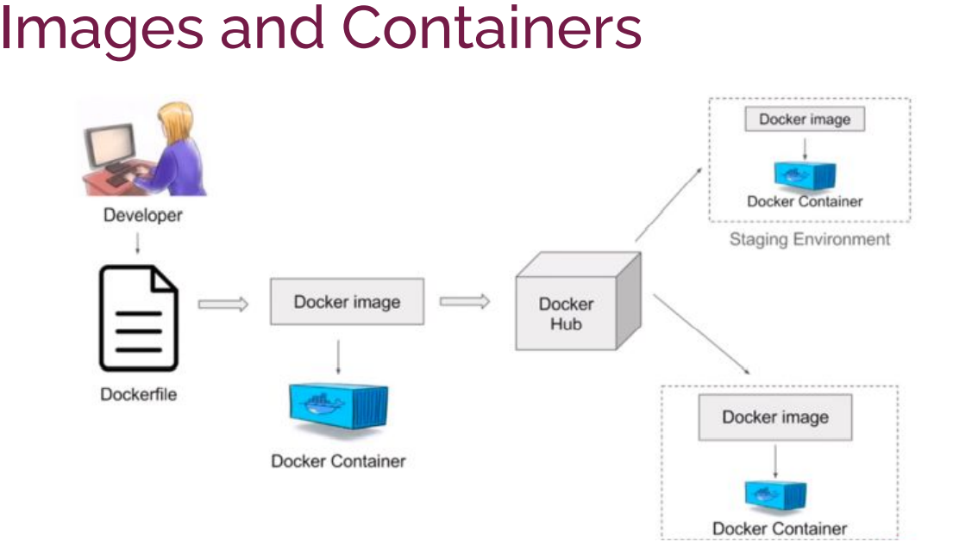

Slide 19
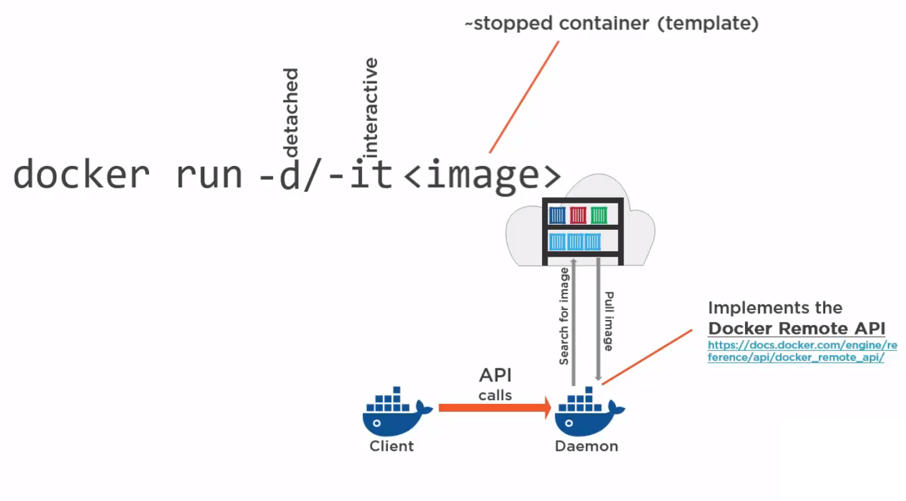
Running Container

Slide 20
