Slide 1
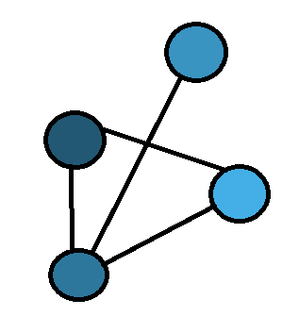
Exploring using MeSH tags for Literature Based Discovery
Timothy Baldock

Slide 2
Motivation
High rate of research
Very difficult for researchers to keep pace
Connections between research are not made as hypothesis
Literature based discovery addresses this
Create automated systems that can predict these links between research

Slide 3
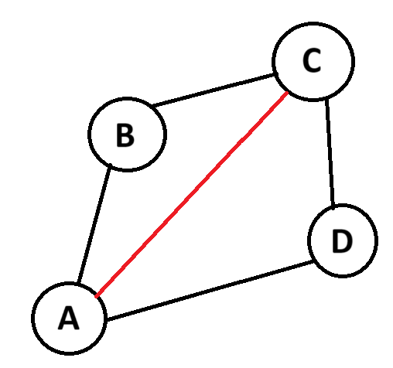
Defining the Data
What is a medical concept
What is a connection between concepts
What is a prediction

Slide 4
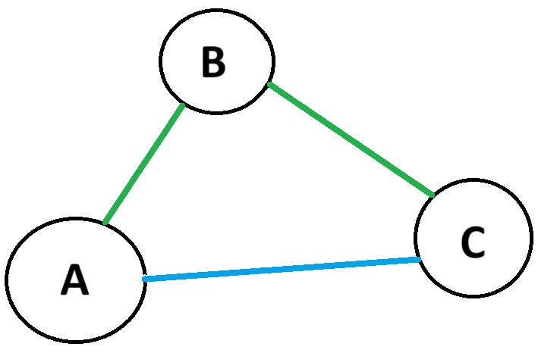
ABC system
ABC approach
If A is connected to B
And B is connected to C
Maybe A is connected to C

Slide 5
Machine Learning
GNN approach
Matrix factorization approach
Use wider trends and patterns in the data
Train on one set and predict on another

Slide 6
Research Questions
RQ1: What is the effect of edge weight on ABC prediction system?
RQ2: How do the three systems compare to each other?
RQ3: Can the systems be combined to create a better prediction system?

Slide 7
Implementation
Built a knowledge graph of MeSH terms
Implemented an ABC prediction system
Implemented an GNN prediction system
Implemented a Matrix factorisation prediction system
Combined these systems in different arrangements

Slide 8
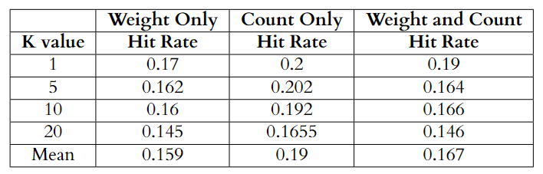
Evaluation
RQ1: What is the effect of edge weight on ABC prediction system?

Slide 9
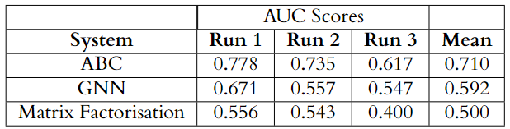
Evaluation
RQ2: How do the three systems compare to each other?

Slide 10
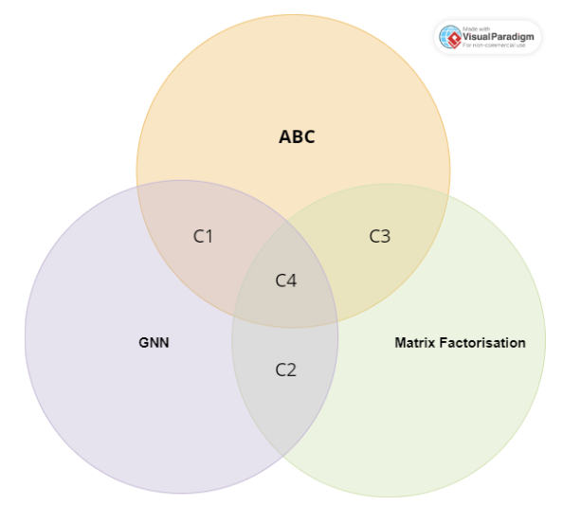
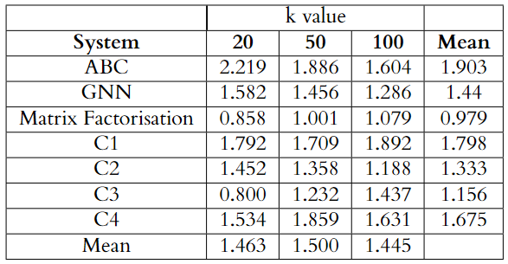
Evaluation
RQ3: Can the systems be combined to create a better prediction system?

Slide 11
Evaluation
The ABC system was the best.
This indicates that the other systems could be improved on
Exploring adding more information to the graph could improve these systems
Combining them in the future might make for interesting results

