Slide 1
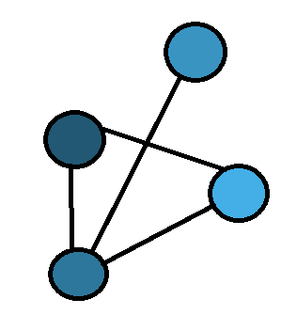
Exploring using MeSH tags for Literature Based Discovery
Timothy Baldock

Slide 2
Motivation
High rate of research
Very difficult for researchers to keep pace
Connections between research are lost
Literature based discovery addresses this
Create automated systems that can predict these links between research

Slide 3
Prediction Systems
What is a medical concept
What is a connection between concepts
What is a prediction
ABC approach
GNN approach
Matrix factorization approach

Slide 4
Research Questions
RQ1: What is the effect of edge weight on ABC prediction system?
RQ2: How do the three systems compare to each other?
RQ3: Can the systems be combined to create a better prediction system?

Slide 5
Implementation
Built a knowledge graph of MeSH terms
Implemented an ABC prediction system
Implemented an GNN prediction system
Implemented a Matrix factorisation prediction system
Combined these systems in different arrangements

Slide 6
Evaluation
RQ1: The weight of the edges reduced the quality of the ABC system’s predictions
RQ2: The ABC system performed the best
RQ3: The combinations, showed potential in being better, but did not prove that they are.

