Slide 1
Chronos Log
Distributed Log Aggregation System with SDN Prioritization
Computer Networks Mini Project — Topic #10 | Deliverable 2: Final Submission
PRESENTED BY
Yatin R • Gurukiran T • Mallesh

Slide 2
Distributed Logging: Problem & Solution
Network Bottlenecks in Microservices & SDN-Based QoS
THE PROBLEM (Best-Effort Networks)
THE SOLUTION (SDN-Based Quality of Service)
• Outage Telemetry Storms
System failures trigger sudden bursts of diagnostic logs from hundreds of microservices.
• Standardized DSCP Tagging
Applications tag packet importance directly in IPv4 headers using standard DiffServ (RFC 2474).
• FIFO Buffer Saturation
Standard network switches treat all packets equally using First-In, First-Out (FIFO) queuing.
• Dynamic SDN Flow Control
Software-Defined Networking (SDN) controllers monitor traffic and program switch flow tables on the fly.
• Indiscriminate Packet Loss
Switch buffer overflows drop critical database alarms alongside non-essential debug chatter.
• Hardware Priority Queuing
Switches route critical packets to reserved high-priority queues and safely shed disposable debug logs.
Consequence: Over 40% of critical outage alerts can be lost during network congestion.
Outcome: Guaranteed delivery and sub-10ms latency for mission-critical alerts.

Slide 3

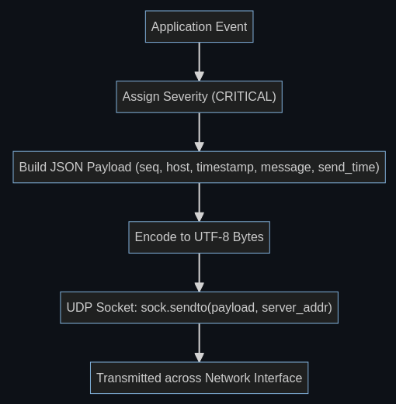
Architecture & Tech Stack: UDP Socket Transport
Client Logging & Zero-Overhead Telemetry
1. Python Socket Implementation
Raw UDP Sockets: Uses socket.AF_INET and SOCK_DGRAM for low-overhead transmission.
Simulated Services: auth-gateway, order-processor, and payment-service.
Datagram Format: Structured JSON encoded into lightweight UTF-8 bytes.
2. Why UDP for Microservice Logging?
Zero Handshake Delay: Sends instantly without waiting for a 3-way connection.
Non-Blocking Calls: App threads never freeze waiting for delivery receipts (ACKs).
Queue Drop Testing: Bypasses TCP window throttling to test actual switch queues.
3. Telemetry Tracking Payload
Sequence Numbers (seq): Allows the server to pinpoint exact dropped packets.
Send Timestamps: Measures precise end-to-end network latency in milliseconds.
Log Severities: 5 standardized levels from DEBUG up to CRITICAL.

Slide 4
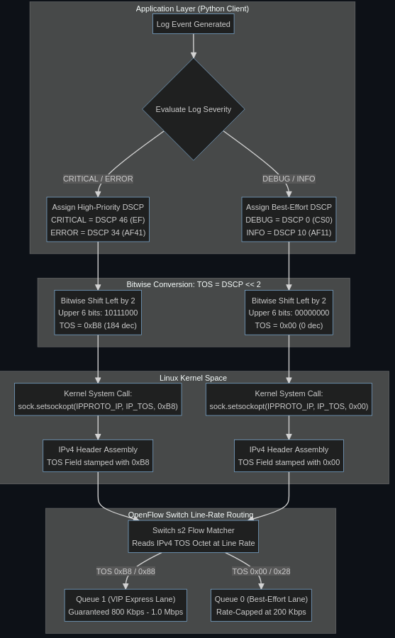

Architecture & Tech Stack: Kernel TOS & DSCP Tagging
Hardware-Level Priority Encoding in the IPv4 Header
1. Priority Tagging in the IP Header
Linux Socket API: sock.setsockopt(IPPROTO_IP, IP_TOS, tos_byte)
Hardware Speed: Switches inspect headers at line rate without reading JSON payloads.
Zero Overhead: Tags directly in the standard 20-byte IPv4 header (RFC 2474).
2. The Bit Shift (dscp << 2)
Bit Conversion: DSCP uses 6 bits, but the Linux socket API expects an 8-bit byte.
Left Shift: Shifting left by 2 positions places priority bits into the TOS field.
3. Severity to Queue Mapping
CRITICAL: DSCP 46 (EF) -> Byte 184 (0xB8) -> Priority Queue 1 (VIP Lane)
ERROR: DSCP 34 (AF41) -> Byte 136 (0x88) -> Priority Queue 1 (VIP Lane)
WARNING: DSCP 26 (AF31) -> Byte 104 (0x68) -> Default Queue 0
INFO / DEBUG: DSCP 10 / 0 -> Byte 40 / 0 -> Default Queue 0 (Best Effort)
Figure 2: IPv4 Header TOS Octet and DSCP Bit-Shift Mapping

Slide 5
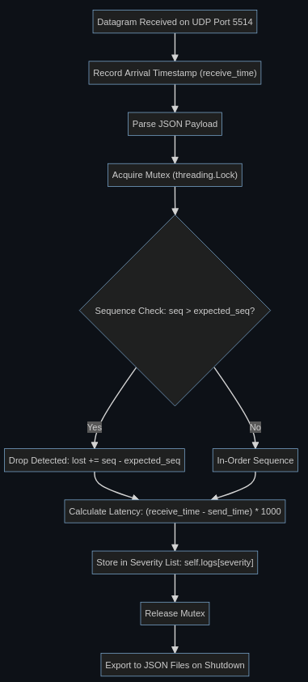
Architecture & Tech Stack: Central Log Server
Receiving Logs, Counting Drops, and Measuring Latency
1. Central Log Ingestion
UDP Socket: Binds to 0.0.0.0:5514 to ingest logs from all network hosts.
Classification: Automatically sorts incoming logs into 5 severity lists.
2. Multi-Threaded Architecture
Receiver Thread: Dedicated loop capturing incoming packets at maximum rate.
Reporter Thread: Prints real-time throughput and loss metrics every 10s.
Thread Lock: Protects shared metrics from concurrent data corruption.
3. Detecting Lost Packets (Sequence Gaps)
UDP Loss Problem: UDP has no native acknowledgment or drop warnings.
Sequence Gaps: Clients number logs (#1, #2...). A missing number proves a drop.
Formula: Lost Packets = Received Number - Expected Number
4. Latency Analysis & Reporting
Transit Delay: Latency = Server Receive Time - Client Send Time (in ms).
Automatic Export: Saves categorized JSON log files on shutdown.

Slide 6
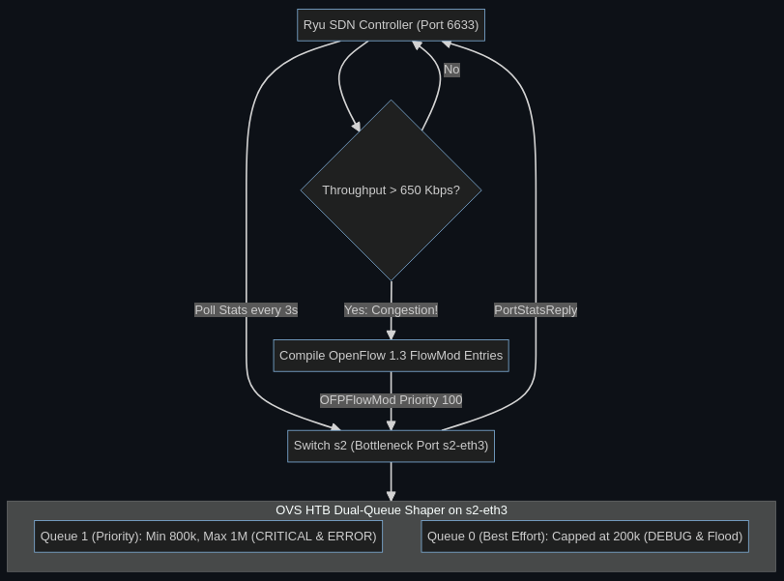
Architecture & Tech Stack: SDN & Quality of Service
Intelligent Traffic Management and Priority Queuing
1. SDN Control Plane (Deliverable 2)
Ryu Controller: Centralized Python controller managing network flow tables.
Open vSwitch (OVS): Software bridges equipped with Linux HTB queues for QoS.
OpenFlow 1.3: Standard protocol used for statistics polling and queue steering.
2. Challenging Scenario: Traffic Overload
Bottleneck Link: Core link between switches s2 and s4 capped at 1.0 Mbps.
5.0 Mbps Flood: Host h4 injects dummy UDP traffic, overloading link by 500%.
3. Dual Hardware Queues (QoS Bands)
Queue 1 (VIP Lane): Guaranteed 800k - 1.0 Mbps, reserved for Critical & Error logs.
Queue 0 (Best Effort): Throttled to 100k - 200 Kbps for flood & debug chatter.
4. Dynamic Flow Prioritization
Telemetry Polling: Ryu polls port byte counters every 4 seconds.
Congestion Trigger: When throughput exceeds 650 Kbps (65%), priority rules activate.
Queue Steering: Proactively routes DSCP 46/34 to Queue 1, shedding debug logs.
Figure 4: Ryu Controller Telemetry and OVS Hardware Queue Steering

Slide 7
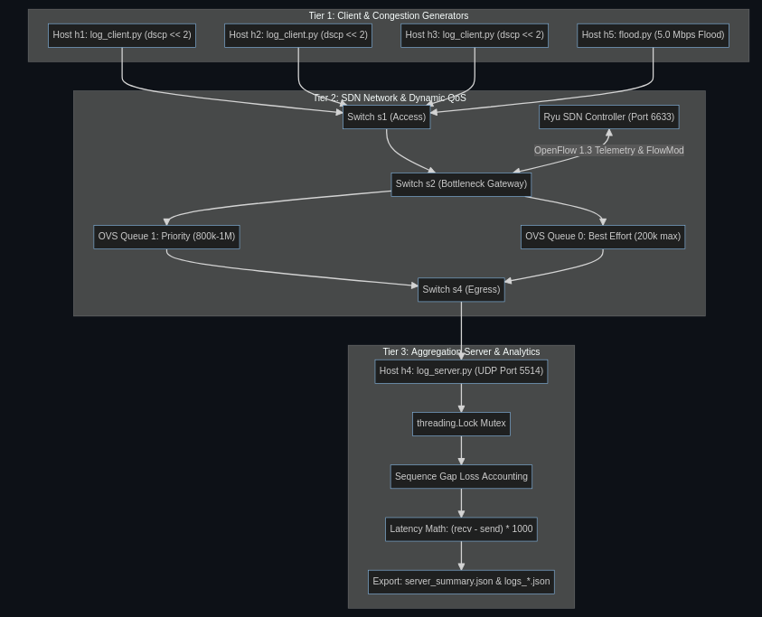
Complete System Architecture Overview
End-to-End Master Blueprint Combining Client, SDN Network, and Aggregation Tiers

Slide 8
Experimental Evaluation & Conclusion
Deliverable 2 Performance Comparison: Baseline FIFO vs. SDN QoS
Deliverable 2 Evaluation Takeaways
Zero Loss for Critical Alerts: Critical packet loss dropped from 41.7% to 0.0% under a 5.0 Mbps flood.
6x Faster Transit Delay: High-priority latency dropped from 48.5 ms down to 8.2 ms via dedicated VIP queue.
Controlled Load Shedding: Disposable DEBUG logs absorbed link saturation (66.7% loss), keeping the VIP lane clear.
Autonomous SDN Control: Ryu controller dynamically activated priority queues with zero manual intervention.
Severity | Baseline Loss | SDN Loss | Latency (Base → SDN) | Hardware Queue
CRITICAL | 41.7% | 0.0% | 48.5 ms → 8.2 ms | Queue 1 (Priority)
ERROR | 40.0% | 0.0% | 47.1 ms → 8.9 ms | Queue 1 (Priority)
WARNING | 39.2% | 25.4% | 45.0 ms → 18.4 ms | Queue 0 (Best Effort)
INFO | 40.8% | 48.2% | 44.2 ms → 24.6 ms | Queue 0 (Best Effort)
DEBUG | 43.1% | 66.7% | 43.9 ms → 28.1 ms | Queue 0 (Best Effort)

