Slide 1
JourneyWorks GCP Production
Solution Design & Architecture Appendix

Slide 2
Executive Summary & Assumptions
Cloud-native managed services for maximum scalability and Gemini LLM integration.
Key Assumptions & Specs:
Direct Communications: 30,000/month (~1,000/day)
Social Media Volume: Handled efficiently via GKE Autopilot scaling
Data Retention: 7 years (~2.5TB storage growth/year)
Compliance & Regulatory:
GDPR (Europe-west region), FCA/PRA Cloud Audit Logs, CMEK encryption

Slide 3
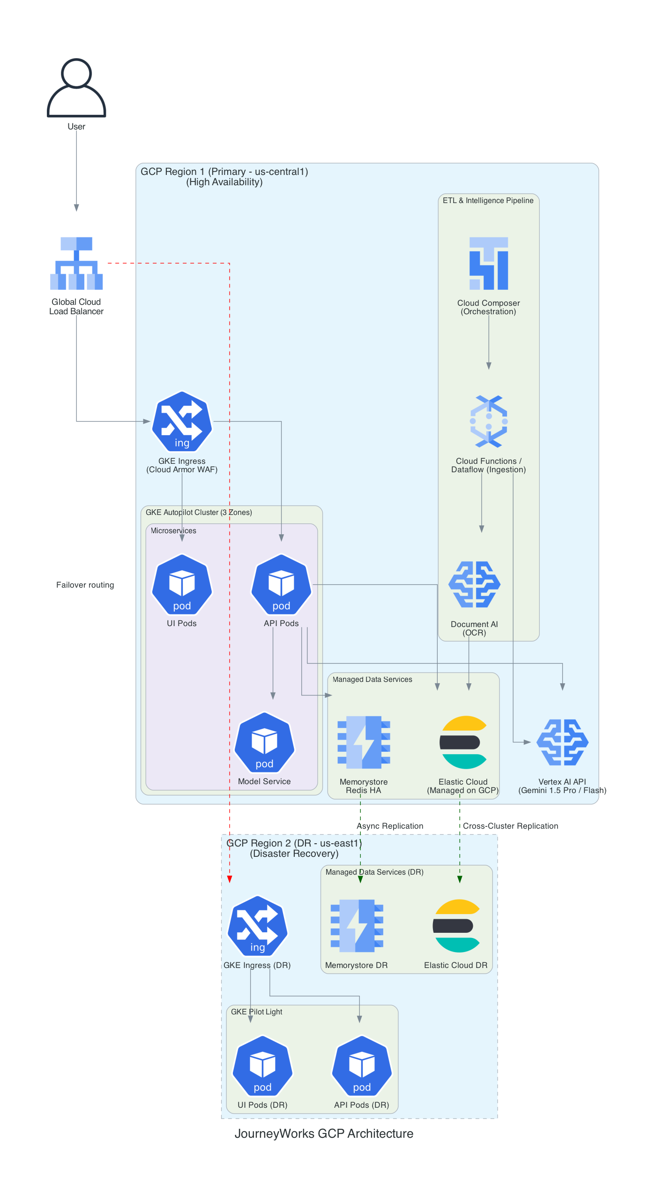
Solution Architecture (Multi-Region HA/DR)

Slide 4
GCP Service Specifications & Security
Compute & Orchestration:
GKE Autopilot: Zero-ops, autoscaling compute.
Cloud Composer & Dataflow: Robust ETL orchestration.
Data Layer:
Elastic Cloud (Managed HA) & Memorystore (Redis).
AI Integration & Security:
Native Vertex AI via Workload Identity Federation (No API keys).
Cloud Armor (WAF) & Private Service Connect.

Slide 5
Cost Estimation & Serverless ROI
GCP Serverless Cost Efficiency (vs On-Premise):
3-Year TCO: $2.49M (vs $2.88M for On-Premise/Hybrid)
Cloud natively avoids over-provisioning and massive up-front GPU CapEx.
Monthly OpEx Highlights:
Vertex AI Inference (75M tokens/mo): ~$400/month.
GKE Autopilot ensures you only pay for active resource consumption.
Development/testing split across right-sized SIT and full UAT environments.

