Slide 1
Stock Market Portfolio Analysis & Investment Strategy (2015–2020)
Kartikey Singh
upGrad & IIITB | Data Science Program (Feb 2025)
DD/MM/YYYY

Slide 2
Objective
Analyze stock market performance from 2015–2020
Evaluate risk, return, and correlations
Construct optimized portfolios for two investor profiles
Compare portfolio performance using return, volatility, and Sharpe ratio
Visualize insights using Python analysis and Power BI dashboards

Slide 3
Investor Profiles
Investor risk preferences used for portfolio construction
Patrick (Conservative Investor)
Initial Capital: $500,000
Goal: $1,000,000 in 5 years
Strategy:
Low volatility stocks
Stable growth
High Sharpe ratio
Capital preservation
Peter (Aggressive Investor)
Initial Capital: $1,000,000
Goal: Maximize returns
Strategy:
High-growth stocks
Higher volatility tolerance
Momentum-based investments

Slide 4
Dataset Description
Overview of data sources used for analysis
Historical stock price data (CSV)
Time Period: Oct 2015 – Sept 2020
Sectors Analyzed:
Technology
Banking
Aviation
Pharmaceutical
Benchmark: S&P 500

Slide 5
Data Preparation & Exploration
Data preprocessing and exploratory analysis workflow
Data Cleaning Steps
Converted date formats
Exploratory Analysis:
Removed duplicate records
Aligned all stocks using Date
Merged datasets into a unified time-series dataframe
Daily returns
Annual returns
Volatility (risk)
Sharpe ratio
Correlation analysis

Slide 6
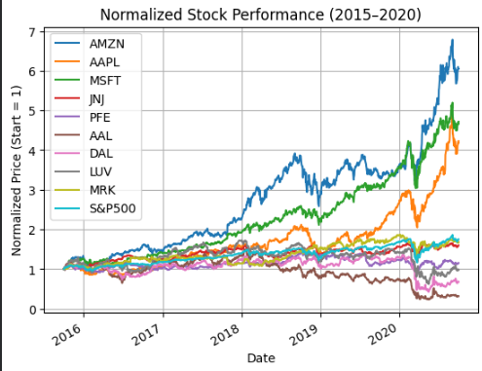
Market Insights
Insights from historical stock market trends
Key Observations from Data
Technology sector dominated performance
AMZN
MSFT
AAPL
Aviation sector showed high volatility
AAL, DAL, LUV
Pharmaceutical stocks provided stability
JNJ
PFE
MRK
Market benchmark:
S&P 500 closely tracks large technology stocks

Slide 7
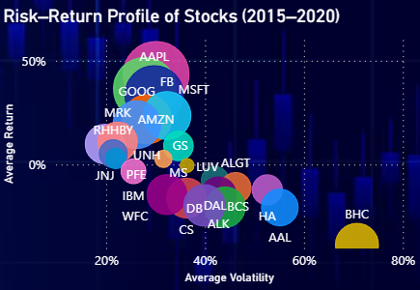
Risk–Return Analysis of Stocks (2015–2020)
Understanding the relationship between risk, return, and Sharpe ratio
Explain:
X-axis → Volatility (Risk)
Y-axis → Annual Return
Bubble size → Sharpe Ratio
Key insight:
AMZN, MSFT, and AAPL deliver strong risk-adjusted returns.
Aviation stocks show high risk with weaker returns.

Slide 8
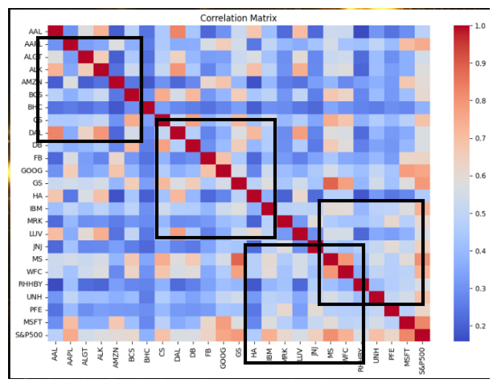
Correlation Analysis
Understanding relationships between stock movements
Key findings:
Technology stocks show strong correlation
Banking stocks tend to move together
Aviation stocks are highly correlated
Pharmaceutical stocks show moderate correlation
Insight:
Diversifying across sectors helps reduce portfolio risk because stocks within the same sector move together.

Slide 9
Portfolio Construction
Portfolio allocation based on investor risk profiles
Patrick’s Portfolio (Conservative)
Stocks Selected:
JNJ
PFE
MRK
UNH
MSFT
Reason:
Stable earnings
Lower volatility
Strong healthcare sector performance
Peter’s Portfolio (Aggressive)
Stocks Selected:
AMZN
Reason:
High growth potential
Technology sector dominance
Momentum-based investing
AAPL
MSFT
ALGT
UNH

Slide 10

Portfolio Performance
Performance comparison of conservative and aggressive portfolios
Insights:
• Patrick achieves his goal of doubling capital • Peter generates higher returns but higher volatility • Peter’s portfolio delivers better risk-adjusted performance

Slide 11
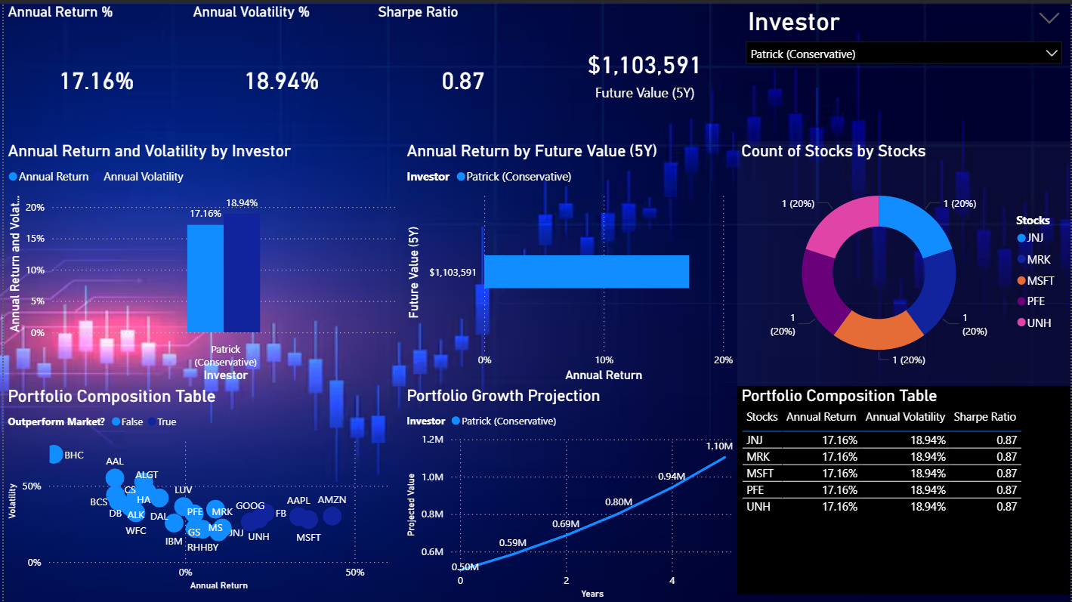
Dashboard Overview
Interactive dashboard for portfolio performance analysis
Features:
Risk vs Return visualization
Portfolio performance comparison
Investor-based filtering
Interactive stock performance analysis
Purpose:
Provides an interactive
dashboard to analyze
portfolio performance,
risk metrics, and
investment insights.
Power BI Dashboard

Slide 12
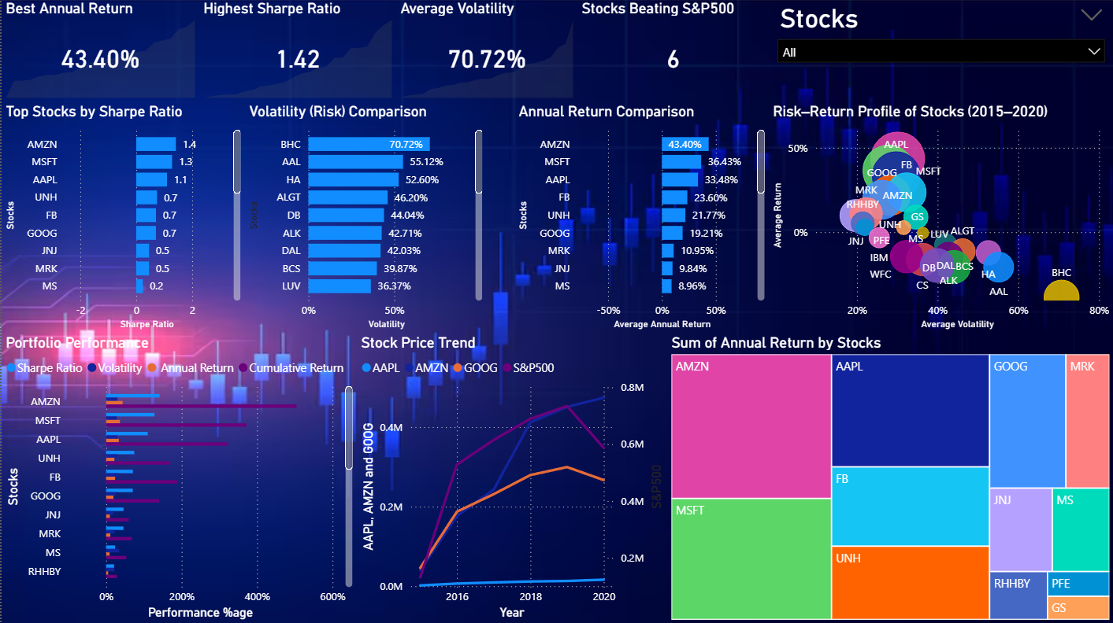
Final Conclusion
Key insights from portfolio analysis and dashboard visualization
Key Takeaways
Technology stocks outperformed the market
Healthcare stocks provided stable returns
Sector diversification reduces portfolio risk
Patrick’s portfolio suits conservative investors
Peter’s portfolio offers higher growth potential
Final Insight:
Data-driven portfolio construction helps investors balance risk, return, and diversification.

Slide 13
Future Improvements
Potential extensions for advanced portfolio analytics
Include more asset classes (ETFs, bonds)
Portfolio optimization using the Efficient Frontier model
Machine learning models for stock price prediction
Real-time portfolio monitoring dashboards

