Slide 1
Stock Portfolio Investment Strategy (2015–2020)
Data-Driven Portfolio Recommendations
Kartikey Singh
upGrad & IIITB | Data Science Program (Feb 2025)
10/03/2026

Slide 2
Investment Goal
Framework for analyzing market performance and portfolio strategy
Analyze stock market performance
Identify top-performing sectors
Build portfolios for two investors
Optimize risk vs return

Slide 3
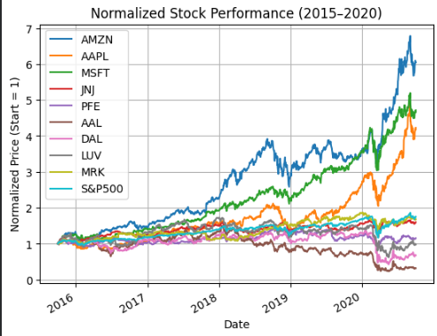
Market Trends
Sector performance insights (2015–2020)
• Technology sector delivered the highest returns • Healthcare stocks showed stable performance • Aviation sector experienced high volatility

Slide 4
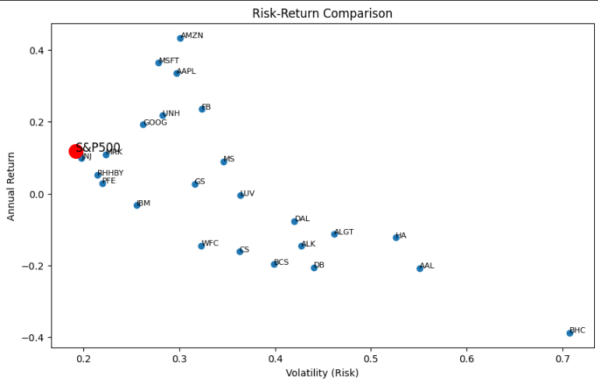
Risk vs Return Analysis
Stock performance comparison (2015–2020)
Higher returns typically involve higher risk
Tech stocks delivered strong returns with moderate risk
Diversification reduces overall portfolio risk

Slide 5


Two Investment Strategies
Strategic portfolio allocation for varying investment objectives
Conservative Portfolio
Goal: Stable growth with lower risk
Stocks:
JNJ
PFE
MRK
UNH
MSFT
Focus:
Aggressive Portfolio
Goal: Maximize return
Stocks:
AMZN
AAPL
MSFT
ALGT
UNH
Focus:
Technology growth
Momentum investing
Higher risk tolerance
Healthcare stability
Strong risk-adjusted returns
Lower volatility

Slide 6
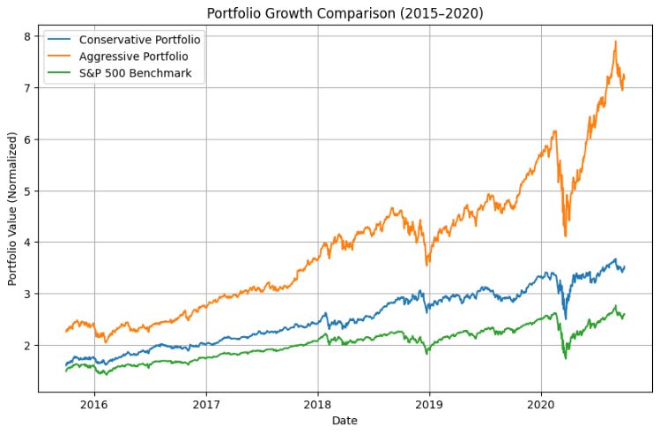
Portfolio Results
Growth and risk-adjusted performance of portfolio strategies
• Conservative portfolio shows stable capital growth • Aggressive portfolio delivers higher return potential • Diversification improves risk-adjusted performance

Slide 7
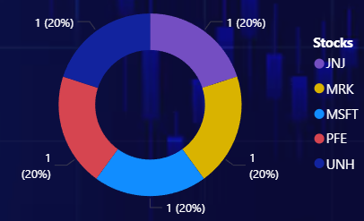
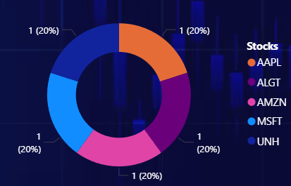

Recommendations
Portfolio allocation strategy based on risk and return insights
Technology stocks delivered the strongest growth
Healthcare stocks provided stable returns
Diversification reduces overall portfolio risk
Conservative Stocks Allocation
Recommendations
✔ Conservative investors → Healthcare + blue-chip tech stocks ✔ Aggressive investors → High-growth technology stocks ✔ Diversified portfolios reduce overall risk
Aggressive Stocks Allocation

Slide 8

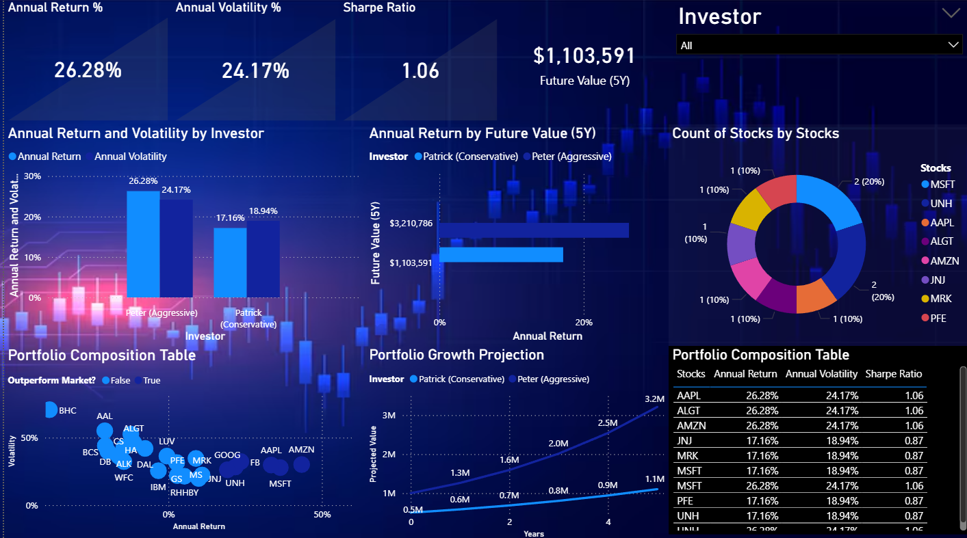
Dashboard
Interactive portfolio performance and risk monitoring
The dashboard helps investors track portfolio performance, assess risk, and identify investment opportunities.

Slide 9
Final Insight
Key investment takeaways
Growth → Technology stocks
Stability → Healthcare stocks
Balanced strategy → Diversified portfolio

