Slide 1
Teaching International Students
What to Expect and How to Communicate

Slide 2
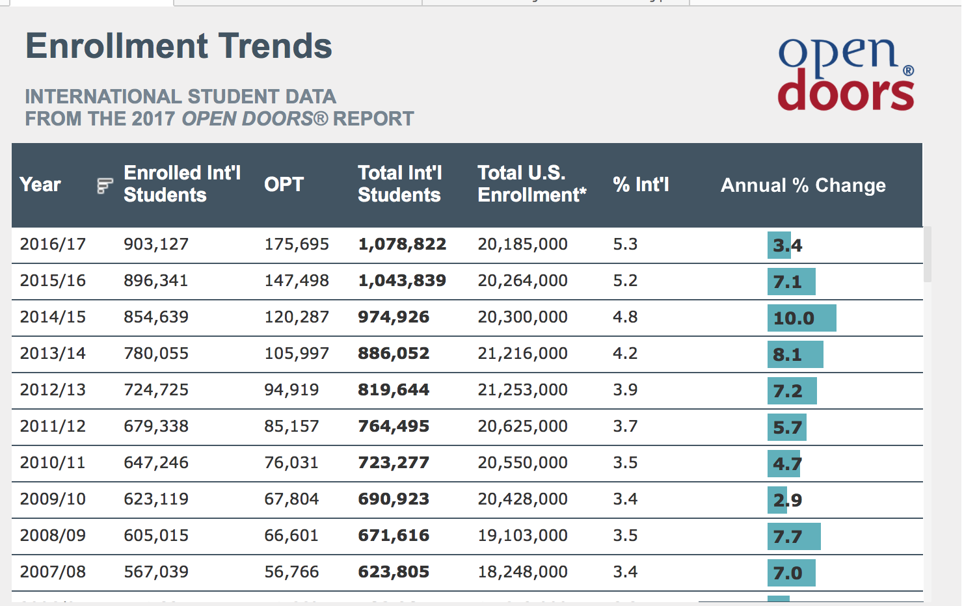
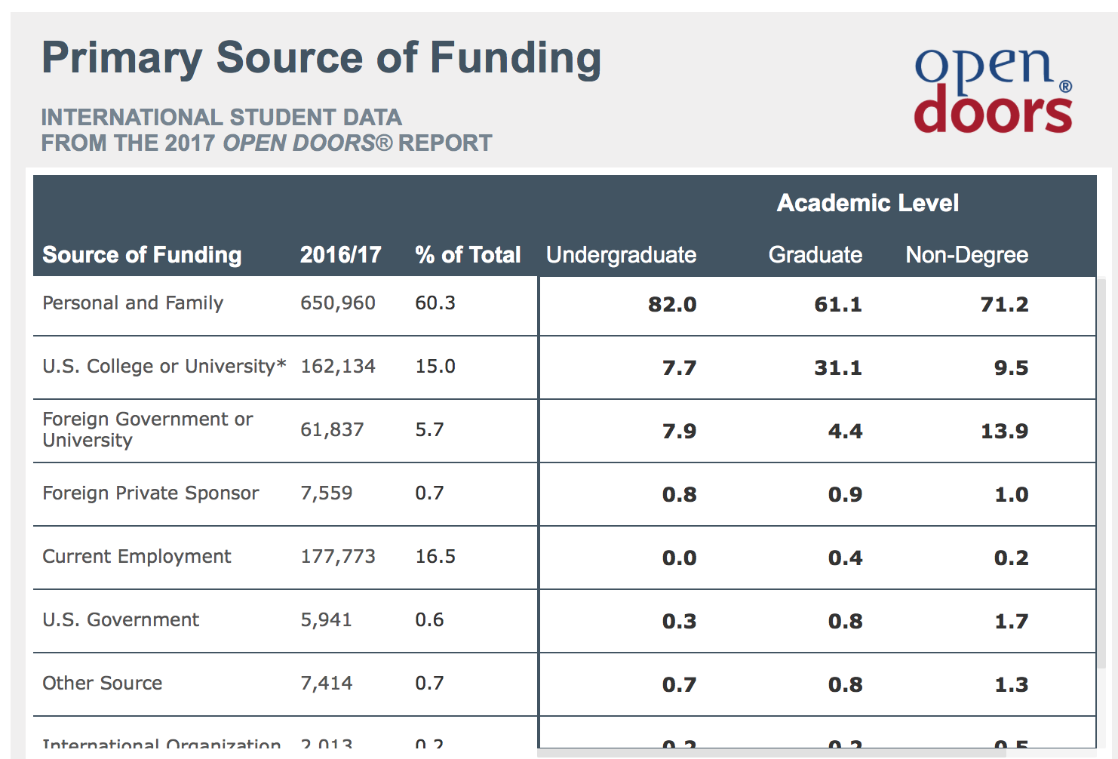
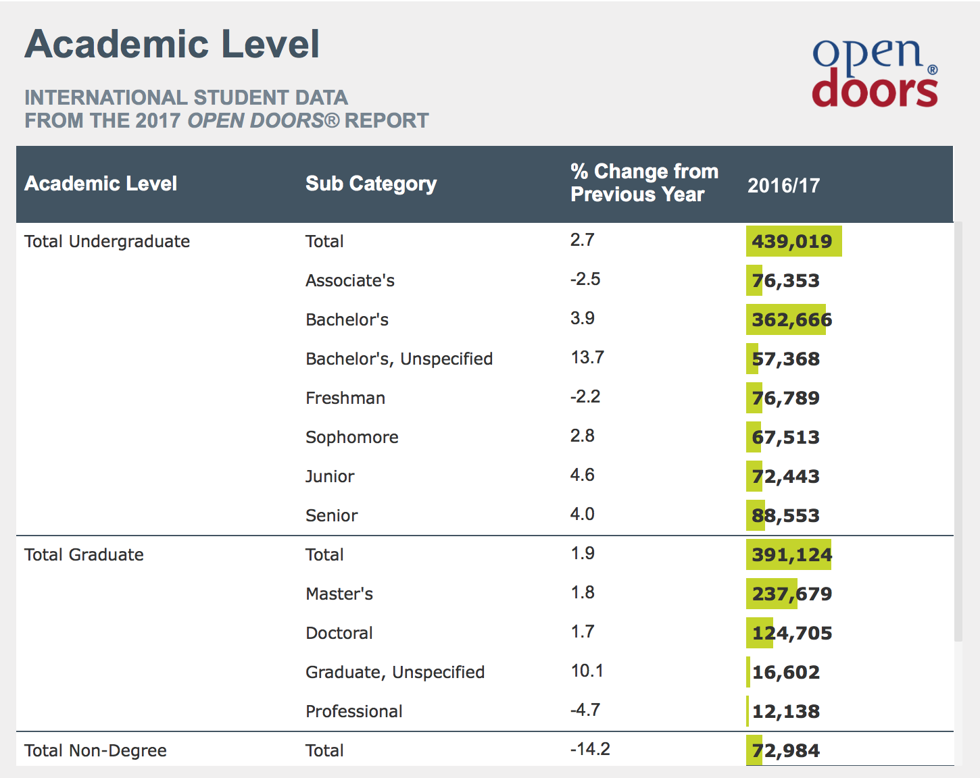
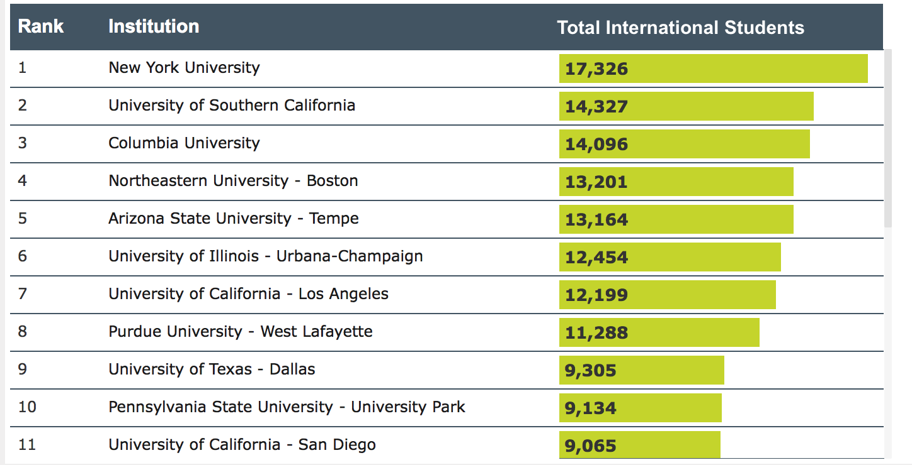
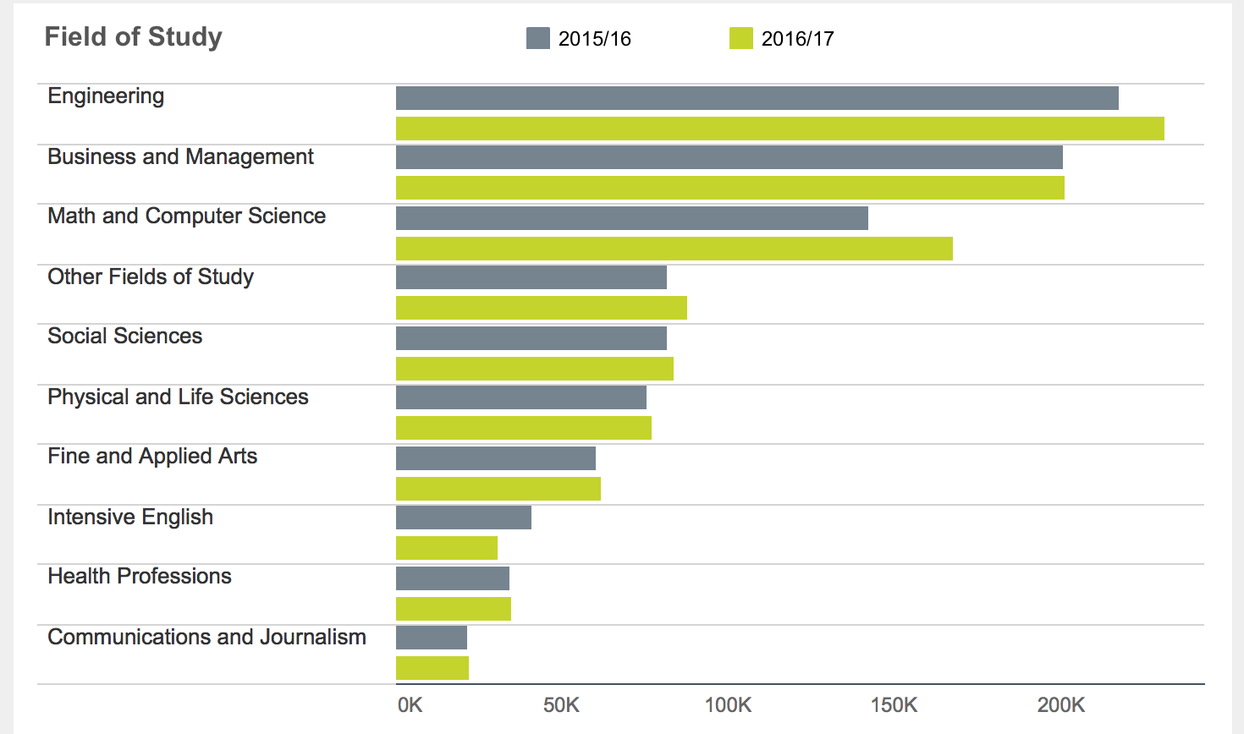
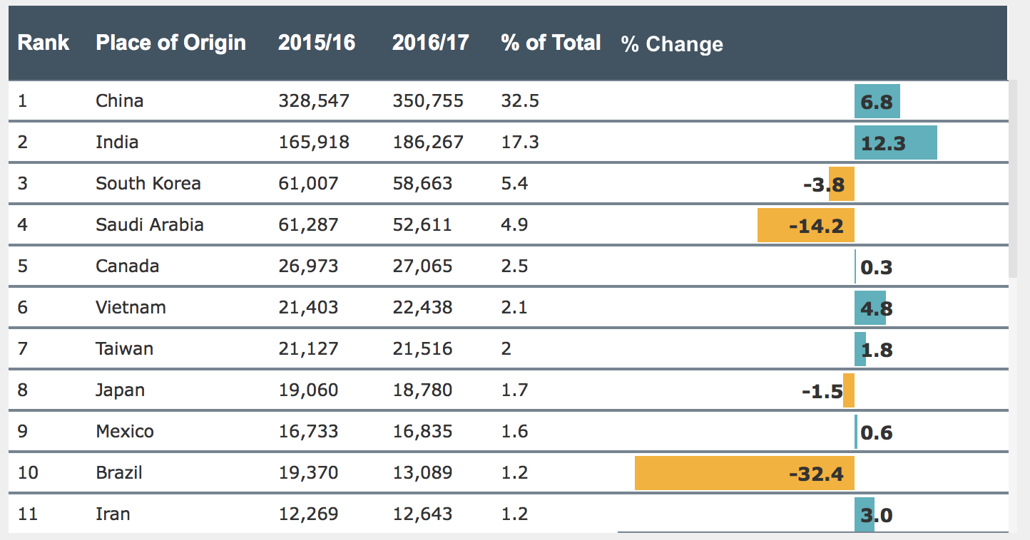
New Trend with International Students
Enrollment
Places of Origin
Leading Host
Institutions
Fields of Study
Academic Level
Primary Source
of Funding

Slide 3
Perspectives on International Students
Interview with International students
  Video 1
Interview with American students
  Video 2

Slide 4
Challenges
Teaching students from countries where English is not their first language
Almost 30% classes are filled by internationals students.
  Spring 2018: 740 international students
How to encourage participation from international students?
How to engage international students?

Slide 5
Keys to Successful Teaching
Keys to successful teaching in a class of international students
Perception
Self-awareness and awareness of others
Inclusive curriculum
  According to the Association of American Colleges & Universities, inclusive classrooms are learning spaces where “active, intentional, and ongoing engagement with diversity” occurs “in ways that increase awareness, content knowledge, cognitive sophistication, and empathetic understanding of the complex individuals interact within systems and institutions.” (source）

Slide 6
Inclusive Teaching
http://www.incurriculum.org.uk/main/the-project/what-is-an-inclusive-curriculum
Group Activities: Please share your ideas of inclusive teaching.

