Slide 1
AN
ORAL PRESENTATION
OF
PROJECT PROPOSAL DEFENCE
ON
DEVELOPMENT OF A WEB-BASED HOSTEL ALLOCATION
MANAGEMENT SYSTEM
BY
ALADESUYI TITILAYOMI BLESSING
SEN/17/2492

Slide 2
INTRODUCTION
Hostel by definition is an establishment which provides cheap food and lodging for specific group of people, it is also seen as a home for students when staying away from their home. It has large well ventilated dormitories and single rooms and is situated in the school premises. To manage the hostel facilities, a lot of data need to be maintained such as number of student hostel can accommodate, hostel rules and regulation, hostel fee, hostel in and out of student, guest and visitor record and so on. So, this needs the system which has an ability to allocate rooms and capture all kind of data and information and analyze it properly for smooth functioning of the hostel.

Slide 3
LITERATURE REVIEW
S/N | Description | Motivation | Objectives | Methodology | Contribution to knowledge | Limitation
1. | Kathiresh M and Naveenkumar P, “Hostel Management System”, 2023 | The problem was that the number of students enrolling every year was always increasing which results in manual registration of accommodation problems. | To eliminate the shortcomings of manual processes and to usher in a new era of increased efficiency and user-friendliness. | The model used is a Computerized System with a GUI-oriented design, | Developing a computerized system with GUI-oriented interface | the design of the Hostel Management System did not focus on student’s individual preferences and personal characteristics
2. | K. Ayanlowo, O. Shoewu, S. O. Olatinwo, O. O. Omitola, and D. D. Bablola, “Development of an Automated Hostel Facility Management System”, 2014. | the existing hostel procedure for students’ allocation was manual which is associated with inadequacies as more personnel are often required and a lot of times are wasted | implement an electronic hostel management system that will streamline registration process, reduce administrative tasks and paper work so as to improve the registration cycle process flow | Hypertext Pre-processor (PHP) and MySQL database were used to implement the research work | The electronic hostel management system for student’s registration increased the speed of the registration | the design of this study incorporates students who are incompatible with each other in the same room

Slide 4
LITERATURE REVIEW
S/N | Description | Motivation | Objectives | Methodology | Contribution to knowledge | Limitation
3. | Aysha Nafrin.T. H, Husna Nasreen M. H, “Design and Implementation of an Internet Based Hostel Accommodation System”, 2022 | The researcher discovered that most hostels were too crowded, poorly built, and lack proper manual registration procedure. | The primary objective of this thesis is to design and implement an Internet-Based Hostel Accommodation System. | Hostel admissions, fees, room, mess allotment - Generates related reports for smooth transactions | the project offers a valuable solution to the challenges faced in educational accommodation management. | the success of the system may be subject to the degree of user training and acceptance
4. | K. E. Omopariola and M. O. Tirimisiyu, “Design and Implementation of Computerized Hostel Allocation Management System,” Ogun State Institute of Technology, 2015. | The motivation of the project is to address the accommodation problem faced by students and school management in higher institutions due to the growing number of students. | Design a computer-driven hostel allocation system for allocating hostel rooms to students and generate reports on hostel occupancy | Visual Basic (VB) is the front-end technology and MS Access is the backend technology. | Facilitate timely allocation of hostel rooms to students and enable management to plan on improving hostel living condition | the research still did not address the problem of shared control over choice of room amongst students

Slide 5
MOTIVATION
The main motivation is to encourage an easy allocation of hostel to student without any bias or hierarchy involved and this will be done by building a trusted web-based hostel system to manage the activities of the Hostel at the beginning of every session
The research is also about building a hostel allocation system to reduce the amount of time that students spend in waiting for a hostel allocation and easy management of the system

Slide 6
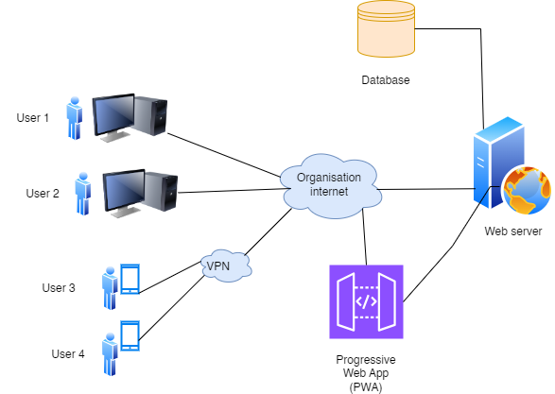
METHODOLOGY
Figure 1: System Architecture of the Proposed System

Slide 7
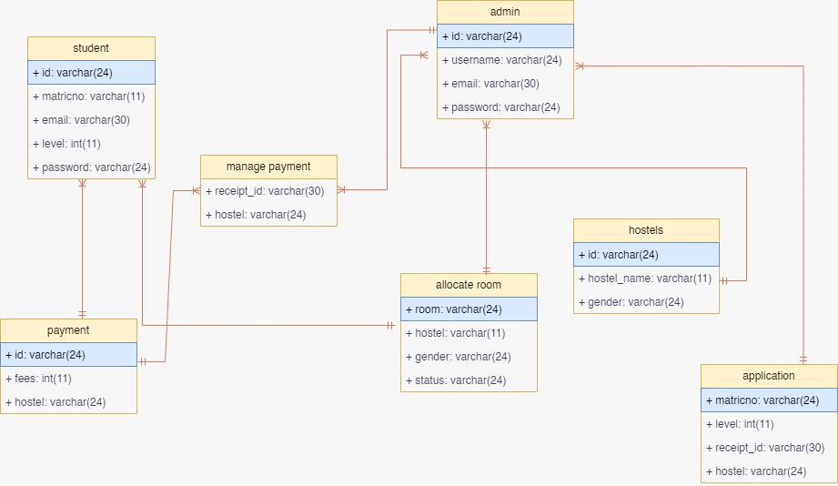
METHODOLOGY
Figure 2: Database Class Diagram

Slide 8
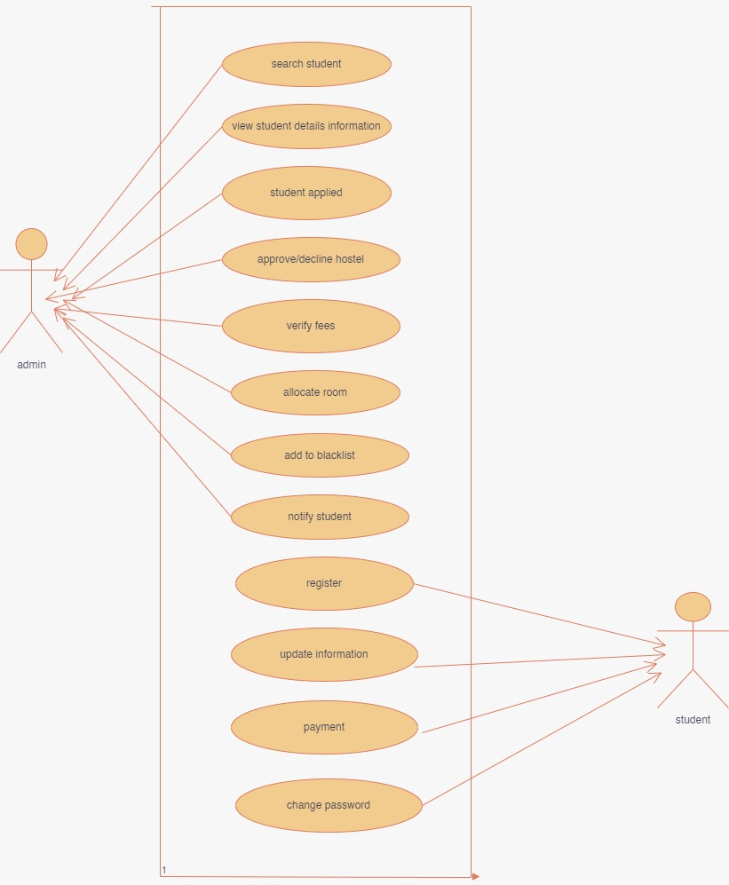
METHODOLOGY
Figure 3: Use Case of The Application

Slide 9
IMPLEMENTATION
The room allocation function allocates room based on the application date.
Establish a connection to your MySQL database.
Execute a SQL query to retrieve the list of applicants from the database.
Order the applicants based on their application time in ascending order (FCFS).
Fetch all applicants into an array.
Call a function (getAvailableRooms) to determine the number of available hostel rooms.
Use a "foreach" loop to iterate through each applicant in the array obtained from the database result.
If there are available rooms, proceed to the next step (allocate room).
If there are no available rooms, print a message indicating that there are no available rooms for the current applicant.
Call a function (allocateRoom) to assign a room to the current applicant.
Update the database to reflect the room allocation.
If successful, print a message indicating the successful allocation.
If unsuccessful, print an appropriate error message.
Continue the loop until all applicants have been processed.

Slide 10
EXPECTED CONTRIBUTIONS
The development of the web-based hostel allocation management system for school hostel would increase the speed of allocating rooms to students and eradicate any form of challenges facing the management of activities in the hostels
Due process to be carried out before allocating rooms will be established.
Also eradicate any impartiality in allocating rooms for students.

Slide 11
CONCLUSION
The development of the web-based hostel allocation management system serves a dual purpose: to enhance the speed and fairness of room allocation for students and to empower staff to efficiently manage and document hostel records and activities. With its focus on speed, efficiency, and impartiality, this system is poised to streamline hostel operations and provide a more equitable living environment for all students.

Slide 12
REFERENCES
Austine J.J (2006)."Hostel management, definition . HostelManagement.com. p. 12.
Johnson A.I (2003). Define: Hostel - what is a hostel? | Hostel Management
Wiki(2014). Limitation of web based hostel management system.
A. R. Mat and S. A. Abd Rahman, “A General Framework Design for eHostel Allocation System : A Case Study on Alamanda College,” UNIMAS, 2006
D. B. Hammad, J. M. Musa, A. G. Rishi, and I. I. Ayuba, “Criteria for
The Selection Of Students’ Accommodation Model in Nigeria Tertiary
Institutions Using Analytic Hierarchy Process,” Acad. Res. Int., vol. 4,
no. 5, pp. 550–556, 2013.
K. Ayanlowo, O. Shoewu, S. O. Olatinwo, O. O. Omitola, and D. D.
Bablola, “Development of an Automated Hostel Facility Management
System,” J. Sci. Eng., vol. 5, no. 1, pp. 1–10, 2014, Accessed: Aug. 05,
2020. [Online]. Available: www.oricpub.com.

Slide 13
THANK YOU

