Slide 1

Chapter 3
Data and Signals
Copyright © The McGraw-Hill Companies, Inc. Permission required for reproduction or display.

Slide 2

Note
To be transmitted, data must be transformed to electromagnetic signals.

Slide 3
3-1 ANALOG AND DIGITAL
Data can be analog or digital. The term analog data refers to information that is continuous; digital data refers to information that has discrete states. Analog data take on continuous values. Digital data take on discrete values.
Topics discussed in this section:
Analog and Digital Data
Analog and Digital Signals
Periodic and Nonperiodic Signals

Slide 4
Note
Data can be analog or digital.
Analog data are continuous and take continuous values.
Digital data have discrete states and take discrete values.

Slide 5
Note
Signals can be analog or digital.
Analog signals can have an infinite number of values in a range; digital signals can have only a limited
number of values.

Slide 6
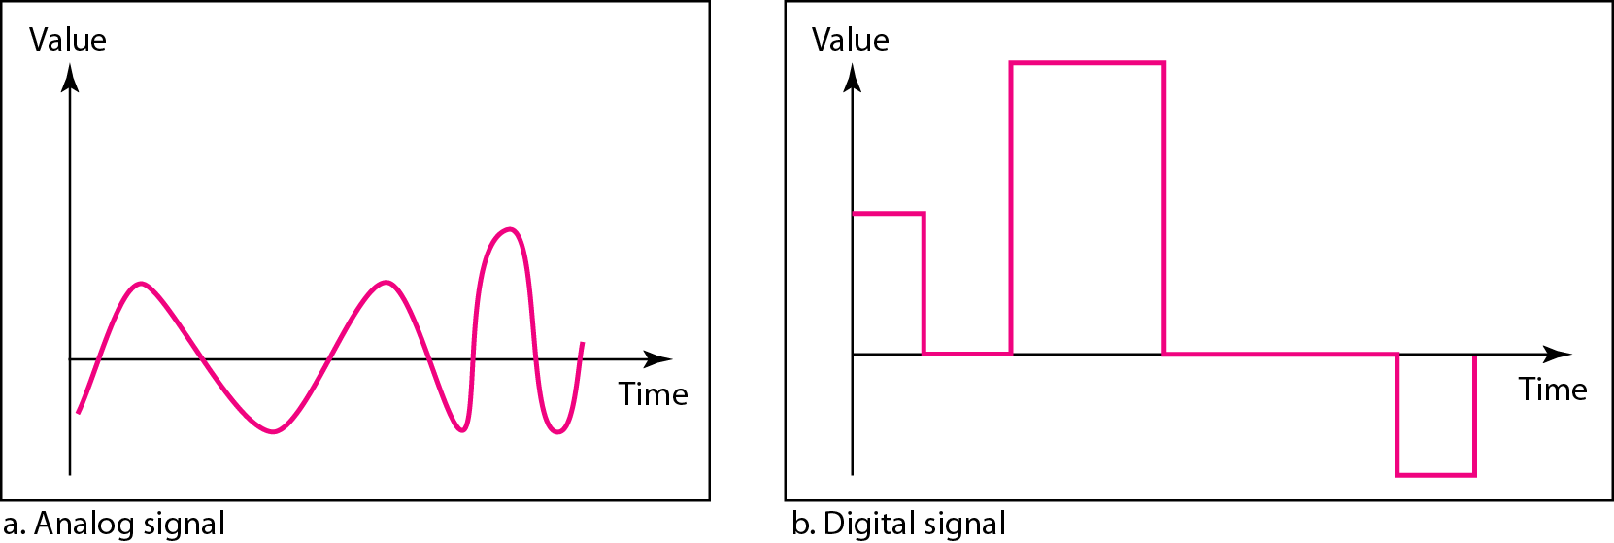
Figure 3.1 Comparison of analog and digital signals

Slide 7
Note
In data communications, we commonly use periodic analog signals and nonperiodic digital signals.

Slide 8
3-2 PERIODIC ANALOG SIGNALS
Periodic analog signals can be classified as simple or composite. A simple periodic analog signal, a sine wave, cannot be decomposed into simpler signals. A composite
periodic analog signal is composed of multiple sine waves.
Topics discussed in this section:
Sine Wave
Wavelength
Time and Frequency Domain
Composite Signals
Bandwidth

Slide 9
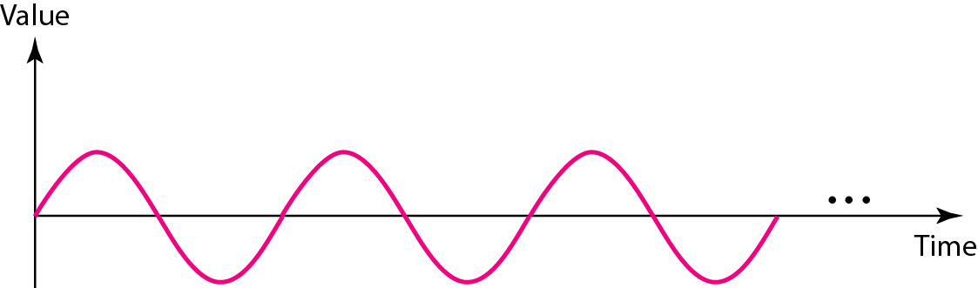
Figure 3.2 A sine wave

Slide 10
Note
We discuss a mathematical approach to sine waves in Appendix C.

Slide 11
Example 3.1
The power in your house can be represented by a sine wave with a peak amplitude of 155 to 170 V. However, it is common knowledge that the voltage of the power in U.S. homes is 110 to 120 V. This discrepancy is due to the fact that these are root mean square (rms) values. The signal is squared and then the average amplitude is calculated. The peak value is equal to 2^{½} × rms value.

Slide 12
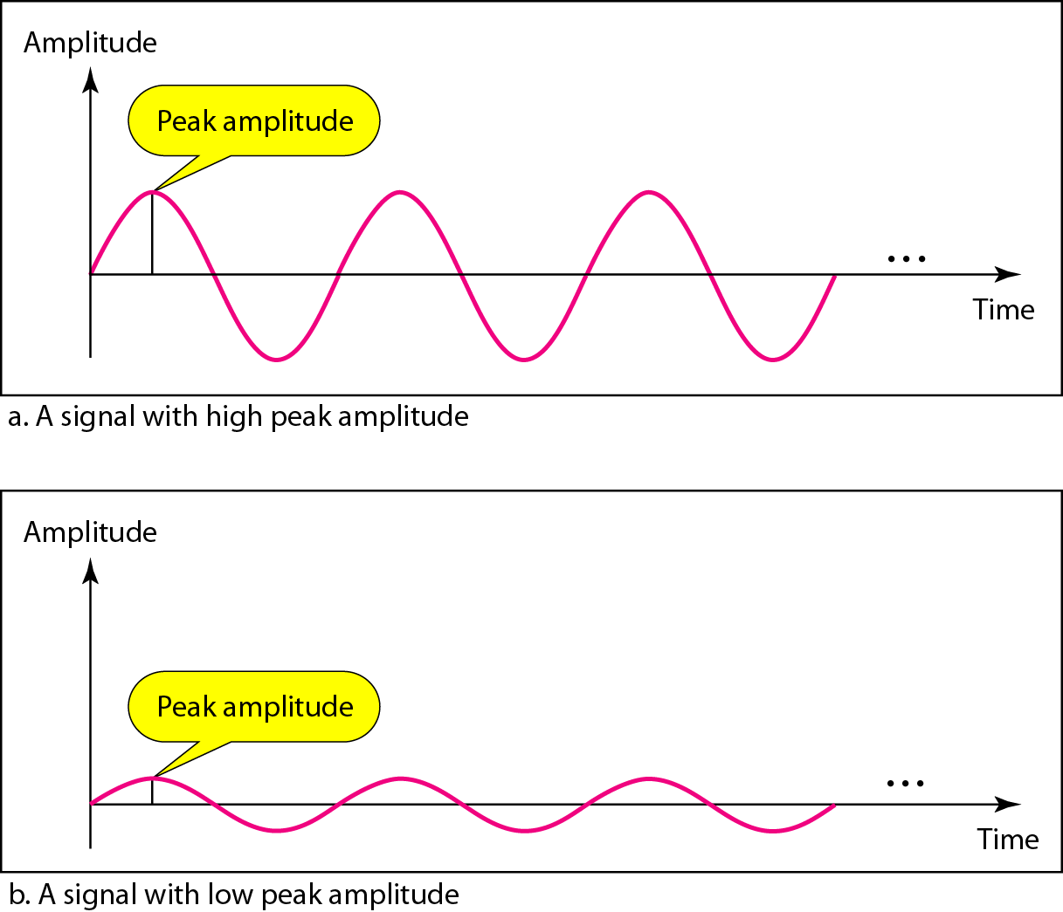
Figure 3.3 Two signals with the same phase and frequency,
but different amplitudes

Slide 13
Example 3.2
The voltage of a battery is a constant; this constant value can be considered a sine wave, as we will see later. For example, the peak value of an AA battery is normally
1.5 V.

Slide 14

Note
Frequency and period are the inverse of each other.

Slide 15
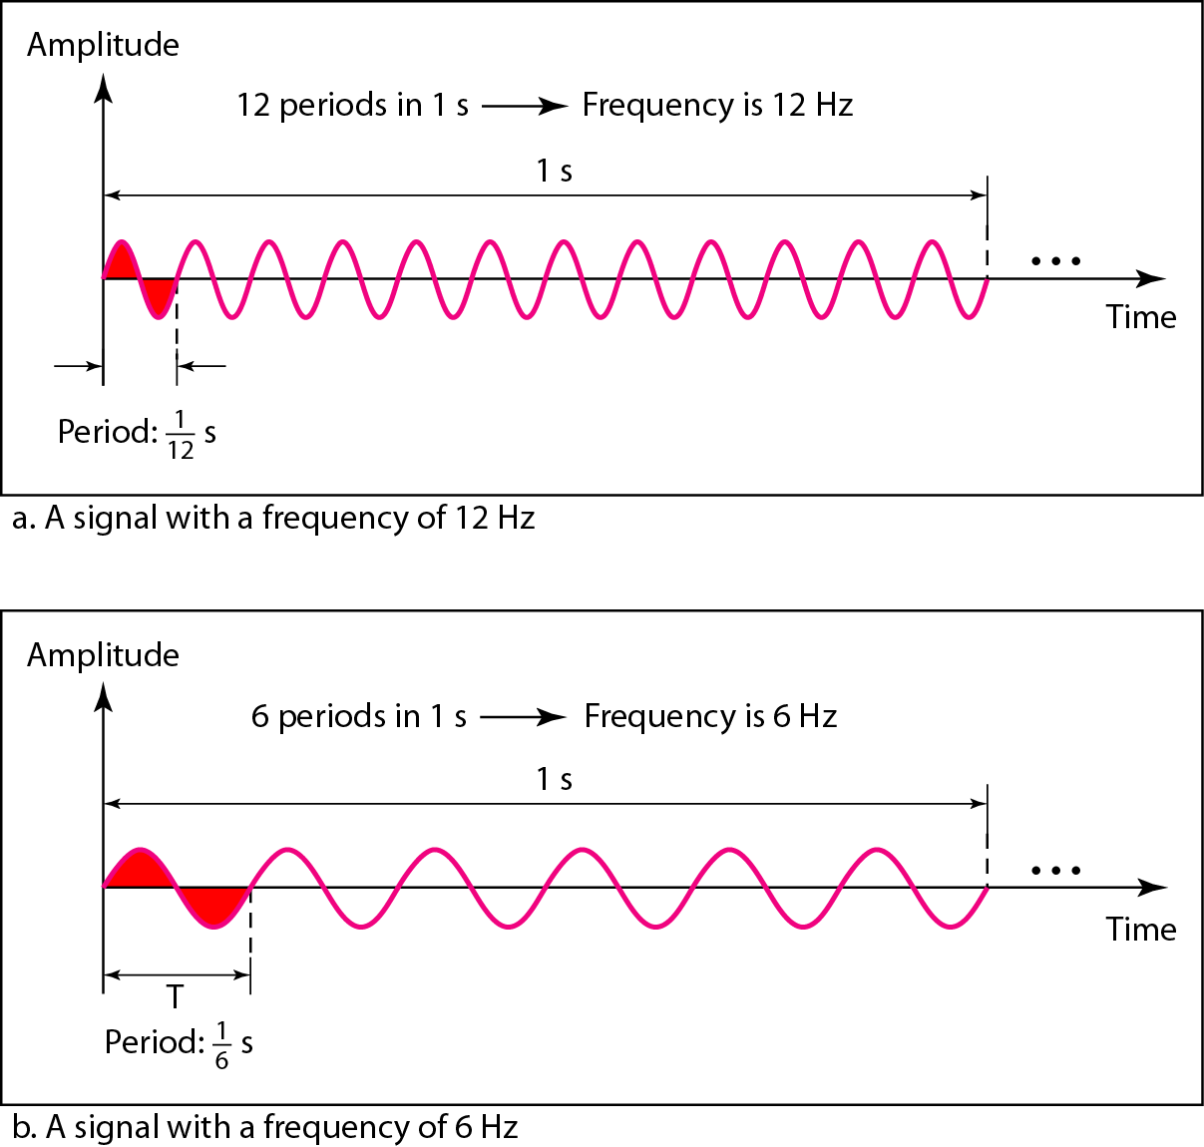
Figure 3.4 Two signals with the same amplitude and phase,
but different frequencies

Slide 16
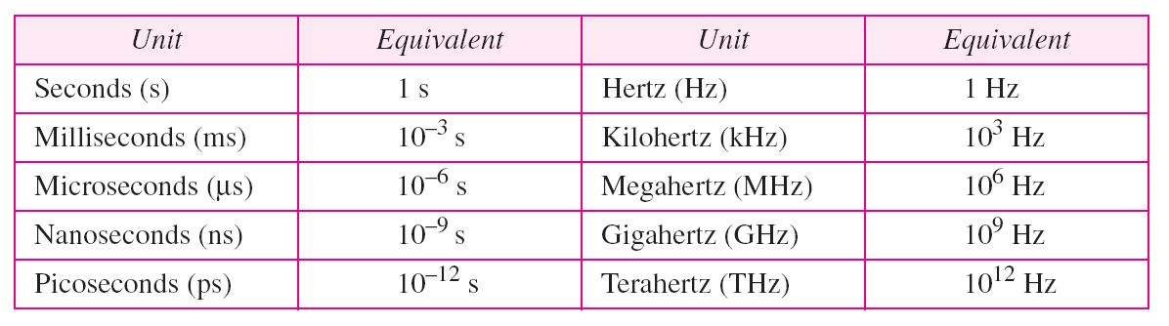
Table 3.1 Units of period and frequency

Slide 17
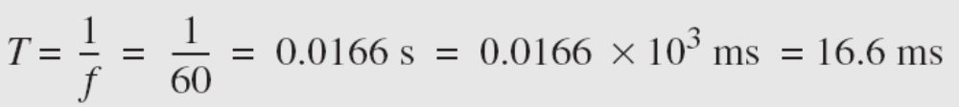
Example 3.3
The power we use at home has a frequency of 60 Hz. The period of this sine wave can be determined as follows:

Slide 18
Example 3.4
Express a period of 100 ms in microseconds.
Solution
From Table 3.1 we find the equivalents of 1 ms (1 ms is 10⁻³ s) and 1 s (1 s is 10⁶ μs). We make the following substitutions:.

Slide 19
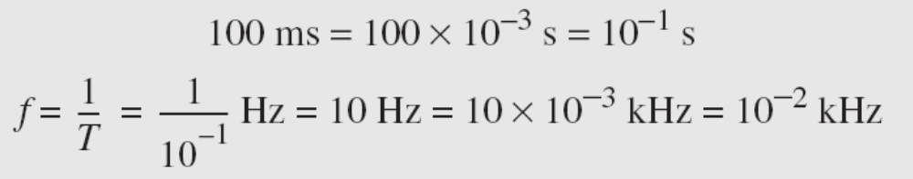
Example 3.5
The period of a signal is 100 ms. What is its frequency in kilohertz?
Solution
First we change 100 ms to seconds, and then we calculate the frequency from the period (1 Hz = 10⁻³ kHz).

Slide 20
Note
Frequency is the rate of change with respect to time.
Change in a short span of time
means high frequency.
Change over a long span of
time means low frequency.

Slide 21
Note
If a signal does not change at all, its frequency is zero.
If a signal changes instantaneously, its frequency is infinite.

Slide 22
Note
Phase describes the position of the waveform relative to time 0.

Slide 23
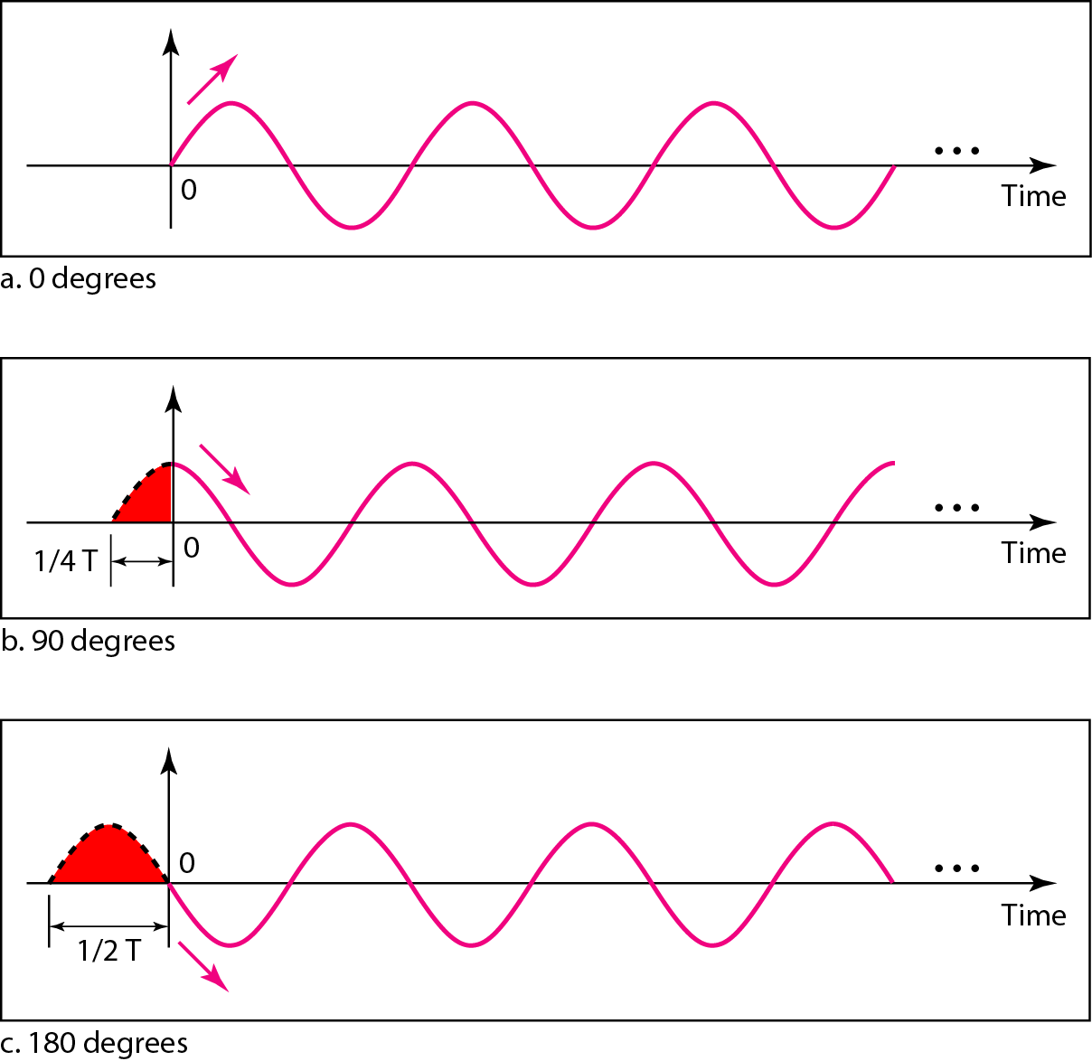
Figure 3.5 Three sine waves with the same amplitude and frequency,
but different phases

Slide 24
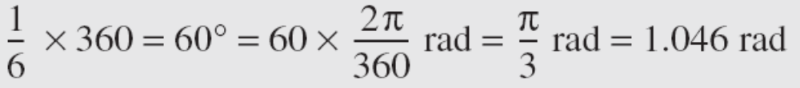
Example 3.6
A sine wave is offset 1/6 cycle with respect to time 0. What is its phase in degrees and radians?
Solution
We know that 1 complete cycle is 360°. Therefore, 1/6 cycle is

Slide 25
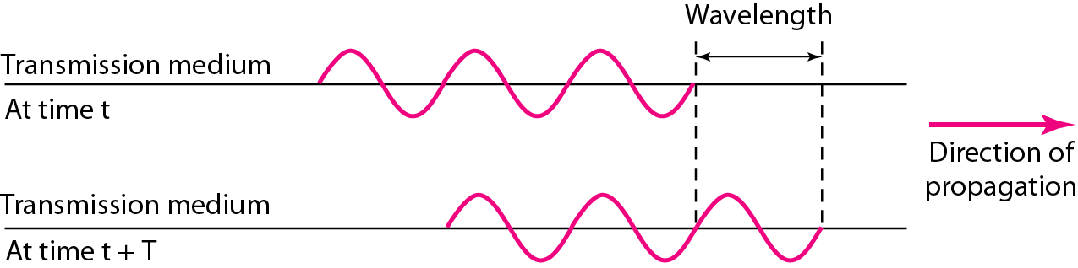
Figure 3.6 Wavelength and period

Slide 26
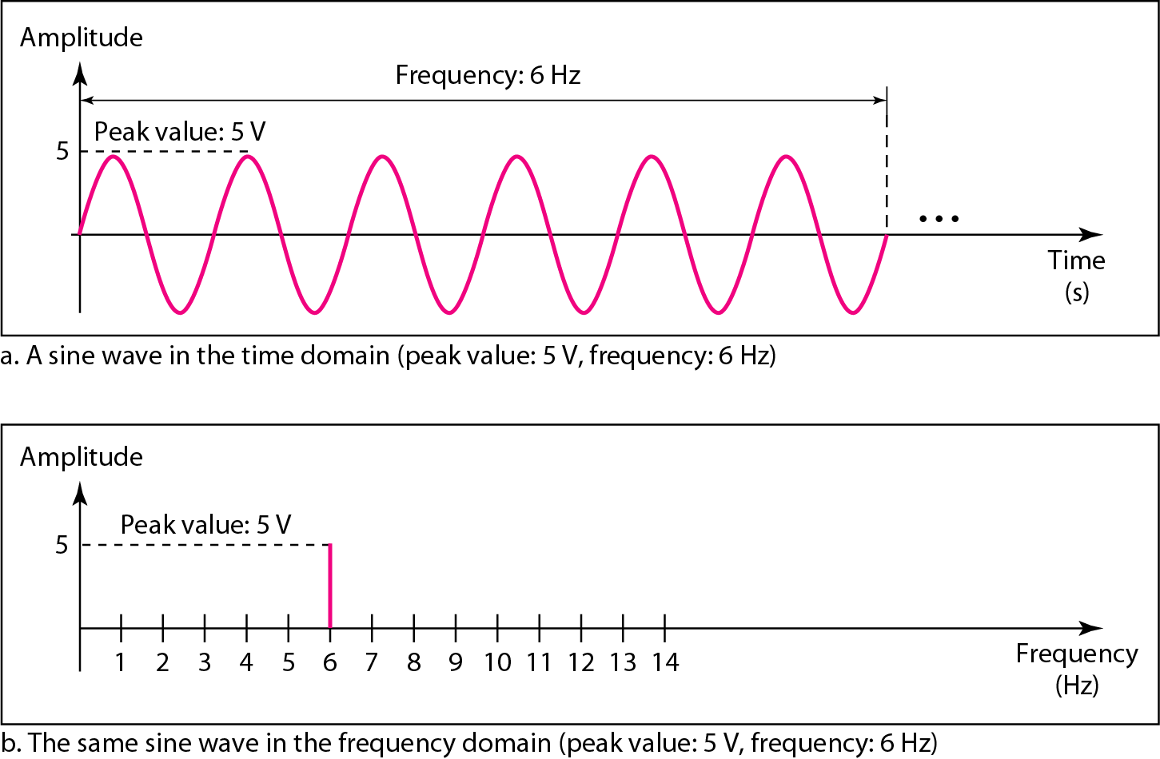
Figure 3.7 The time-domain and frequency-domain plots of a sine wave

Slide 27
Note
A complete sine wave in the time domain can be represented by one single spike in the frequency domain.

Slide 28
Example 3.7
The frequency domain is more compact and useful when we are dealing with more than one sine wave. For example, Figure 3.8 shows three sine waves, each with different amplitude and frequency. All can be represented by three spikes in the frequency domain.

Slide 29
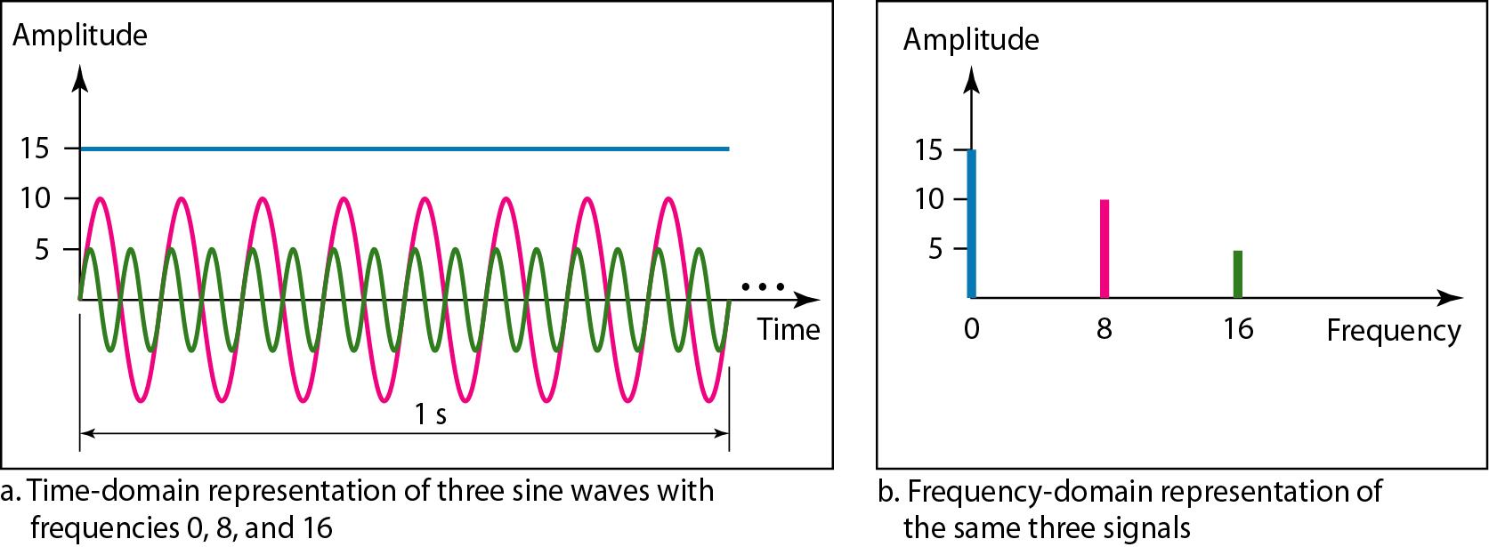
Figure 3.8 The time domain and frequency domain of three sine waves

Slide 30
Note
A single-frequency sine wave is not useful in data communications;
we need to send a composite signal, a signal made of many simple sine waves.

Slide 31
Note
According to Fourier analysis, any composite signal is a combination of
simple sine waves with different frequencies, amplitudes, and phases.
Fourier analysis is discussed in Appendix C.

Slide 32
Note
If the composite signal is periodic, the decomposition gives a series of signals with discrete frequencies;
if the composite signal is nonperiodic, the decomposition gives a combination of sine waves with continuous frequencies.

Slide 33
Example 3.8
Figure 3.9 shows a periodic composite signal with frequency f. This type of signal is not typical of those found in data communications. We can consider it to be three alarm systems, each with a different frequency. The analysis of this signal can give us a good understanding of how to decompose signals.

Slide 34
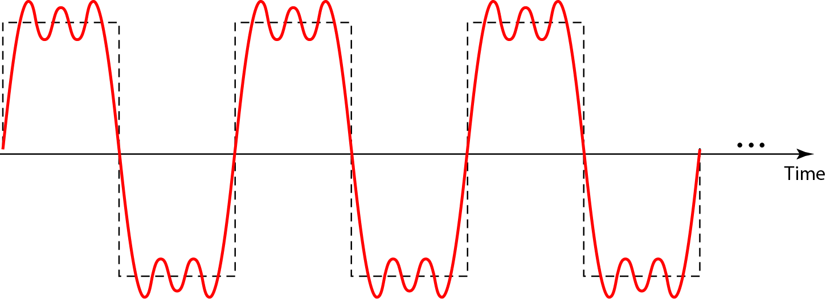
Figure 3.9 A composite periodic signal

Slide 35
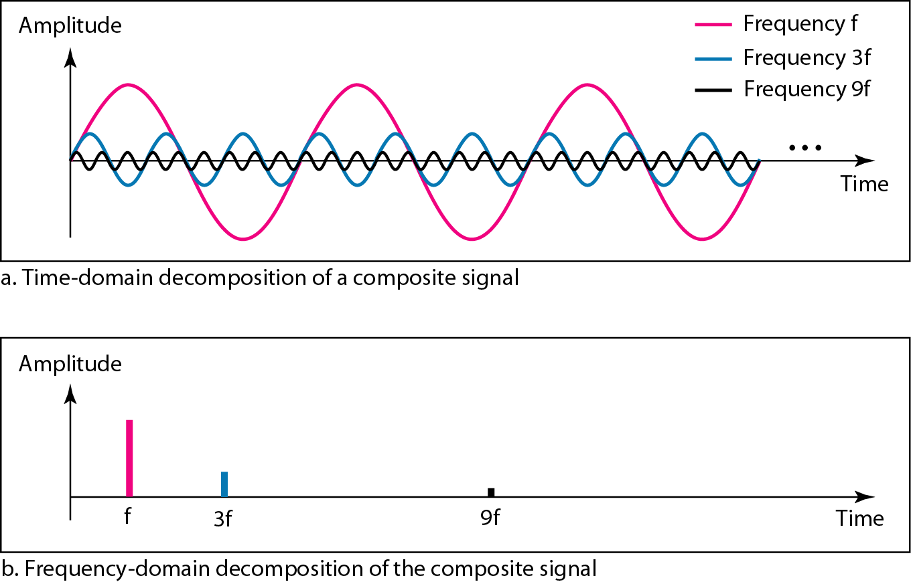
Figure 3.10 Decomposition of a composite periodic signal in the time and
frequency domains

Slide 36
Example 3.9
Figure 3.11 shows a nonperiodic composite signal. It can be the signal created by a microphone or a telephone set when a word or two is pronounced. In this case, the composite signal cannot be periodic, because that implies that we are repeating the same word or words with exactly the same tone.

Slide 37
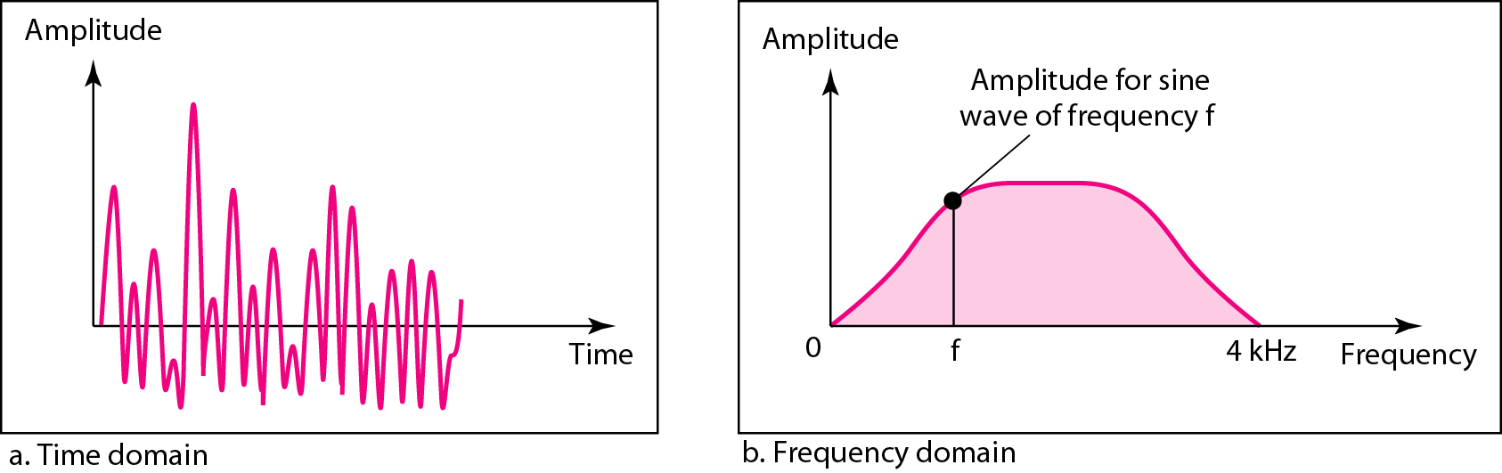
Figure 3.11 The time and frequency domains of a nonperiodic signal

Slide 38
Note
The bandwidth of a composite signal is the difference between the
highest and the lowest frequencies contained in that signal.

Slide 39
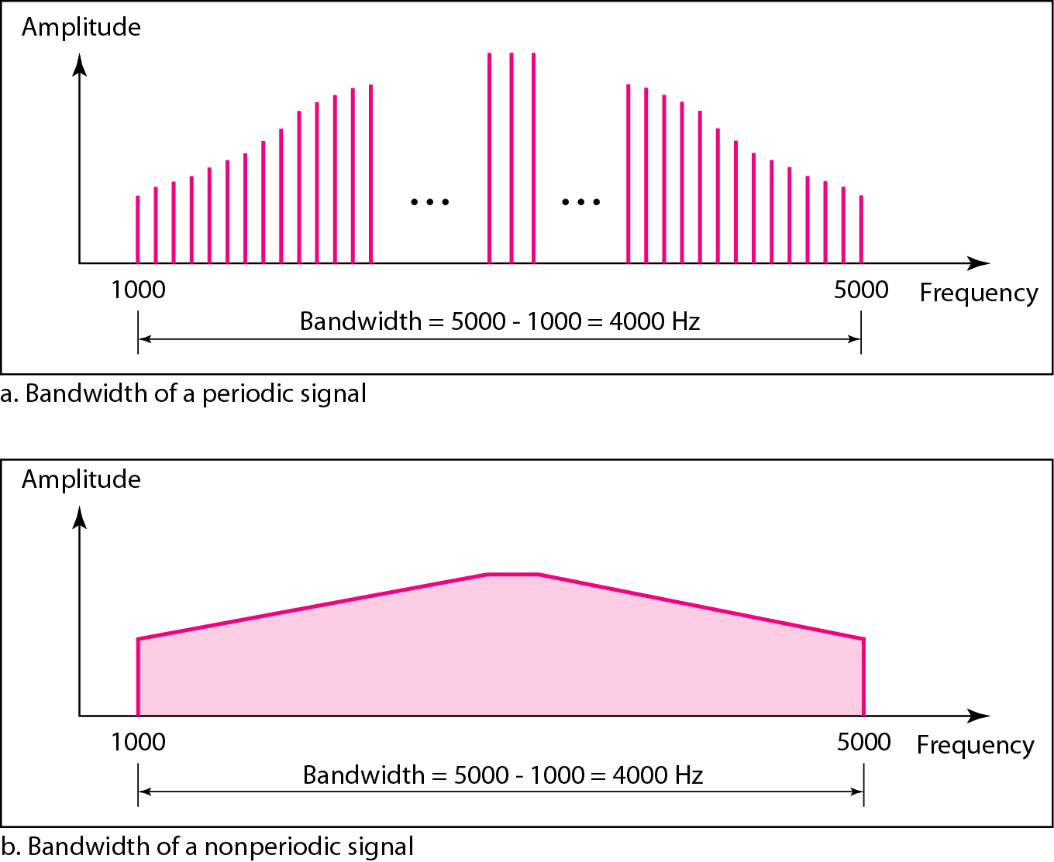
Figure 3.12 The bandwidth of periodic and nonperiodic composite signals

Slide 40

Example 3.10
If a periodic signal is decomposed into five sine waves with frequencies of 100, 300, 500, 700, and 900 Hz, what is its bandwidth? Draw the spectrum, assuming all components have a maximum amplitude of 10 V.
Solution
Let f_{h} be the highest frequency, f_{l} the lowest frequency, and B the bandwidth. Then
The spectrum has only five spikes, at 100, 300, 500, 700, and 900 Hz (see Figure 3.13).

Slide 41
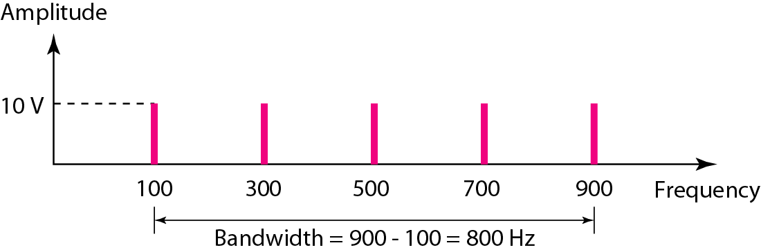
Figure 3.13 The bandwidth for Example 3.10

Slide 42
Example 3.11
A periodic signal has a bandwidth of 20 Hz. The highest frequency is 60 Hz. What is the lowest frequency? Draw the spectrum if the signal contains all frequencies of the same amplitude.
Solution
Let f_{h} be the highest frequency, f_{l} the lowest frequency, and B the bandwidth. Then
The spectrum contains all integer frequencies. We show this by a series of spikes (see Figure 3.14).

Slide 43
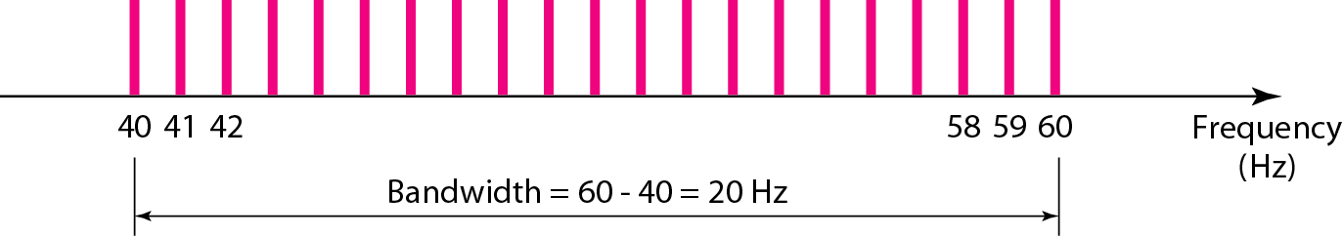
Figure 3.14 The bandwidth for Example 3.11

Slide 44
Example 3.12
A nonperiodic composite signal has a bandwidth of 200 kHz, with a middle frequency of 140 kHz and peak amplitude of 20 V. The two extreme frequencies have an amplitude of 0. Draw the frequency domain of the signal.
Solution
The lowest frequency must be at 40 kHz and the highest at 240 kHz. Figure 3.15 shows the frequency domain and the bandwidth.

Slide 45
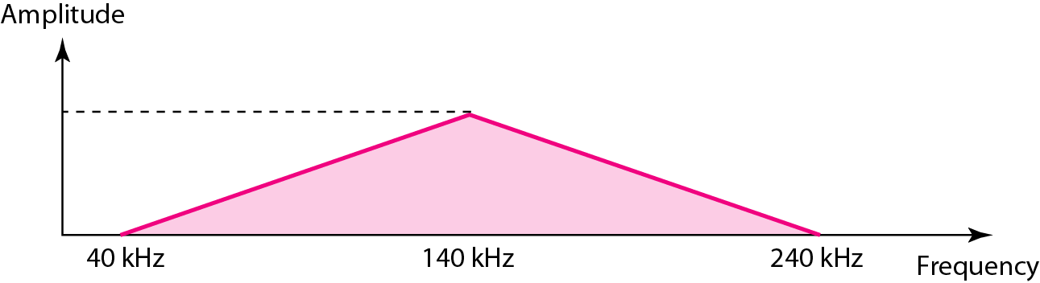
Figure 3.15 The bandwidth for Example 3.12

Slide 46
Example 3.13
An example of a nonperiodic composite signal is the signal propagated by an AM radio station. In the United States, each AM radio station is assigned a 10-kHz bandwidth. The total bandwidth dedicated to AM radio ranges from 530 to 1700 kHz. We will show the rationale behind this 10-kHz bandwidth in Chapter 5.

Slide 47
Example 3.14
Another example of a nonperiodic composite signal is the signal propagated by an FM radio station. In the United States, each FM radio station is assigned a 200-kHz bandwidth. The total bandwidth dedicated to FM radio ranges from 88 to 108 MHz. We will show the rationale behind this 200-kHz bandwidth in Chapter 5.

Slide 48
Example 3.15
Another example of a nonperiodic composite signal is the signal received by an old-fashioned analog black-and-white TV. A TV screen is made up of pixels. If we assume a resolution of 525 × 700, we have 367,500 pixels per screen. If we scan the screen 30 times per second, this is 367,500 × 30 = 11,025,000 pixels per second. The worst-case scenario is alternating black and white pixels. We can send 2 pixels per cycle. Therefore, we need 11,025,000 / 2 = 5,512,500 cycles per second, or Hz. The bandwidth needed is 5.5125 MHz.

Slide 49
3-3 DIGITAL SIGNALS
In addition to being represented by an analog signal, information can also be represented by a digital signal. For example, a 1 can be encoded as a positive voltage and a 0 as zero voltage. A digital signal can have more than two levels. In this case, we can send more than 1 bit for each level.
Topics discussed in this section:
Bit Rate
Bit Length
Digital Signal as a Composite Analog Signal
Application Layer

Slide 50
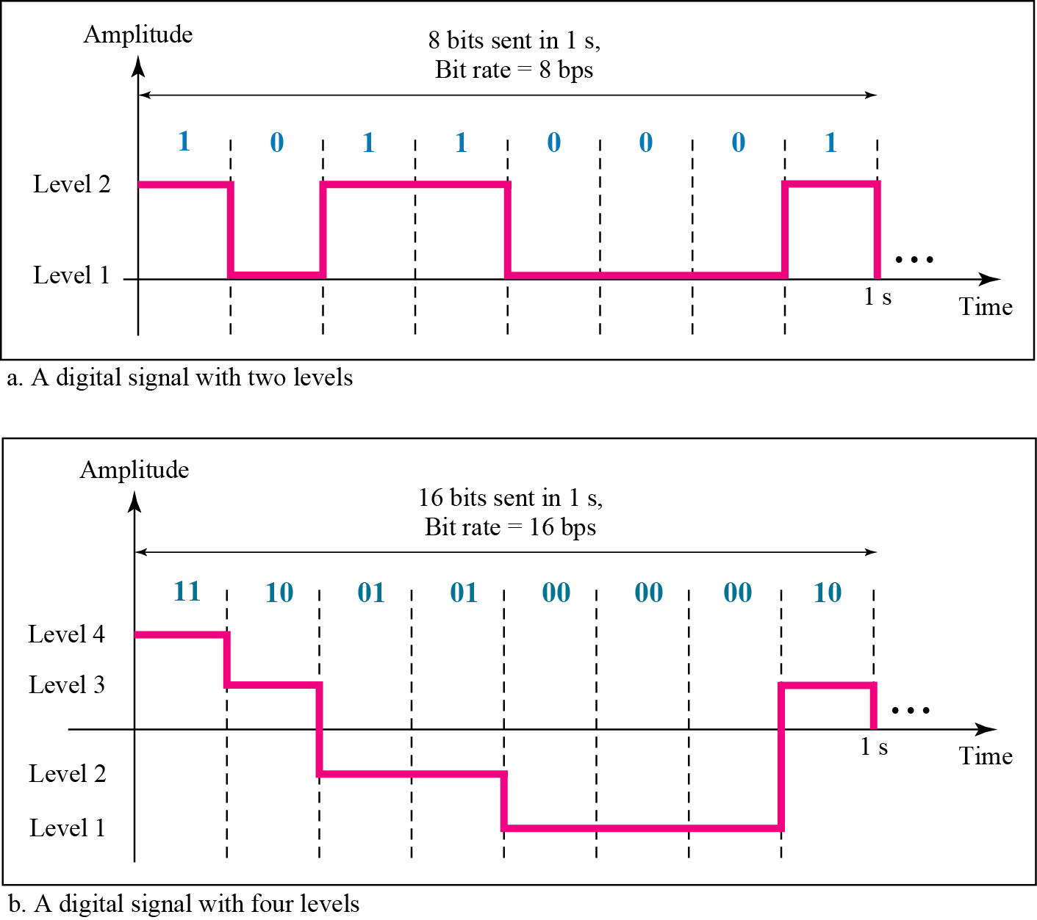
Figure 3.16 Two digital signals: one with two signal levels and the other
with four signal levels

Slide 51
Note
Appendix C reviews information about exponential and logarithmic functions.
Appendix C reviews information about exponential and logarithmic functions.

Slide 52
Example 3.16
A digital signal has eight levels. How many bits are needed per level? We calculate the number of bits from the formula
Each signal level is represented by 3 bits.

Slide 53
Example 3.17
A digital signal has nine levels. How many bits are needed per level? We calculate the number of bits by using the formula. Each signal level is represented by 3.17 bits. However, this answer is not realistic. The number of bits sent per level needs to be an integer as well as a power of 2. For this example, 4 bits can represent one level.

Slide 54
Example 3.18
Assume we need to download text documents at the rate of 100 pages per minute. What is the required bit rate of the channel?
Solution
A page is an average of 24 lines with 80 characters in each line. If we assume that one character requires 8 bits, the bit rate is

Slide 55
Example 3.19
A digitized voice channel, as we will see in Chapter 4, is made by digitizing a 4-kHz bandwidth analog voice signal. We need to sample the signal at twice the highest frequency (two samples per hertz). We assume that each sample requires 8 bits. What is the required bit rate?
Solution
The bit rate can be calculated as

Slide 56
Example 3.20
What is the bit rate for high-definition TV (HDTV)?
Solution
HDTV uses digital signals to broadcast high quality video signals. The HDTV screen is normally a ratio of 16 : 9. There are 1920 by 1080 pixels per screen, and the screen is renewed 30 times per second. Twenty-four bits represents one color pixel.
The TV stations reduce this rate to 20 to 40 Mbps through compression.

Slide 57
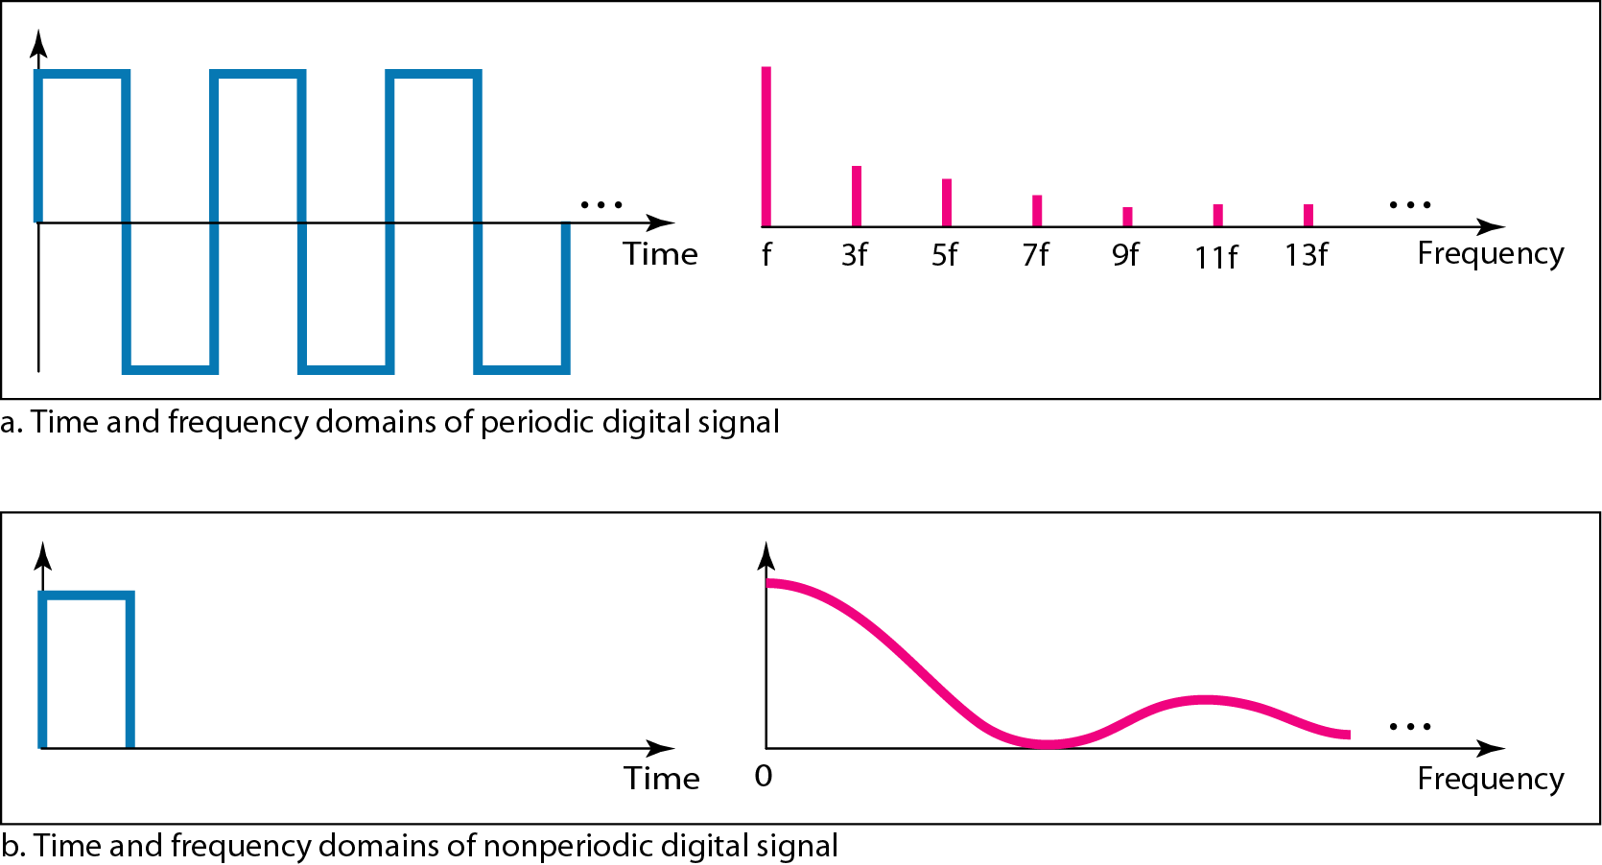
Figure 3.17 The time and frequency domains of periodic and nonperiodic
digital signals

Slide 58
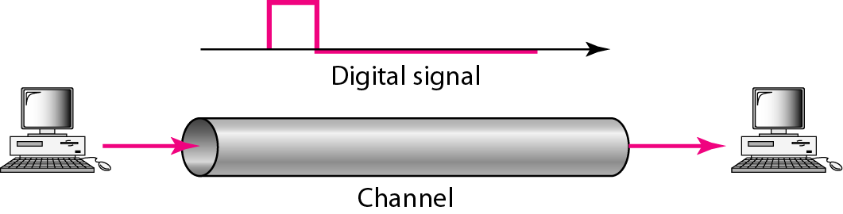
Figure 3.18 Baseband transmission

Slide 59
Note
A digital signal is a composite analog signal with an infinite bandwidth.

Slide 60
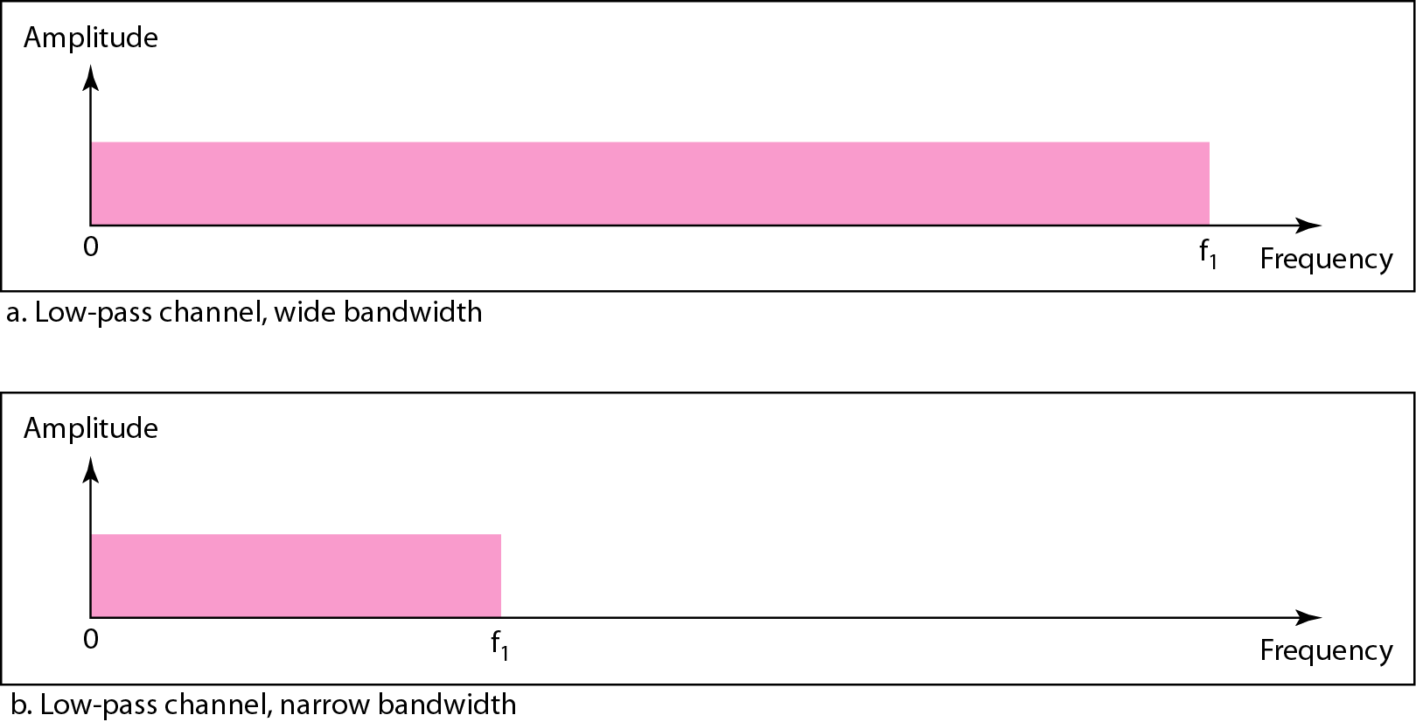
Figure 3.19 Bandwidths of two low-pass channels

Slide 61
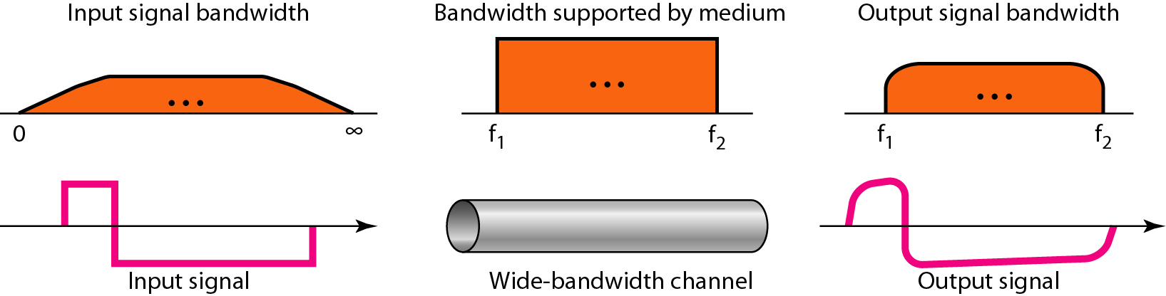
Figure 3.20 Baseband transmission using a dedicated medium

Slide 62
Note
Baseband transmission of a digital signal that preserves the shape of the digital signal is possible only if we have a low-pass channel with an infinite or very wide bandwidth.

Slide 63
Example 3.21
An example of a dedicated channel where the entire bandwidth of the medium is used as one single channel is a LAN. Almost every wired LAN today uses a dedicated channel for two stations communicating with each other. In a bus topology LAN with multipoint connections, only two stations can communicate with each other at each moment in time (timesharing); the other stations need to refrain from sending data. In a star topology LAN, the entire channel between each station and the hub is used for communication between these two entities. We study LANs in Chapter 14.

Slide 64
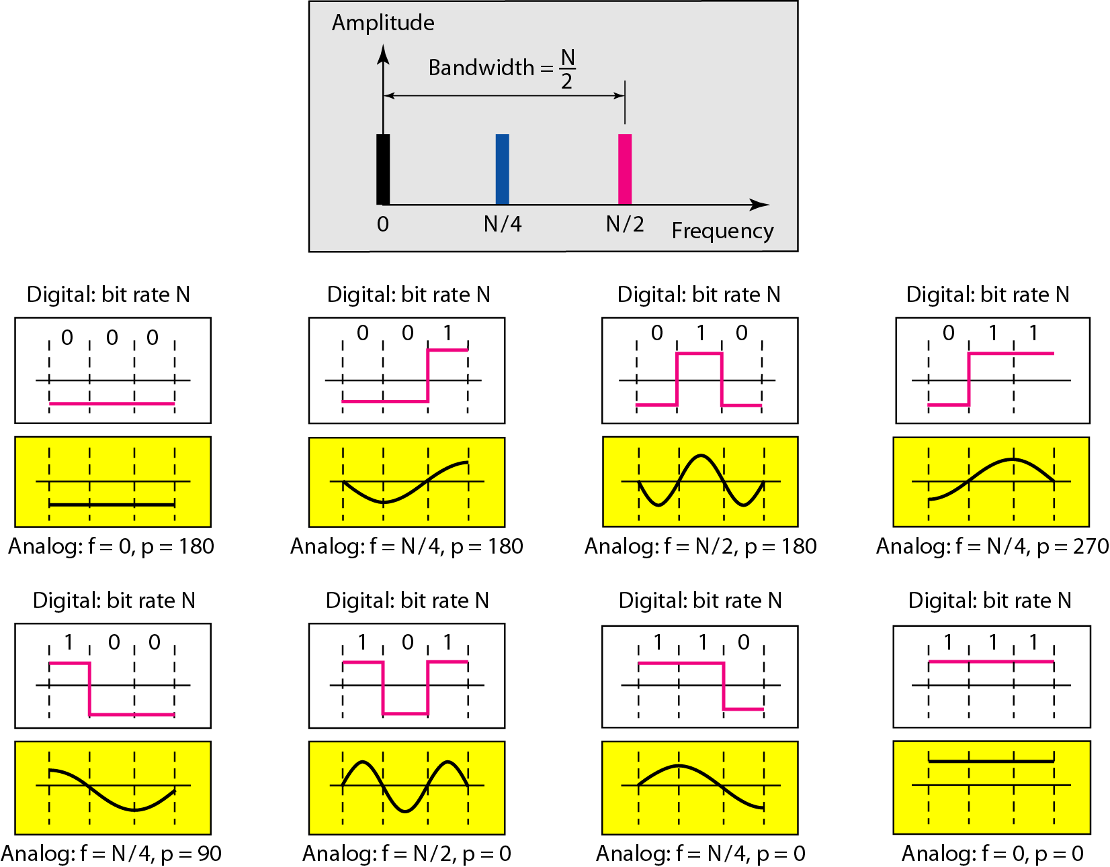
Figure 3.21 Rough approximation of a digital signal using the first harmonic
for worst case

Slide 65
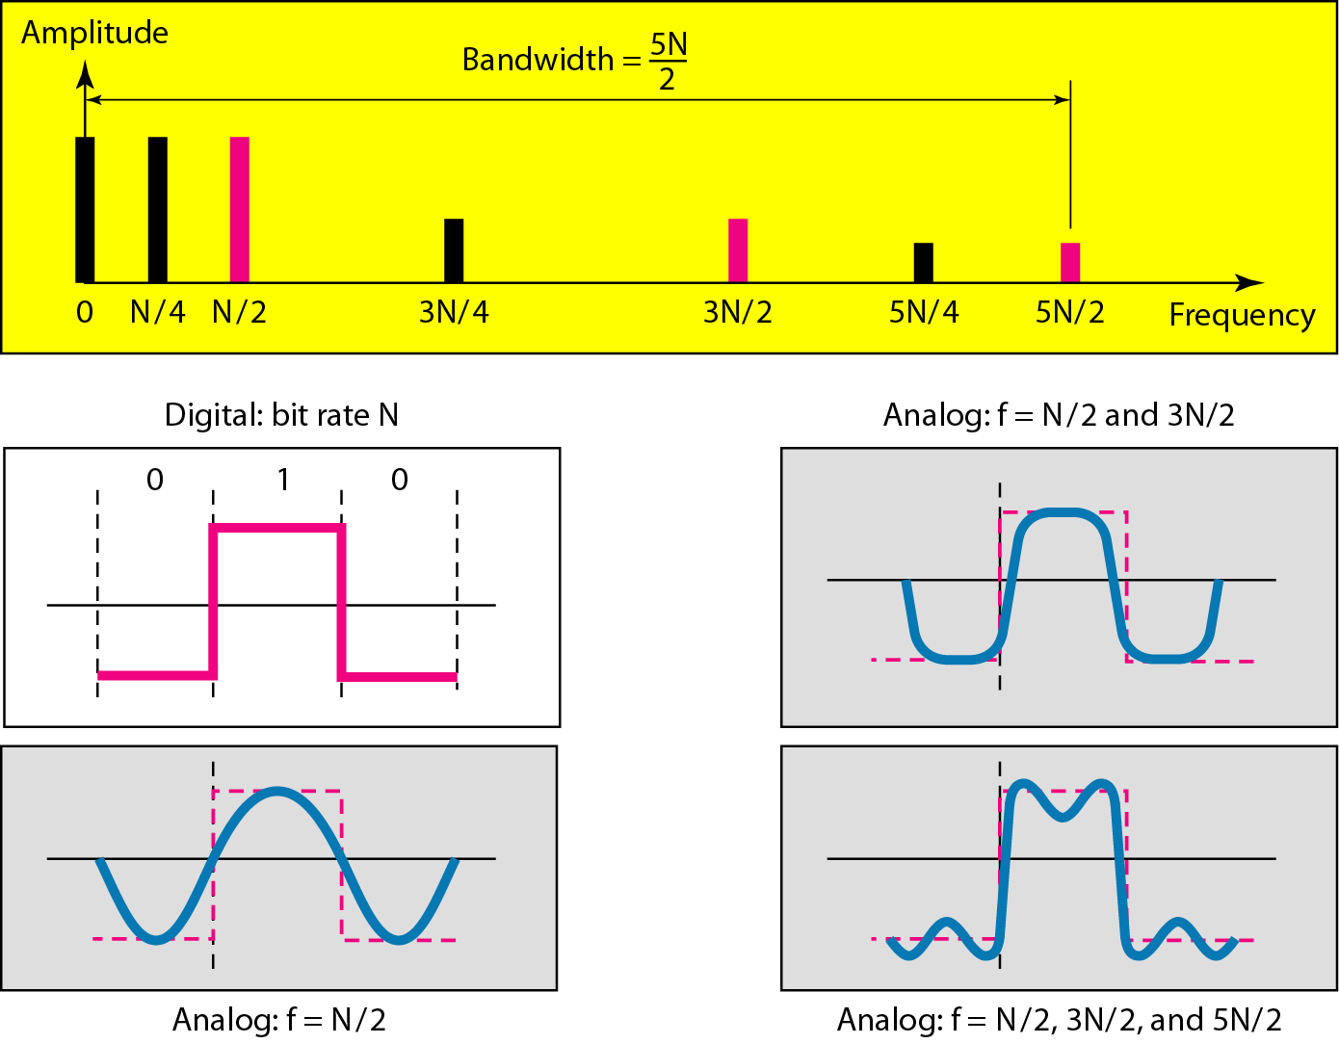
Figure 3.22 Simulating a digital signal with first three harmonics

Slide 66
Note
In baseband transmission, the required bandwidth is proportional to the bit rate;
if we need to send bits faster, we need more bandwidth.
In baseband transmission, the required bandwidth is proportional to the bit rate;
if we need to send bits faster, we need more bandwidth.

Slide 67
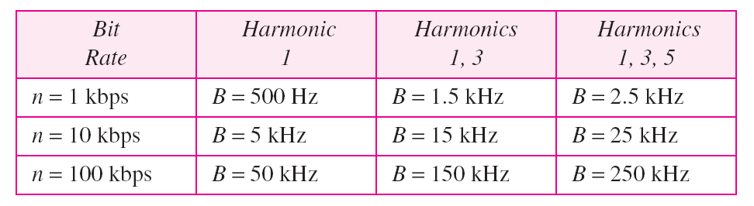
Table 3.2 Bandwidth requirements

Slide 68
Example 3.22
What is the required bandwidth of a low-pass channel if we need to send 1 Mbps by using baseband transmission?
Solution
The answer depends on the accuracy desired.
a. The minimum bandwidth, is B = bit rate /2, or 500 kHz.
b. A better solution is to use the first and the third
harmonics with B = 3 × 500 kHz = 1.5 MHz.
c. Still a better solution is to use the first, third, and fifth
harmonics with B = 5 × 500 kHz = 2.5 MHz.

Slide 69
Example 3.22
We have a low-pass channel with bandwidth 100 kHz. What is the maximum bit rate of this
channel?
Solution
The maximum bit rate can be achieved if we use the first harmonic. The bit rate is 2 times the available bandwidth, or 200 kbps.

Slide 70
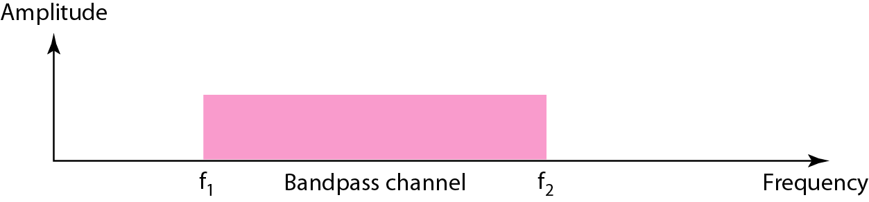
Figure 3.23 Bandwidth of a bandpass channel

Slide 71
Note
If the available channel is a bandpass channel, we cannot send the digital signal directly to the channel;
we need to convert the digital signal to an analog signal before transmission.

Slide 72
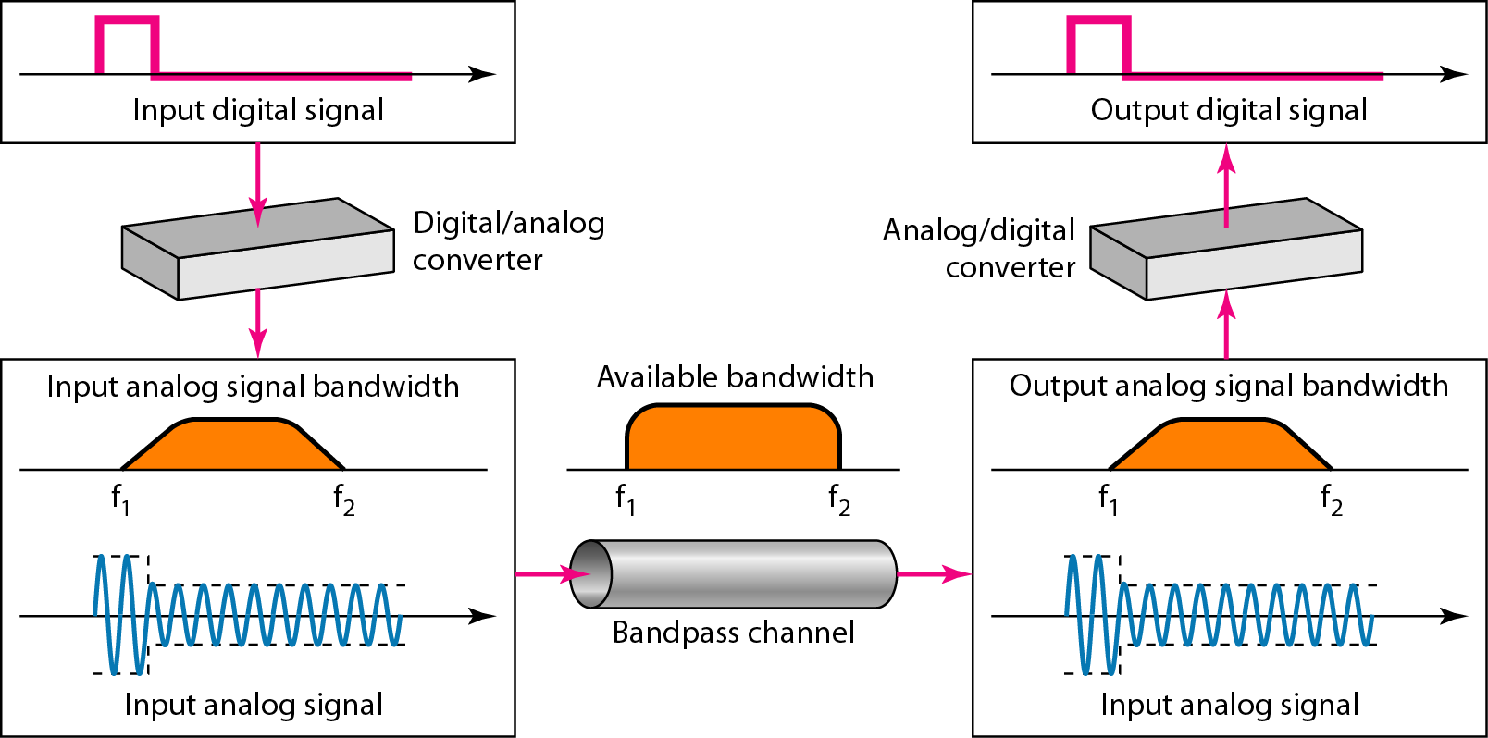
Figure 3.24 Modulation of a digital signal for transmission on a bandpass
channel

Slide 73
Example 3.24
An example of broadband transmission using modulation is the sending of computer data through a telephone subscriber line, the line connecting a resident to the central telephone office. These lines are designed to carry voice with a limited bandwidth. The channel is considered a bandpass channel. We convert the digital signal from the computer to an analog signal, and send the analog signal. We can install two converters to change the digital signal to analog and vice versa at the receiving end. The converter, in this case, is called a modem which we discuss in detail in Chapter 5.

Slide 74
Example 3.25
A second example is the digital cellular telephone. For better reception, digital cellular phones convert the analog voice signal to a digital signal (see Chapter 16). Although the bandwidth allocated to a company providing digital cellular phone service is very wide, we still cannot send the digital signal without conversion. The reason is that we only have a bandpass channel available between caller and callee. We need to convert the digitized voice to a composite analog signal before sending.

Slide 75
3-4 TRANSMISSION IMPAIRMENT
Signals travel through transmission media, which are not perfect. The imperfection causes signal impairment. This means that the signal at the beginning of the medium is not the same as the signal at the end of the medium. What is sent is not what is received. Three causes of impairment are attenuation, distortion, and noise.
Topics discussed in this section:
Attenuation
Distortion
Noise

Slide 76
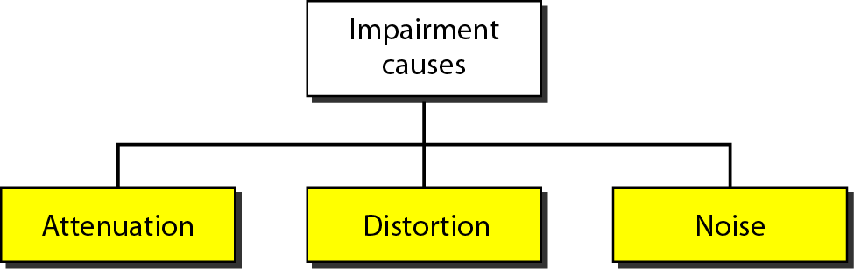
Figure 3.25 Causes of impairment

Slide 77
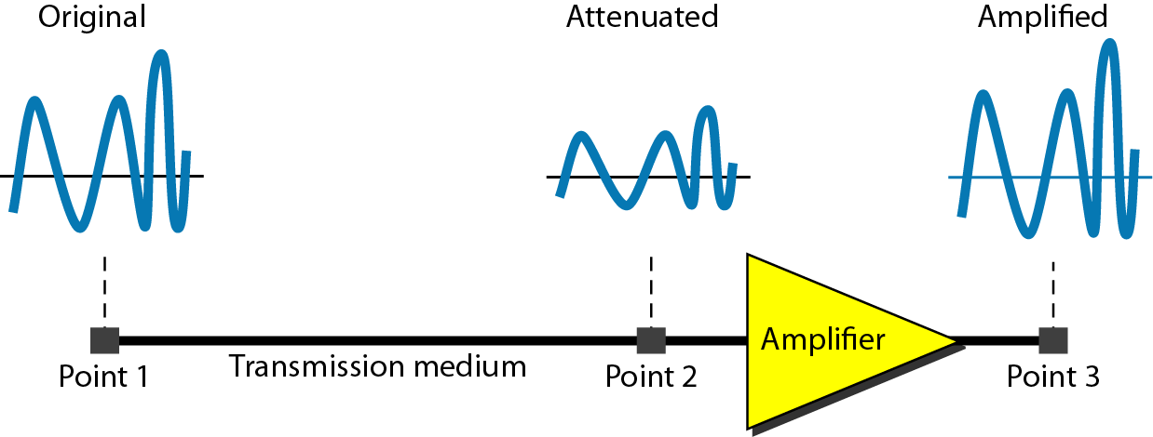
Figure 3.26 Attenuation

Slide 78

Example 3.26
Suppose a signal travels through a transmission medium and its power is reduced to one-half. This means that P2 is (1/2)P1. In this case, the attenuation (loss of power) can be calculated as
A loss of 3 dB (–3 dB) is equivalent to losing one-half the power.

Slide 79

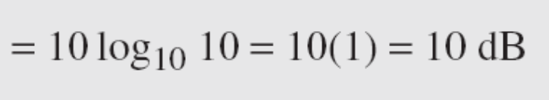
Example 3.27
A signal travels through an amplifier, and its power is increased 10 times. This means that P₂ = 10P₁ . In this case, the amplification (gain of power) can be calculated as

Slide 80

Example 3.28
One reason that engineers use the decibel to measure the changes in the strength of a signal is that decibel numbers can be added (or subtracted) when we are measuring several points (cascading) instead of just two. In Figure 3.27 a signal travels from point 1 to point 4. In this case, the decibel value can be calculated as

Slide 81
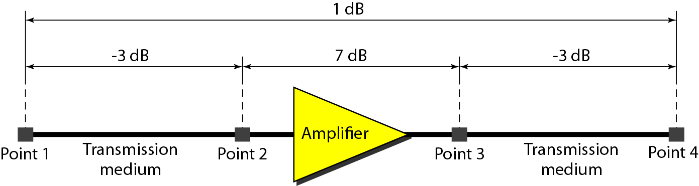
Figure 3.27 Decibels for Example 3.28

Slide 82
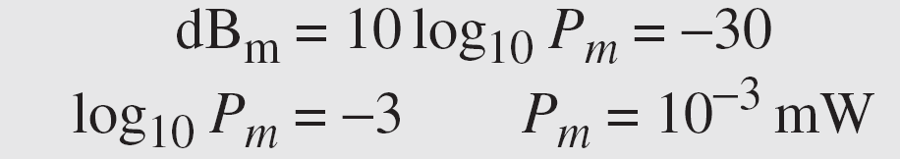
Example 3.29
Sometimes the decibel is used to measure signal power in milliwatts. In this case, it is referred to as dB_{m} and is calculated as dB_{m} = 10 log10 P_{m} , where P_{m} is the power in milliwatts. Calculate the power of a signal with dB_{m} = −30.
Solution
We can calculate the power in the signal as

Slide 83
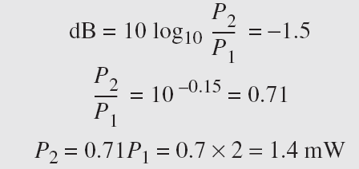
Example 3.30
The loss in a cable is usually defined in decibels per kilometer (dB/km). If the signal at the beginning of a cable with −0.3 dB/km has a power of 2 mW, what is the power of the signal at 5 km?
Solution
The loss in the cable in decibels is 5 × (−0.3) = −1.5 dB. We can calculate the power as

Slide 84
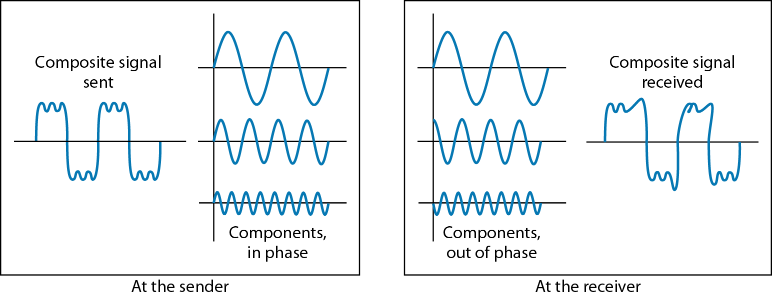
Figure 3.28 Distortion

Slide 85
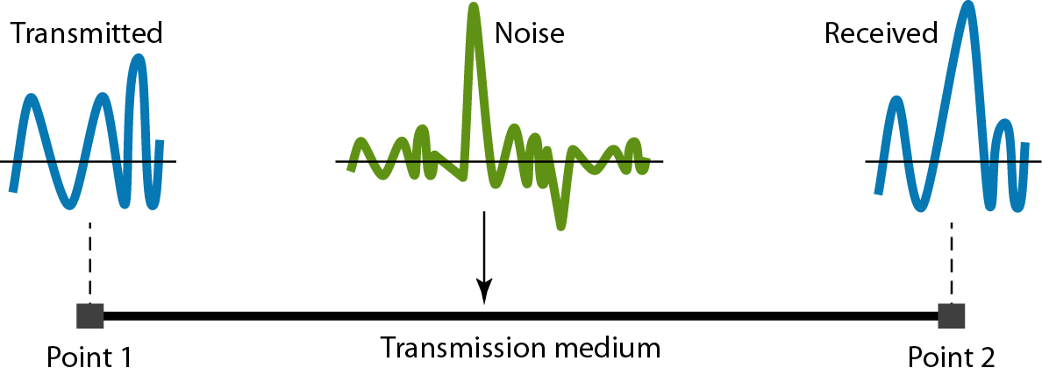
Figure 3.29 Noise

Slide 86
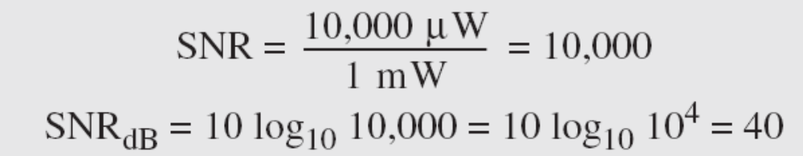
Example 3.31
The power of a signal is 10 mW and the power of the noise is 1 μW; what are the values of SNR and SNR_{dB} ?
Solution
The values of SNR and SNRdB can be calculated as follows:

Slide 87
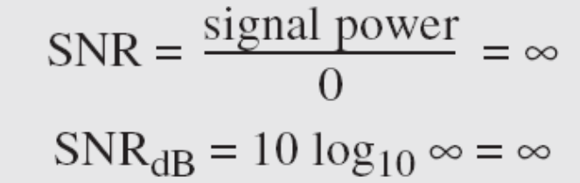
Example 3.32
The values of SNR and SNRdB for a noiseless channel are
We can never achieve this ratio in real life; it is an ideal.

Slide 88
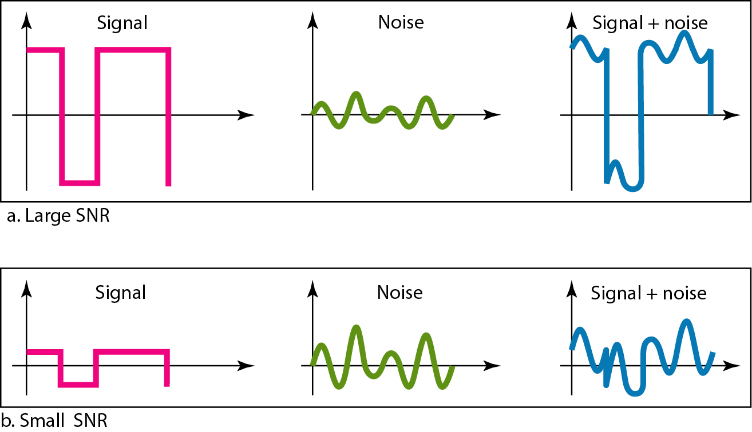
Figure 3.30 Two cases of SNR: a high SNR and a low SNR

Slide 89
3-5 DATA RATE LIMITS
A very important consideration in data communications is how fast we can send data, in bits per second, over a channel. Data rate depends on three factors:
1. The bandwidth available
2. The level of the signals we use
3. The quality of the channel (the level of noise)
Topics discussed in this section:
Noiseless Channel: Nyquist Bit Rate
Noisy Channel: Shannon Capacity
Using Both Limits

Slide 90
Note
Increasing the levels of a signal may reduce the reliability of the system.

Slide 91
Example 3.33
Does the Nyquist theorem bit rate agree with the intuitive bit rate described in baseband transmission?
Solution
They match when we have only two levels. We said, in baseband transmission, the bit rate is 2 times the bandwidth if we use only the first harmonic in the worst case. However, the Nyquist formula is more general than what we derived intuitively; it can be applied to baseband transmission and modulation. Also, it can be applied when we have two or more levels of signals.

Slide 92
Example 3.34
Consider a noiseless channel with a bandwidth of 3000 Hz transmitting a signal with two signal levels. The maximum bit rate can be calculated as

Slide 93
Example 3.35
Consider the same noiseless channel transmitting a signal with four signal levels (for each level, we send 2 bits). The maximum bit rate can be calculated as

Slide 94

Example 3.36
We need to send 265 kbps over a noiseless channel with a bandwidth of 20 kHz. How many signal levels do we need?
Solution
We can use the Nyquist formula as shown:
Since this result is not a power of 2, we need to either increase the number of levels or reduce the bit rate. If we have 128 levels, the bit rate is 280 kbps. If we have 64 levels, the bit rate is 240 kbps.

Slide 95
Example 3.37
Consider an extremely noisy channel in which the value of the signal-to-noise ratio is almost zero. In other words, the noise is so strong that the signal is faint. For this channel the capacity C is calculated as
This means that the capacity of this channel is zero regardless of the bandwidth. In other words, we cannot receive any data through this channel.

Slide 96
Example 3.38
We can calculate the theoretical highest bit rate of a regular telephone line. A telephone line normally has a bandwidth of 3000. The signal-to-noise ratio is usually 3162. For this channel the capacity is calculated as
This means that the highest bit rate for a telephone line is 34.860 kbps. If we want to send data faster than this, we can either increase the bandwidth of the line or improve the signal-to-noise ratio.

Slide 97
Example 3.39
The signal-to-noise ratio is often given in decibels. Assume that SNR_{dB} = 36 and the channel bandwidth is 2 MHz. The theoretical channel capacity can be calculated as

Slide 98


Example 3.40
For practical purposes, when the SNR is very high, we can assume that SNR + 1 is almost the same as SNR. In these cases, the theoretical channel capacity can be simplified to
For example, we can calculate the theoretical capacity of the previous example as

Slide 99
Example 3.41
We have a channel with a 1-MHz bandwidth. The SNR for this channel is 63. What are the appropriate bit rate and signal level?
Solution
First, we use the Shannon formula to find the upper limit.

Slide 100
Example 3.41 (continued)
The Shannon formula gives us 6 Mbps, the upper limit. For better performance we choose something lower, 4 Mbps, for example. Then we use the Nyquist formula to find the number of signal levels.

Slide 101
Note
The Shannon capacity gives us the upper limit; the Nyquist formula tells us how many signal levels we need.

Slide 102
3-6 PERFORMANCE
One important issue in networking is the performance of the network—how good is it? We discuss quality of service, an overall measurement of network performance, in greater detail in Chapter 24. In this section, we introduce terms that we need for future chapters.
Topics discussed in this section:
Bandwidth
Throughput
Latency (Delay)
Bandwidth-Delay Product

Slide 103
Note
In networking, we use the term bandwidth in two contexts.
❏ The first, bandwidth in hertz, refers to
the range of frequencies in a
composite signal or the range of
frequencies that a channel can pass.
❏ The second, bandwidth in bits per
second, refers to the speed of bit
transmission in a channel or link.

Slide 104
Example 3.42
The bandwidth of a subscriber line is 4 kHz for voice or data. The bandwidth of this line for data transmission
can be up to 56,000 bps using a sophisticated modem to change the digital signal to analog.

Slide 105
Example 3.43
If the telephone company improves the quality of the line and increases the bandwidth to 8 kHz, we can send 112,000 bps by using the same technology as mentioned in Example 3.42.

Slide 106

Example 3.44
A network with bandwidth of 10 Mbps can pass only an average of 12,000 frames per minute with each frame carrying an average of 10,000 bits. What is the throughput of this network?
Solution
We can calculate the throughput as
The throughput is almost one-fifth of the bandwidth in this case.

Slide 107

Example 3.45
What is the propagation time if the distance between the two points is 12,000 km? Assume the propagation speed to be 2.4 × 108 m/s in cable.
Solution
We can calculate the propagation time as
The example shows that a bit can go over the Atlantic Ocean in only 50 ms if there is a direct cable between the source and the destination.

Slide 108
Example 3.46
What are the propagation time and the transmission time for a 2.5-kbyte message (an e-mail) if the bandwidth of the network is 1 Gbps? Assume that the distance between the sender and the receiver is 12,000 km and that light travels at 2.4 × 108 m/s.
Solution
We can calculate the propagation and transmission time as shown on the next slide:

Slide 109
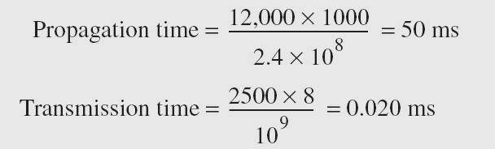
Example 3.46 (continued)
Note that in this case, because the message is short and the bandwidth is high, the dominant factor is the propagation time, not the transmission time. The transmission time can be ignored.

Slide 110
Example 3.47
What are the propagation time and the transmission time for a 5-Mbyte message (an image) if the bandwidth of the network is 1 Mbps? Assume that the distance between the sender and the receiver is 12,000 km and that light travels at 2.4 × 10⁸ m/s.
Solution
We can calculate the propagation and transmission times as shown on the next slide.

Slide 111
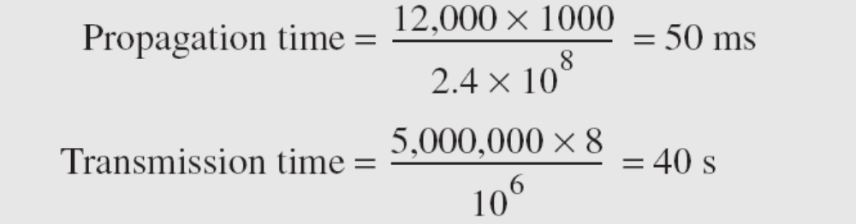
Example 3.47 (continued)
Note that in this case, because the message is very long and the bandwidth is not very high, the dominant factor is the transmission time, not the propagation time. The propagation time can be ignored.

Slide 112
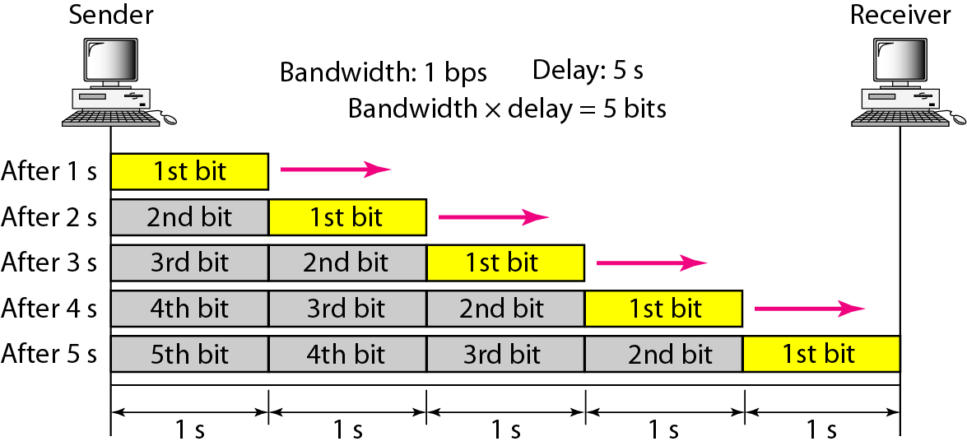
Figure 3.31 Filling the link with bits for case 1

Slide 113
Example 3.48
We can think about the link between two points as a pipe. The cross section of the pipe represents the bandwidth, and the length of the pipe represents the delay. We can say the volume of the pipe defines the bandwidth-delay product, as shown in Figure 3.33.

Slide 114
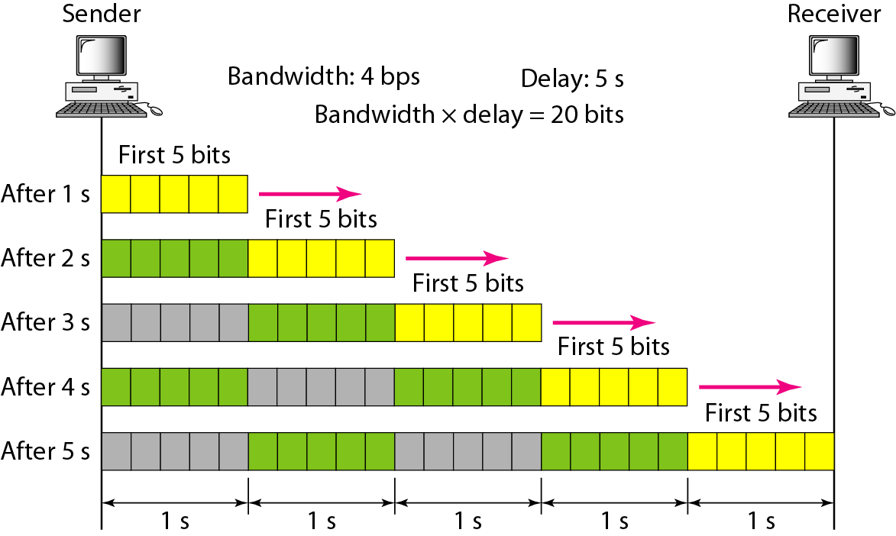
Figure 3.32 Filling the link with bits in case 2

Slide 115
Note
The bandwidth-delay product defines the number of bits that can fill the link.

Slide 116

Figure 3.33 Concept of bandwidth-delay product

