Slide 1

Chapter 8
Switching
Copyright © The McGraw-Hill Companies, Inc. Permission required for reproduction or display.

Slide 2
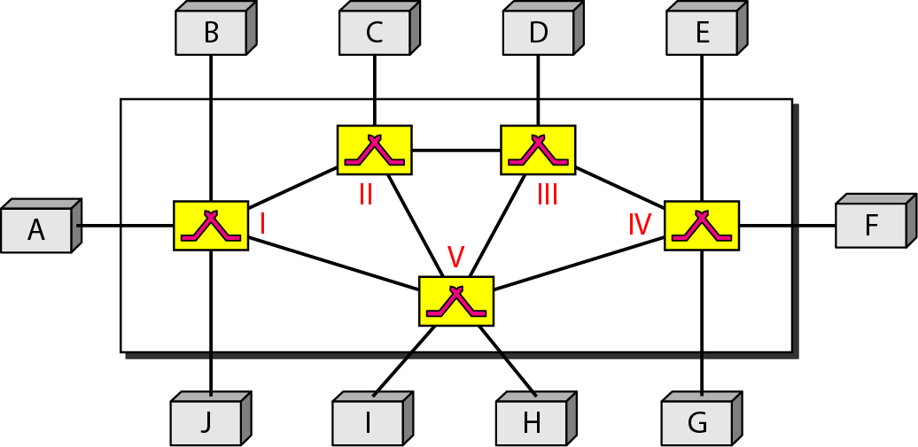
Figure 8.1 Switched network

Slide 3
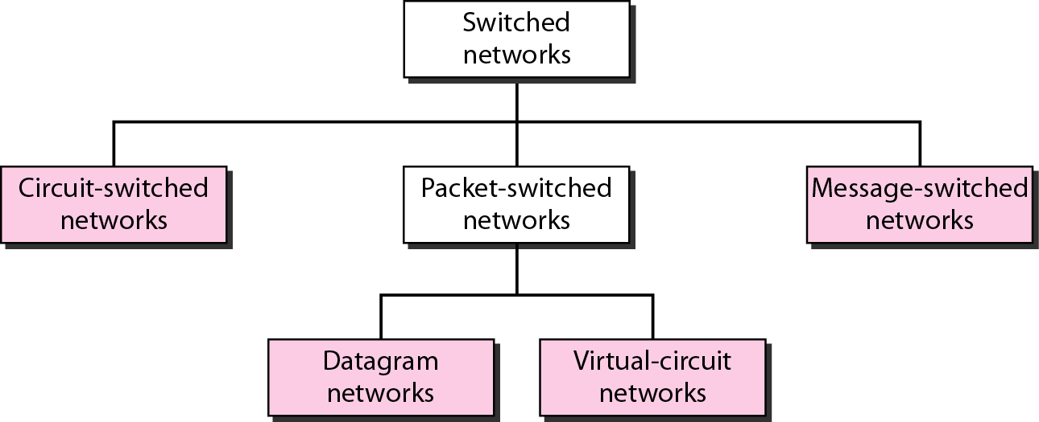
Figure 8.2 Taxonomy of switched networks

Slide 4
8-1 CIRCUIT-SWITCHED NETWORKS
A circuit-switched network consists of a set of switches connected by physical links. A connection between two stations is a dedicated path made of one or more links. However, each connection uses only one dedicated channel on each link. Each link is normally divided into n channels by using FDM or TDM.
Topics discussed in this section:
Three Phases
Efficiency
Delay
Circuit-Switched Technology in Telephone Networks

Slide 5

Note
A circuit-switched network is made of a set of switches connected by physical links, in which each link is
divided into n channels.

Slide 6
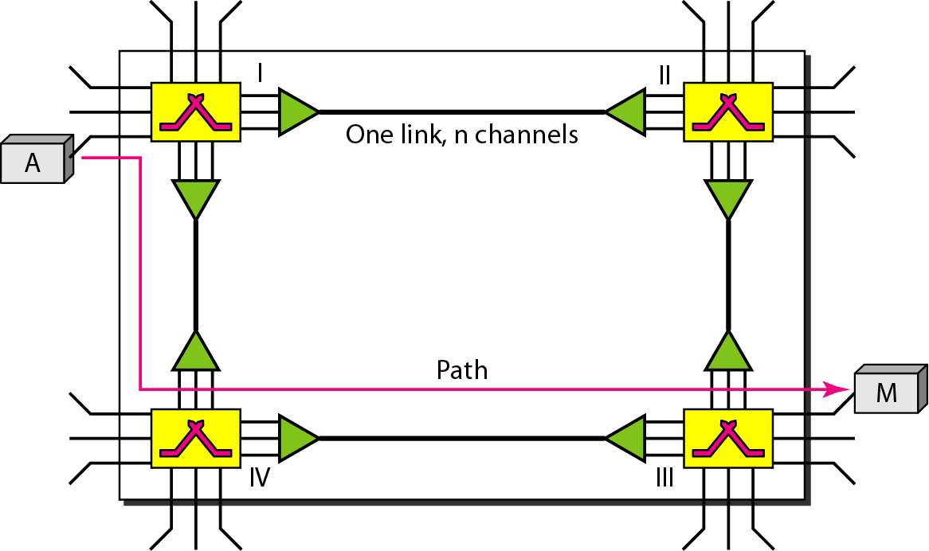
Figure 8.3 A trivial circuit-switched network

Slide 7
Note
In circuit switching, the resources need to be reserved during the setup phase;
the resources remain dedicated for the entire duration of data transfer until the teardown phase.

Slide 8
Example 8.1
As a trivial example, let us use a circuit-switched network to connect eight telephones in a small area. Communication is through 4-kHz voice channels. We assume that each link uses FDM to connect a maximum of two voice channels. The bandwidth of each link is then 8 kHz. Figure 8.4 shows the situation. Telephone 1 is connected to telephone 7; 2 to 5; 3 to 8; and 4 to 6. Of course the situation may change when new connections are made. The switch controls the connections.

Slide 9
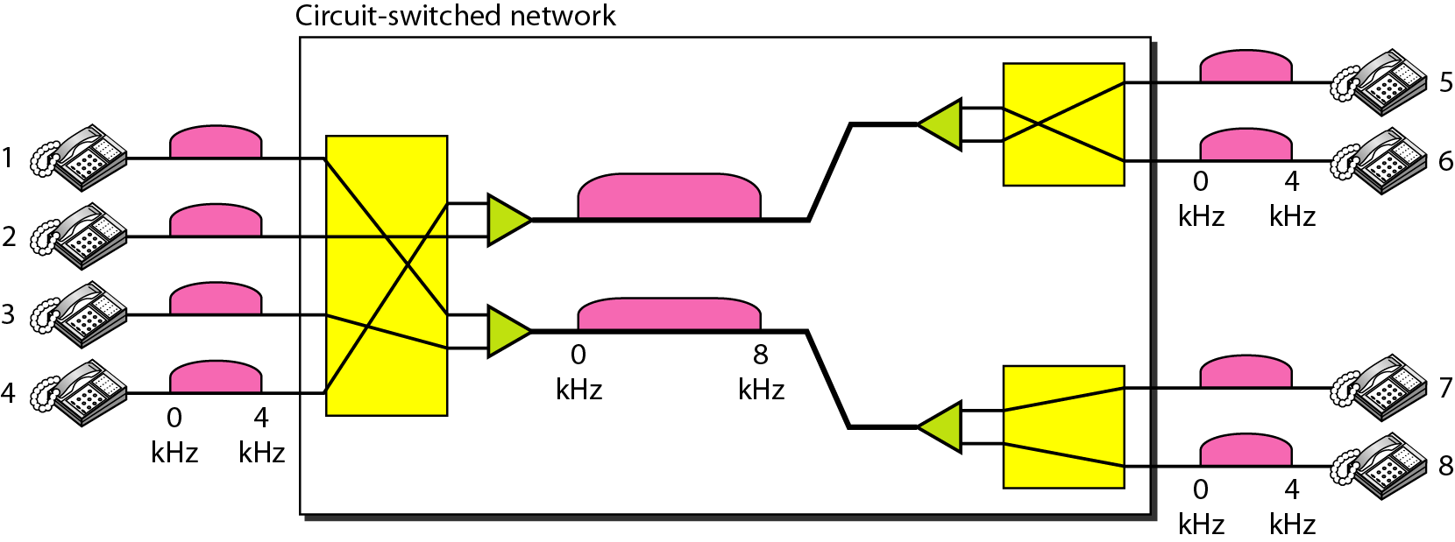
Figure 8.4 Circuit-switched network used in Example 8.1

Slide 10
Example 8.2
As another example, consider a circuit-switched network that connects computers in two remote offices of a private company. The offices are connected using a T-1 line leased from a communication service provider. There are two 4 × 8 (4 inputs and 8 outputs) switches in this network. For each switch, four output ports are folded into the input ports to allow communication between computers in the same office. Four other output ports allow communication between the two offices. Figure 8.5 shows the situation.

Slide 11
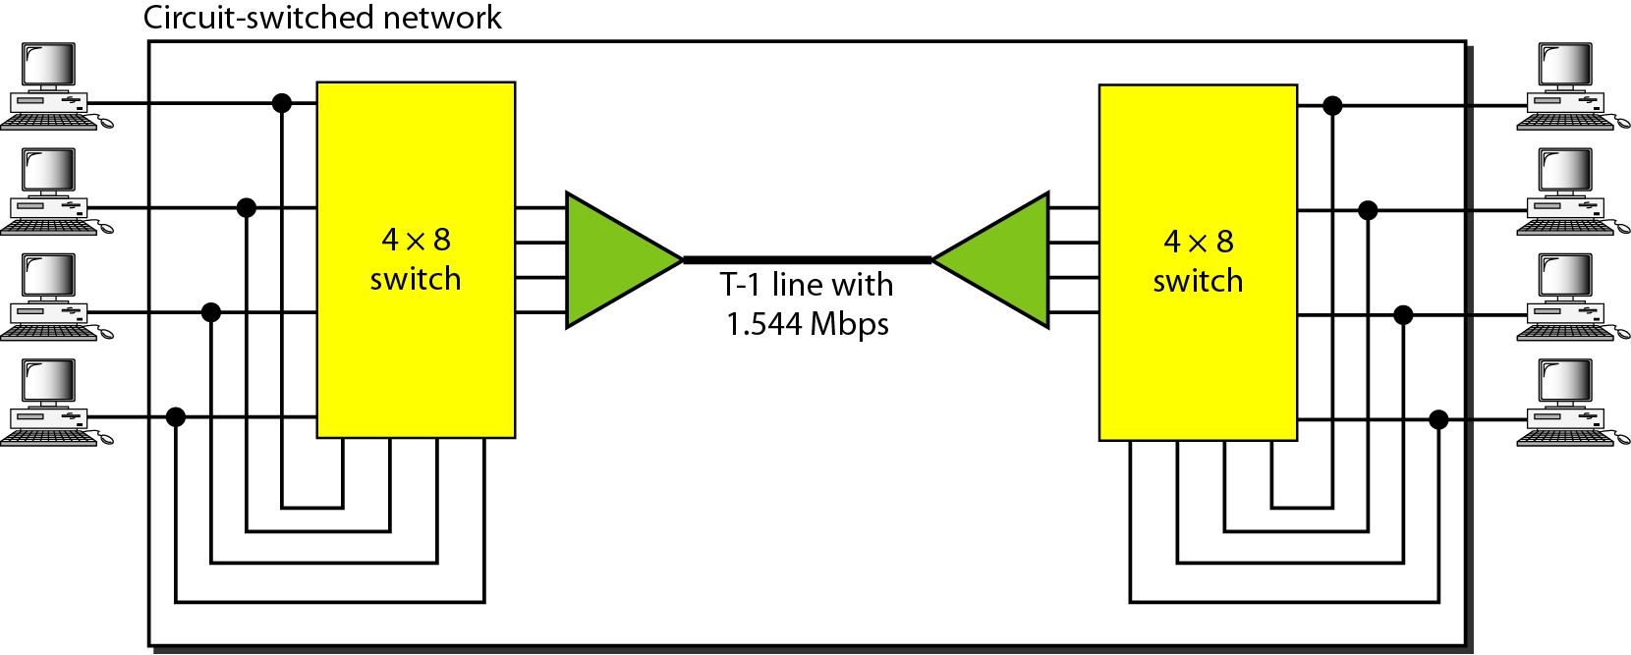
Figure 8.5 Circuit-switched network used in Example 8.2

Slide 12
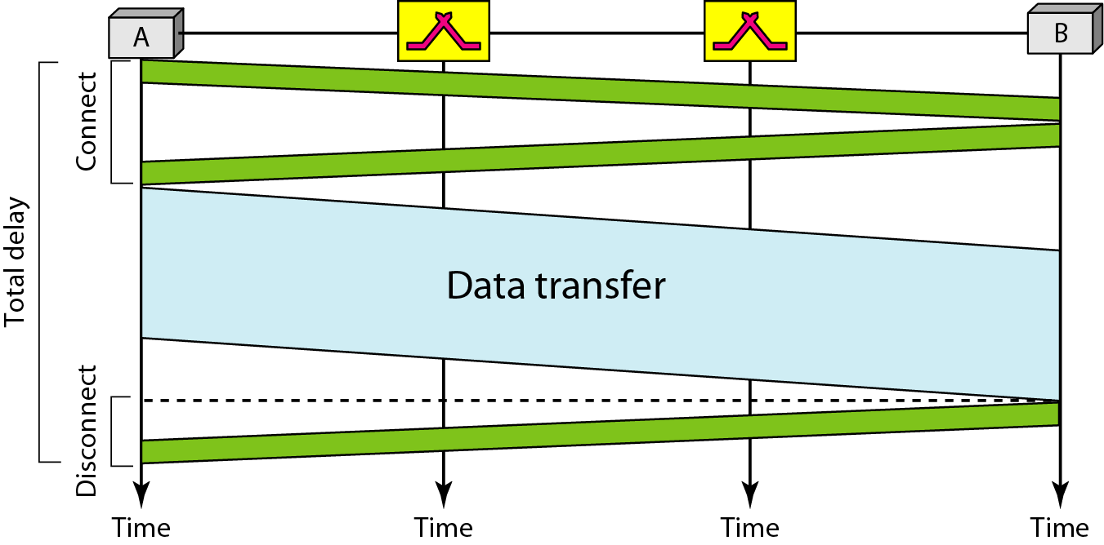
Figure 8.6 Delay in a circuit-switched network

Slide 13
Note
Switching at the physical layer in the traditional telephone network uses
the circuit-switching approach.

Slide 14
8-2 DATAGRAM NETWORKS
In data communications, we need to send messages from one end system to another. If the message is going to pass through a packet-switched network, it needs to be divided into packets of fixed or variable size. The size of the packet is determined by the network and the governing protocol.
Topics discussed in this section:
Routing Table
Efficiency
Delay
Datagram Networks in the Internet

Slide 15
Note
In a packet-switched network, there
is no resource reservation;
resources are allocated on demand.

Slide 16
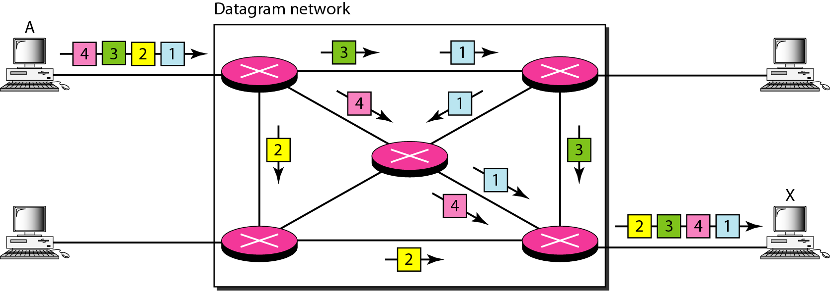
Figure 8.7 A datagram network with four switches (routers)

Slide 17
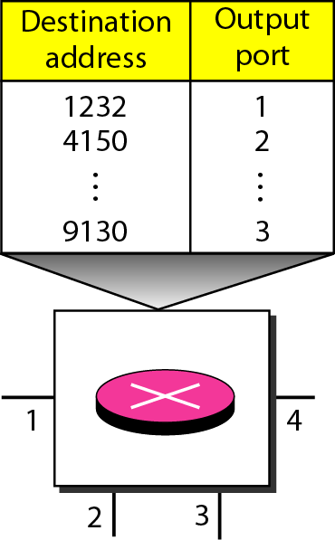
Figure 8.8 Routing table in a datagram network

Slide 18
Note
A switch in a datagram network uses a routing table that is based on the destination address.

Slide 19
Note
The destination address in the header of a packet in a datagram network
remains the same during the entire journey of the packet.

Slide 20
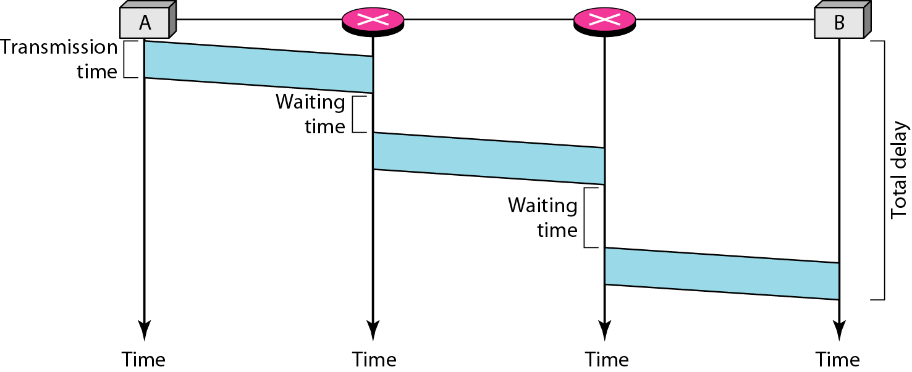
Figure 8.9 Delay in a datagram network

Slide 21
Note
Switching in the Internet is done by using the datagram approach
to packet switching at
the network layer.

Slide 22
8-3 VIRTUAL-CIRCUIT NETWORKS
A virtual-circuit network is a cross between a circuit-switched network and a datagram network. It has some characteristics of both.
Topics discussed in this section:
Addressing
Three Phases
Efficiency
Delay
Circuit-Switched Technology in WANs

Slide 23
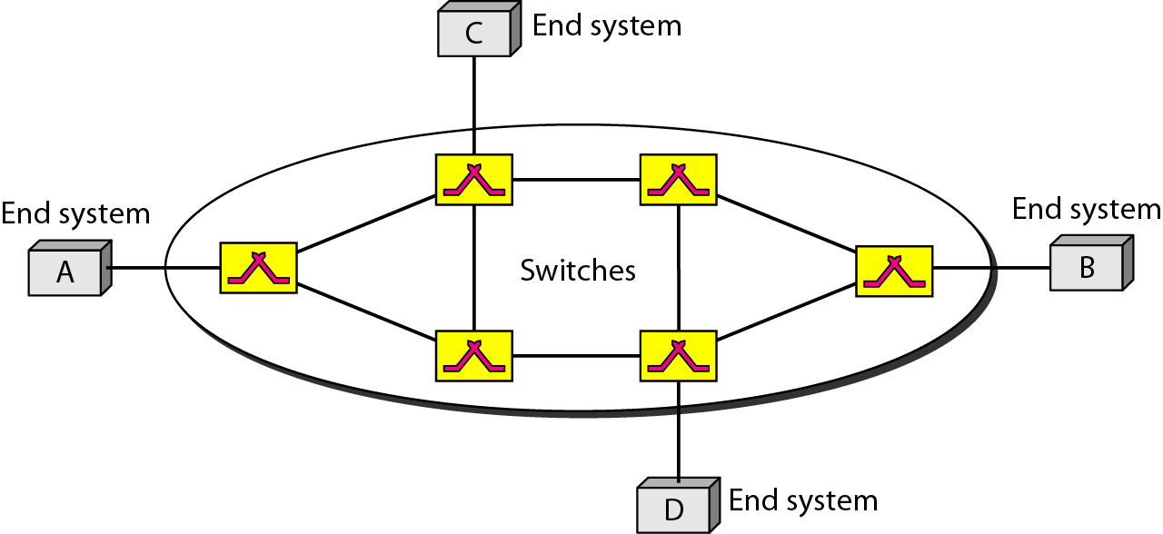
Figure 8.10 Virtual-circuit network

Slide 24
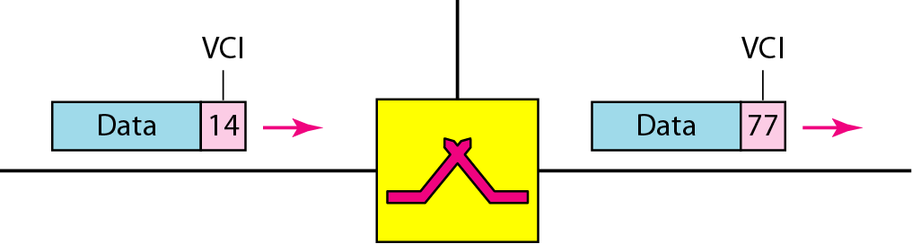
Figure 8.11 Virtual-circuit identifier

Slide 25
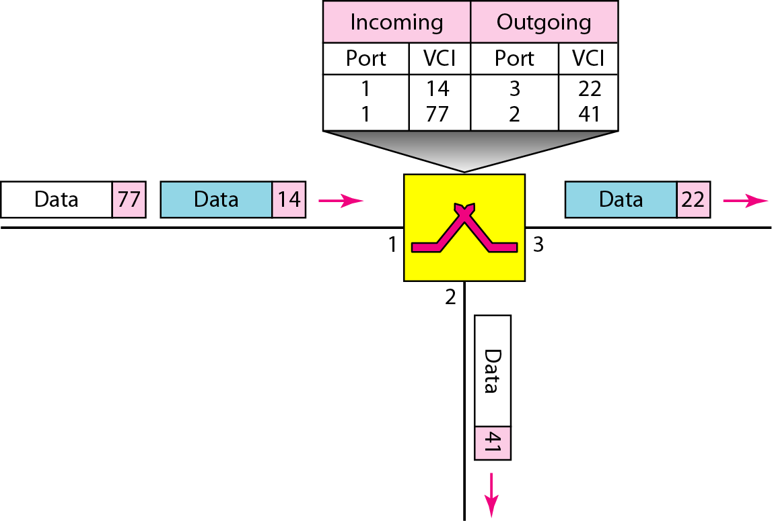
Figure 8.12 Switch and tables in a virtual-circuit network

Slide 26
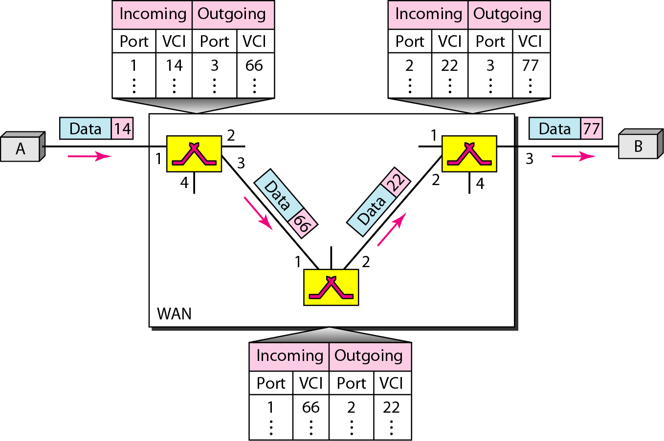
Figure 8.13 Source-to-destination data transfer in a virtual-circuit network

Slide 27
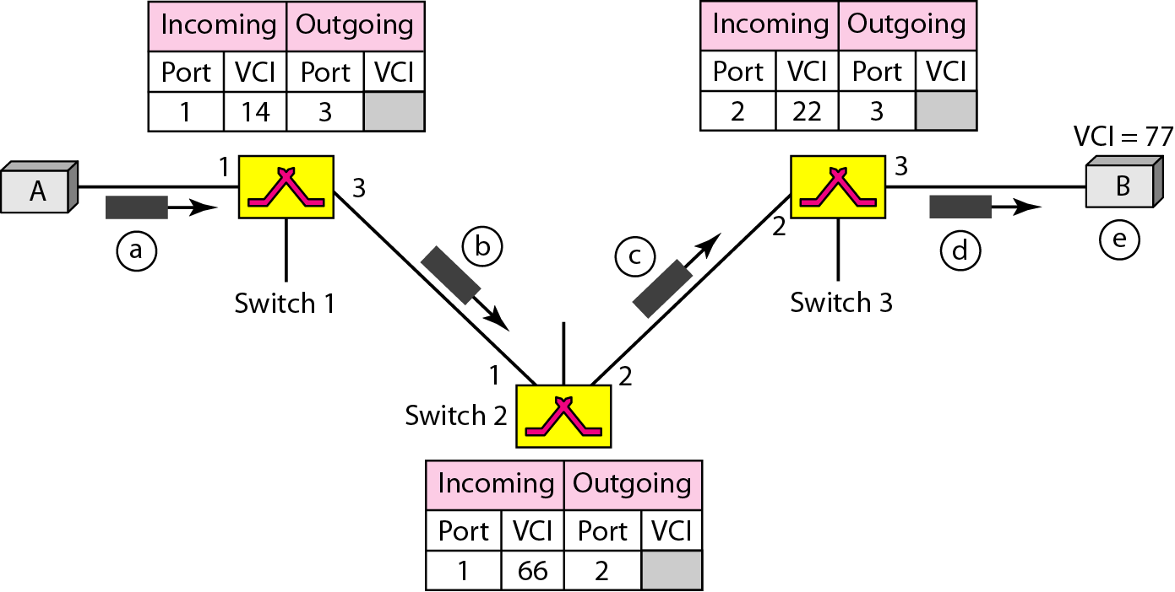
Figure 8.14 Setup request in a virtual-circuit network

Slide 28
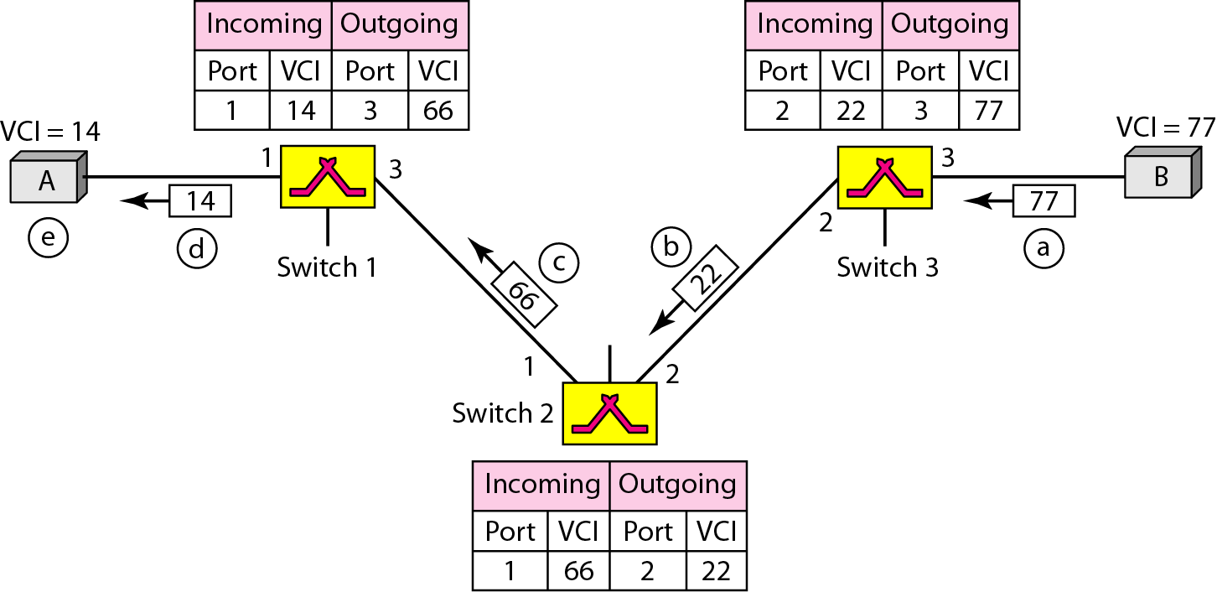
Figure 8.15 Setup acknowledgment in a virtual-circuit network

Slide 29
Note
In virtual-circuit switching, all packets belonging to the same source and
destination travel the same path;
but the packets may arrive at the destination with different delays
if resource allocation is on demand.

Slide 30
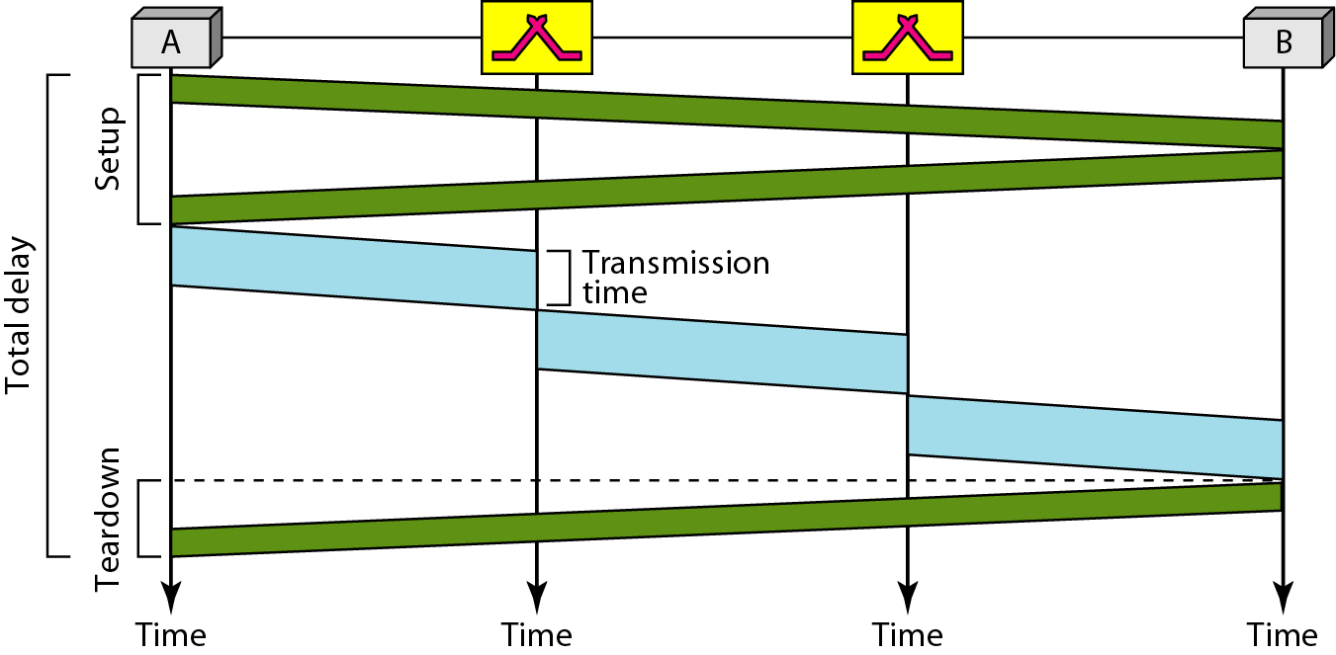
Figure 8.16 Delay in a virtual-circuit network

Slide 31
Note
Switching at the data link layer in a switched WAN is normally
implemented by using
virtual-circuit techniques.

Slide 32
8-4 STRUCTURE OF A SWITCH
We use switches in circuit-switched and packet-switched networks. In this section, we discuss the structures of the switches used in each type of network.
Topics discussed in this section:
Structure of Circuit Switches
Structure of Packet Switches

Slide 33
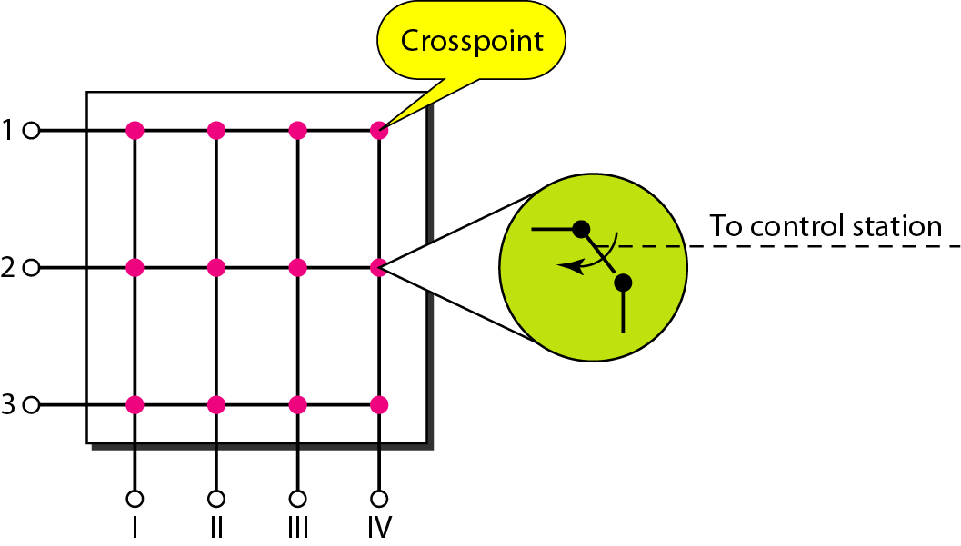
Figure 8.17 Crossbar switch with three inputs and four outputs

Slide 34
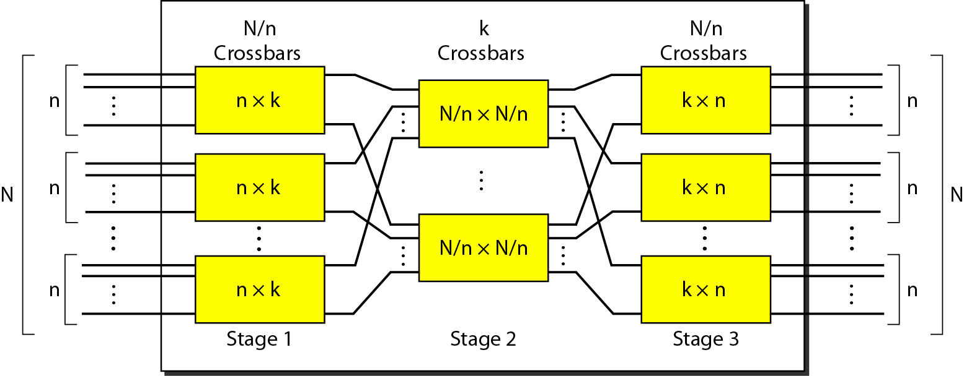
Figure 8.18 Multistage switch

Slide 35
Note
In a three-stage switch, the total
number of crosspoints is
2kN + k(N/n)²
which is much smaller than the number of crosspoints in a single-stage switch (N²).

Slide 36
Example 8.3
Design a three-stage, 200 × 200 switch (N = 200) with
k = 4 and n = 20.
Solution
In the first stage we have N/n or 10 crossbars, each of size 20 × 4. In the second stage, we have 4 crossbars, each of size 10 × 10. In the third stage, we have 10 crossbars, each of size 4 × 20. The total number of crosspoints is 2kN + k(N/n)², or 2000 crosspoints. This is 5 percent of the number of crosspoints in a single-stage switch (200 × 200 = 40,000).

Slide 37
Note
According to the Clos criterion:
n = (N/2)^{1/2}
k > 2n – 1
Crosspoints ≥ 4N [(2N)^{1/2} – 1]

Slide 38
Example 8.4
Redesign the previous three-stage, 200 × 200 switch, using the Clos criteria with a minimum number of crosspoints.
Solution
We let n = (200/2)^{1/2}, or n = 10. We calculate k = 2n − 1 = 19. In the first stage, we have 200/10, or 20, crossbars, each with 10 × 19 crosspoints. In the second stage, we have 19 crossbars, each with 10 × 10 crosspoints. In the third stage, we have 20 crossbars each with 19 × 10 crosspoints. The total number of crosspoints is 20(10 × 19) + 19(10 × 10) + 20(19 ×10) = 9500.

Slide 39
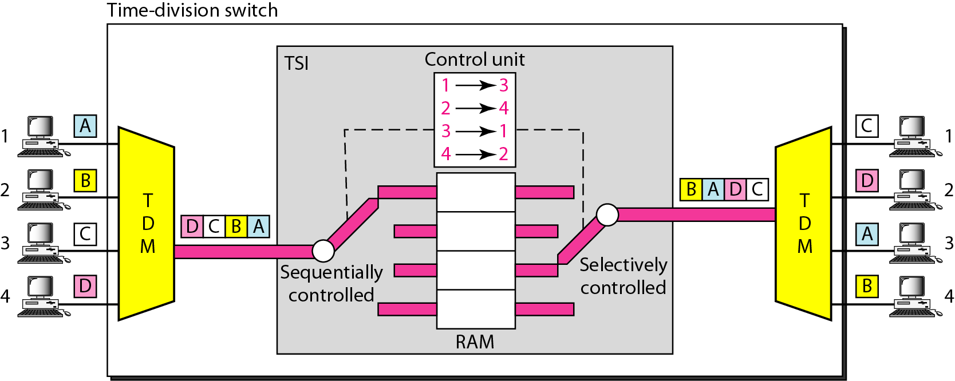
Figure 8.19 Time-slot interchange

Slide 40
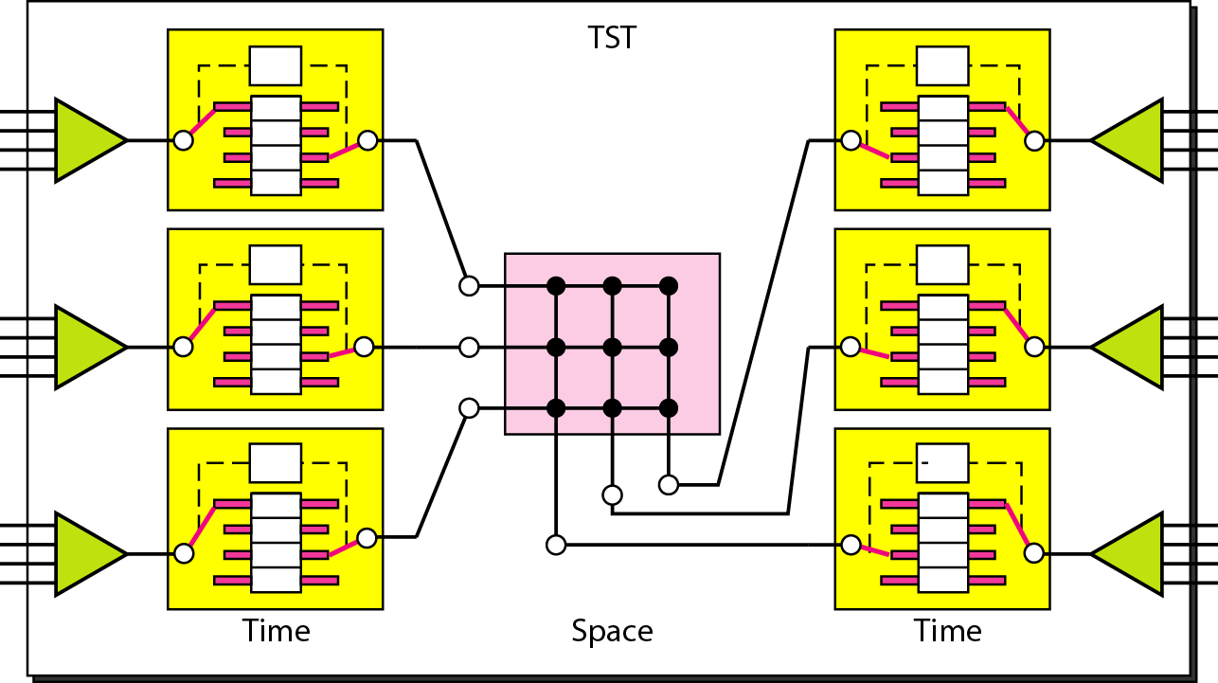
Figure 8.20 Time-space-time switch

Slide 41
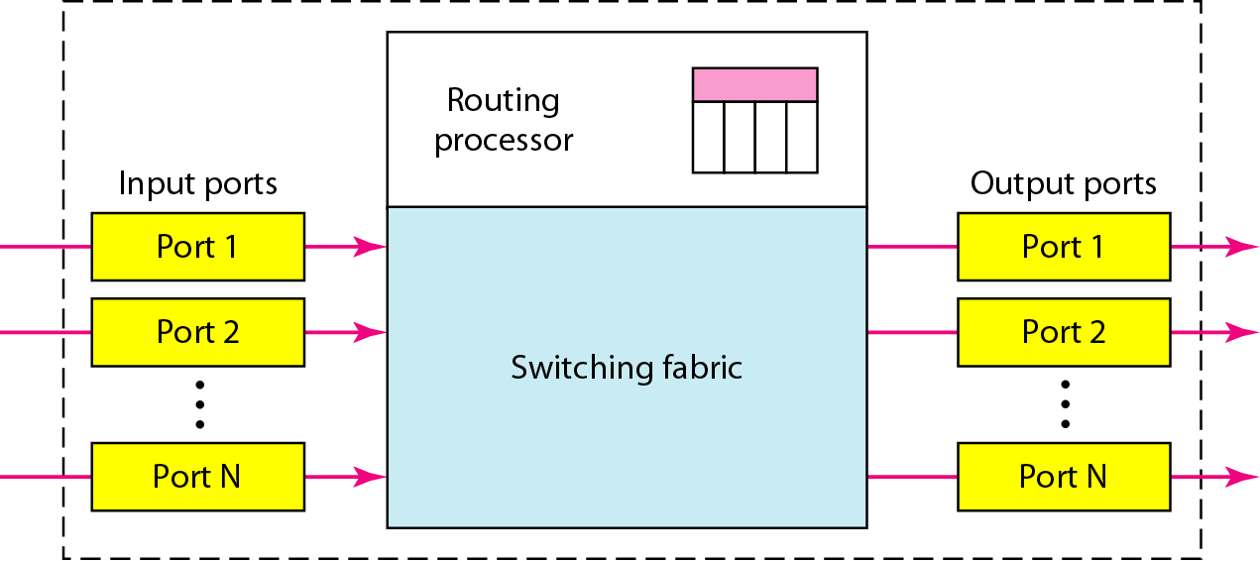
Figure 8.21 Packet switch components

Slide 42
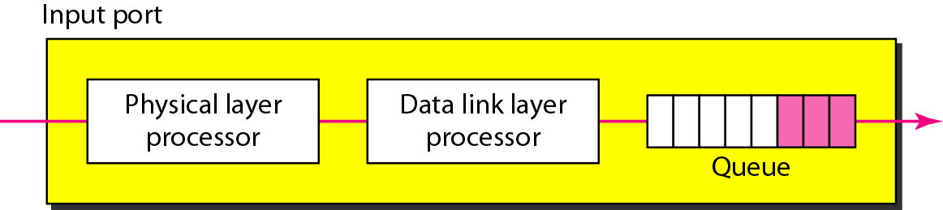
Figure 8.22 Input port

Slide 43
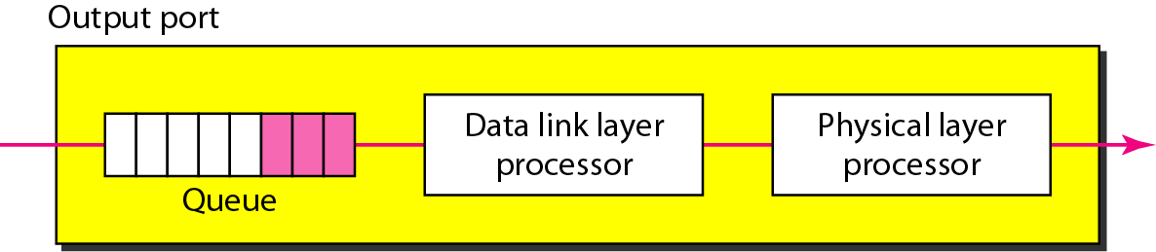
Figure 8.23 Output port

Slide 44
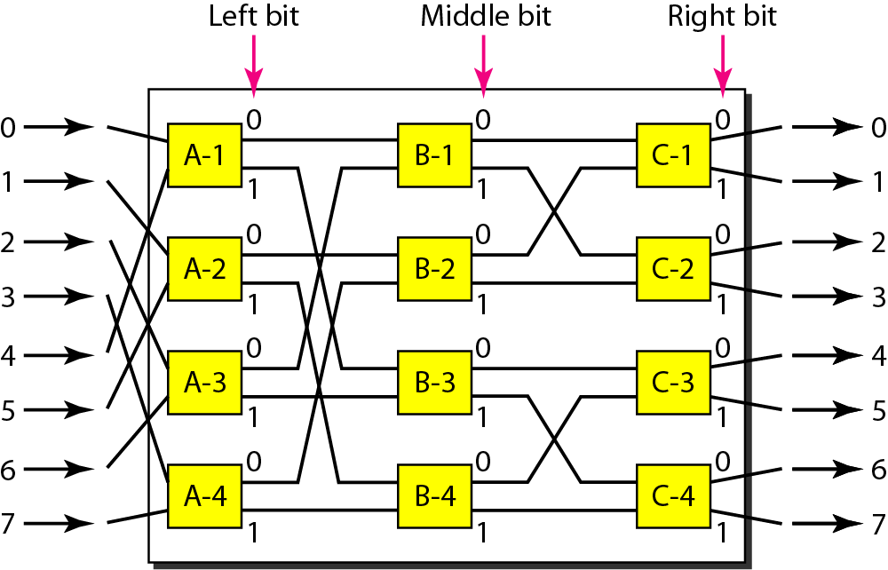
Figure 8.24 A banyan switch

Slide 45
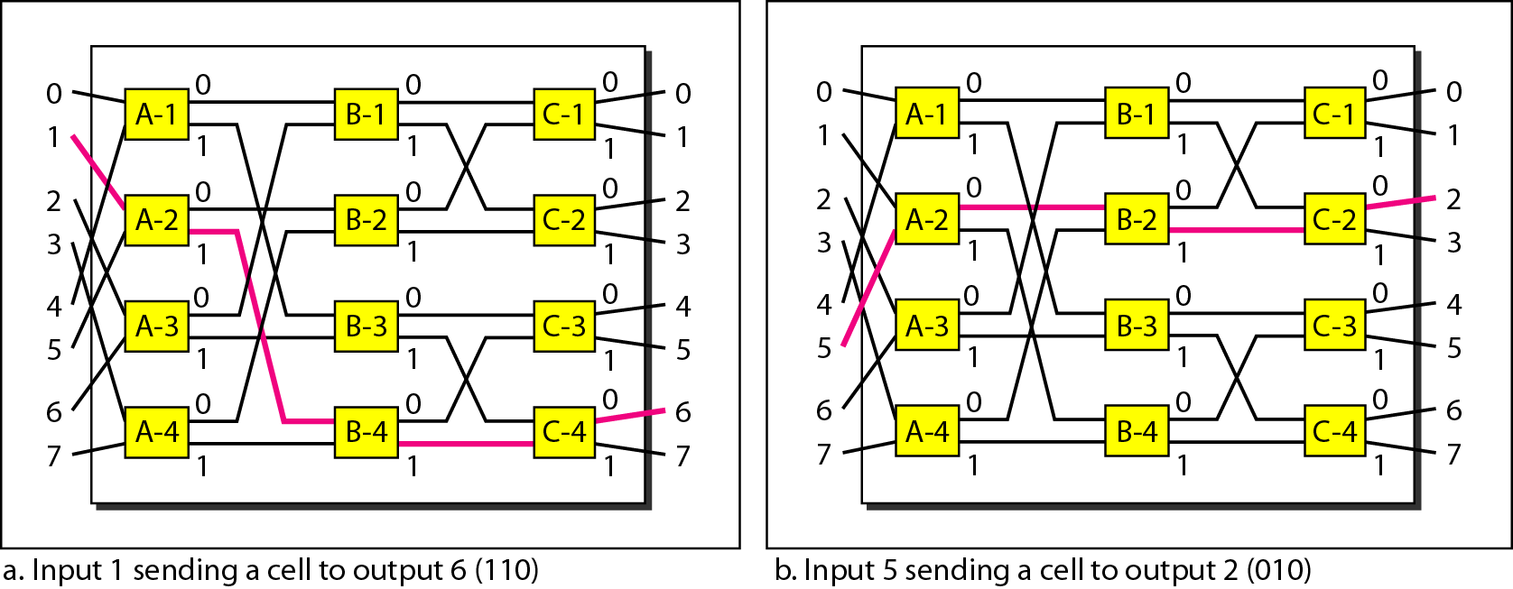
Figure 8.25 Examples of routing in a banyan switch

Slide 46
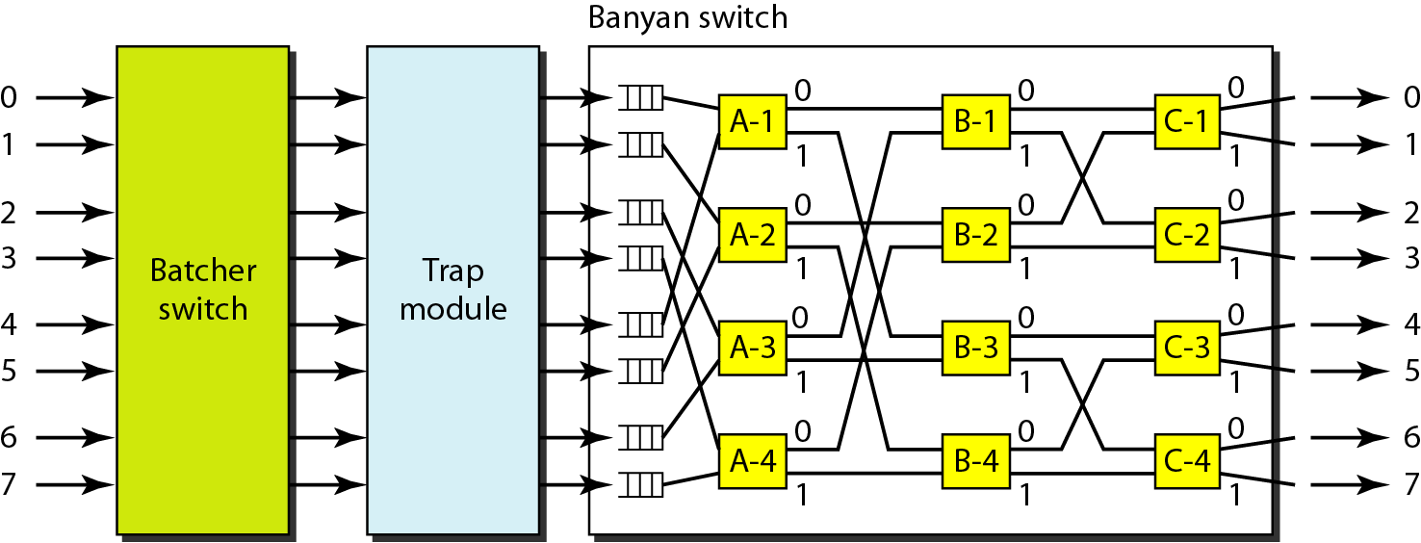
Figure 8.26 Batcher-banyan switch

Slide 47
