Slide 1
Textify AI
Monetize B2C AI solutions

Slide 2
01.
02.
03.
About me
About textify
COST OF BUILDING AN AI APPLICATION
04.
05.
POSSIBLE WAYS TO MONETIZE
BEST APPROACH TO MONETIZE

Slide 3
01.
About me

Slide 4
Personal info
Siddhesh Kanawade
Junior Undergraduate,
IIT Gandhinagar,
India
Github
https://github.com/SiddheshKanawade
Linkedin
https://www.linkedin.com/in/siddhesh-kanawade-9a9950208
Contact
siddhesh.kanawade@iitgn.ac.in
Timezone
GMT +5:30
Location
Nashik, India

Slide 5



Industrial experience
Google Summer of Code 2022 [May 2022 - Sept 2022]
Open Source contributor at Casbin
Casbin: an authorization library that supports access control models like ACL, RBAC, ABAC.
Contributed to rust version of Casbin: Casbin-rs
Skill: Rust, Git, CI/CD, Middleware
Granular AI [Sept 2022 - Jan 2023]
ML Product Intern
Responsible to build multiple micro-services for Granular’s GeoEngine Platform
Skill: Python, Docker, Kubernetes, Minikube
Niramai Health Analytix Pvt. Ltd [May 2022 - Aug 2022]
Mobile Application Developer Intern
Worked in a team of experienced App Developers to develop a widget in flutter capable of login, signup and booking appointment.
Skill: Flutter, Dart, Razorpay(payment gateway)

Slide 6
Projects
E commerce website
About: An extended e commerce catalog which supports bid, barter and merchandise. Integrated with razorpay payment gateway for seamless transaction.
Github: https://github.com/SiddheshKanawade/CDSlite
Skill: Python, Flask, HTML, CSS, Jquery
Public-Cryptography-System
About: Implemented Diffie Hellman Key Generation and Newton Raphson Method - in Cryptography.
Github: https://github.com/SiddheshKanawade/Public-Cryptography-System
Skill: Python, Flask
Meal App
About: Developed and implemented intuitive front-end for recipe android application
Github: https://github.com/SiddheshKanawade/Meal-App
Skill: Flutter, Dart
Cache-Simulator
About: Designed and implemented cache-simulator, which demonstrates different replacement, and mapping policies that the actual CPUs implement
Github: https://github.com/SiddheshKanawade/Cache-Simulator
Skill: Python, Flask
Geoclassifier
About: Trained a multi-class classifier to classify a geographical area and made a demo using Grad io
Github:
Skill: Python, Grad io
Expense App
About: Implemented front-end for an expense application capable of tracking the expense over a week
Github: https://github.com/SiddheshKanawade/Expense-App
Skill: Flutter, Dart

Slide 7
02.
ABOUT TEXTIFY
World's First AI membership

Slide 8
Textify ai
Textify AI is a platform that offers a range of NLP tools, such as sentiment analysis, text classification, entity recognition, and summarization. These tools can be used to automate and improve various tasks related to text analysis, such as customer feedback analysis, social media monitoring, content moderation, and content generation. The platform uses advanced machine learning algorithms to analyze and understand text data, enabling businesses and individuals to gain valuable insights from unstructured data sources.

Slide 9
03.
COST OF BUILDING AN AI APPLICATION

Slide 10
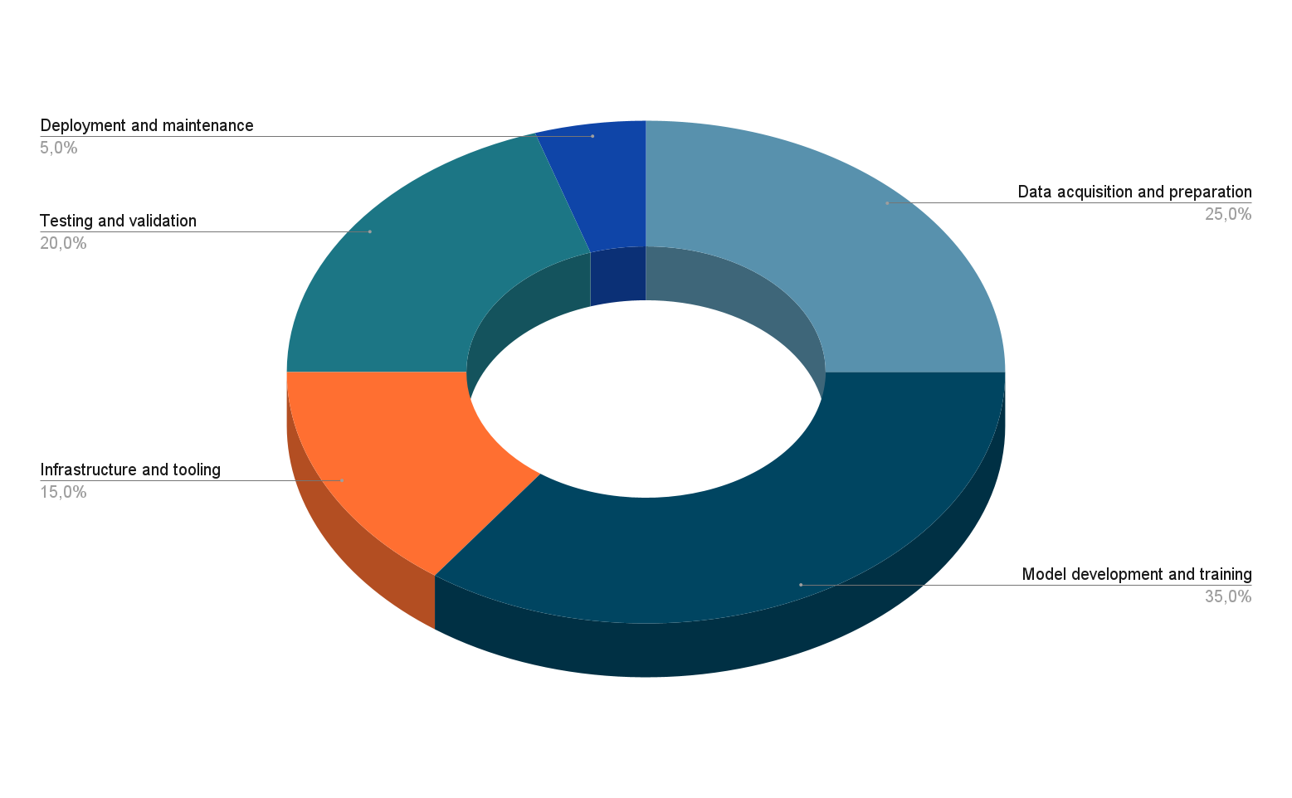
Cost of producing an ai application

Slide 11
04.
POSSIBLE WAYS TO MONETIZE

Slide 12
Ways to monetize
Pay-per-use
Charge customers a fee each time they use an AI solution on platform. Good option for customers who only need occasional use of the solution.
Freemium
Offer a basic version of the AI solution for free, but charge customers for additional features or functionality. User retention will be high in this case and initially we can have more audience for feedback.
Micropayments
B2C solutions could generate revenue through micropayments or smaller fees charged for specific actions or features. Allowing micropayments help attract rare users.
Transaction-based revenue
B2C AI applications could generate revenue through transaction fees or commissions. For example, a shopping assistant can get us commission for every product sold through its recommendation engine.
Partnerships and integrations
Example: AI-powered personal finance app could integrate with banking institutions and financial services providers, and receive a commission for each referral or transaction.
Data analysis and insights
B2C AI applications can provide valuable data analysis and insights to businesses and organizations, which could be monetized through licensing agreements or consulting services.
White-labeling
B2C AI applications could be white-labeled and sold to other businesses or organizations for use in their own products or services.
Licensing and royalties
Licensing agreements and royalties could serve as a monetization strategy for B2C AI applications. As an illustration, an AI-based music composition tool could be licensed to musicians and music producers, with royalties paid on any music created using the tool.

Slide 13
Ways to monetize
Affiliate marketing
Affiliate marketing is a performance-based marketing strategy where an advertiser pays a commission to an affiliate for driving sales or leads.
Custom AI development
Monetize a B2C AI platform by offering custom AI development, generating high-value revenue for businesses/individuals.
Non-profit partnerships
Example: Monetize AI translation tool by partnering with refugee support orgs to provide free/discounted services, revenue through other channels.
Marketplace model
Allow providers to set their own prices for their AI solutions, and take a commission on each sale.
Training and education:
An effective way to monetize AI solutions is by offering training and education services, helping customers learn to use AI effectively while generating additional revenue for the platform. This provides value to customers and enhances the platform's business model.

Slide 14
05.
BEST APPROACH TO MONETIZE

Slide 15
Best approach don’t exist
Every monetization technique mentioned in the previous slides is a best suite for some type of AI solution.
For example, best approach can vary based on the use case and popularity of the solution. Like for a solution as popular as chat GPT, subscription model may work best, but for something less popular, we can use pay per use, so that user doesn’t spend unnecessarily.
While considering the monetization solution we must consider: user retention, pricing, scalability of platform, pricing, target market segment, existing solutions, user experience and ease in user feedback for more user interaction.

Slide 16
Best plausible solution
Credit-based system
Credit-based monetization is a pricing model where customers purchase credits or tokens to use a platform's services, instead of paying a fixed fee for each use or a subscription fee. The amount of credits required to use the platform's services varies based on usage, with customers paying for what they use. This can provide a flexible and scalable pricing structure for both the platform and its customers, particularly for B2C AI solutions that have variable usage rates and customer needs.
Covers: Pay-per-use, Freemium(give the user some free credits as they join the platform), Micropayments(a credit will be the smallest indivisible unit), etc
Credit-based system ensures that user can access to almost all the services on the platform after executing a single transaction, benefiting the user experience and hence increasing user retention.
One example of a company using credit-based monetization is AWS (Amazon Web Services). They offer a pay-as-you-go pricing model where customers purchase credits (known as "AWS credits") to use their cloud computing services. The amount of credits needed for each service varies based on usage, and customers only pay for what they use. This allows for flexible pricing and scalability, which can be attractive to customers with varying needs and usage patterns.

Slide 17
Best plausible solution
Benefit of using Credit-based monetization
Flexibility: Credit-based monetization can offer a more flexible pricing structure for both the platform and its customers, as customers only pay for what they use and can purchase credits in varying amounts.
Scalability: This model can allow for scalability, as the amount of credits required for each service can vary based on usage. This can be particularly useful for B2C AI solutions that have variable usage rates and customer needs.
Increased customer engagement: Credits can incentivize customers to continue using the platform's services in order to use up their purchased credits, potentially increasing customer engagement and retention.
Potential for increased revenue: Customers may be more likely to purchase credits in bulk or higher amounts to take advantage of discounts, potentially resulting in increased revenue for the platform.

Slide 18
Best plausible solution
Implementing Credit Based System
Determine the value of credits: Determine the monetary value of each credit and how much each service will cost in credits
Offer credit packages: Different packages of credits for customers to purchase, with higher discounts for larger credit packages
Allow for credit refunds: Allow customers to receive refunds for unused credits or transfer credits to other customers.
Communicate credit usage: Clearly communicate to customers how many credits they have remaining and how many credits are required for each service.
Caution:
We have to be cautious when using credit based monetization technique. Its relatively complex for an user to understand, if there are credits left in the account of the user, then they may not buy new credits, It's important to carefully consider such limitations and weigh them against the potential benefits of a credit-based system before implementing it as a monetization strategy.

Slide 19
Best plausible solution
Some important points
Pricing: I suggest to have a trade-off between dynamic pricing and static pricing. I believe the price should be revised quarterly or once in six months.
Like having an AI/ML model or some other automated solution that has current financial conditions as input and price(or similar parameter) as output, if the price falls below some threshold, its alarming and we should change the price of product/service accordingly.
Should have different plans for individuals or some consumers and enterprise level consumers.
Should be cautious of Regulatory compliance, depending on your location and the nature of your platform, there may be regulatory requirements you need to consider when implementing a credit-based system.

Slide 20
THANKS

