Slide 1

Automation Testing With Selenium

Slide 2
Table of Contents
1. Software Testing 2. Manual Testing 3. Automation Testing
4. Need for Automation Testing 5. Factors In Selecting Automation Testing Tool 6. The Selenium Browser Automation 7. Selenium Web-Driver 8. Selenium Installation 9. Java Installation 10. Environment Variable Set-up
11. Eclipse IDE Installation
12. Selenium Web-driver Installation 13. Getting Started With Selenium Web-driver a) Browsers b) Third party drivers and plugins 14. Locating Elements 15. Performing actions on the AUT
16. Sample Script.

Slide 3
Software Testing
Software Testing is the process of verifying and validating a software product against the requirement of the client. It can alternatively be defined as the process of finding bugs in the software product in order to improve the quality of the software.
Software Testing is questioning a product in order to evaluate it.
Software Testing is the process used to help identify the correctness, completeness, security and quality of developed software.
Testing the test-ability of the product is software called software testing.

Slide 4
Manual Testing
Manual Testing is a sort of Software Testing where Testers physically/manually execute test cases without using any automation tool for executing test cases/scripts. Manual Testing is the most crude of all testing forms and helps discover bugs in the software product .
Any new application must be manually tested before its testing is being automated. Manual Testing requires more exertion yet is important to check automation possibility.
One of the Software Testing Fundamental is "100% Automation is beyond the realm of imagination".

Slide 5
Automation Testing
Automation Testing means utilizing a Automation software tool to execute test case scripts / test suite.
Automation testing tools can likewise enter test data into the System Under Test, think about expected and real outcomes and create itemized test reports.
Progressive development cycles will require execution of same test suite more than once. Utilizing a test automation tool, it's conceivable to record the test suite and re-play it as required. When the test suite is mechanized, no human intercession is required. The objective of Automation is to decrease the quantity of experiments to be run physically and not to take out Manual Testing through and through.

Slide 6
Need for Automation Testing
In Manual Testing all the things considered, all fields, every negative situation is time and cash consuming.
Manual Testing can end up exhausting and subsequently mistake inclined.
Fewer Human Resources-Automation does not require Human intercession. You can run computerized test unattended.
Automation expands the speed of test execution.
Automation enables increment To test Coverage.
Reusability-Automation test scripts can be re-used with some modifications.
Reliability-Testing with Automation tool Improves Accuracy.
Accelerate cross-browser and cross-device testing.
Running Tests 24/7- No matter where you are in the world. You can start the tests when you leave the office and when you get back in the morning you can see the results and keep on working.

Slide 7
Factors In Selecting Automation Testing Tool
Identify the requirement for tools- You need to precisely identify the test tool requirements. All the requirements must be documented and reviewed by project teams and the management board.
Evaluate the tools and vendors- Analyse the commercial and open source tools that are available in the market, based on the project requirement.
Estimate cost and benefit- A cost-benefit analysis should be performed before acquiring or building a tool
Identifying and planning internal implementation (including coaching and mentoring for those new to the use of the tool).

Slide 8
The Selenium Browser Automation
Selenium is an umbrella project for a range of tools and libraries that enable and support the automation of web browsers. At the core of Selenium is WebDriver, an interface to write instruction sets that can be run interchangeably in many browsers. Selenium is not just one tool or API but it composes many tools. WebDriver
If you are beginning with desktop website or mobile website test automation, then you are going to be using WebDriver APIs. WebDriver uses browser automation APIs provided by browser vendors to control browser and run tests. This is as if a real user is operating the browser. Since WebDriver does not require its API to be compiled with application code, it is not intrusive. Hence, you are testing the same application which you push live.

Slide 9
The Selenium Browser Automation
IDE
IDE (Integrated Development Environment) is the tool you use to develop your Selenium test cases. It’s an easy-to-use Chrome and Firefox extension and is generally the most efficient way to develop test cases. It records the users’ actions in the browser for you, using existing Selenium commands, with parameters defined by the context of that element. This is not only a time-saver but also an excellent way of learning Selenium script syntax.
Grid
Soon after the development of WebDriver tests, you may face a need of running your tests on multiple browser and operating system combinations. This is where Grid comes to the rescue.

Slide 10
Selenium Web-Driver
If you’re testing any desktop website or mobile website test automation, then you are going to be using WebDriver APIs. WebDriver uses browser automation APIs provided by browser vendors to control browser and run tests.
This is as if a real user is operating the browser.
It allows users to simulate common activities performed by end-users; entering text into fields, selecting drop-down values and checking boxes, and clicking links in documents.
It also provides many other controls such as mouse movement, arbitrary JavaScript execution, and much more.

Slide 11
Selenium Installation
The process of installing Selenium involves 3 steps, namely:
Install Java
Install Eclipse IDE
Install Selenium WebDriver
Let’s get started. Selenium supports various programming languages like Java, Python, C#, Perl, Ruby etc. Java is one of the most widely used languages for Selenium. Selenium supports various programming languages like Java, Python, C#, Perl, Ruby etc. Let’s begin and understand the process of Java Installation. The very first step, needed for Java installation is to configure Java environment so that later on Java codes can be used to drive the selenium.

Slide 12
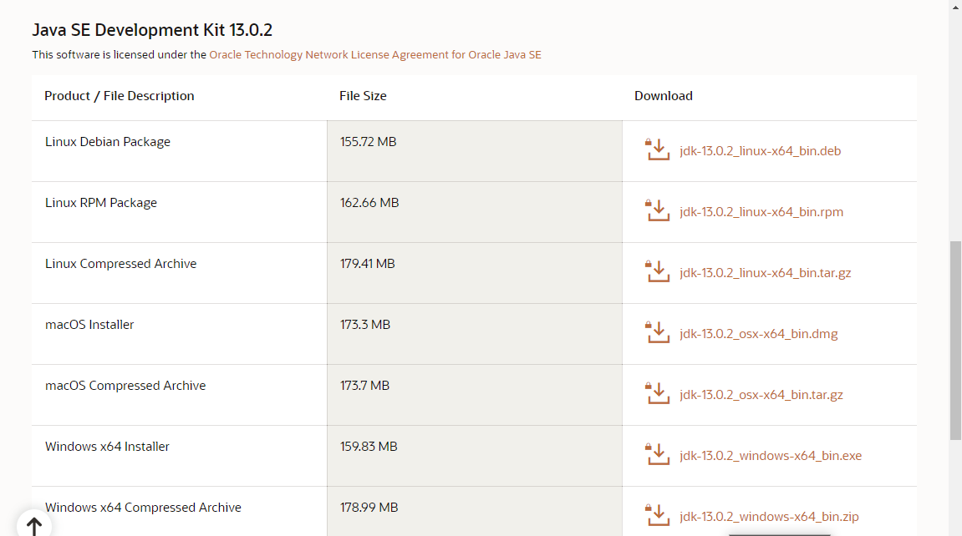
Java Installation
Follow below steps to complete your Java installation.
1) Go to the Java Downloads Page and click on the option for Java Platform (JDK). (https://www.oracle.com/java/technologies/javase-downloads.html) 2 )In the next page, select the Accept License Agreement check box, accept it and click the download link against your matching system configuration.
3) You can run the installer once the download is over and follow onscreen instructions.

Slide 13
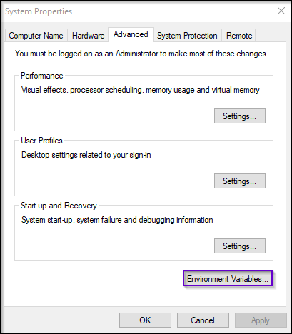
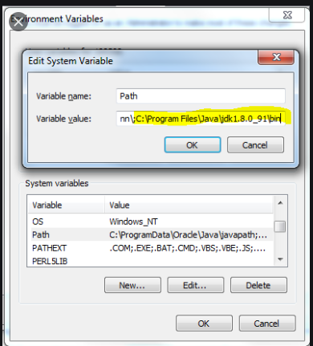
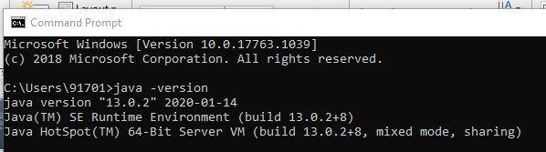
Environment Variable Set-up
1) You need to search the “Advanced system settings”
Click on ‘Environment Variables’ under ‘Advanced’ tab..
2) In the section System Variables, find the PATH environment variable and select it. 3) Click Edit. If the PATH environment variable does not exist, click New.
4) In the Edit System Variable (or New System Variable) window, specify the value of the PATH environment variable. Click OK. Close all remaining windows by clicking OK.
5) Once installation is complete, open command prompt and type “java -version”. 5) If you see the following screen you are good to move to the next step

Slide 14
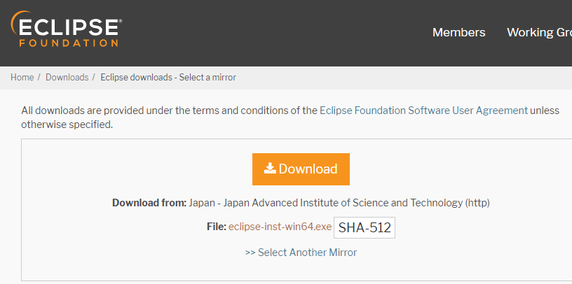
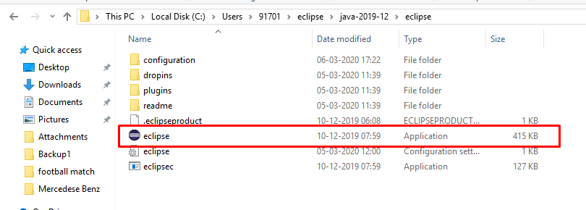
Eclipse IDE Installation
Follow the below steps to configure Eclipse on your system:
Navigate to the following URL – https://www.eclipse.org/downloads/ and select the download link depending on your system architecture – (32 Bit or 64 Bit) and download it.
Once the download is over, extract the zipped file and save it to any directory. The root folder is the eclipse.
Open the folder and launch eclipse.exe.

Slide 15
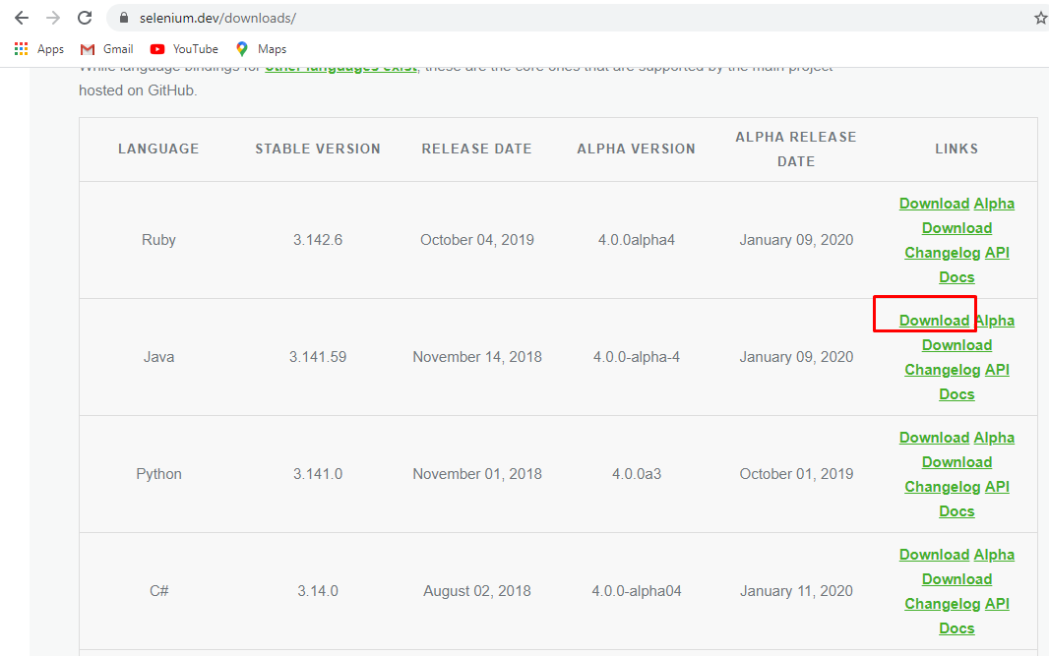
Selenium Web-driver Installation
1)Open the browser and navigate to https://www.selenium.dev/
2) Click ‘Download’ menu and choose ‘Download stable version’. For Java.
3) Extract the zip file and save it in your selenium folder. 4) Add the extracted jar files into your selenium.

Slide 16
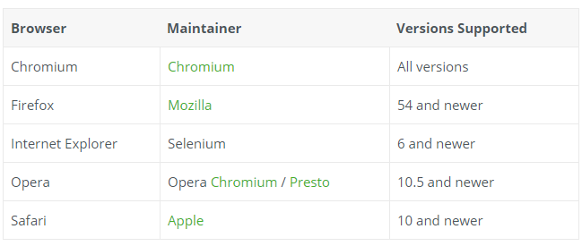
Getting Started With Selenium Web-driver
1. Browsers
The Selenium framework officially supports the following browsers:

Slide 17
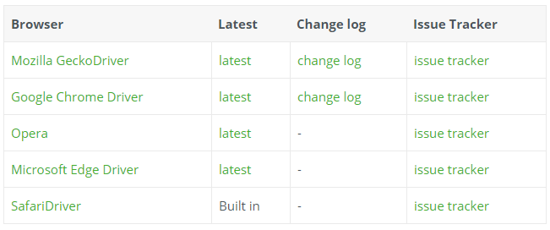
Getting Started With Selenium Web-driver
2. Third party drivers and plugins
Selenium can be extended through the use of plugins. Here are a number of plugins created and maintained by third parties.

Slide 18
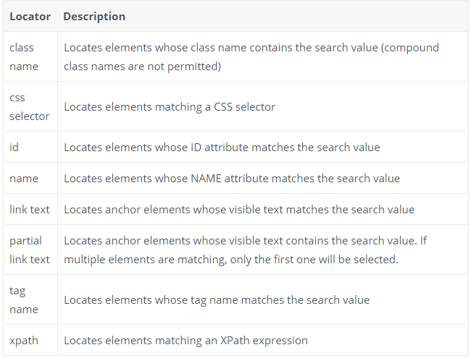
Locating Elements
There are eight different built-in element location strategies in WebDriver:

Slide 19
Locating Elements
Locating one element
One of the most fundamental techniques to learn when using WebDriver is how to find elements on the page. WebDriver offers a number of built-in selector types, amongst them finding an element by its ID attribute: For Example:
WebElement cheese = driver.findElement(By.id("cheese")); driver.findElement(By.cssSelector("#cheese #cheddar"));

Slide 20
Performing actions on the AUT
Some basic actions that can be performed by Selenium Web-driver: 1) You can set an element’s text using the sendKeys method as follows:
String name = "Charles";
driver.findElement(By.name("name")).sendKeys(name);
2) Some web applications use JavaScript libraries to add drag-and-drop functionality.
WebElement source = driver.findElement(By.id("source"));
WebElement target = driver.findElement(By.id("target"));
new Actions(driver).dragAndDrop(source, target).build().perform();
3) You can click on an element using the click method:
driver.findElement(By.cssSelector("input[type='submit']")).click();

Slide 21
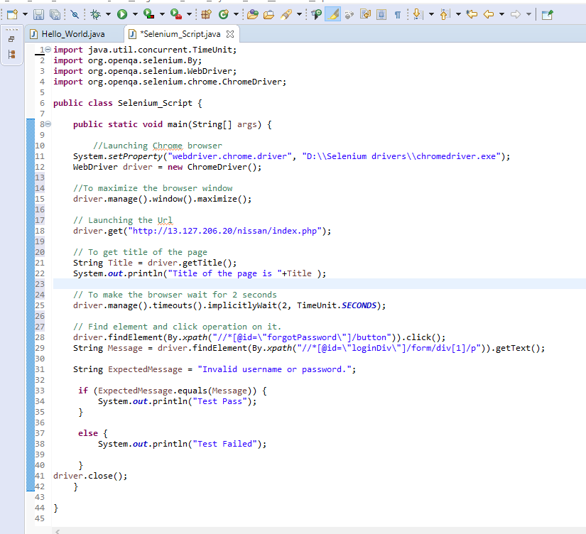
Sample Selenium Script with java
The shown selenium script is just checking the validation message appearing for leaving the mandatory fields blank.
We can similarly create the scripts for all the test cases/scenarios with the help of selenium web-driver.
Here’s the link of the execution of the created script:
https://drive.google.com/open?id=1s3QBLGjBEaymD_S8yLhfnVABgQGLrY-N

Slide 22
References
Official website of Selenium https://www.selenium.dev/
https://learnbasicsofsoftwaretesting.blogspot.com/
https://en.wikipedia.org/wiki/Selenium_(software)

Slide 23


Thank You

