Slide 1


Code for Good
Team 10

Slide 2
Basic Challenges
Identified Solution
Mobilization
SMS Based Registration
Digitalization of the data collection and analysis
Add-Ons
Academics and graphical data
Exotel
Data collection via forms and graphical analysis
Relative data and the success rate

Slide 3
Flow Chart
Pratham
Sign In
Center Head
Student
Mentor

Slide 4
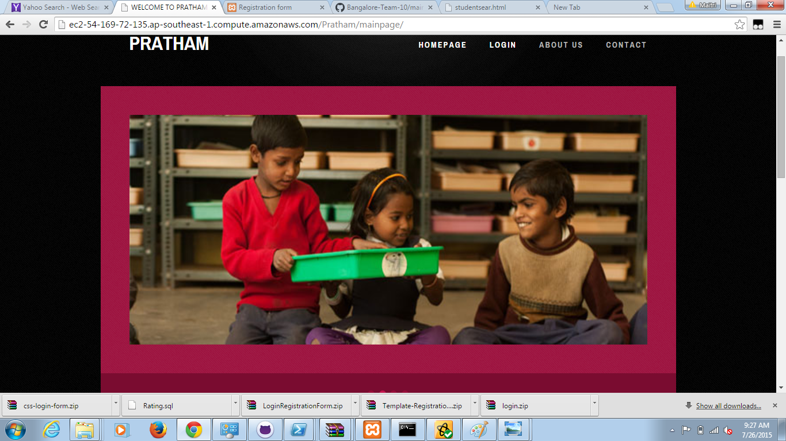
HOME PAGE

Slide 5
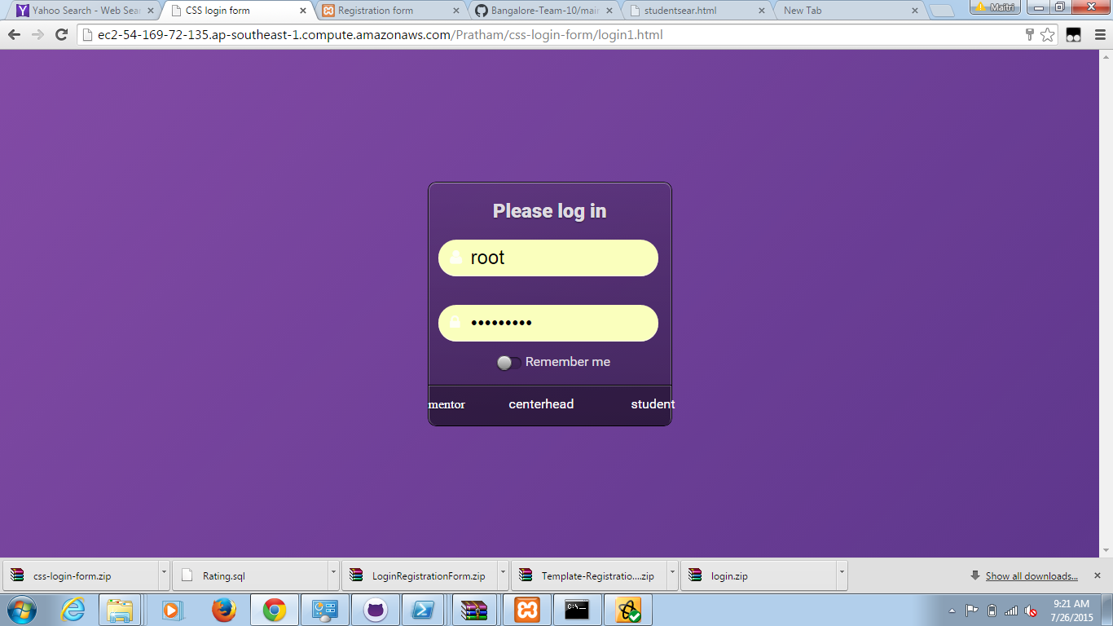
LOGIN PAGE

Slide 6
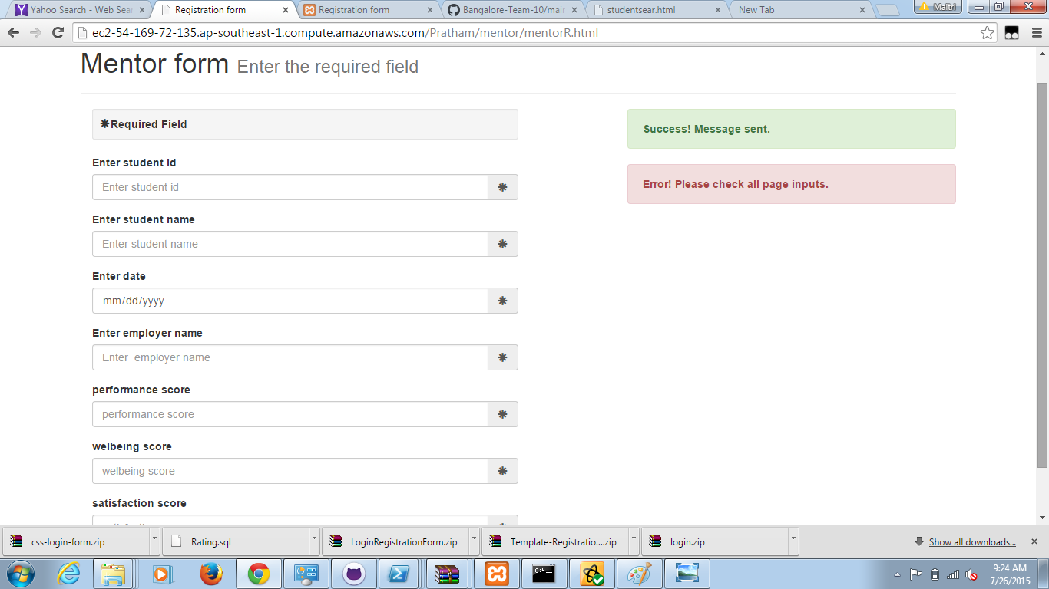
MENTOR REGISTRATION

Slide 7
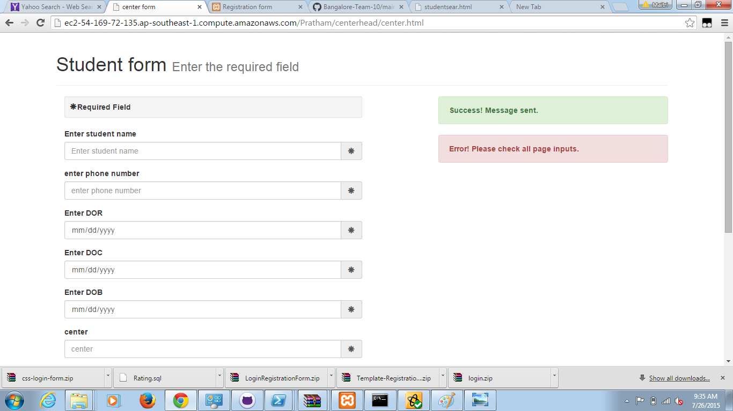
STUDENT REGISTRATION

Slide 8
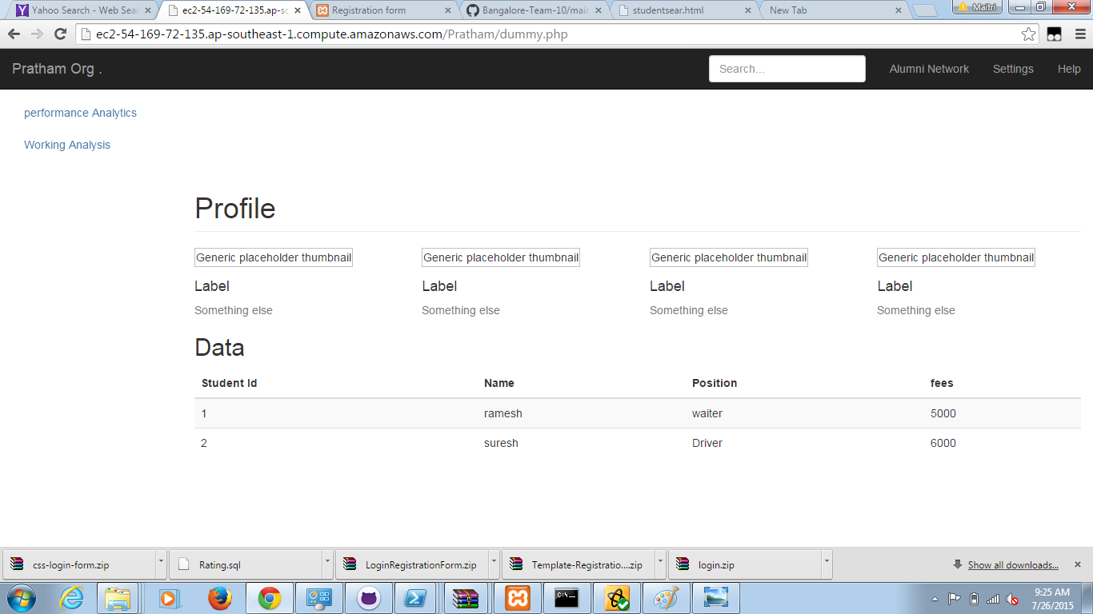
STUDENT PAGE

Slide 9
TEAM MEMBERS
Maitri Hegde
Ruchika Shah
Shreya Raidu
Spandana kandukuri
Varun
Vidwan Raj

Slide 10


Slide 11


