Slide 1
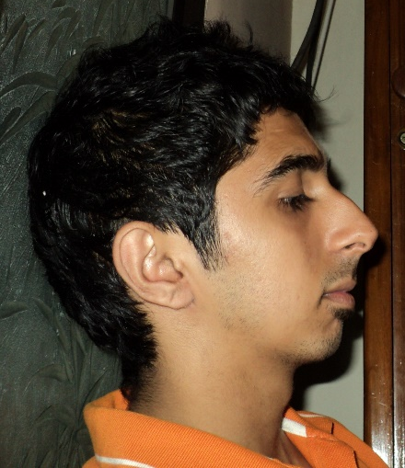
Anish Narang
8
3
4
Teamwork
Enthusiastic
Cooperation
SKILLS
Experience

