Slide 1

ISLI premiership
JP Morgan – Code for Good - Bengaluru Team 5
Aditya
Dhruv N Shah
Surya Sruthi
MV Phani Deepthi
Quamar Fatima

Slide 2
In A Nut Shell..
Introduction
Features
Technologies
Design
Implementation
Conclusion

Slide 3
Introduction
Problem statement
A mobile or web application which enables -
data collection
tracking
supporting the school leaders.
Developed a Web application which can be rendered on an Android mobile.

Slide 4
Features
Class room Observation
Teachers Actions and Student Actions
Strengths
Areas of development
Next Steps
Priorities
The Three Domains
School Visits
Premiership Badges

Slide 5
Technologies used
Front End
PHP
HTML
CSS
ELGG framework
Android sdk
Back end
MySql

Slide 6
Design Usecase diagram
Fig. 1. Usecase Diagram depicting the ISLI staff access scenarios

Slide 7
Sequential Diagram
Fig.2. Sequence Diagram for registration-user validation context.

Slide 8
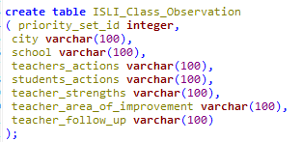
Implementation
Elgg provides the basic functionality to run a social network and is very extensible.
Elgg supports recent versions of MySQL.
Fig .3. database schema for class observation feature

Slide 9
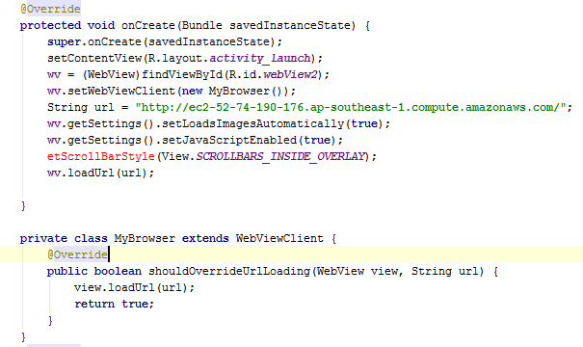
Implementation
Rendered the developed web application in Android mobile to enable periodical notifications.
Fig. 4 . WebViewClient code snippet

Slide 10
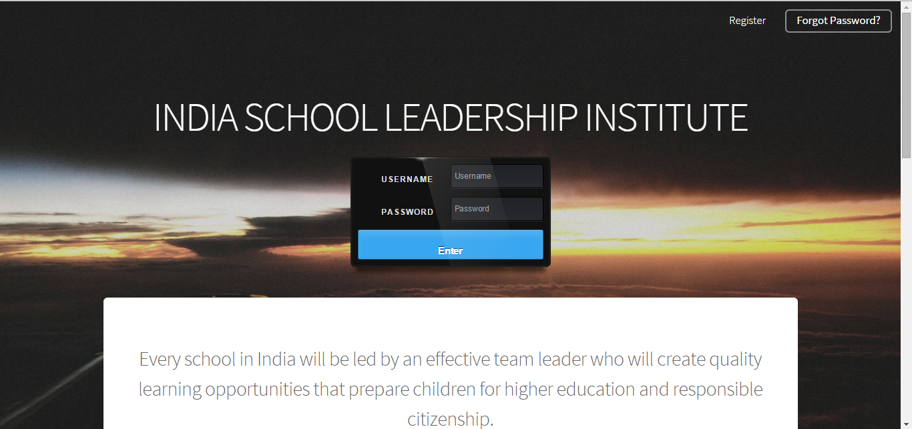
Screen Shots

Slide 11
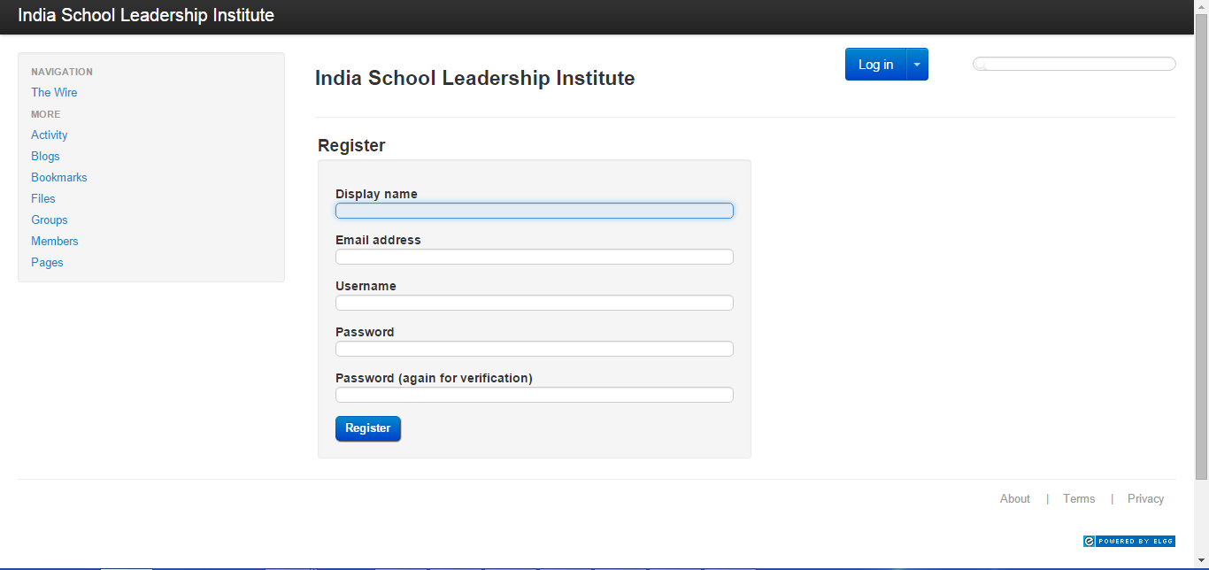

Slide 12
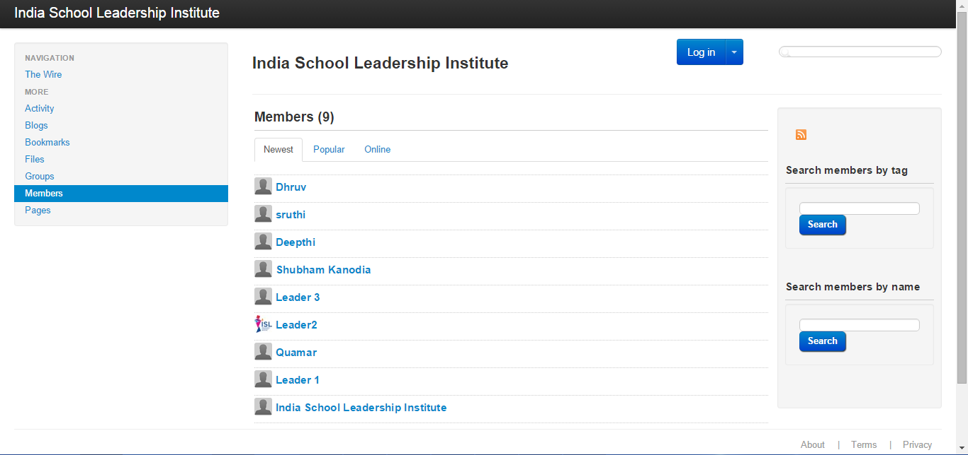

Slide 13

Any Queries..?

Slide 14


