Slide 1


Code For Good 2015
Group 2

Slide 2
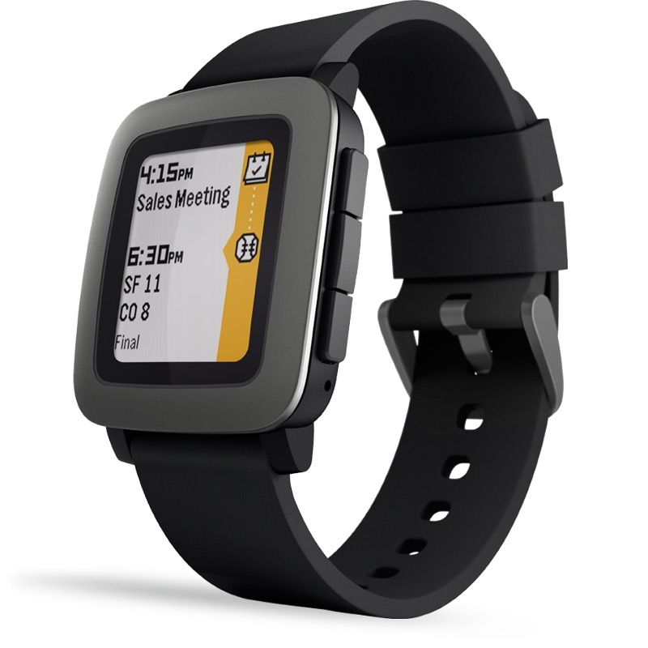
Pebble Time
Student Performance Tracker
Written in C
Focused around:
Attendance
Grades
Extra Curricular Activities
Stressors
Utilizing:
GPS Tracking
Website integration
http://ljffwatch.weebly.com/
CultOfMac.com

Slide 3
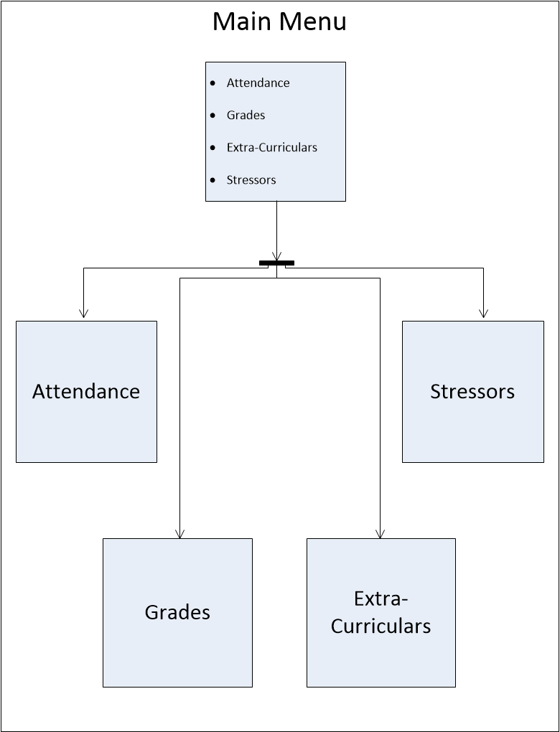

Slide 4
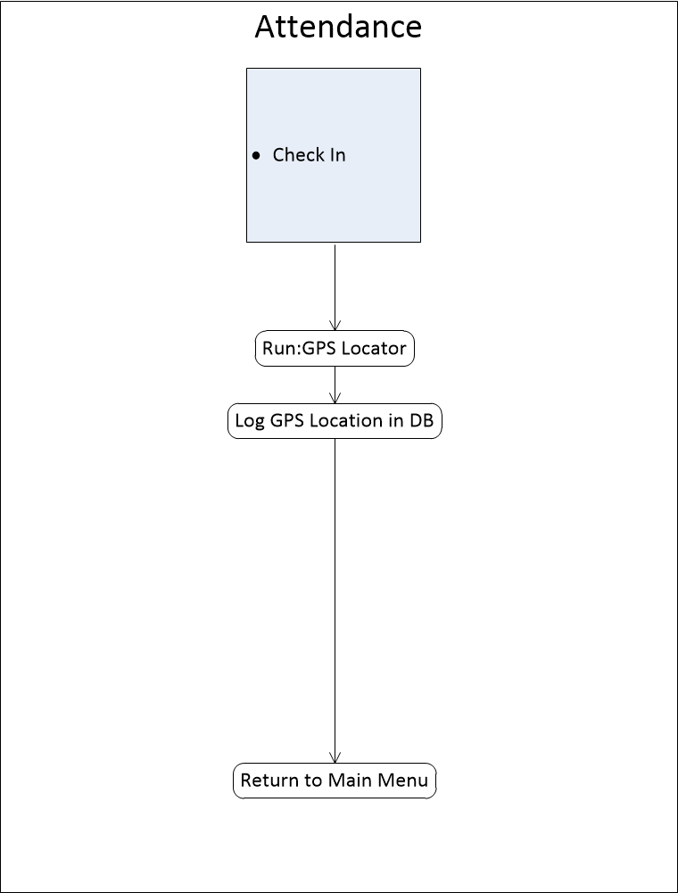
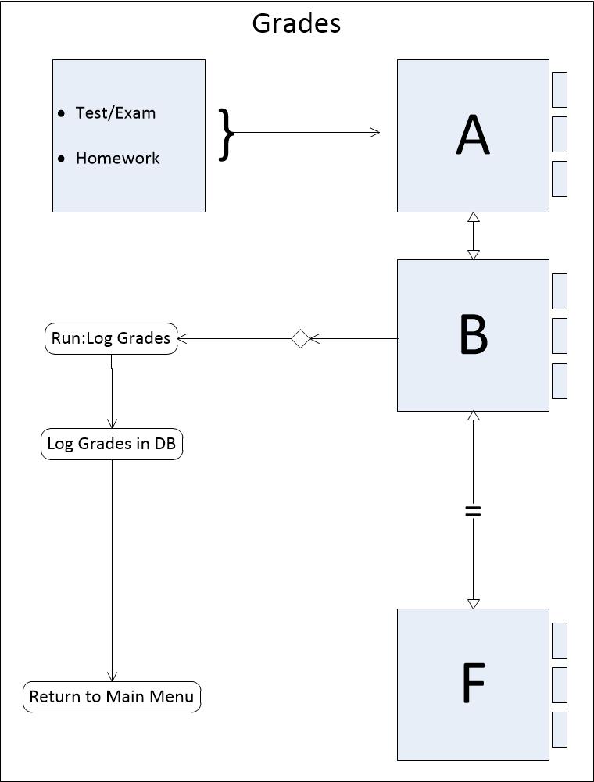

Slide 5
