Slide 1
Ask Lebron
A personal connection with, personable man.

Slide 2
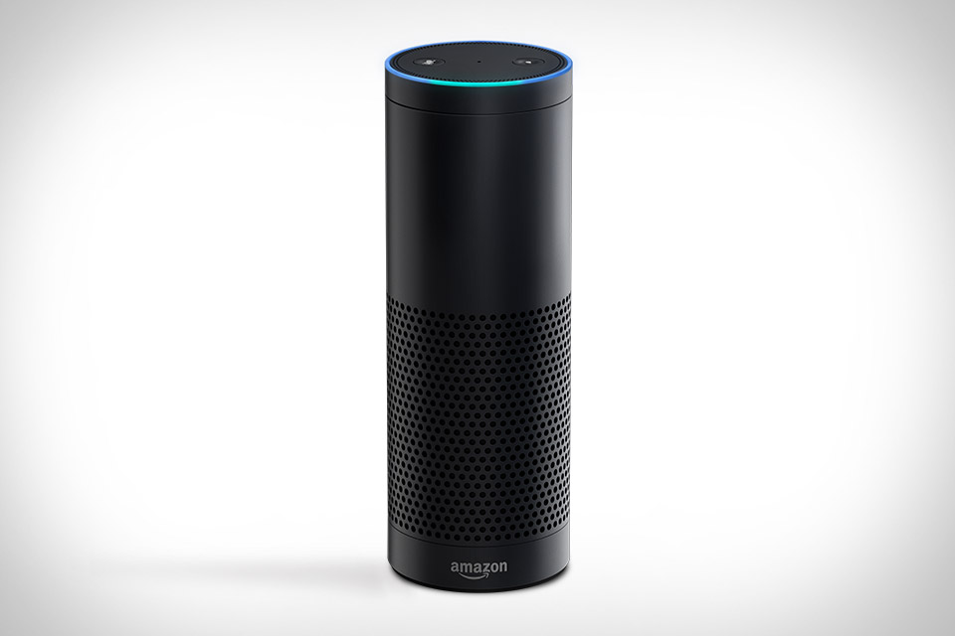
Amazon Echo
An impressive I/O device that can uniquely interact with students.
Priced at ~$180
Cloud based
http://uncrate.com/p/2014/11/amazon-echo.jpg

Slide 3
Structure
Web interface
School
Database
LJFF

Slide 4
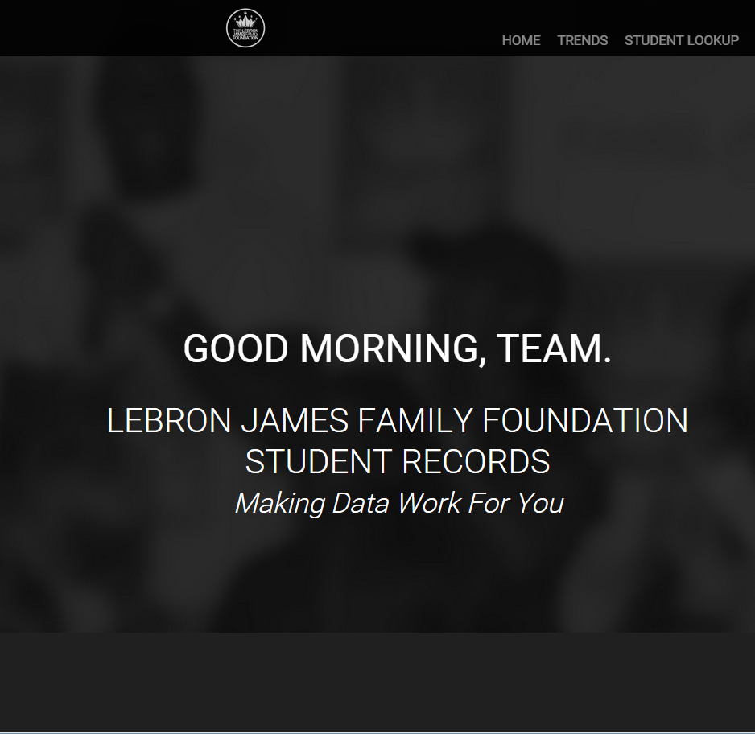
Web Portal
Simple access to powerful analytics.
Connection to a data base.
Ability to implement a connection based support system for the kids

Slide 5

Database
Backbone of the system.
Allows the ability to keep large amounts of data for use.
Keep tracks of merits, of the kids.

