Slide 1


Slide 2


The Vision
Retrieve data in a meaningful way to establish a lasting positive relationship with the student and improve their future.
2 / Vision

Slide 3

Keywords
Positive:
User: “So today was fantastic, I had a great day and learned a lot. It was really nice to go on the Friday field trip.”
Echo: “That’s good to hear. I’m glad you had a great day, keep me updated.”
Negative:
User: “So today sucked, I wasn’t motivated and our field trip was boring.”
Echo: “I’m sorry today didn’t go as you planned. What can I do to help?”
1 / Keywords

Slide 4


The Platform
3 / Platform

Slide 5

Staying on Track
Features to ensure students are organized and prepared.
RemindMe
QuizMe
13 / Outcome

Slide 6

Security
All communication occurs over an encrypted link (SSL)
Passwords are hashed and salted
2FA on web platform
7 / Features

Slide 7
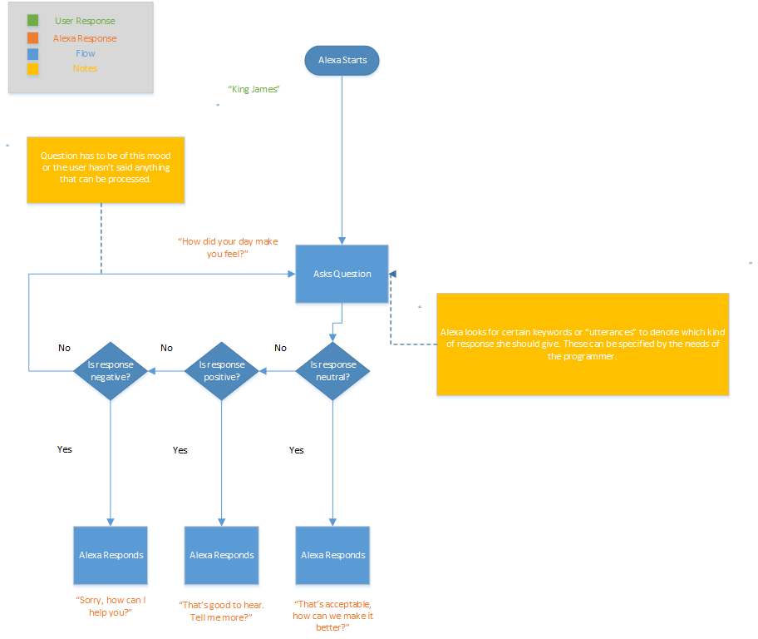

Echo Dynamic Processing
2 / Issues

Slide 8

Thank you so much
Questions, Suggestions, & Feedback?

