Slide 1
Complex Systems Project
Rescaled Range and Power Laws for Crime in Baltimore, by District.
Frederick R. “Randy” Carlson

Slide 2
First of at least three parts
Ultimate Goal – Check to see if persistence in urban blight causes persistence in crime.
Intermediate Goal – Do a rescaled range analysis of Baltimore’s Police Districts.
Tools: Minitab, Matlab and Possibly a (very) old tool called Benoit.
Results, a persistence equation and some sort of simple value per district.
Data: From Open Baltimore.

Slide 3
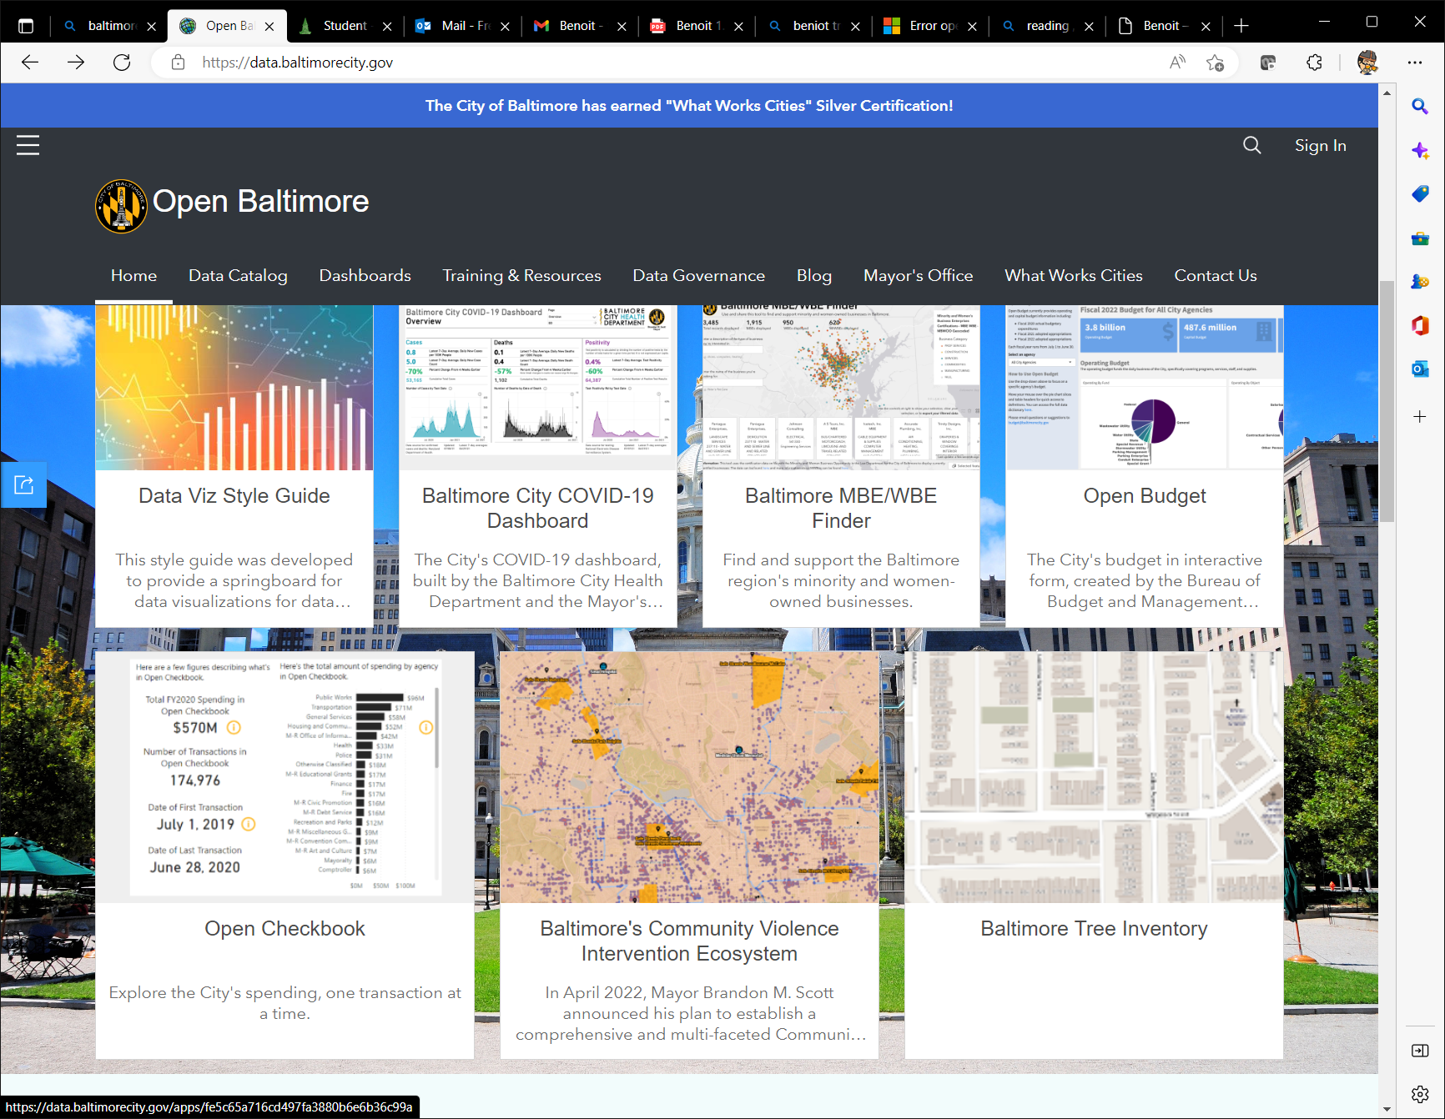
Data
Not really an issue
Baltimore PD has excellent data sources.

Slide 4
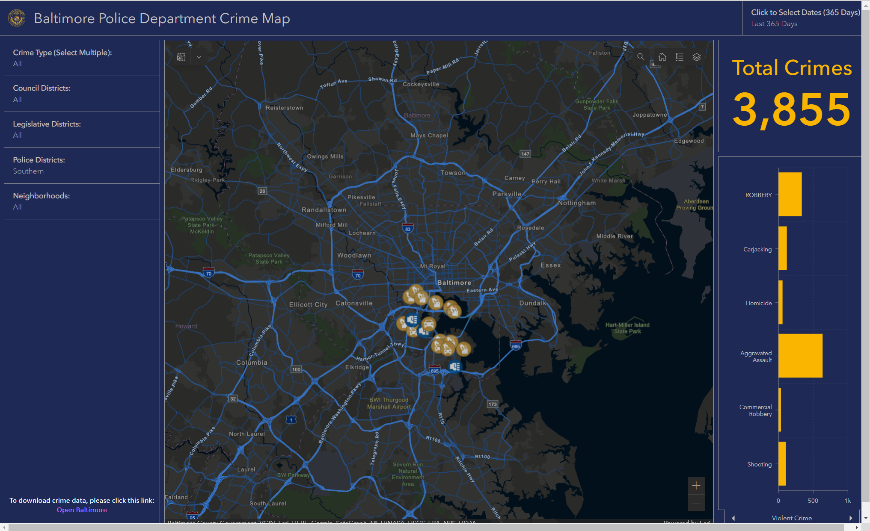

Slide 5
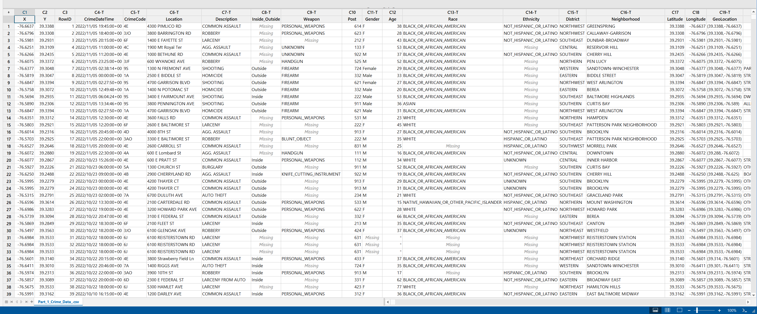
Last 10 years of crime data – and Geo Located

Slide 6
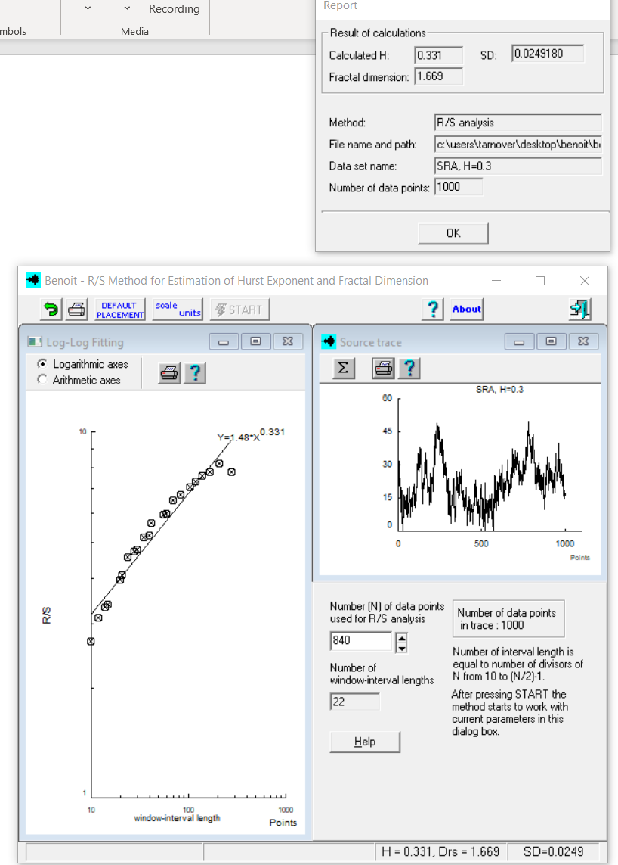

Slide 7
References
Multifractal Approach to the Analysis of Crime Dynamics: Results for Burglary in San Francisco – Melgarejo and Obergon
Fractal Dimension of Policing - Verma

