Slide 1
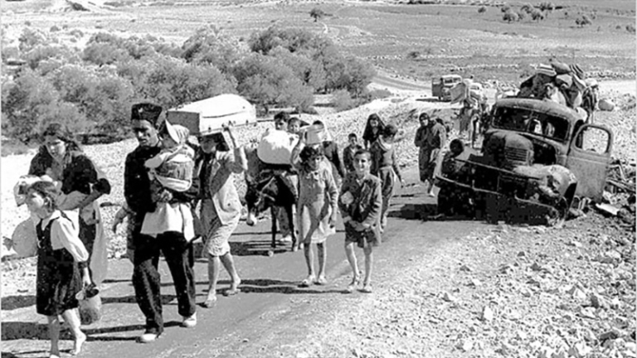
??? ?????? ???????
?????? ?????????? ????????? ?? ?????? ???????
????? ??????? ?? ???? ???????? ???????? ?? ????? ?? ???? ??????? ??????? ????? ??????
?????: ??? ??????? ???? ?????????
????? ??????? ????? | ???? ???????? ??????? ????????
???????? ???????? (G_STUDIES) | ???? 2026
???? ????? ?? ????? ?????? ???????

Slide 2
????? ?????
??? ?????? ??? ??????
????? ???? ?? ?????? ????????? ??? ??????? ?? ?????? ????????.
????? ?????? ?????? ???? ?????? ?? ?????? ??????
?????? ?????????: ??? ?????? ??????? ?????????
????????? ???????? ?????????? ??? ????? ?????????
????? ??????: ???????? ????? ???????? ?????? ????? ???????
???? ??????? ????? ?????? ????? ??????
????? ??????? ?????? ?????? ????? ???????
???? ?????? ????? ????? ??????
????? ?????? ?????? ??????

Slide 3
?????? ????????
???? ?????
?????? ?????????? ???? ?????? ??????? ???? ?? ???? ????? ?????? ?????? ?????.
????? ?????
??????? ????????
????? ?????????
????? ???????
10
15
6
4+
?? ??????? ??? ???????
????? ??????? ?????????
?????? ????????
??????? ??????? ???????
?????? ????? ????? ??????? ?????? ???????? ???? ???? ???????? ???????? ??????????.
????????? ????????? ??????????? ???? ?????? ??????? ?? ??? ????? ?? ??? ???? ??????.
???????? ???????? ??????? ??? ???? ???????? ????? ???? ??? ??? ??????? ???? ???? ?????? ??????? ??????? ????? ???????.

Slide 4
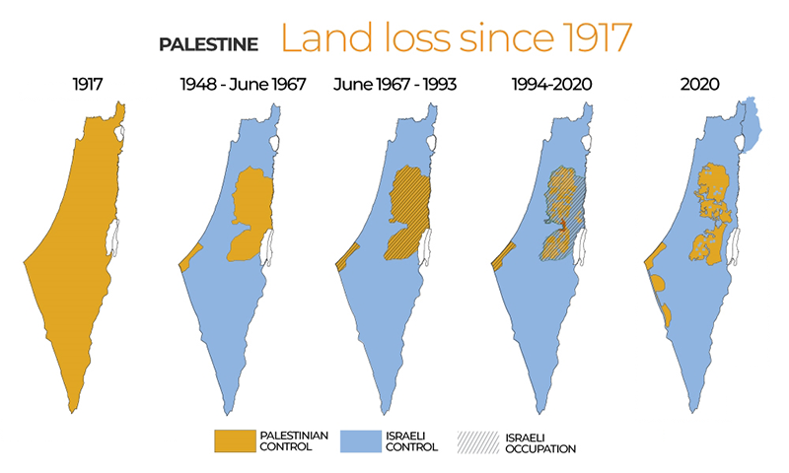
?????? ?????????
?? ??? ????? ??? ?????? ??? ?????
??????? ??????? ?? ????? ???? ?????? ???? ?? ??? ?????.
1917: ??? ????? ???? ???? ????? ???????? ????? ???? ?????? ????????.
???? ???????? ????????? ????? ????? ?????? ??????????? ???????? ??? ??? ??? ??????.
1948: ?????? ????? ???? ?????? ????? ?????? ??? ???? ???? ???????? ???????.
1967 ??? ?????: ???? ???????? ?????? ??????? ????????? ??? ????? ???????? ??????????.
???????: ?????? ????? ?????? ?? ????????? ????????? ?????????? ?? ???? ?????.
????? ??????? ???????? ????????? ?? ??????

Slide 5
????? ??????? ?????????
????? ????? ????? ????????? ????? ???? ??????
??? ?????? ??????? ???????? ?????? ??????? ???? ?? ?????? ??????? ???????? ?????????.
?? ????? ?????? ??? ?????? ?????? ?? ??? ?????? ?????????.
?????? ?????? ?????? ???? ???? ??????? ??????? ?? ??????????? ????? ?????? ??????.
????????? ?????? ??? ??????? ???????? ?????? ??????? ???? ????? ???? ?????? ?? ????? ????? ???????.
??? ???? ???? ????? ??????? ?????? ?????? ?????? ???????? ??????.
??????? ???? ?????: ?????? ???????? ??????????? ??? ?????? ???????? ??????? ??? ????????.
???? ????? ?? ??? ?????? ?????????

Slide 6
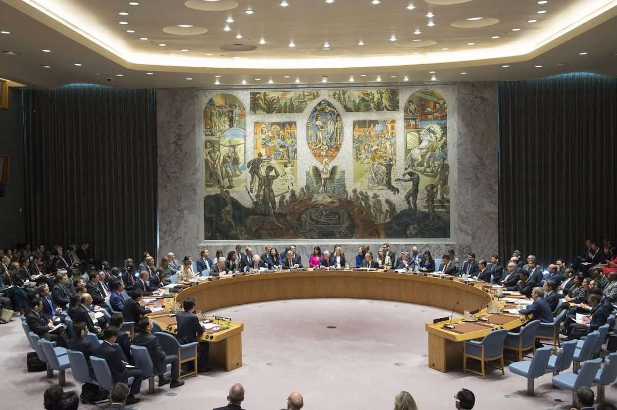
????? ??????
??? ????? ?????? ??? ?????? ??????
??? ???? ??? ????? ????? ???????? ????? ???????? ?????? ????? ??????.
?????? ??? ????? ????? ??????? ???? ????? ??? ??? ??????? ????????? ???????.
?????? ????? ??????? ???? ?????? ??? ???????? ?????????? ???? ????? ????? ?????? ??????.
?????? ??? ????? ????? ??????? ?????? ??????? ??????????? ?????? ???????.
?????? ?? ??? ??????? ???? ?? ???? ?? ???? ?????? ?????? ???? ?????????.
????? ??????? ??????: ICJ 2024? ???? 2334? ??????? ????? ???????.

Slide 7
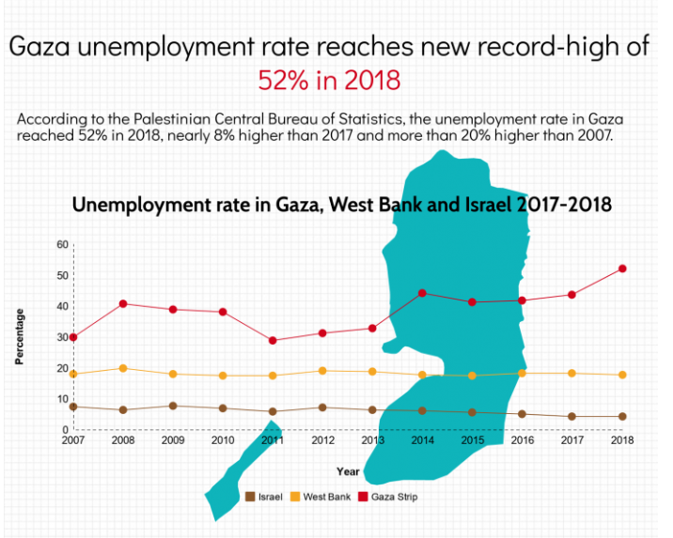
??? ?????????
?????? ?? ???? ??????? ???? ?? ???? ????? ?????? ?????
????? ????????? ?????????? ??? ????? ?? ????? ??????.
????????
??? ?????
??????
????? ???
??? ?????
????? ?????
?????? ???????? ???? ?????
???? ????? ?????
????? ????? ?????
???? ?????? ???????? ?? ??? ??? 2007 ???? ???? ???????? ????? ?????? ?????.
?????? ????? ?????? ?????? ????? ??????? ???? ??? ????? ??????? ??? ????? ???? ?????.
?????? ?????????? ?? ?????? ?????? ?????? ?????? ???????? ?????? ????????? ???? ???????? ?????.

Slide 8
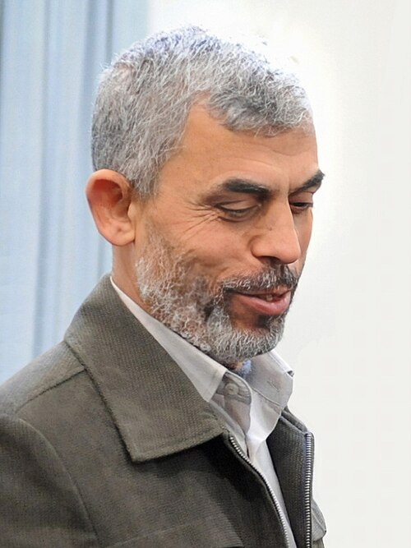
??????? ?? ??????
???? ???????: ??? ????? ??????
?????? ???????? ???: ??????? ???? ????? ???????? ?? ?????? ????? ????? ??????? ????.
??? ?? ???? ??? ???? ???????? ?? ???? ????? ?????? ????? ?????? ?????????.
???? ????? ????? ?? ?????? ???????????? ??? ?? ??? ?? ???? ?????? ?????? ???????.
????? ?? ????? ????? ?????? ?? ?????? ????????? ??????? ???? ???? ???? ???? ?????.
????? ??????? ??? ????? ??? ??? ????? ????? ?????? ??? ?????? ???? ???? ?????? ????? ?? ????? ?????????.
???????? ????????: ????? ??????? ??? ?????? ????????? ????????? ??????????? ???? ???????.

Slide 9
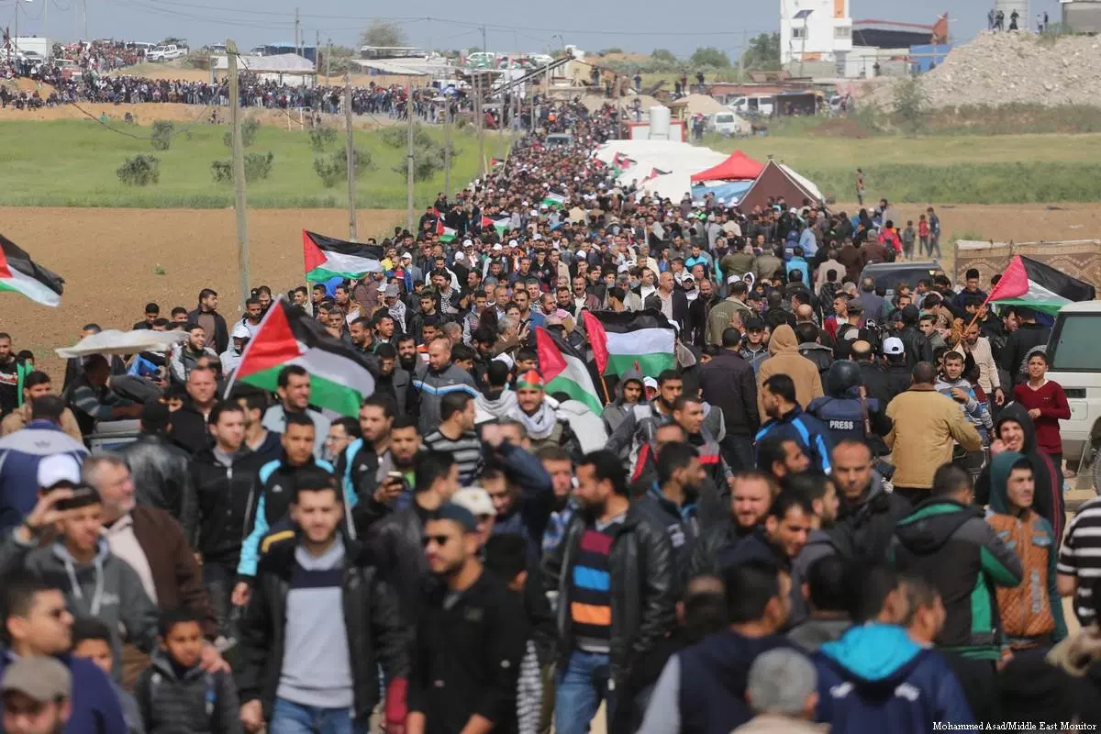
??????? ?????????
????? ????? ?????? ??? ???????
?? ?????? ?????? ??? ???????? ?????? ??? 7 ??????.
2018: ?????? ?????? ???? ????? ????? ??? ?????? ??????? ???????? ???????? ??????.
??????? ??????? ??????? ????? ??? ???? ????? ???????? ?? ???? ????? ?????? ???????? ????????.
?????? 7 ?????? ??? ????? ????? ???? ??????? ?????? ?????? ????? ????????? ??? ????? ??????.
?????? ??????? ?????? ??? ?????? ???????? ????? ?????? ????????? ???????????? ?????????.
???????? ????????: ??????? ?? ????? ????????? ??????? ???? ?? ???? ????? ????? ?????? ???????.

Slide 10
??????? ???????
???? ?????? ?? ??? ???????
?????? ?? ????? ?????? ????? ?????? ?????? ?? ???????? ?????? ???????.
????? ?????
??????? ????? ??????
??????? ???????? ????? ??????? ???? ??? ?????? ????? ????? ????? ?? ?????.
?????? ?????????? ???? ?? ???? ?????? ?????? ????? ???????? ?? ????? ???????.
????? ???????? ????? ????? ??????? ??????? ?????? ????? ????????? ?? ??? ?? ????? ??.
????? ??????? ?????? ??? ?????? ??? ????????.
??? ????? ???????? ???? ???????? ????????? ?????? ???????.
????? ?????? ??????? ??? ???? ?????? ?? ????? ?????? ???.
???????? ??? ?????? ?????? ????????? ??? ??? ???? ??????.

Slide 11
????? ???????
?? ???? ????? ???? ??????
????? ????? ???????? ??????? ????????? ????????? ???? ?????? ???????? ?? ???????.
ICJ (2024)
01
???? ???? ??????? ?? ??????? ????????? ???????
UN Security Council 2334
02
?????? ???????? ??????? ?????????? ???? ???????
Amnesty International (2022)
03
??????? ??????? ??????? ??????? ?? ???????????
Human Rights Watch (2021)
04
????? ??????? ???????? ?????????
UNRWA (2024)
05
???? ?????? ???????? ???? ???????? ???????????
World Bank (2024)
06
????? ????????? ????? ??????? ??? ???????? ?????????
Khalidi (2020)
07
?????? ????????? ?????????? ??????????
Papp? (2006)
08
????? ??????? ?????? ????????? ???????

Slide 12
??????? ????????
?????? ?????????? ???? ???????? ???? ??????? ???????? ??????? ??? ???? ??????? ???????? ???????? ??? ??? ?????.
??? ?????? ????? ??? ?????? ????????? ?????????? ????????? ??????????? ??????????.
??????? ??????? ?? ????? ?? ??? ????? ???????? ??? ?????? ????????.
?????? ???????? ???? ?? ?????? ?????: ???????? ????? ???????? ?? ?? ????? ??????? ???.
????? ???

