Slide 1
BANK OF CLI
A terminal banking application in Java, Postgres, and Maven
GOAL • ARCHITECTURE • TECH STACK • ERROR HANDLING

Slide 2
SECTION 01
The MVPs
1
Secure Access: Users must register and log in using a unique Account ID and PIN .
2
Balance Management: Users can check their current account balance at any time.
3
The Transaction Engine:
Deposit : Add funds to an account.
Withdraw : Remove funds (the system must prevent overdrawing!).
Transfer : Move money securely between two different accounts.
4
Audit Trail: Users can view their recent transaction history.
5
System Logging: The application must maintain a log file to track activity. You are required to use:
INFO : To record successful actions (e.g., “User successfully logged in”).
ERROR : To record failures or security risks (e.g., “Incorrect PIN entered” or “Database connection lost”).
2

Slide 3
SECTION 02
The multi-layered layout
com.Bankofcli
├─ api
│ └─ Main
├─ domain
│ ├─ Account
│ └─ Transaction
├─ persistence
│ ├─ impl
│ │ ├─ AccountDAOImpl
│ │ ├─ ConnectionFactory
│ │ └─ TransactionDAOImpl
│ ├─ AccountDAO
│ ├─TransactionDAO
│ └─ Custom Exceptions
└─ service
├─ impl
│ └─ AccountServiceImpl
├─ AccountService
└─ Custom Exceptions
api
The Interface — Main is the terminal menu and composition root.
domain
Plain entities: Account, Transaction. No outside imports.
persistence
The Vault — DAOs, Postgres impls, and connection/data-access exceptions.
service
The Brains — AccountService, its implementation, and four business exceptions.
3

Slide 4
SECTION 02
The Clean Code architecture
Database
Database
Persistance
Persistance
Service
AccountService — the banking rules, in the service package
Service
Domain
AccountDAO / TransactionDAO interfaces, in persistence
Domain
Account and transaction in the domain
4

Slide 5
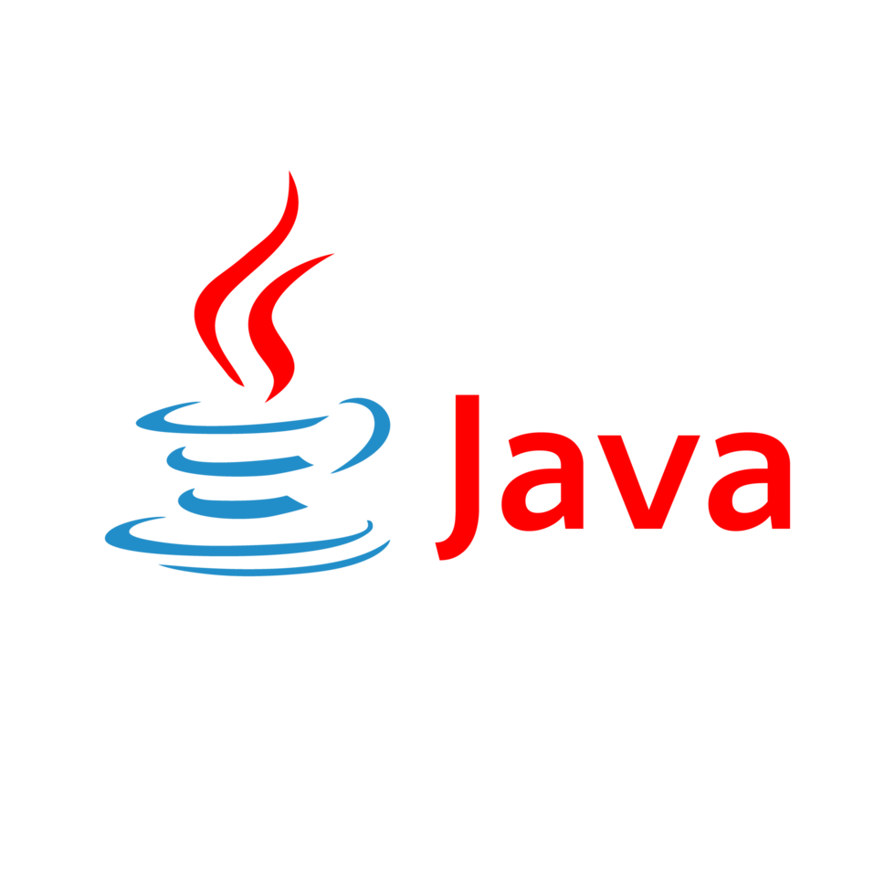





SECTION 03
The tech stack
Every layer of Bank of CLI is built on a small, deliberate set of tools.
JV
MV
PG
Core language for all layers
Dependency management via pom.xml
Relational database, run in Docker
JD
JU
GH
PreparedStatement + ResultSet, no ORM
Positive & negative tests
Git + GitHub
5

Slide 6
SECTION 04
Live Demo
6

